Slide 1
Primary Care Providers Working in Mental Health Settings:
Improving Health Status in Persons with Mental Illness
Lori Raney, MD
With: Katie Friedebach, MD; Todd Wahrenburger, MD; Jeff Levine, MD; and Susan Girois, MD

Slide 2
Disclosures
Dr. Raney: Consultant, National Council
Dr. Wahrenberger: Nothing to disclose
Dr. Girois: PBHCI Grantee
Dr. Levine: PBHCI Grantee
Dr. Friedebach: Nothing to disclose

Slide 3
About This Course
These modules are intended for primary care providers (PCPs) working in public mental health settings, a growing trend across the country to deal with the health disparity experienced by people with serious mental illnesses (SMI).
The goal is to help facilitate their work in this environment, which may be unfamiliar to many PCPs, so they can best serve this population of patients.

Slide 4
Modules
Module 1: Introduction to Primary and Behavioral Heathcare Integration
Module 2: Overview of the Behavioral Health Environment
Module 3: Approach to the Physical Exam and Health Behavior Change
Module 4: Psychopharmacology and Working with Psychiatric Providers
Module 5: Roles for PCPs in the Behavioral Health Environment

Slide 5
Module 1
Introduction to Primary and Behavioral Healthcare Integration
Learning Objectives:
Appreciate the reasons for premature mortality
Know SMI and Global Assessment of Functioning (GAF) definitions
Recognize diagnostic features of the major disorders
List the current models for providing primary care in behavioral health settings
Know the Core Principles of Integrated Care

Slide 6
Pre Test Questions
The premature mortality seen in the general SMI population is estimated to be:
  25 – 30 years
  20 – 25 years
  15 – 20 years
  10 – 15 years
What percent of illness contributing to this early mortality is preventable?
  20%
  40%
  60%
  80%
What are the leading illnesses that contribute to early mortality in the public SMI population?
  Cardiovascular
  Infectious disease
  Cancers
  All of the above

Slide 7
Overview of Module 1
What is the problem?
Why is this a problem?
Define the target population
Specific diagnosis included
Barriers to treatment
Cost issues
What models are out there?
Spectrum of collaborative care

Slide 8
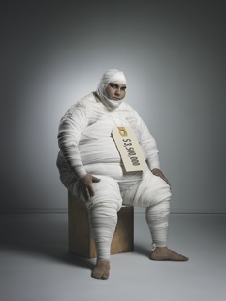
Why primary care services in mental health?
High rates of physical illness with mental illness
Premature mortality
People with mental illness receive a lower quality of care in primary care settings
High cost of physical illness with mental illness
Access problems

Slide 9
Decreased Life Span
  People with mental illness have a shorter lifespan compared with the general population. In the past 30 years, the mortality gap has progressively increased from 10-15 years to 15-25 years lost.
  Compared to the general population, people with SMI lose more than 25 years of normal life span. (Lutterman, 2003)
  Suicide and injury account for about 30-40% of excess mortality. 60% of premature deaths in persons with schizophrenia are due to medical conditions such as cardiovascular, pulmonary, and infectious diseases. (Parks, 2006)
  Men with schizophrenia die 15 years earlier, women 12 years (Crump, 2013)
Notes:
Several subsequent studies across other settings has led to adjustment of this early figure of 25 years to 15-20

Slide 10
Life Span with and Without Mental Disorders
Ben Druss, MD
Notes:
Here it is again but includes a separate category for any mental illness compared to those in public sector who often have SMI

Slide 11
Past Year SMI Among Adults
18 and Older
18-25
26-49
50+
Male
Female
Data courtesy of SAMHSA
Notes:
Many patients die before the age of 50 reflecting the mortality from all causes. Data from SAMHSA

Slide 12
Preventable Causes of Death
N Engl J Med. 2007 Sep 20;357(12):1221-8.

Slide 13
Cardiovascular Disease Risk Factors
Modifiable Risk Factors | Schizophrenia - Estimated Prevalence and Relative Risk (RR) | Bipolar Disorder - Estimated Prevalence and Relative Risk (RR)
Obesity | 45–55%, 1.5-2X RR¹ | 26%⁵
Smoking | 50–80%, 2-3X RR² | 55%⁶
Diabetes | 10–14%, 2X RR³ | 10%⁷
Hypertension | ≥18%⁴ | 15%⁵
Dyslipidemia | Up to 5X RR⁸ | 42%
Metabolic syndrome | ^{43%} | 37%
1. Davidson S, et al. Aust N Z J Psychiatry. 2001;35:196-202. 2. Allison DB, et al. J Clin Psychiatry. 1999; 60:215-220.
3. Dixon L, et al. J Nerv Ment Dis. 1999;187:496-502. 4. Herran A, et al. Schizophr Res. 2000;41:373-381.
5. MeElroy SL, et al. J Clin Psychiatry. 2002;63:207-213. 6. Ucok A, et al. Psychiatry Clin Neurosci. 2004;58:434-437.
7. Cassidy F, et al. Am J Psychiatry. 1999;156:1417-1420. 8. Allebeck. Schizophr Bull. 1999;15(1)81-89. 9. VanCampfort, AJP, 2013

Slide 14


Cumulative Effect of Many Problems
Modifiable risk factors:
Smoking, weight
and inactivity
Social isolation/Vulnerability
Violence
Unemployment/
poverty
Lack of access
to care
Medication/
Polypharmacy
Separate silos of care
Notes:
Medications, especially the atypical antipsychotic drugs, effect on weight gain, dyslipidemia and glucose metabolism
High rates of smoking, lack of weight management/nutrition, and physical inactivity
Lack of access to/utilization of preventive community healthcare, including health promotion services and resources
Poverty
Social isolation – increases the risk of premature death
Separation of health and mental health into separate systems at the federal, state and local level with lack of coordinated infrastructure.

Slide 15
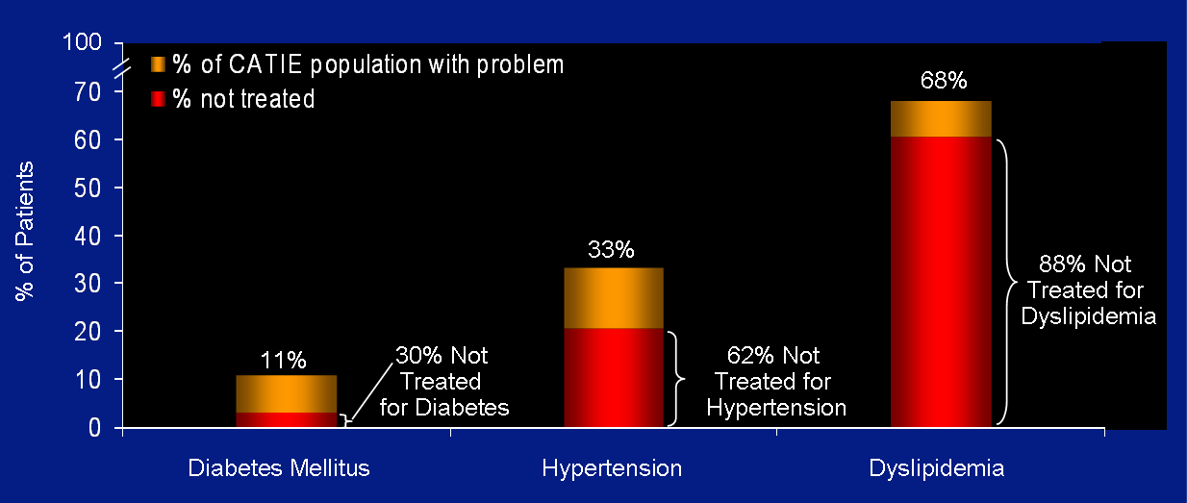
Rates of Non-treatment
Nasralla, et al Schizophrenia Research 2006(86)

Slide 16
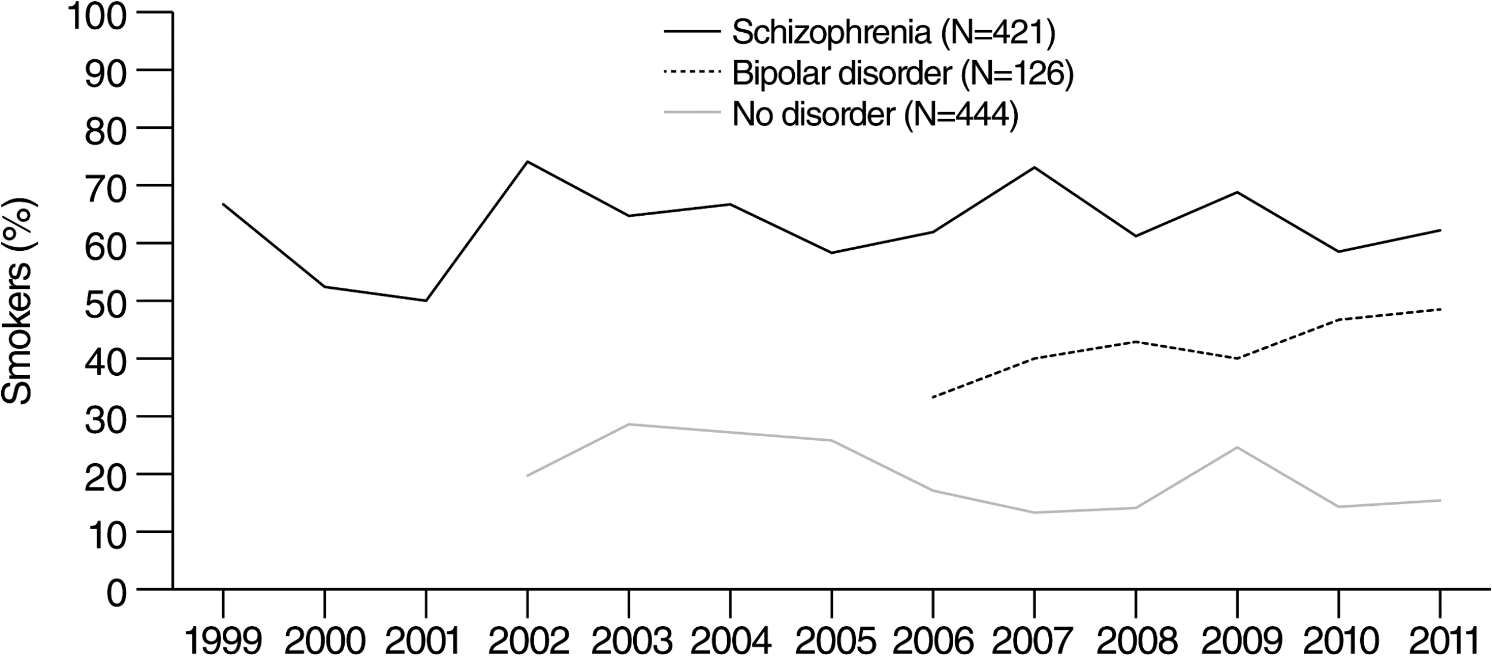
Cigarette Smoking Among Persons With Schizophrenia or Bipolar Disorder
Data are not shown for the bipolar disorder sample prior to 2007 or for the control group (no psychiatric illness) for 2004 because N<10 for each of these years for these groups. Number of persons in each of the other groups, by year, follows. For schizophrenia: 1999, 15; 2000, 21; 2001, 10; 2002, 27; 2003, 34; 2004, 15; 2005, 48; 2006, 21; 2007, 26; 2008, 49; 2009, 77; 2010, 41; 2011, 37. For bipolar disorder: 2007, 15; 2008, 14; 2009, 20; 2010, 30; 2011, 33. For the no-disorder control group: 2002, 71; 2003, 28; 2005, 66; 2006, 35; 2007, 45; 2008, 64; 2009, 61; 2010, 35; 2011, 39
Psychiatric Services. 2013;64(1):44-50. doi:10.1176/appi.ps.201200143

Slide 17
History of SMI Nomenclature
In 1993, at the request of the Senate, the National Advisory Mental Health Council enumerated and operationalized “severe mental disorders.” They were published in the American Journal of Psychiatry.
Includes schizophrenia, schizoaffective disorders, bipolar disorder, autism, and severe forms of depression, panic disorder, and obsessive-compulsive disorder.
Fuller Torrey, MD

Slide 18
Definition: Serious Mental Illness (SMI)
A mental, behavioral, or emotional disorder (excluding substance use and developmental disorders)
Functional disability in areas of social and occupational functioning
Functional impairment that substantially interferes with or limits one or more major life activities – GAF <50
1:20 of general US population has an SMI (vs. 1:5 for all mental illnesses)
SAMHSA
Notes:
Evolved from “Chronically Mentally Ill”
Chronically mentally ill used to identify pts who lived in long-term institutions or hospitals. After passage of Kennedy’s Community Mental Health Centers Act in 1963, deinstitutionalization and increased use of antipsychotics moved care of CMI patients from institutions to communities. Also, with successful treatment, some pts were no longer chronic.

Slide 19
Global Assessment of Functioning (GAF) Score
61 – 100 No symptoms. Superior functioning in a wide range of activities - Mild symptoms (e.g., depressed mood and mild insomnia) OR some difficulty in social, occupational, or school.
51 - 60 Moderate symptoms (e.g., flat affect and circumstantial speech, occasional panic attacks) OR moderate difficulty in social, occupational, or school functioning
41 - 50 Serious symptoms (e.g., suicidal ideation, severe obsessional rituals) OR any serious impairment in social, occupational, or school functioning
31 - 40 Some impairment in reality testing or communication (e.g., speech is at times illogical, or irrelevant) OR major impairment in several areas
21 - 30 Behavior is considerably influenced by delusions or hallucinations OR serious impairment in communication or judgment (e.g., sometimes incoherent, acts inappropriately, suicidal preoccupation) OR inability to function in almost all areas (e.g., stays in bed, no job)
11 - 20 Some danger of hurting self or others (e.g., suicide attempts without clear expectation of death; frequently violent; manic excitement) OR occasionally fails to maintain hygiene, OR severe impairment in communication (e.g., largely incoherent or mute)
1 - 10 Persistent danger of severely hurting self or others (e.g., recurrent violence) OR persistent inability to maintain minimal personal hygiene OR serious suicidal act with clear expectation of death.
DSM-IV TR
Notes:
This scale was recently eliminated from DSM V but is useful in assessing level of functioning

Slide 20
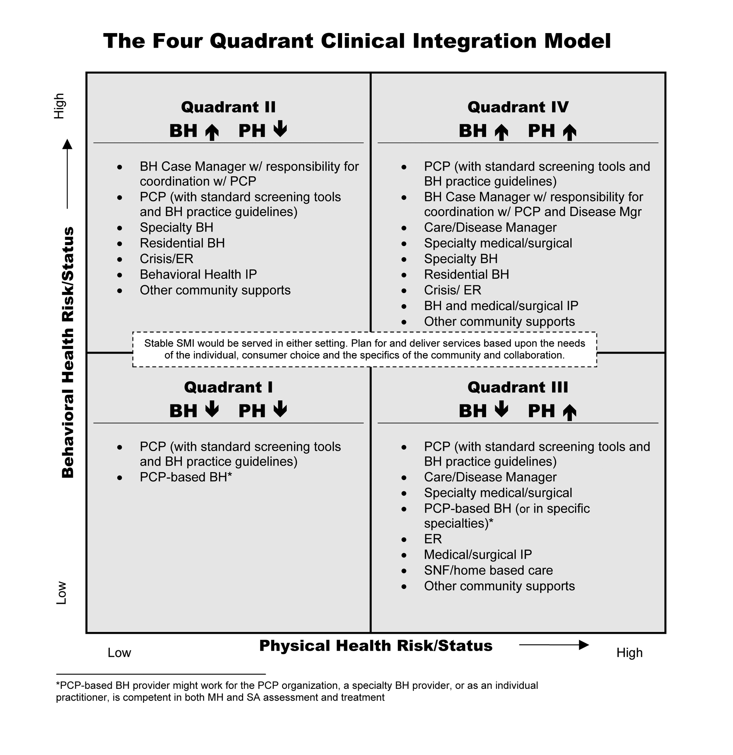
Four Quadrant Model
Notes:
The Four Quadrant model was developed to help consider the location and types of services that could be provided to best meet the needs of patients. Quadrant IV represents the population in public settings with SMI

Slide 21
Common Diagnosis: SMI
Major depression
Bipolar disorder
Anxiety: Severe OCD, PTSD
Schizophrenia
Borderline personality disorder
Notes:
Note: Bipolar disorder accounts for only 1-6% of all mood disorders, compared to 15-20% major depression.

Slide 22
What Causes Mental Illness?
Genetics
Environment

Slide 23
Diagnostic Criteria: Schizophrenia
Positive symptoms – at least two
  Hallucinations – auditory most common
  Delusions – paranoid, somatic, grandiose
  Disorganized speech
  Grossly disorganized or catatonic behavior
Negative symptoms
  Flat affect – blank look, lack of expression
  Lack of motivation/drive/desire to pursue goals
  Lack of additional, unprompted content seen in normal speech patterns – monotone, monosyllabic
Social/Occupational Dysfunction
DSM V 2013
Notes:
Specific criteria. Disorganized behavior refers to actions such as grimacing, postures, odd statements, unpredictable or inappropriate emotional responses, behaviors that appear bizarre and have no purpose, lack of inhibition or impulse control. Catatonia includes a reduction in movements and speech to the point of almost ceasing these activities. Resistance to change position and may sometimes hold an awkward or uncomfortable position for hours.

Slide 24
Bipolar Disorder
Bipolar I Disorder is mainly defined by
Manic or mixed episodes that last at least seven days
Severe manic symptoms that need immediate hospital care
Episodes of depression, typically lasting at least two weeks.
Bipolar II Disorder is defined by shifting back and forth between
Episodes of depression
Hypomanic episodes - less severe form of mania
Mania: high energy, reduced sleep, euphoria, risk taking, irritable, talkative, racing thoughts, grandiose, increased activity
DSM V
Notes:
Hypomania is a less severe form of mania where patients often feel good, have more energy, are more productive. Can evolve to manic episode in some.
If accompanied by psychosis is considered mania and not hypomania

Slide 25
Schizoaffective Disorder
Schizophrenia + Bipolar disorder
An uninterrupted period of illness where at some point there is either a manic, depressed or mixed episode for the majority of the disorder’s duration after Criteria A for schizophrenia has been met
DSM V 2013
Notes:
Schizoaffective DO represents a hybrid of the two. Tih

Slide 26
Borderline Personality Disorder
Personality disorder: A lifelong pattern in the way a person thinks, feels, and behaves that is exceptionally rigid, extreme, maladaptive, damaging to self or others, and leads to social and/or occupational impairment.

Slide 27
Depression and Anxiety Disorders
Meet criteria for SMI when:
Depression complicated by
  treatment resistance – failure to respond to medications or therapy
  psychosis
Anxiety complicated by
  treatment resistance
  co-morbid with personality disorder
Notes:
While disorders such as schizophrenia are known to be included in the SMI realm, and depression and anxiety are usually not, sometimes depression and anxiety can reach a level of severity where they would be considered as serious mental illnesses

Slide 28
Other Psychiatric Comorbidity with SMI
Depression – 25%
  Suicide
    10% of depressed patients with schizophrenia
    5% (all causes)
Trauma – 29% PTSD
Substance Use Disorders
  47% of SMI population use alcohol
  44% Cannabis
  50 – 80% use tobacco products
Buckley, PF et al: 2009, Padgett, D.K., and E.L. Struening 1992, Carey KB, CareyMP, Simons JS. 2003, Kaylee H, Taylor M: 2010
Notes:
In addition to SMI, other behavioral health disorders can be diagnosed in addition

Slide 29
Comorbid Alcohol Disorders
Diagnosis | Lifetime Prevalence of Alcohol abuse or dependence
Bipolar I | 46.2%
Bipolar II | 39.2%
Schizophrenia | 33.7%
Panic Disorder | 28.7%
Unipolar Depression | 16.5%
General Population | 13.8%
Regier DA et al. JAMA, 1990
Notes:
This study shows slightly different rates of alcohol use and compares with other mental illnesses

Slide 30
Barriers to Providing Primary Care to Psychiatric Populations
Cultural
Mental health staff and patients not used to incorporating primary care as part of job
Financial
Rarely funded
Billing medical services challenging
Motivational
Lack of perceived need for care
Organizational
Devoting space, time, and money
Logistical
Clinic location not always close proximity, which is crucial to success
Space limitations
Specialists do not cross boundaries
High no show rate, take extra time
Different languages
Psychiatric staff not provided resources to provide care (medical assistants to take vitals before appointments, blood pressure cuffs, scales)
Mental health staff feel time pressure to address screening, vital signs and may feel “out of scope of practice”
Lack of motivation as part of negative symptoms of schizophrenia
Behavioral health EHRs may lack capacity to track physical health indicators
Not perceived as part of the mission
Not always in same building
Notes:
This slide transitions the audience to a discussion of reasons why there are healthcare issues in this population and proceeds in subsequent slides to look at this in more detail

Slide 31

Patient Level Factors
Lack of motivation,
apathy
Cognitive impairment
Lack of perceived need for health care
Poverty
Comorbidity
Fear and distrust
Poor social, communication skills
Lack of access
to care
Notes:
There are a number of factors leading to struggles with getting the healthcare needed

Slide 32

Provider Level Factors
Why bother?
“Just treat the Schizophrenia and leave the rest.”
Attribute physical sx to mental illness and miss the problems
Lack of Knowledge about specific disorders
Take too long, high no-show, impacts bottom line
Fear and Distrust
Discomfort
Lester HE. BMJ, doi.1136/bmj.38440.418426.8F 2005

Slide 33
Cost of Health Complexity
Patient Type
% of Patients
% of Costs
100
90
80
70
60
50
40
30
20
10
Acute Illness
Self-resolving illness
Low grade acute illness
Low
1/3
Serious Chronic Illness
Chronic diseases
Moderate to severe acute illness
SMI population here
Health Complexity
Multiple diagnoses
Physical & mental health co-morbidity
High health service use
Impairment and disability
Personal, social, financial upheaval
Health system issues
Medium
1/3
High
1/3
Adapted from Meier DE, J Pall Med, 7:119-134, 2004

Slide 34
The Wagner Chronic Care Model
Community
Health System
Resources and Policies
Health Care Organization
Clinical
Information
Systems
Self-
Management
Support
Delivery
System
Design
Decision
Support
PRODUCTIVE
INTERACTIONS
Prepared,
Proactive,
Multidisciplinary
Practice Team
Informed,
Activated
Patient/family
Improved Outcomes

Slide 35
Principles of Effective Integrated
Behavioral Healthcare
Person-Centered Team Care / Collaborative Care
Colocation is not Collaboration. Team members learn to work differently.
Measurement-Based Treatment to Target
Population-Based Care
All patients tracked in a registry: no one “falls through the cracks.”
Evidence-Based Care
Accountable Care
Treatments are actively changed until the clinical goals are achieved.
Treatments used are ‘evidence-based.’
Providers are accountable and reimbursed for quality of care and clinical outcomes, not just the volume of care provided.

Slide 36
Developing Models
Primary Care Access, Referral and Evaluation (PCARE)
SAMHSA/HRSA Primary and Behavioral Health Care Integration (PBHCI) Grantees
2703 Medicaid State Plan Amendments (SPA)
  Allow for enhanced Medicaid funding (usually case rate) for Health Home for patients with SMI
  May be located in a community mental health center so sometimes called “behavioral health home”
Notes:
There is not a robust evidence base for addressing chronic medical conditions in public mental health settings. This list is what has been investigated and current studies underway. Each will be discussed in subsequent slides

Slide 37
PCARE
Study: Nurse care managers - communication and advocacy to overcome barriers to primary medical care. (Druss et al, 2010)
Intervention group received
  more recommended preventive services
  higher proportion of evidence-based services for cardio metabolic conditions
Results:
more likely to have a primary care provider (71.2% versus 51.9%)
Reduction in Framingham Cardiovascular Risk Index score in intervention group 6.9% compared to usual care 9.8%
Notes:
The first study to show if you successfully connect patients with SMI with primary care services you can get enhanced outcomes

Slide 38
PBHCI Grantees by HHS Region
AK
(2)
Region 10
7 Grantees
Region 1
13 Grantees
Region 5
19 Grantees
Region 8
5 Grantees
VT
ME (2)
WA
(3)
MN
Region 2
12 Grantees
NH (1)
MT
ND
WI
MI
(1)
NY(8)
MA (4)
OR
(2)
RI (3)
ID
SD
IL
(5)
IN
(6)
OH
(7)
CT (3)
WY
PA (2)
NJ (4)
UT
(1)
CO
(4)
NE (1)
IA
WV
(2)
DE
Region 7
1 Grantee
VA
(3)
MD (1)
NV
DC
CA
(11)
KS
MO
Region 3
8 Grantees
KY
(1)
AZ
(1)
OK
(4)
TN (1)
NC (1)
Region 9
12 Grantees
NM
AR
SC
(1)
MS
GA
(4)
Region 4
15 Grantees
TX
(3)
LA
(1)
AL
HI
Region 6
8 Grantees
FL
(7)
As of 03/01/14
Notes:
Region 1 has 13 grantees, 3 in RI

Slide 39
PBHCI Staffing Approach
Grant-funded additions to the team
PCP
Psychiatrist
Care
Manager
Case
Manager
Core Team
Patient
Lines of communication facilitated through HIT
Other Behavioral Health Clinicians, Peer Specialists, Substance Treatment, Wellness Coach
Vocational Rehabilitation
Notes:
New members added to the typical mental health treatment team

Slide 40
Change in PBHCI Physical Health Indicators
Notes:
Changes in blood pressure, glucose and cholesterol are promising

Slide 41
RAND Evaluation 2013
Registries not simple to construct – data gathering difficult
Recruiting and retaining qualified staff – PCP turnover
Patient recruitment difficult
Space and licenses to do primary care are difficult to obtain
Sharf, D et al Psychiatric Services 2013
Notes:
First published evaluation of PBHCI

Slide 42
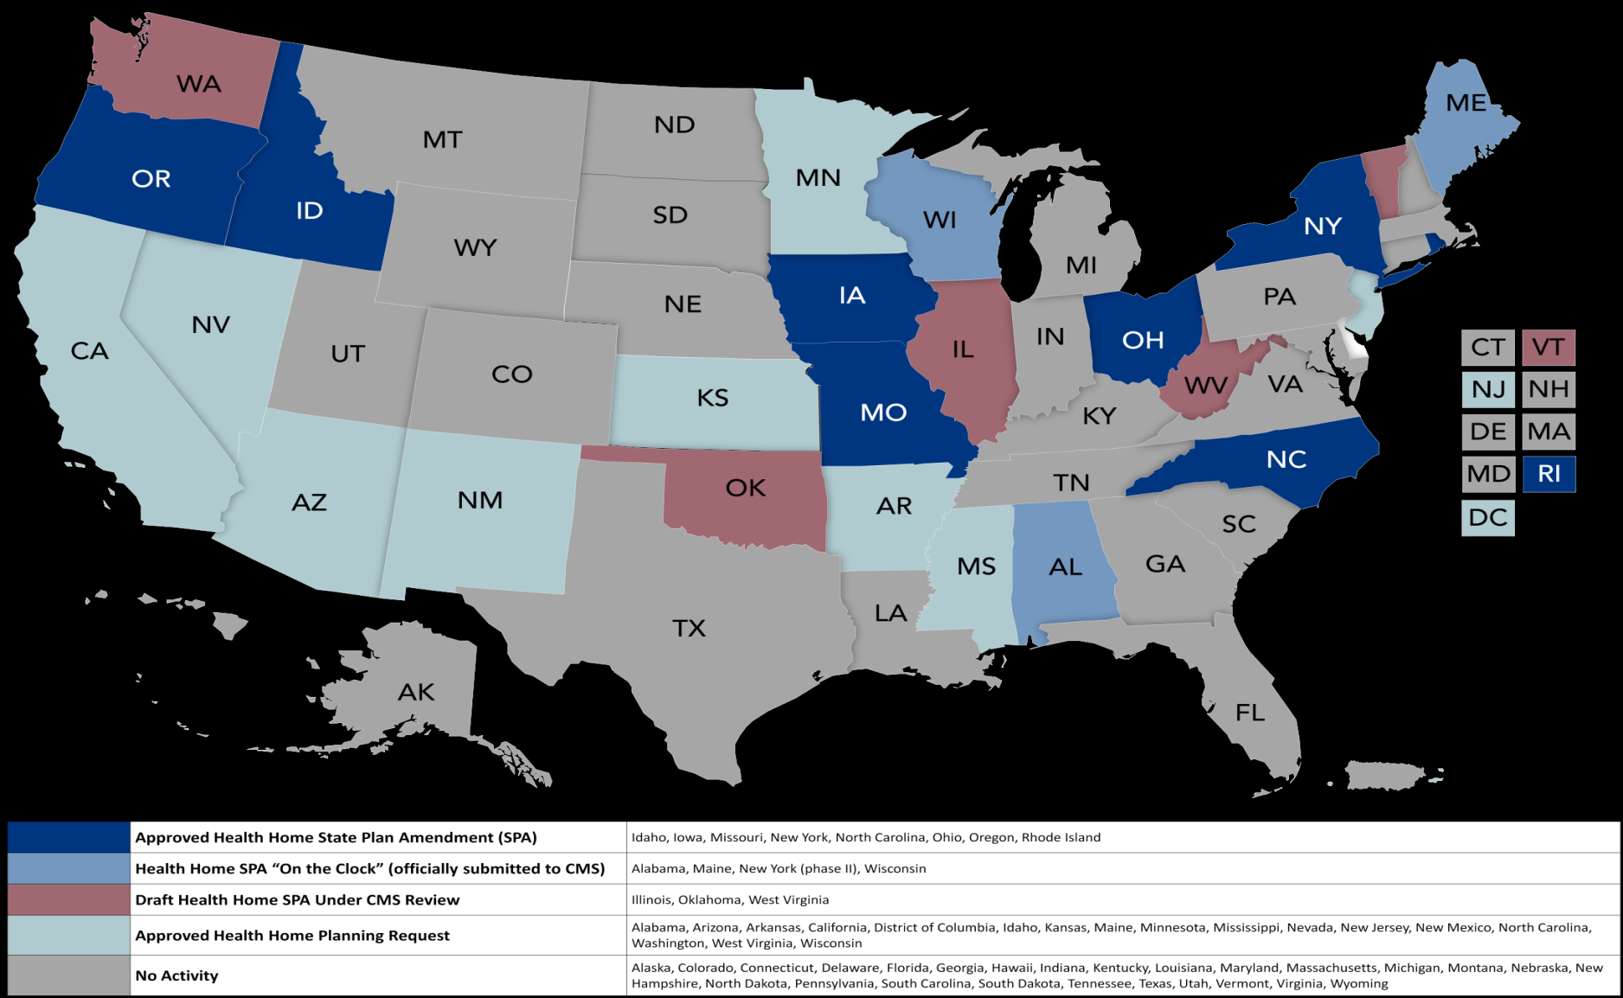
Medicaid Health Home SPAs, 2013
Notes:
Eight states approved; Rhode Island, Missouri, Oregon, North Carolina, New York, Ohio, Idaho, and Iowa
All use a version of per member per month or case rate payments
All except NC include SPMI; Missouri, Ohio, Rhode Island and NY Sate focus on it.
All allow CMHCS to be providers.

Slide 43
Health Home Team Approach – Missouri and Ohio
Consultant PCP
Psychiatrist
Core Team
Nurse Care
Manager
CSW/
Case Mgr
PCP
Patient
Other Behavioral Health Clinicians, Substance Tx, Vocational Rehabilitation
Other Community Resources
Other
Resources
Notes:
Consultant (or Embedded) PCPs are added to the team along with Care Managers. Clinical Support Workers (MI) or Qualified Health Home Specialists (OH) are added or current case managers are retrained to fulfill this role. PCP consultants provide caseload review, population data analysis to set priorities and adjust treatment approach.

Slide 44
Diabetes Outcomes: Missouri
HbA1c testing provides an estimation of average blood glucose values in people with diabetes. Enrollees in the health home program received substantially more HbA1c testing than those not enrolled.
Joe Parks, MD, Missouri Institute of Mental Health, 2013
Notes:
Data from Missouri on showing impact of behavioral health home interventions to improve compliance with care

Slide 45
Person-Centered Collaborative Care Opportunities
Behavioral Health in Primary Care Settings
Primary Care in Behavioral Health Settings
Notes:
This slide begins and introduction to collaborative care

Slide 46

Lexicon for Integrated Care
Patient- Centered Care
Integrated Care
Coordinated Care
Shared Care
Collaborative Care
Co-located Care
Integrated Primary Care or Primary Care in Behavioral Health
Behavioral Health Care
Patient-Centered Medical Home
Mental Health Care
Substance Abuse Care
Primary Care
Adapted from: Peek, CJ - A family tree of related terms used in behavioral health and primary care integration

Slide 47
Lexicon – Integrated Care
The care that results from a practice team of primary care and behavioral health clinicians, working with patients and families, using a systematic and cost-effective approach, to provide patient-centered care for a defined population.
This care may address:
Mental health and substance abuse conditions
Health behaviors (including their contribution to chronic medical issues)
Life stressors and crisis
Stress related physical symptoms
Ineffective patterns of health care utilization
Lexicon
Notes:
Definition of Integrated Care from the Agency for Health Research and Quality

Slide 48
Standard Framework of Integration
COORDINATION
We discuss patients, exchange information if needed
Collaboration from a distance
CO-LOCATION
We are in the same facility, may share some functions/staffing, discuss patients
INTEGRATION
System–wide transformation, merged practice, frequent communication as a team
Doherty et al, 2013
Notes:
There are different ways to approach how primary care and behavioral health come in contact with each other and this slide demonstrates that spectrum

Slide 49
Core Principles of Collaborative Care
Patient-Centered Care Teams
Team-based care: effective collaboration between PCPs and behavioral health providers.
Measurement-Based Treatment to Target
Population-Based Care
Behavioral health patients tracked in a registry: no one “falls through the cracks.”
Measurable treatment goals clearly defined and tracked for each patient.
Treatments are evidence-based.
Treatments are actively changed until the clinical goals are achieved.
Nurses, social workers, psychologists, psychiatrists, licensed counselors, pharmacists, and medical assistants can all play an important role.
Evidence-Based Care
AIMS 2010
Notes:
These 4 principles are widely used to describe what is needed to make integration effective

Slide 50
Tasks Related to Principles
Find Patients:
Screening, identification and determination of medical diagnoses
Track Patients:
Systematic follow-up and use of registry
Program Oversight and Quality Improvement:
Review outcomes, determine priorities, make adjustments
Treat Patients:
- Evidence-based treatment of medical and mental health conditions
- Heath behavior change
- Timely treatment adjust
Notes:
This slide shows how the Core Principles are adapted to care in the behavioral health setting

Slide 51
Roles for PCPs in Behavioral Health Settings
Direct Care
Chronic medical conditions
Preventive care
Collaboration
Psychiatric providers
Care managers, case managers
Population-Based Care
Establishing priorities
Track outcomes, adjust care
Education
Leader
Non-medical staff
Patients
Champion healthcare change
Help shape system of care
Notes:
A look at the roles for PCPs – this will be a theme for the remainder of the Modules given the introduction in Module 1

Slide 52
“Different models must be tested - the cost and suffering of doing nothing is unacceptable.”
Vieweg, et al., American Journal of Medicine. March 2012

Slide 53
Reflection and Discussion
What outcomes do we hope to achieve by addressing the health issues in the SMI population?
Is this “tomorrow’s model?”

Slide 54
Post Test Questions
The premature mortality seen in the general SMI population is estimated to be:
  25 – 30 years
  20 – 25 years
  15 – 20 years
  10 – 15 years
What percent of illness contributing to this early mortality is preventable?
  20%
  40%
  60%
  80%
What are the leading illnesses that contribute to early mortality in the public SMI population?
  Cardiovascular diseases
  Infectious diseases
  Cancers
  All of the above

Slide 55
Post Test Answers
The premature mortality seen in the general SMI population is estimated to be:
  25 – 30 years
  20 – 25 years
  15 – 20 years
  10 – 15 years
What percent of illness contributing to this early mortality is preventable?
  20%
  40%
  60%
  80%
What are the leading illnesses that contribute to early mortality in the public SMI population?
  Cardiovascular diseases
  Infectious diseases
  Cancers
  All of the above

Slide 56
References
Colton CW, Manderscheid RW. Prev Chronic Dis [serial online] 2006 Apr
Parks, J, NASMHPD Directors Report , Morbidity and Mortality in People with Serious Mental Illness, 2006
Davidson S, et al. Aust N Z J Psychiatry. 2001;35:196-202. 2. Allison DB, et al. J Clin Psychiatry. 1999; 60:215-220.
3. Dixon L, et al. J Nerv Ment Dis. 1999;187:496-502. 4. Herran A, et al. Schizophr Res. 2000;41:373-381.
5. MeElroy SL, et al. J Clin Psychiatry. 2002;63:207-213. 6. Ucok A, et al. Psychiatry Clin Neurosci. 2004;58:434-437.
Nasralla, et al Schizophrenia Research 2006(86)
Psychiatric Services. 2013;64(1):44-50. doi:10.1176/appi.ps.201200143
Spollen JJ.Perspectives in Serious Mental Illness. www.medscape.com
McDevitt J et al. Clinical practice recommendations-Evidenced-based guidelines for integrated care.2002
Buckley, PF et al: Psychiatric Comordities and Schizophrenia, Schizophrenia Bulletin, 2009, 35(2), 383-402
Carey KB, Carey MP, Simons JS. Correlates of substance use disorder among psychiatric outpatients: focus on cognition, social role functioning, and psychiatric status. J Nerv Ment Dis. 2003;191(5):300-8.
Kaylee H, Taylor M: 2010; Suicide and schizophrenia: a systematic review of rates and risk factors:. J Psychopharmacol. 2010 November; 24(4_supplement): 81–90.
Regier DA et al. JAMA, 1990
Lester HE. BMJ, doi.1136/bmj.38440.418426.8F 2005
Meier DE, J Pall Med, 7:119-134, 2004
Adapted from: Peek, CJ - A family tree of related terms used in behavioral health and primary care integration http://integrationacademy.ahrq.gov/lexicon 2012

Slide 57
End of Module 1

