Slide 1
Primary Care Providers Working in Mental Health Settings:
Improving Health Status in Persons with Mental Illness
Lori Raney, MD
With: Katie Friedebach, MD; Todd Wahrenburger, MD; Jeff Levine, MD; and Susan Girois, MD

Slide 2
Disclosures
Dr. Raney: Consultant, National Council
Dr. Wahrenberger: Nothing to disclose
Dr. Girois: PBHCI Grantee
Dr. Levine: PBHCI Grantee
Dr. Friedebach: Nothing to disclose

Slide 3
Module 3
The Physical Exam and Health Behavior Change
Learning Objectives:
Understand the prevalence of comorbid behavioral health and medical conditions
Describe the best approach to the physical exam
List medical conditions that may mimic psychiatric disorders
Discuss health behavior change approaches

Slide 4
Pre Test Questions
What comorbid behavioral health diagnosis are common with serious mental illness (SMI)?
  Trauma-related disorders
  Simple phobia
  Adjustment disorders
  Paraphilias
To reduce anxiety, the purpose of the first appointment could be to
  Gather information
  Make the next appointment
  Introduce staff
  All of the above
Common reasons for medical visits for people with SMI include all except
  Abdominal pain
  Chest Pain
  Well visit
  Headache

Slide 5
Overview of Module 3
Comorbidities
Screening guidelines and preventive care
Approach to the exam
Cultural considerations
Advanced directives
Health behavior change

Slide 6
Medical Illnesses
Cardiovascular disease (CVD) - Leading cause of death, diabetes, hypertension, dyslipidemias, obesity, smoking, metabolic syndrome (discussed in Module 1)
Cancer – same rate as general population, but diagnosed late. Second leading cause of death. Cancer incidence:
  Men – lung, stomach/pancreatic/esophageal, kidney
  Women – lung, kidney, breast
Infectious diseases – limited data
  Hepatitis C (HCV) – 4-10% outpatients – growing concern
  Human Immunodeficiency Virus (HIV) - 2.7 % outpatient sample, 17% homeless population
  Tuberculosis (TB) – 17% inpatient sample
Chronic pain – 36.6% schizophrenia
Cad Saude Publica. 2010 Mar;26(3):591-602
Pirl WF et al. Psych Serv 2005;56:1614.
Freudenreich O et al. Psychosomatics 2007;48:405.
Viron M et al. Comm Ment Health J (in press)
Kisely, et al, JAMA Psychiatry ,Vol 70 (no.2) Feb 2013
Notes:
Medical problems that lead to early mortality and suffering

Slide 7
Medical Mimics of Psychiatric Disorders
Features suggesting a non-psychiatric origin:
Late onset of initial presentation
Known underlying medical condition
Atypical presentation of a specific psychiatric diagnosis
Absence of personal and family history of psychiatric illnesses
Illicit substance use
Medication use
Treatment resistance or unusual response to treatment
Sudden onset of mental symptoms
Abnormal vital signs
Waxing and waning mental status
Notes:
Important to remember other illnesses can look like psychiatric disorders. In the SMI population these same conditions can mimic worsening psychiatric conditions

Slide 8
These problems can occur in a variety of systems
Neurological: Seizures, tumors, multiple sclerosis, Parkinson’s
Endocrine: Parathyroid, thyroid, adrenal, pancreatic
Infectious: Neurosyphilis, herpes viral encephalitis, HIV encephalopathy, meningitis
Autoimmune: Lupus
Metabolic: Hyponatremia, hepatic and uremic encephalopathy, porphyria
Vitamin Deficiencies: B-1 (thiamine), B12, folate
Exogenous: Medications, metals, substance abuse, solvents
Notes:
These problems can occur in a variety of systems

Slide 9
Common Medical Complaints
Pain – 36.6% of patients report pain. Most common:
  abdominal (30.7%)
  head, face, and mouth (24%)
  back (14.7%)
Insomnia
Cough, sore throat, headache
Cad Saude Publica. 2010 Mar;26(3):591-602
Notes:
The medical complaints are much like what is seen in general primary care with pain the most prevalent

Slide 10
Screening/Preventive Services Essential
American Diabetes Association (ADA) and American Psychiatric Association (APA) guidelines for second generation antipsychotics (SGAs) – Psychiatric providers
HIV, TB, HCV – many are in “high risk” category
U.S. Preventive Services Task Force recommendations – age recommended – cancers common
Substance use, smoking, “medical” marijuana, meth
Prevention – flu shots, immunizations, etc.
Notes:
There are a number of screening measures that need to be considered in this population esp with higher rates of some illnesses. Don’t
forget about flu shots and immunizations. Many of the SMI patients will fall into “high risk” category and need to be screened

Slide 11
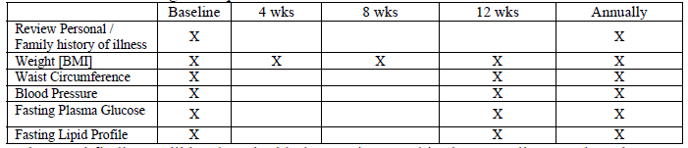
ADA/APA Screening Guidelines for SGAs
American Association of Clinical Endocrinologists, North American Association for the Study of Obesity: Consensus development conference on antipsychotic drugs and obesity and diabetes. Diabetes Care 2004; 27:596–601
Notes:
Table of frequency of measurement. Psychiatric providers have low screening rates for many reasons including patients having lack of access to care

Slide 12
Two Worlds
Primary Care | Behavioral Health
Continuity is goal | Full recovery and treatment graduation is goal – “close the chart”
No stigma | Stigma common
Data shared | Data private
Large panels | Small panels
Flexible scheduling | Fixed scheduling
Fast-paced | Slower pace
Time is independent | Time is dependent – “50 min hour”
Flexible Boundaries | Firm boundaries
Treatment external (labs, procedures) | Relationship with provider IS treatment
Notes:
Different characteristics of the environments and their different cultures. This is often a difficult gap for many to try and merge. PCPs may notice some of these differences when they work in behavioral health environments

Slide 13
Concerns in Approaching the Exam
Provider’s View | Patient’s View
We don’t understand them | They don’t understand me
They are mentally ill | They are incompetent
They take too long | They aren’t patient with me
They don’t do what we say | They want to control me
They scare me | They scare me
Notes:
Patients and providers may enter the exam with concerns that hamper treatment.

Slide 14
The Exam Room Set-up
On the walls – Anatomic pictures could be viewed as scary, educational material on diet/exercise is good option, patient/consumer art work
May need to keep the door open for patients with anxiety or paranoia
Larger exam room to keep from feeling closed in and give the patient and provider space
Well-ventilated – smokers, malodorous patients
Notes:
Things to consider in the exam room

Slide 15
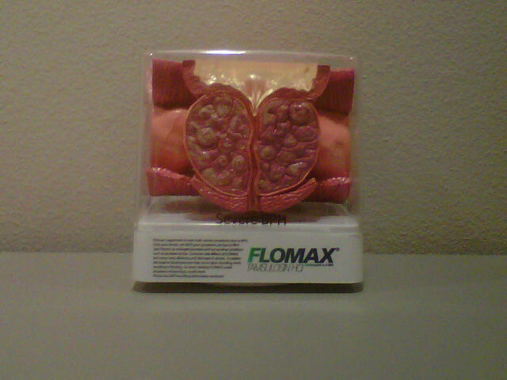
Example of a model you may not want in the exam room – enlarged prostate!

Slide 16



Approach to the Exam – Reset Expectations
Longer appointment
due to aspects of illness
such as poverty of speech,
apathy, disorganization,
positive symptoms may make
it harder to get accurate
history. 2-4 appts per hour,
smaller panel size - half
Sensitive to trauma
Especially sexual trauma
with women. Be ready for
emotional response to exam,
take time to explain and go
slow
Avoid bombardment
Start with 1-2 goals and move through the list over the course of multiple appointments - plenty of pent up need has to be managed carefully
Notes:
It is very important to grasp this will be a different type of exam due to multiple issues related to a person having a severe mental illness.

Slide 17
Exam Tips
Calm demeanor - don’t challenge delusions – reassurance and understanding, work around the positive symptoms
Correct misinformation about medical care
Purpose of first visit could be introductions, tour, gather information, opportunity for patient to ask questions, make the next appointment
Maintain appropriate boundaries
This is team-based care, so use the resources of the team
  Co-visits with other staff (case managers, peers), huddles to pre-plan – chart review and medication reconciliation before the patient enters the room
  Understand that with some patients you may get most of your information from staff rather than the patient
Slower pace
Be willing to cut the visit short and try another day!
Notes:
These visits are in contrast to the usual visit a PCP may be expecting

Slide 18
Electronic Health Records
Can be helpful for showing patient x-rays, reviewing notes, especially if they are worried about what you are telling them
Typing can be distracting – gauge how the patient is responding if you are doing concurrent documentation
Notes:
What is helpful and not helpful with EHRs

Slide 19
Positive Symptoms that may interfere with Exam
Delusions
  Paranoid – someone is out to get me
  Somatic – have cancer, guts are rotting, bug eggs in my scalp
Disorganization
  Dress
  Language
  Hygiene
Hallucinations – especially auditory
  Could say provider is going to “harm”
  Could say provider is “good”
  Could say patient is “stupid” to be here

Slide 20
Example: Positive Symptoms
Patient with Bipolar DO, currently manic, refusing medication except for Valium. C/O vaginal discharge. PCP enters room to do pelvic exam and patient found naked, scrubbing the sink. She is smiling, has rapid speech and states she is not ashamed to be seen in her “birthday suit.”
What approach would you take with this patient?
Notes:
Here the PCP would calmly direct the patient to proceed with the exam or if too agitated may end appointment and try again when patient is calmer

Slide 21

Negative Symptoms – Absence of ….
Speech – monosyllabic, less overall, monotone
Motivation – can be low
Interest – disinterest in certain things
Expression – flat affect
Gestures – reduced
Lack of ability to experience joy or act spontaneously
25% have “deficit syndrome” – severe negative symptoms
Notes:
These symptoms can also hamper the exam process because they make it difficult to get much information. May need to rely on other staff or family to help fill in the information

Slide 22
Example: Negative Symptoms
Difficult to assess patient’s abdominal pain. He does not volunteer any information. However, his counselor did send him in for visit given this has apparently been going on for some time. Will get a KUB to start and check for constipation.
Trial of Lansoprazole and close follow up.
He was not able to get a urine sample for us today. Refused to even try.
PCP note in EMR 2013
What approach might you take with this patient?

Slide 23
Trauma-Informed Care
Most individuals seeking public behavioral health services and other public services, such as homeless and domestic violence services have histories of physical and sexual abuse and other types of trauma-inducing experiences.
These experiences often lead to mental health and co-occurring chronic health conditions, such as substance abuse, eating disorders, and HIV/AIDS.
To become trauma-informed, every part of an organization and its service delivery system is assessed and potentially modified to include a basic understanding of how trauma affects the life of an individual seeking services.
Trauma-informed organizations, programs, and services are based on an understanding of the vulnerabilities or triggers of trauma survivors that traditional service delivery approaches may exacerbate, so that these services can be more supportive and avoid re-traumatization.
www.samhsa.gov/nctic/trauma.asp

Slide 24
Trauma
May negatively influence access to and engagement in primary care
Avoidance of medical and dental services
Non-adherence to treatment
Postponing medical and dental services until things get very bad
Misuse of medical treatment services – ex. over use of ER services and misuse of pain meds
Notes:
This slides starts a series on trauma which we have already mentioned there is a high prevalence of in individuals with SMI

Slide 25
Medical Settings may be Distressing for People with Trauma Experiences
Invasive procedures
Removal of clothing
Physical touch
Personal questions that may be embarrassing/distressing
Power dynamics of relationship
Gender of healthcare provider
Vulnerable physical position
Loss of and lack of privacy

Slide 26
Signs of Distress
Emotional reactions – anxiety, fear, powerlessness, helplessness, worry, anger
Physical or somatic reactions – nausea, light headedness, increase in BP, headaches, stomach aches, increase in heart rate and respiration or holding breath
Behavioral reactions – crying, uncooperative, argumentative, unresponsive, restlessness
Cognitive reactions – memory impairment or forgetfulness, inability to give adequate history

Slide 27
Physical Exam of the Patient with a History of Trauma
Chaperone important
Explain what you are going to do “You need a breast exam”
Let them know when you are going to touch them and where, “I am going to touch your left breast now”
Ask if it’s ok to proceed “Ready?”
Check in from time to time “Are you doing ok?”
Notes:
Tips for the PE

Slide 28
Resource
Handbook on Sensitive Practice for Health Care Practitioner: Lessons from Adult Survivors of childhood sexual abuse
Schachter, C.L., Stalker, C.A., Teram, E., Lasiuk, G.C., Danilkewich, A.
(2009). Ottawa: Public Health Agency of Canada.
Handbook on Sensitive Practice
Notes:
Excellent resource

Slide 29
Patients who are Suicidal
Rare events are difficult to predict
Previous suicide attempt history somewhat helpful in prediction
Take them seriously
  15% Bipolar DO - suicide
  5% Schizophrenia - suicide
Ask about command hallucinations (voices) telling to harm self
Ask how they would do it
Ask if they have means to carry out their plan (pills, firearms, rope)
Get help from your team – if a patient is expressing these thoughts there are crisis services available within your system
Have a written, well thought out plan for emergencies – who to call
Notes:
It is important to remember you do not have to manage this alone – the behavioral health setting often has good crisis resources to manage these situations.

Slide 30
Controlled Substances
Chronic pain common in patients with SMI (36%)
Narcotics can actually make conditions like anxiety and depression worse
Use sparingly and for short duration if possible. Will have to deny request for these medications (frequently) as you do with all patients!
Prevents antidepressants from working (anti – depressant vs. depressant)
Contracts helpful – close ALL loopholes (esp. patients with personality disorders) – single provider in clinic for patient
Methadone and Suboxone useful
Pregabalin (Lyrica), gabapentin, SNRIs - duloxetine (Cymbalta) and venlafaxine (Effexor) can be helpful for pain
Use state pharmacy data banks for controlled substances when needed
Notes:
PCPs will face many of the same concerns with controlled substances in the SMI population that they do in primary care settings

Slide 31
De-escalation
Appear calm, centered, self-assured (even if you aren’t)
Eye contact – not too much, not too little
Neutral facial expression, eye level, monotone voice
Minimize body movements, relaxed and alert posture
Don’t point or shake finger, do not touch
Do not get defensive, be respectful while setting limits
Be honest
Position yourself for safety – make sure the person doesn’t feel trapped, separate patient from others
Bring in a co-worker if possible
Empathize with feelings, not behavior “I know you feel…but”
Trust your instincts
Have a plan – call 911, etc.
CIT International
Notes:
Interactive exercise here – agitated patient, could do role play. Also see next slide

Slide 32
Example: How to Talk to Mr. X
Mr. X, It must be very frustrating to feel like all the doctors think that your symptoms are not real... you may also feel that the doctors don't really know what they are doing since they have not been able to make a proper diagnosis for you.

Slide 33
Pregnancy and SMI
Gestational complications due to comorbid health behavior problems including smoking, obesity, substance use, sexual practices, teratogenic side effects of medications
Increased symptoms of mental illness due to insomnia, hormones
Birth complications – low birth weight, addiction/withdrawal concerns, incidence of return of more severe symptoms (e.g., psychosis)
Early infancy – child welfare involvement, adoption, bonding issues
Need for intensive oversight, high risk multispecialty clinics key if available – check to see if patient has access to prenatal care
** Patient involvement in treatment decisions is crucial
Notes:
Very difficult area for treatment in patient who has active symptoms . With an planned pregnancy there are issues with choosing medications that are safe in pregancy

Slide 34
Coordinating Care with Specialists
Use care managers to facilitate referrals and get information back to care team
Referral form to take with them
Secure email, fax, or scan copy of your notes in electronic medical record
Case managers and peer specialists encourage, get them there – “activation” crucial
Find specialists that work well with people with mental illness and treat them with respect
Notes:
There are specialists who will not want to work with patients with SMI so try not to send them there if you can.

Slide 35
Daily Huddles
Plan for changes in the workflow, manage crises before they arise, make adjustments to improve access and staff member’s quality of life
Share details of care being provided by individual members to get a more comprehensive picture of the patient
Huddle length – 7-10 min
Huddle leader – can rotate or choose
Bring your laptop – separate EMRs, paper charts
Get available labs, reports, etc. in advance
Medication reconciliation in advance of appointment
Who needs to be rescreened (PHQ-9, HbA1c, etc.)?
Check for openings - might be able to work someone in?
Notes:
Huddles are a useful practice in chronic disease management

Slide 36
Example: First Visit
H.B. is a 57 year old AA female with schizoaffective DO who presents with case management staff. She has been to the office before just to stand in the waiting room and come back and "check out" the exam room. Last week, I was able to talk to her briefly between patients and she said that her toe nails were too long. Maybe I could help with that. This week she comes to the exam room with staff and allows a check of her BP and after cutting one toe nail, tells me that hurt and she will think about cutting the rest, despite the fact that her feet look like bird claws. Eventually, we may be able to further exam the patient and even get blood work. This may take several months.
How would you approach this patient?

Slide 37
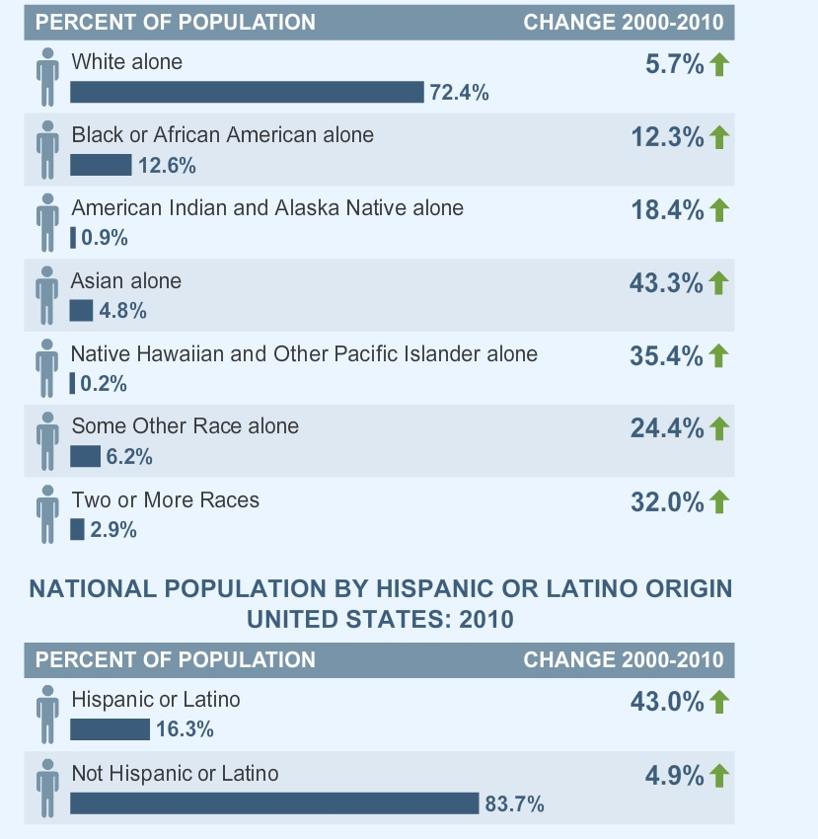
US Population by Race
US Census Bureau, 2010
Notes:
Rates of different groups in US

Slide 38



Cultural Considerations
Some cultures may want family to be included in treatment planning
Somatic distress instead of emotional distress often expressed in some cultures
Explore different beliefs about healing
Drug metabolism can be affected by race
Under-diagnosis in people of color is an issue
Culturally diverse staff helpful

Slide 39
Adverse Drug Reactions
Enzyme | Top 27 Drugs Causing ADRs in Literature Review | Poor Metabolizers (%)
CYP 1A2 | Carbemazepine, diltiazem, erythromycin, fluoxetine, imipramine, *isoniazid, naproxen, nortriptyline, phenytoin, rifampin, theophylline, *verapamil | White 12
CYP 2C9 | Fluoxetine, *ibuprofen, *imipramine, isoniazid, naproxen, phenytoin, *piroxicam, *rifampin, verapamil, warfarin | White 2-6
CYP 2C19 | Fluoxetine, imipramine, *isoniazid, nortriptyline, phenytoin, rifampin, warfarin | White 2-6 Asian 15-23
CYP 2D6 | Diltiazem, fluoxetine, *imipramine, paroxetine, *metoprolol, *nortriptyline, theophylline | East Asian – 0-2% AA – 0-19% Caucasians – 3-10% (40% IM, only 50% “normal”)
Drugs with Increased ADRs and their 450 Enzymes – JAMA 2001

Slide 40
Mental Health Advanced Directives
Describes what a patient wants to happen in a future mental health crisis when they are not able to decide for themselves or communicate effectively
Lists the mental health treatments they prefer in an critical situation
Appoint someone to make mental health decisions for them (proxy decision maker)
Must be written when competent to do so
Varies by state, forms available at State by State
Notes:
This is different from advanced directives PCPs are used to and covers mental health crisis only

Slide 41

Health Behavior Change
Notes:
Starts the section on heath behavior change

Slide 42
Interventions to Reduce Risks of CVD Small Changes can have Significant Impact
Blood cholesterol
  10% ↓ = 30% ↓ in CVD (200-180)
High blood pressure (> 140 SBP or 90 DBP)
  ~ 6 mm Hg ↓ = 16% ↓ in CVD; 42% ↓ in stroke
Diabetes (HbA1c > 7)
  1% point ↓ HbA1c = 21% ↓ in DM related deaths, 14% ↓ in MI, 37% ↓ in microvascular complications
Cigarette smoking cessation
  ~ 50% ↓ in CVD
Maintenance of ideal body weight (BMI = 18.5-25)
  35%-55% ↓ in CVD
  5 – 10 % ↓ can lead to “clinically significant” changes
Maintenance of active lifestyle (~30min walk daily)
  35%-55% ↓ in CVD
Stratton, et al, BMJ 2000
Hennekens CH. Circulation 1998;97:1095-1102.
Rich-Edwards JW, et al. N Engl J Med 1995;332:1758-1766.
Bassuk SS, Manson JE. J Appl Physiol 2005;99:1193-1204
Notes:
This slide shows the impact small changes in health parpameters can have on certain conditions. This helps set the stage for the next few slides that help appreciate the impact the staff in public mental health settings might have if they all pitch in together for improving the health of patients
Potential Risk Factors for CVD
From about 1925 to 1965, the US experienced a 40-year-long ever-mounting epidemic of CVD. That trend was reversed over the next 30 years, thanks to clinical and public policy efforts aimed at modifying established risk factors. But much work remains to be done. Heart disease currently kills 1 out of every 3 Americans, making it the leading cause of mortality in the US. Together, stroke and CHD kill 40% of all Americans.¹
This slide shows the magnitude of cardiovascular risk by showing the potential magnitude of risk reduction for each of 5 risk factors.¹⁻³
With an approach to improving modifiable risk factors, the risk for CHD can be decreased significantly.¹ Cessation of cigarette smoking, to take 1 example, could lower CHD risk by at least 50%. Risk reduction occurs even in elderly persons, and begins within months after a person stops smoking. Smoking cessation is especially important in developing countries, where an epidemic of tobacco use is now unfolding. Unless this trend is reversed, experts predict that smoking will lead to a major increase in cardiovascular disease in these countries over the next several decades.¹
A 6 mm Hg decrease in elevated diastolic pressure can produce a 16% decrease in CHD, a 14% decrease in MI, and a 42% decrease in stroke
A 10% decrease in blood cholesterol can produce a 30% decrease in CHD risk
Since increased weight is frequently associated with hypertension, glycemic abnormalities, and abnormal lipids, it is difficult to separate out the effects of weight on CVD risk.² Women who maintain an ideal body weight have a 35% to 60% lower risk of MI.²
An active lifestyle is also critical to reduction of cardiovascular risk. In a review of the role of physical activity in reducing the risk of type 2 diabetes and CVD.³ Bassuk and Manson reported that moderate activity, 30 minutes daily, can prevent CHD; walking briskly 1 to 2.5 hours a week can reduce risk by 30%-50%; and 3 hours of brisk walking per week was equivalent to 1.5 hours of vigorous exercise.
References:
Hennekens CH, Increasing burden of cardiovascular disease: current knowledge and future directions for research on risk factors. Circulation. 1998;97:1095-1102.
Rich-Edwards JW, Manson JE, Hennekens CH, Buring JE. The primary prevention of coronary heart disease in women. N Engl J Med. 1995;332:1758-1766.
Bassuk SS, Manson JE. Epidemiological evidence for the role of physical activity in reducing risk of type 2 diabetes and cardiovascular disease. J Appl Physiol. 2005;99:1193-1204.

Slide 43

Low Hanging Fruit
BMI
Smoking
Hypertension
Lipids
Diabetes
Notes:
Treatment of BMI and smoking are tough in any population. Hypertension, diabetes and dyslipidmias present unique opportunities if you can at least get patients on medications while you are negotiating life style changes

Slide 44
How Many Interactions with Patients During a Year?
Primary Care Settings: 4 – 6
Mental Health Settings:
Psychiatrist – 4
Nurse – 4
Case Manager – 20
Therapist/Crisis – 5
Peer Specialists – 15
                40 – 50 opportunities a year?
Notes:
The public mental health setting offers a unique opportunity to take advantage of the extensive number of staff who touch the lives of patients, presenting an opportunity to address health change

Slide 45

Force Multiplier Effect
A trait or a combination of traits which make a given force more effective than that same force would be without it.
Notes:
This idea came from the military but can apply in behavioral health settings to utilizing the number of opportunities available to impact change

Slide 46

Patient Services 2
Case Manager
LCSW
Patient
(Client)
Individual therapy
Group therapy
Vocational
Services
Substance Use
Psych
Community Support Workers
PCP
Psychiatric Providers
Psychologist
Licensed therapist
Admin
Nurse
Peers
Housing
Addictions Counselor
Notes:
The different staff found in public mental health settings – the PCP is a new addition

Slide 47
A Shared Base of Health Literacy
Medical Knowledge for Non- medical Staff
What are the illnesses and why should I care? What does it have to do with mental illness anyway?
Hypertension – Systolic? Diastolic? Millimeters of Mercury? Stroke?
Diabetes – What is Hemoglobin A one C, foot exams?
Dyslipidemias – I’ve heard of “good” and “bad” cholesterol but what’s the ratio business?
Asthma – inhaled corticosteroids? How do you use that thing?
Smoking – What does NRT stand for?
Obesity – This is bad and diet and exercise treat but what is BMI?
Health Maintenance – You want me to encourage my female patients to get Pap smears?
Notes:
In order to take advantage of the force multiplier effect all staff must have a basic set of core knowledge about health conditions

Slide 48
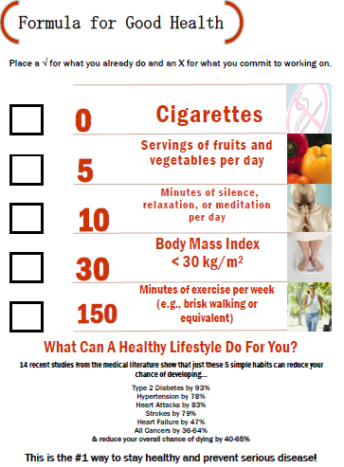
Staff Training – Get Creative
Brown bag lunches
Show staff how to use BP cuffs
One pagers – diabetes, hypertension
Patient education
Emails to all staff – latest news
Articles/websites
“Med Spots” at staff meeting (15 minutes)
Case to Care training
Summary of Case Management to Care Management
Kopes-Kerr, Am Fam Physician. 2010 Sep 15;82(6):610-614
Notes:
Training in basic medical conditions can be accomplished in many ways and by various staff

Slide 49

Health Behavior Change
Many opportunities in mental heath settings!
Examples of health behavior change models:
Health Belief/Health Action Model
Relapse Prevention Model
Health Action Process Approach
Motivational Interviewing
Notes:
Great paperback for all staff to have on using MI – examples throughout for using MI in addresssing obesity, diabetes management, smoking

Slide 50
Health Behavior Coaching
(if you only have 5 minutes…)
Motivational interviewing – Elicit their reasons for change
Why do you think you need to…lose weight, stop smoking, lower your blood pressure, lower your cholesterol, lower your blood sugar?
How do you want to do it?
Exercise: Patient has BMI 32. Use this method to discuss their weight
Rollnick and Miller, MI in Healthcare 2007
Notes:
Simple way to start thinking about how to do MI in a short amount of time
Can do interactive exercise here – patient has BMI of 32. Using the Why and How describe how you would discuss their weight

Slide 51

Self-Management
Ability to control your symptoms and explore how your health problems affect your life
Stanford Self-Management Program
6 weeks
Topics: dealing with emotions, exercise, nutrition medications, communication, decision-making
Peer Programs:
Whole Health Action Management (WHAM)
www.integration.samhsa.gov/health-wellness/wham
Health and Recovery Peer (HARP)
Notes:
Patients spend most of their time outside the treatment center. It is important to teach them how to manage their illnesses on their own as much as possible

Slide 52
Implementation-Ready Health Promotion Programs
Bartels, 2012
Notes:
A nice summary of all the programs out there – rich data base

Slide 53
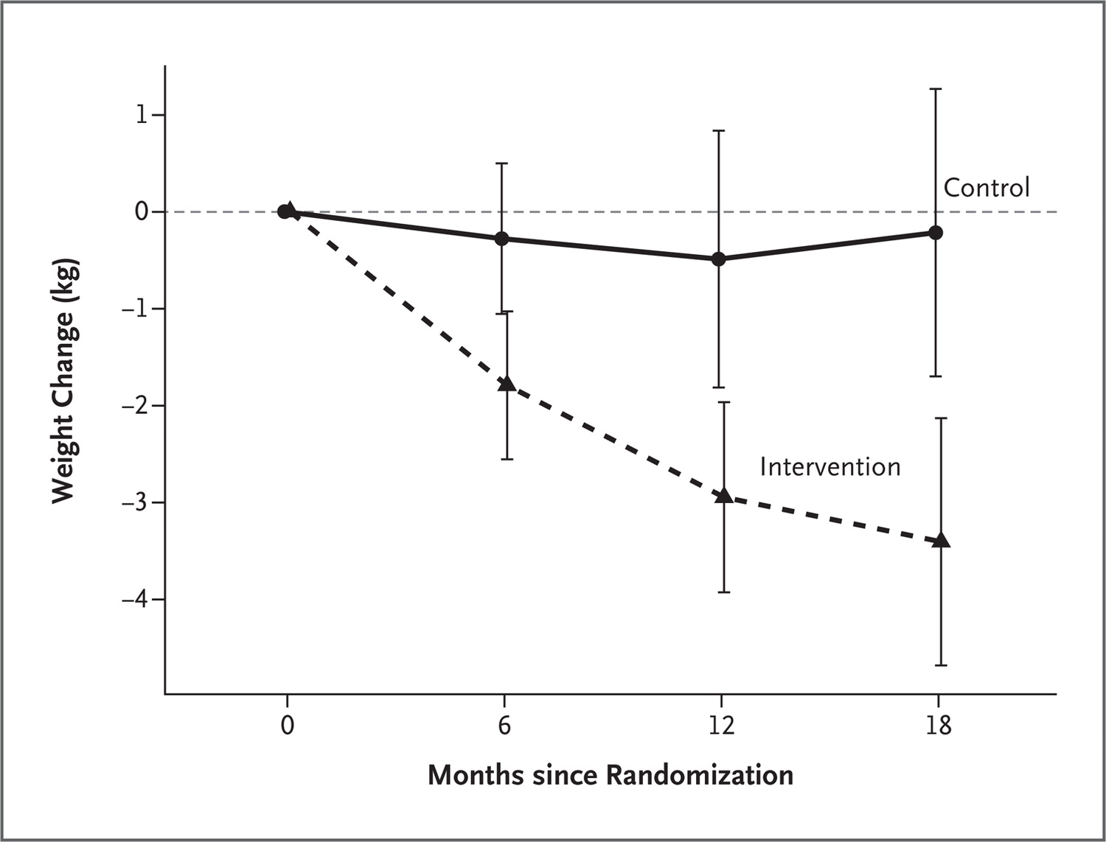
ACHIEVE: Mean Weight Change
Daumit GL et al. N Engl J Med 2013. DOI: 10.1056/NEJMoa1214530
Notes:
Even relatively small amounts of weight loss are clinically significant. Meaningful weight loss can be achieved.
Figure 2. Mean Weight Change, According to Study Group. The model-based estimates of the mean difference in changes in weight (the change in the intervention group minus the change in the control group) between the two groups at 6, 12, and 18 months were −1.5 kg (95% CI, −2.6 to −0.4; P=0.007), −2.5 kg (95% CI, −4.1 to −0.8; P=0.004), and −3.2 kg (95% CI, −5.1 to −1.2; P=0.002), respectively. To convert values for weight to pounds, multiply by 2.2.

Slide 54
Simple Behavior Change Plan
STEP ONE:
Choose a tiny step.
(Walk one block.)
STEP TWO:
Find a spot.
(Every morning on my way to work.)
STEP THREE:
Train the cycle.
(Do it every day.)
STEP FOUR:
Assess Outcomes.
(Did it change? Any changes?)
Notes:
Here is an example of how to provide very simple instructions to patients. Do not want to overwhelm them and want an opportunity to succeed.

Slide 55
Shared Decision-Making
An interactive and collaborative process between individuals and their healthcare providers to make healthcare decisions pertinent to an individual's personal recovery.
Involves discussing options, reaching consensus, and deciding on best course of treatment together as partners.
Consistent with the values of choice, self-determination, and empowerment
Provides a means of enhancing consumer involvement in mental healthcare, which has recognized benefits for positive treatment outcomes.
Notes:
This is important across all aspects of health care

Slide 56
Exercise: Shared Decision-Making
A 67 year old female with schizoaffective DO and severe knee DJD comes in because she cannot stand the pain any longer. She has exhausted medical remedies and you advise referral for surgery. She refuses the surgery and decides to live with the pain and disability. Although you advised her to have the procedure, the risk of mortality is low and you continue to help her with non-surgical remedies so you can revisit when she is ready to discuss
Notes:
What could you do to make this a better interaction given the ideas presented in the previous slide?

Slide 57
Exercise: Shared Decision-Making (Cont’d)
The same patient comes in 5 months later with a hard breast mass. After mammogram, you advise surgical evaluation. She refuses because she is afraid of surgery. At this point, you become more reluctant to allow her to just "wait and watch." Three months later, the mass is larger and she still refuses surgery. Her clinician tells her that if she doesn't get a surgical evaluation then they might not be able to care for her further.
Notes:
What would you do to make this a better interaction? The risk for not taking the physician’s advise is higher than in the previous example

Slide 58
Person-Centered Treatment Plan
Plan provider and patient create so everyone knows what is going on
Involves collaboration, partnership and shared decision making
Reduces fragmentation of services
Serves as a roadmap to guide the recovery process
Identifies everyone’s role in the treatment
Identifies outcomes (both behavioral and physical)
Used to monitor progress and recovery
Notes:
Transitions to Treatment plans and how they are helpful

Slide 59
Integrated Service Planning is the Goal
(MH, SUD, Physical Health)
Measureable Goals and Objectives
Strengths and Weaknesses
**Medical Condition Goals
Cultural, Spiritual Considerations
Patient and Family Input
Goal is Integrated
Service Plan!
Notes:
Service planning is an important aspect of treatment in mental health settings. These plans are often generated by therapy and case management staff with input from other treatment providers and patients (and their families if appropriate).

Slide 60
Reflections and Discussion
How might you approach patients differently given the information you have received?
What staff education do you think would be beneficial to maximize the “force multiplier effect”?

Slide 61
Post Test Questions
What comorbid behavioral health diagnosis are common with SMI?
  Trauma-related disorders
  Simple phobia
  Adjustment disorders
  Paraphilias
To reduce anxiety, the purpose of the first appointment could be to
  Gather information
  Make the next appointment
  Introduce staff
  All of the above
Common reasons for medical visits for people with SMI include all except
  Abdominal pain
  Chest Pain
  Well visit
  Headache

Slide 62
Post Test Answers
What comorbid behavioral health diagnosis are common with SMI?
  Trauma-related disorders
  Simple phobia
  Adjustment disorders
  Paraphilias
To reduce anxiety, the purpose of the first appointment could be to
  Gather information
  Make the next appointment
  Introduce staff
  All of the above
Common reasons for medical visits for people with SMI include all except
  Abdominal pain
  Chest Pain
  Well visit
  Headache

Slide 63
Resources
Schizophrenia for Primary Care Providers: How to Contribute to the Care of a Vulnerable Patient Population, Mark Viron, MD, Travis Baggett, MD, MPH, Michele Hill, MB, MRCPsych, Oliver Freudenreich, MD, The American Journal of Medicine, Vol 125, No 3, March 2012
Formula for Good Health AAFP.org
Handbook of Sensitive Practices for HealthCare Providers, Schachter, C.L., Stalker, C.A., Teram, E., Lasiuk, G.C., Danilkewich, A.(2009). Handbook on sensitive practice for health care practitioner: Lessons from adult survivors of childhood sexual abuse. Ottawa: Public Health Agency of Canada.
PHAC SPC GC.ca

Slide 64
Resources (Cont’d)
Cad Saude Publica. 2010 Mar;26(3):591-602
Pirl WF et al. Psych Serv 2005;56:1614.
Freudenreich O et al. Psychosomatics 2007;48:405.
Viron M et al. Comm Ment Health J (in press)
Kisely, et al, JAMA Psychiatry ,Vol 70 (no.2) Feb 2013
American Association of Clinical Endocrinologists, North American Association for the Study of Obesity: Consensus development conference on antipsychotic drugs and obesity and diabetes. Diabetes Care 2004; 27:596–601
Schachter, C.L., Stalker, C.A., Teram, E., Lasiuk, G.C., Danilkewich, A. (2009). Handbook on sensitive practice for health care practitioner: Lessons from adult survivors of childhood sexual abuse. Ottawa: Public Health Agency of Canada.
Drugs with Increase ADRs and Their 450 Enzymes – JAMA 2001
Stratton, et al, BMJ 2000,
Hennekens CH. Circulation 1998;97:1095-1102.
Rich-Edwards JW, et al. N Engl J Med 1995;332:1758-1766.
Kopes-Kerr, Am Fam Physician. 2010 Sep 15;82(6):610-614
Rollnick and Miller, MI in Healthcare 2007
Daumit GL et al. N Engl J Med 2013. DOI: 10.1056/NEJMoa1214530
99:1193-1204

Slide 65
End of Module 3

