Slide 1
Applying Theories, Perspectives, and Practice Models to Integrated Health
Module 3
Judith Anne DeBonis PhD
Department of Social Work
California State University Northridge

Slide 2
Module 3
Theories, Perspectives, and Practice Models in Integrated Health
By the end of this module students will:
  Learn how a variety of theories, perspectives and practice models can be useful in their application to Integrated Health
  Identify and understand the impact of personal (practitioner and patient) practice and explanatory models on clinical practice and behavior
  Gain experience, skill, and confidence (through practice scenarios) in applying theories to practice
    Increase more detailed knowledge and understanding of the application of Stage of Change theory to Integrated Health

Slide 3
The Basic Value of Theories …¹
Theories help us to explain or predict behavior, to inform policy, guide practice and direct research.
  For behavioral health professionals:
  Inform the questions we ask
  Frame the comprehensiveness of our assessment
  Offer a vantage point that respects diversity and complexity
  Provide a lens through which we organize vast amount of information or view data
“It is the theory that decides what we can observe.”
Albert Einstein

Slide 4
Contribution of Theory to Integrated Health? ²
Assessment is part of treatment
  When conducted effectively, a good assessment is not just about diagnosis, but offers opportunities for the patient to identify strengths and gain insight and self-understanding.
Theories can act as a roadmap for the questions to ask or for decisions about the direction taken in an assessment. It can offer options for strengthening the partnership with the patient and encourage practitioner’s to consider a variety of vantage points which can lead to a more comprehensive understanding of the patient’s experiences

Slide 5
Using Common Theories to Enhance Assessment ³
Environmental
or Systems Theory
Behavior is influenced by a person’s environment. Interventions aimed at the individual and the environment have potential for positive outcomes.
Human
Developmental Theory
People have different needs and capacities related to the current phase of their life history.
Grief and Loss
Theory
All persons experience losses that have the potential to result in feelings and reactions: denial, anger, depression, bargaining, and acceptance.
Social Support
Theory
No one should try to go it alone. Having access to a network of support may result in improved healthcare outcomes.

Slide 6

Group Activity
Generating Questions Associated with Theories…
Think of your client population. What areas of a person’s life come to mind when you consider how these theories relate to that person?
Environmental
or Systems Theory
Human
Developmental Theory
Applying the theory to your practice…
Grief and Loss
Theory
Brainstorm at least
2 questions for each theory that lead you to a better understanding of the person.
Social Support
Theory

Slide 7
BioPsychoSocialSpiritual

Slide 8
Biological, Psychological, Social Relational and Spiritual Aspects—A Person-Focused Approach¹
Purpose
Contributions
  Collects information regarding history, development, biology, genetics, psychology, social, spiritual, and environmental aspects of health
  Offers a structure to examine current mental status
  Provides insight into personal strengths and weakness including social role, environmental resources, mental health and physical health
  Holistic- person and situation context
  Helps tie together theories to better understand aspects of the person and environment
  Gives integration and interconnectedness to contrasting qualities of the person
  Identifying possibilities for engaging micro and macro systems of practice

Slide 9
Group Activity
Person and Environmental Focused Mandalas…
“We do not give priority to either the person or the environment, but rather see person and environment as inextricably related.” ¹
  Using the mandalas (on the next slide) of human behavior theories, consider how these various theories might be useful in practice with people who have a combination of health, mental health, and substance use disorders.
  Start by examining a clinical case example, or reading a narrative written by a person living with one or more of chronic conditions.
  Applying both the person-focused and environmental mandalas, examine how they interact and impact on the person’s experience.

Slide 10
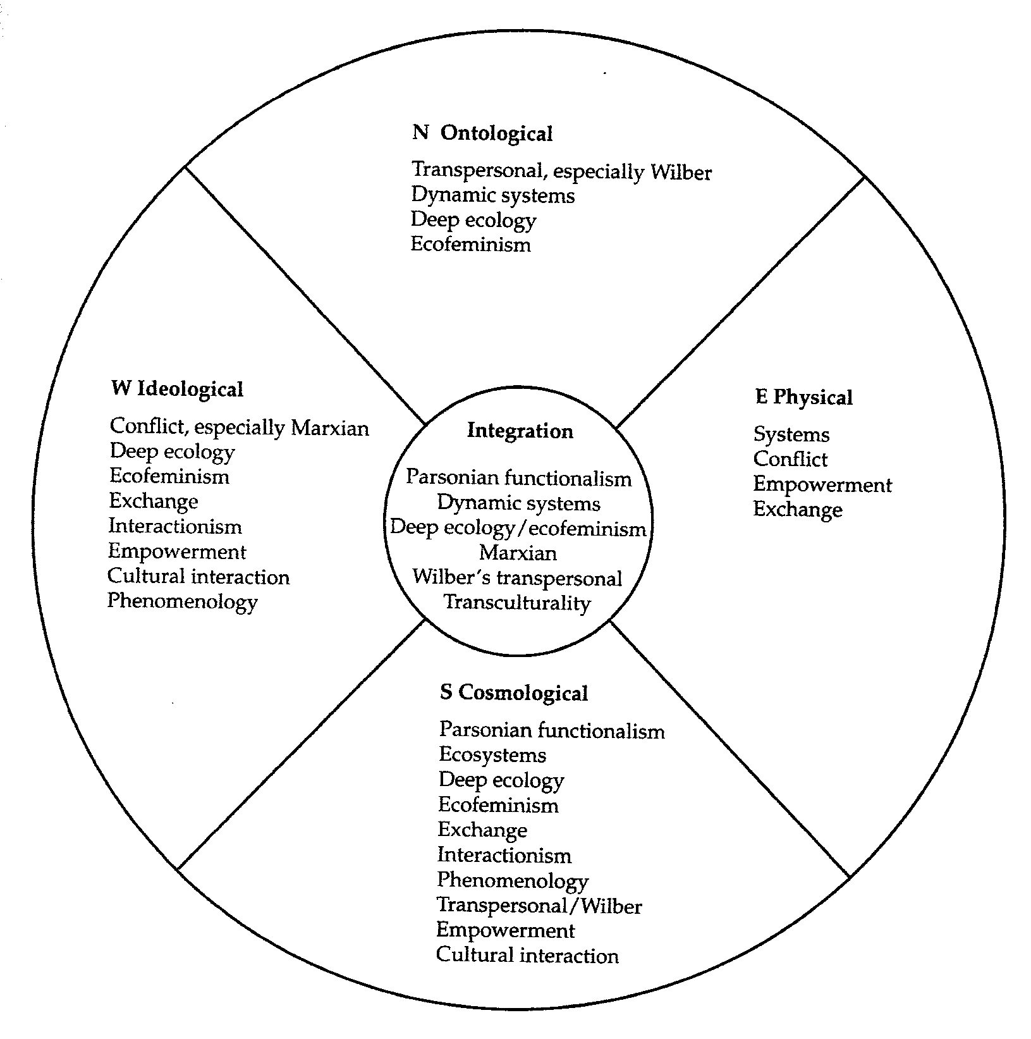
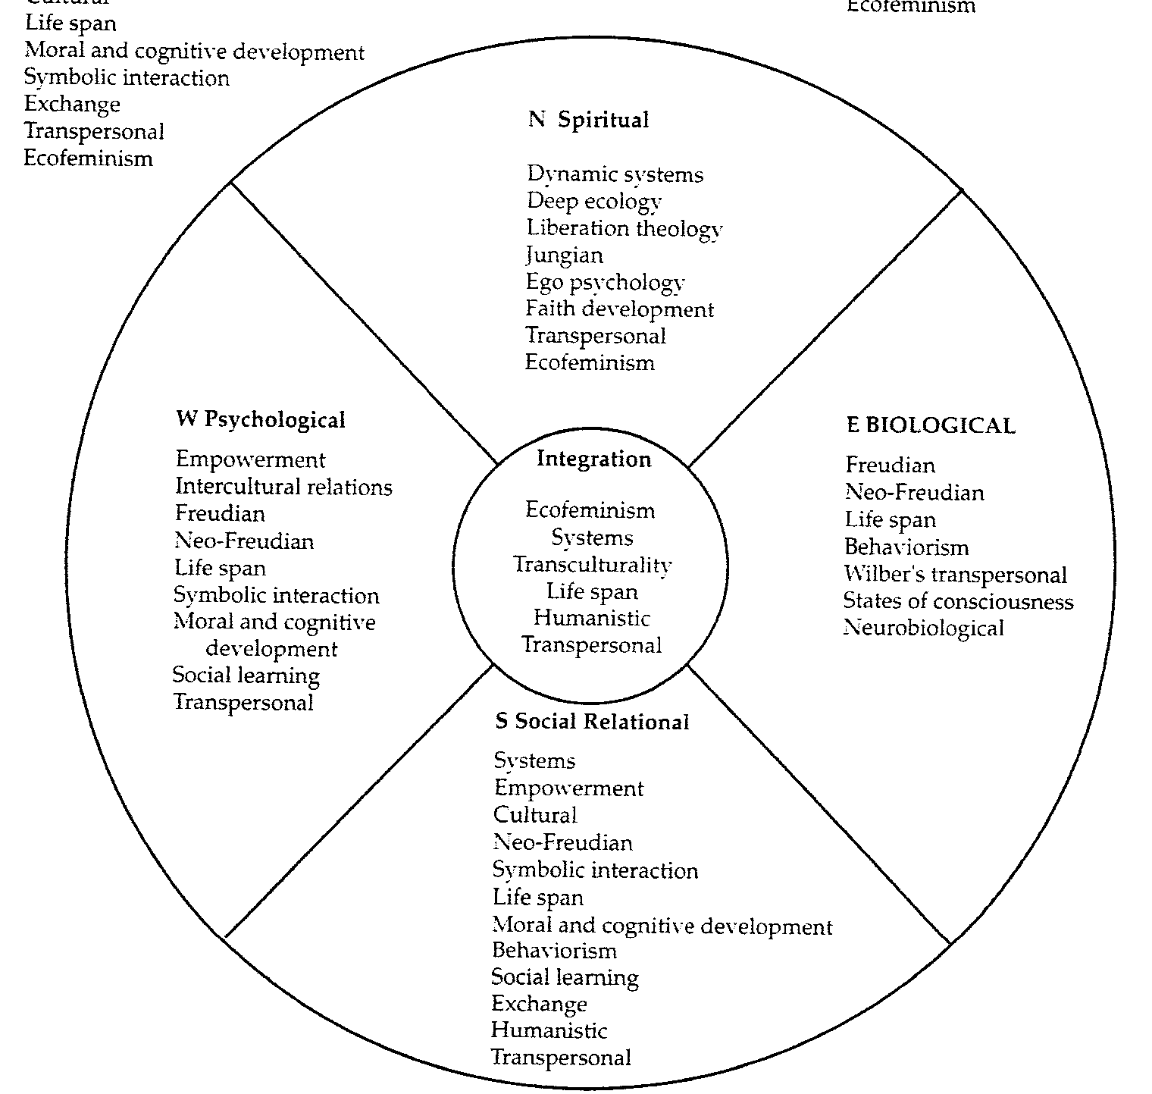
Person and Environmental Focused Mandalas¹
Person-Focused
Environmental-Focused

Slide 11
Explanatory Models
Take a few minutes to think about and discuss the following question:
What is your explanatory model for mental health and substance use problems?
  Stories and experiences from real life
  Messages we carry with us
  Impact on our role as a social worker

Slide 12
Stress
Vulnerability

Slide 13
History of Mental Disorders
  Ancient Egyptians did not differentiate between mental and physical illnesses⁴
  Thought the heart was responsible for mental symptoms
  Later shifted to blaming, stigmatizing⁵
  The label of mental illness became the entire definition of who the person is
  Stigma continues to be one of the largest barriers to understanding and treatment

Slide 14
Typical Reactions Towards Mental Illness⁶
Myths and misconceptions about mental illness:
  Depressed people should just “snap out of it”
  The mentally ill are dangerous, often commit crimes
  All mental illness involves psychotic episodes
  It’s fun to be manic
  Schizophrenia = multiple personality disorder
  Families are the cause of mental illness
  Supportive therapy can’t help the mentally ill
  People with schizophrenia can only do low level jobs
  A schizophrenic is a schizophrenic is a schizophrenic
Despite new scientific evidence and information, these ideas persist

Slide 15
Factors Contributing to Mental Health Disorders⁶
A combination of environmental and genetic factors contribute to mental illness
  No blood test for mental illness
  Common for individuals to blame themselves for their feelings, thoughts, and behaviors
  Common to feel embarrassed about them
Mental disorders are not caused by
personal laziness or weak character

Slide 16
The Stress Vulnerability Model⁷
  Amount of vulnerability differs from person to person
  For some conditions, related to factors like early exposure to viral infection in utero
  Impacts vulnerability by either triggering the onset of the disorder or worsening the course
  Stress can include life events, relationships, etc.
Illness/
symptoms
Genetics, biological vulnerabilities
Stress in the environment
  Reduce person’s biological vulnerability and stress
  Factors include medication, coping skills, communication, and problem solving skills and structure
  Combinations of stress and vulnerabilities may lead to different types of a disorder
  Individuals and families can build protective factors to minimize or manage stress
  May help reduce severity of symptoms and impact the illness course positively
Protective factors

Slide 17
Group Activity
How do the causal models of mental health disorders impact practice?
  What are some of the benefits that come from understanding the causal factors for mental health and substance use disorders?
  Does increased understanding help to reduce the associated stigma?
  What impact can knowledge about causal factors have on the person and the family?
  How would you apply the knowledge from the stress vulnerability model to help people reduce the severity of their symptoms and positively impact their illness course?

Slide 18
Practice Theory Models
Take a few minutes to think about and discuss the following question:
What are the essential components of your practice model for mental health and substance use problems?
  What is your belief about change?
  What motivates persons to take action on behalf of their health?
  How hopeful are you that recovery is possible?
  Can persons with chronic conditions also be resilient?

Slide 19
Practice Theory Models⁸
Assumptions of three dimensions:
Human Behavior
  Assumptions and research about risk and resilience factors that affect human development and behavior
Change Process
  Theories about how people change their thoughts, feelings, and behaviors in different situations
Interventions
  Skills
  Techniques
  Strategies
  Used in the practitioner-client interactions
  Why do people behave as they do? What role does the environment play?
How do people change? What activates or motivates the process?
What activities can improve client adaptation or well-being?

Slide 20
Critical Examination of Theory⁸
“While practice theories have made positive contributions to social work practice, they all have strengths and limitations”
  Scientific evidence does not support the theoretical assumptions
  While there may be merit in the underlying theory, the intervention has not been adequately tested or shown to be effective
  The theory is not broadly applicable to treating a wide range of psychosocial problems
1
2
3

Slide 21
Strengths and Resiliency

Slide 22
Consider An Example⁹
The individual is a college student in their junior year at the local university where classes began a little more than a week ago.
  Read the process recording and note your thoughts as you take in the information being presented
  Please note specific information that appears most important or significant to your beginning understanding
  While you may want more information, think of what immediately comes to mind in terms of defining the problem or diagnosis and how you would go about starting to work with this person?
  As a group, take time to collect and process findings...

Slide 23
Process Recording⁹
“ I called last week to make this appointment because I just felt that I was not going to make it. I felt so anxious and stressed at school the other day, I had to leave and did not attend my first class session. Actually, it was my first day back in school since taking a break last year. I had pushed myself too hard with work, school, and trying to keep the gay alliance going, I just couldn’t do it anymore. My drinking was getting worse and I was yelling at my partner so much I was always leaving to get away to clam down. My Dad would hit my Mother and he drank a lot. Maybe I am just too much like him”.

Slide 24
Basic Assumptions of Strengths Perspective^{10,11,12}
  Everyone possesses strengths
  Motivation is increased when strengths are emphasized
  Cooperative, mutually respectful relationships promote identification of client strengths
  Focusing on strengths diminishes the temptation to blame or judge
  All environments—even the most bleak— contain resources
How many observations about the previous case example were “strength-based?”
What percentage of the discussion focused on problems or took a deficit perspective?

Slide 25
Strengths-Based Practice? ⁹
Traditional models assume that “truth” is discovered only by looking at underlying and often hidden meanings that only professional expertise can understand?
  Medical/pathology vs. strengths/solution focus
  Shift in frames are not easy tasks
  Using the language of strengths is insufficient
Frames provide a set of rules and expectations for behavior

Slide 26
Empowerment

Slide 27
Consider Some Examples¹³
“Examples of not seeing what is there and examples of seeing what is not there”
  “My patients don’t want to be empowered…they want me to tell them what to do”
  “I want to empower my patients to improve their compliance with their treatment”
  “Some patients cannot be empowered due to age, education or culture”
  “I only use empowerment with some of my patients…it’s in my bag of tricks but I wouldn’t use it with a newly diagnosed patient”

Slide 28
Empowering Approach?¹³
“Empowerment occurs when the practitioner’s goal is to increase the capacity of the client to think critically and make autonomous, informed decisions…it also occurs when clients are actually making autonomous informed decisions”
Reflect on your reactions
Challenge – consider how fully the spirit of empowerment can be applied in clinical settings with various patient populations
  Compliance vs. Adherence vs. Empowerment
  Empowerment is a process and an outcome
  No empowerment without respect

Slide 29
Defining Empowerment for Health
Empowerment is a process by which people gain mastery over their lives.” ¹⁴
J. Rappaport
Empowerment is an educational process designed to help patients develop the knowledge, skills, attitudes, and degree of self-awareness necessary to effectively assume responsibility for their health-related decisions.” ¹⁵
Feste – Anderson

Slide 30
Sharing of Power¹⁶
Compliance
Empowerment
“Let’s decide together what is the best care for your conditions.”
“You must do what I tell you.”
An authoritative act designed to reduce patient autonomy and constrain freedom of choice
An agreement designed to support the promotion of self-management, taking into account the patients’ perspectives on their condition, their goals, expectations, and needs

Slide 31
Empowerment Applied¹⁷
Empowered Patients – “Own” Their Health Condition
Have skills for making decisions
and changes as needed
Make decisions and direct their life in a way that helps them meet their goals
    Active participants in:
    Setting goals
    Building action plans
    Identifying barriers
    Problem solving
Are effective self-managers
Have strong self-efficacy
    Comfortable and confident about taking needed action

Slide 32
How Do Patients Become Empowered?^{17,18}
Through Self-Management Education
Traditional Patient Education
Offers information
Defines problems
Self-Management Education
Teaches problem solving
Helps patients identify problems, make decisions, take actions
Self-management compliments rather than substitutes for traditional patient education
A partnership will require both educators and learners
to interact with respect as equals

Slide 33
Paolo Freire¹⁹
“There isn’t Dialogue Without Humility”
  The content of education based on true dialogue is not intended to convey information or impose ideas
  It is to provide an organized structure so individuals can
    Identify their own goals
    Initiate their own decisions and actions
    Experience their own power
Switching from a “banking” to a “problem–posing” approach to education
“Education for liberation”

Slide 34
Bloom’s Educational Model
About “Into,” “Through,” and “Beyond”²⁰
✓
  Provide education and information on the basics
  Involve patients
Into …
Knowledge
1
✓
Through … Skill Building
  Offer patients opportunities to put information or skills into action
  Help patients to learn through experience
2
  Help patients go beyond the basics and fine-tune their skills
  Encourage patients to keep building on what they’ve learned
✓
Beyond …Increasing self efficacy
3

Slide 35
Group Activity
Patient Education and Empowerment
  Using Bloom’s 3-step model of education (from the previous slide) and Freire’s model of empowerment, practice through role play how you might assess a patient’s educational needs and individualize the needs based on the three different steps.
  Based on these models, how might you modify or enhance any current patient educational materials that you’ve seen used in our healthcare system?
  Consider the advantages, disadvantages and impact of an individualized model vs. the “one size fits all” educational approach?

Slide 36
The Real Goal of Empowerment is Increased Self Efficacy…²¹
Patient Empowerment
Increased Sense of
Self-Efficacy
“Increased self-efficacy allows patients to view disease and symptoms differently, giving more opportunities for effective self-management”²¹
Enhanced Self-Management Skills

Slide 37
Person Centered

Slide 38
Patient as Central to the Process¹⁶
Individuals Makes Decisions About:
  Life-style
  Taking medicine
  Physical activity
  Blending information with personal culture, expectations, wishes, and attitude
The person is, in fact, the true manager of his or her well being. Ultimately, the question is not whether patients will manage their health or diseases, but how they will manage.

Slide 39
Medical Model¹ vs.
Person-Centered Model of Care¹
Traditional Medical Model
Evolving Healthcare Model
Person-Centered Model

Slide 40
Health Management

Slide 41
Important Changes in Health Management²²
Three points:
  Chronic disease is the major reason for seeking healthcare in the U.S.
  Treating chronic medical conditions requires a different model of care
  The “new” models of care for chronic conditions require a change in both patient and provider roles
The Global Burden of Disease, a study sponsored by the World Health Organization, projected that by the year 2020, mortality and disability from disease would shift from predominantly acute illnesses to chronic conditions.

Slide 42
1) Chronic Disease: The Major Reason for Seeking Healthcare in the U.S.²²
  Shift from acute illnesses to chronic conditions
  Chronic disease is the primary cause of disability in the U.S.
  Chronic disease accounts for 70% of all healthcare expenditures in the U.S.
  As many as 45% of the general population and 88% of persons aged 65 or older have at least one chronic condition

Slide 43
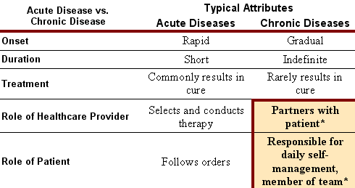
2) Treating Chronic Conditions Requires a Different Model of Care²³

Slide 44
3) Need for Change in Patient and Provider Roles^{24,25}
The “patient/professional” partnership involves collaborative care and self-management education
  Patients are expected to do what is needed on a daily basis
  Providers act as consultants, resource persons, and offer treatment suggestions
Patient/Healthcare Provider Team
Healthcare Providers
Patients
Provide clinical expertise, experience with the chronic condition, and evidence-based knowledge
Know more about themselves, what motivate them, what they are willing to change, and what has helped them feel better

Slide 45
Wagner’s Chronic Care Model²⁶
Improved Health Outcomes are achieved when patients take an active role in their care. Social Work providers can serve to promote patient empowerment and behavioral activation which are essential to effective self-management.

Slide 46
Lorig’s Components of Self-Management ^{23,24,27}
Living with a chronic condition requires patient
self-management in three key areas:
Medical Management
Behavioral Management
Emotional Management
Take medicines, adhere to special diet, test blood sugars
Adjust to life with chronic illness—maintain, change, or create new life roles
Deal with emotional consequences of having a chronic condition

Slide 47
Group Activity
Good Chronic Care Requires Self-Management
“Growing evidence from around the world suggests that patients with chronic conditions do better when they receive effective treatment within an integrated system of care which includes self-management support and regular follow up.” ²²
Consider the Following Questions:
  How would you create effective treatment that includes self-management support and regular follow-up?
  What characterizes a prepared practice team?
  What characterizes an informed practice team?
  What characterizes an informed activated patient?²⁶
  What specifically can social work providers do to promote patient empowerment toward behavioral activation?

Slide 48
Health Beliefs

Slide 49
Health Belief Model ^{3,28}
Purpose
Contribution
  Offers understanding or insight into a person:
  How the person prioritizes health and health problems
  Belief about the causes health problems or what symptoms mean
  Hopefulness about whether treatment will help
  Sense of how worthwhile certain actions might be in preventing disease or treating health problems or risks
  Helps individualize a comprehensive assessment:
    What do you think caused your problems?
    Why do you think it started when it did?
    How does it effect you?
    What worries you most?
    What kind of treatment do you think you should receive?

Slide 50
Group Activity
Beliefs about Pain
The messages that “pain equals harm” and or that all pain is a signal that something is wrong can contribute to disability and distress for persons with chronic conditions.²⁸
Consider the Following Questions:
  Brainstorm about some of the common beliefs about pain and how these might impact behavior.
  What types of questions might you ask to understand the person’s belief? How have they coped with pain?
  How could education and information be used to address these issues? What would the goal be?

Slide 51
The Client’s Theory of Change

Slide 52
The Client’s Theory of Change ²⁹
Purpose
Contribution
An “informal” theory which explains a person’s :
  Perceptions and views about the nature of the problem and it’s possible resolution
  Opinion about what is known to be helpful or unhelpful in dealing with the problem
  NOTE: this theory needs to be discovered through dialogue characterized by “caring curiosity”
  Helps to direct the focus of treatment based on the patient’s expertise and knowledge, reinforcing engagement and motivation
  Highlights strengths and abilities in the patient that may have been overlooked or forgotten
  Provides details on previous experiences of change which offer opportunities to make a successful plan in the present

Slide 53
Activity
Client’s Theory of Change …
Prompting a client to reflect on successful ways that they have coped or positively made changes in the past, can help to uncover resources (internal and external) used to resolve current problems.²⁹
Consider the Following Questions:
  When the goal is to discover the client’s theory, what role and stance is the most effective for the practitioner to take? (Hint: there is more than one right answer here)
  Are the models of education (Lorig, Freire, Bloom) compatible with this theory? Could they be used in combination?
  How would a solution-focused approach serve the discovery of the client’s theory of change? (Be specific)

Slide 54
Stage of Change

Slide 55
Stage of Change Theory³⁰
Purpose
Contributions
  Identify the stages that changers go through
  Measure the person’s readiness to change and offer stage-matched interventions
  Identify what is needed at each stage to move through the process and make behavior change
  Recognize change as a process
  See every person in the process of change and intervene accordingly
  Recognize relapse as part of the change process
  Measure progress both through changes in stage or in changes in behavior

Slide 56
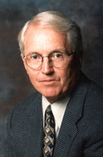
James Prochaska
Stage of Change Guru
Five Stages of Change³⁰
Precontemplation
Contemplation
Preparation
Action
Maintenance

Slide 57
Stage of Change…Details³⁰
Five Stages of Change
Precontemplation
Contemplation
Preparation
Action
Maintenance
People in this Stage
No intent to change yet, unaware or deny personal relevance
Aware of the problem, ambivalent about change
Getting ready to change, choosing a plan
Trying to change, not yet consistent in doing it
Practice being consistent, avoid slipping back
Tip Offs
“There’s nothing I really need to change”
“It might be good for me, but it’s too hard”
“I’ve started to make small changes”
“I wish I was more consistent”
“I’m working hard not to lose the progress I’ve made”

Slide 58
10 Principles for Applying Stage of Change Theory ^{30,31,32}
1
Change is a process rather than an event
6
Insight is necessary but not sufficient for permanent change
Change is characterized by stages
People who are not in the action stage may still be “actively” changing
2
7
Identifying the person’s stage of readiness is essential to tailoring interventions that will be most effective
Understanding how to maintain change is also a key to successful change
3
8
4
Moving one stage at a time is the most reasonable goal
9
People can be at different stages for different problems
5
Knowing the changer’s stage helps to individualize the approach
10
The goal is for full freedom from the problem

Slide 59
Activity
For each of the detailed Stage of Change principles that follow…
Consider the Following Questions:
  How does the principle support the goals of Integrated Health?
  If implemented, what changes would this principle make to your thinking or behavior or practices with the patients you encounter?
  What (if any) barriers exist which would limit the full use of the Stage of Change principles?

Slide 60
Change is a Process Rather Than an Event
1
It is common for people to change gradually — from being uninterested, to considering a change, to deciding and preparing to make a change — over months and years.

Slide 61
Change is Characterized by Stages
2
Each of the stages corresponds to an individual’s readiness to change — precontemplation (never), contemplation (maybe), preparation (will soon), action (doing it now), maintenance (sticking to it), and termination (never go back) — giving an indication of when change will occur.

Slide 62
Identifying the Person’s Stage of Readiness is Essential to Tailoring Interventions that will be Most Effective
3
Associated Change Processes Per Stage
A
B
C
D
E
For each stage there are associated change processes — activities that people can apply or engage in to help modify thinking, feeling, and behavior— which explain how people progress through the stages. Doing the right things at the right times is the key.

Slide 63
Moving One Stage at a Time is the Most Reasonable Goal
4
Because there is essential learning and experience that is gained from going through each stage, skipping stages is not a good idea. People will vary on the amount of time needed in each stage — both shifts in readiness and behavior change are measures of success.

Slide 64
Knowing the Changer’s Stage Helps to Individualize the Approach
5
Healthcare providers, family, and friends can offer help that is more targeted to the person’s particular needs, and offer it in the best way, when they match the stage.

Slide 65
Insight is Necessary But Not Sufficient for Permanent Change
6
Two mistakes to avoid in the process — trying to modify behaviors by becoming more aware or trying to modify behavior before there is insight about the problem. Either will likely to result in temporary change or may be an obstacle to progressing further.

Slide 66
People Who are Not in the Action Stage May Still be “Actively” Changing
7
Prochaska found that only 10-20% of people were in action, more in contemplation and the most in precontemplation. However, since important changes in attitudes, feelings, intentions during early stages are the foundation for changes in behavior, all people should be included for participation regardless of their motivation level or intent to change.
In Pre-
Contemplation
In
Contemplation
In Action

Slide 67
Understanding How to Maintain Change is Also a Key to Successful Change
8
It is rare to overcome a problem on the first attempt —sometimes 3 to 4 tries are needed before change is permanent. Both recycling through the stages and relapses back to old behavior are common and considered necessary to learn how to sustain change.

Slide 68
People can be at Different Stages for Different Problems
9
Each problem should be evaluated separately so that stage-matched strategies can be chosen.

Slide 69
The Goal is for Full Freedom from the Problem
10
While improving a problem can help, discovering how to solve the problem is the aim and hope — leaving the person with zero or minimal risk from a particular behavior.

Slide 70
Group Activity
Putting together the “theories” of change…
  Considering both the Client’s theory of change and Prochaska’s stages of change:
  As a group, choose a case example that includes a patient in one of the Prochaska stages of change. Specify the area of behavior change that will be the focus of the conversation.
  Role play using 3 students per group
    One student will portray a patient
    One student will conduct the interview
    The last student will take notes about the ways in which the interviewer was able to incorporate the theories and draw out the client’s theory of change.
  Discuss what worked well. What obstacles were encountered.
  How did it feel to play the patient? the practitioner?

Slide 71
Self-Determination Theory

Slide 72
Self-Determination Theory³³
Purpose
Contributions
  The initiation and maintenance of positive health behaviors is under the person’s control and therefore are highly dependent on self-care actions.
  Maximizing autonomy, competence and relatedness are essential for patients to be successful
  Human behavior plays an critical role in health outcomes and in the efficacy of treatments
  Practitioners can support patients by attending to their need for autonomy, competence, and relatedness
  Supports ethical ideals to empower patients to be active participants in healthcare decisions and actions

Slide 73
Autonomy, Competence, Relatedness³³
What Practitioners Should Do and Not Do:
Do More of These
Support patients to explore resistances and barriers
Give feedback
Compliment mastery, skill
Provide respectful, caring encounters
Avoid These
Suggesting incentives
Motivating through authority
Showing disapproval
Over-challenging the patient beyond current capacity
The patient/provider partnership is an important medium and vehicle for change.

Slide 74
Group Activity
Self-Determination Theory …
Consider the Following Questions:
  How would you apply this theory? Where? When?
  How might this theory support an Integrated Health model?
  What circumstances might make it more challenging to apply?
  What types of responses would you anticipate from patients? family members? physicians?

Slide 75
In Closing…
Questions?
Thoughts?
Comments?

Slide 76
References:
Applying Theories, Perspectives, and Practice Models to Integrated Health
Robbins, S. P., Chatterjee, P., & Canda, E. R. (2005). Contemporary human behavior theory: A critical perspective for social work. New York: Allyn & Bacon.
Curtis, R., & Christian, E. (2012). Integrated care: Applying to theory to practice. New York: Taylor and Francis Group.
Health Education Behavior Models and Theories—A Review of the Literature-:Part 1. MSUcares: Mississippi State University Extension Service. http://msucares.com/health/health/appa1.htm (accessed 9/24/2004).
Okasha, A. (1999). Mental health in the Middle East: An Egyptian perspective. Pergamon, 19, 917-933.
Goffman, E. (1963). Stigma. New Jersey: Prentice-Hall.
Harding, C.M., & Zahmiser, J. H. (1994). Empirical correction of seven myths about schizophrenia with implications for treatment. Acta Psychiatric Scandinavica, 90 (suppl. 384), 140-146.
Nuechterlein, K., & Dawson, M.E. (1984). A heuristic vulnerability-stress model of schizophrenia. Schizophrenia Bulletin, 10, 300-12.
O’Hare, T. (2009). Essential skills of social work practice. Chicago: Lyceum Books, Inc.
Blundo, R. (2001). Learning Strengths-Based Practice: Challenging our Personal and Professional Frames. Families in Society: The Journal of Contemporary Human Services, 82(3), 296-304.
DeJong, P., & Berg, I. K. (2013). Interviewing for solutions. Pacific Grove, CA: Brooks/Cole.
Marty, D., Rapp, C. A., Carlson, L. (2001). The experts speak: The critical ingredients of strengths model case management. PsychiatricRehabilitation Journal 24(3).
Rapp, C. A., Saleebey, D., & Sullivan, W. P. (2005). The future of strengths based social work. Advances in Social Work 6(1), 79-90.
Anderson, R.M., & Funnell, M.M. (2009). Patient Empowerment: Myths and Misconceptions. Patient Education and Counseling 79(3), 277-282. Doi:10.1016/j.per.2009.07.025
Rappaport J. (1987). Term of empowerment / exemplars of prevention: toward a theory for community psychology. American J. Counselling Psychology 15, 121-149.
Feste C., & Anderson R.M. (1995). Empowerment: from philosophy to practice. Patient Education Counselling, 26,139-144.

Slide 77
References:
Applying Theories, Perspectives, and Practice Models to Integrated Health (Cont’d)
Mola, E. (2006). Dalla compliance all’ empowerment: Due approcci alla malattia. Quaderon di comunicazione, fiducia e sicuerezza,dipartimento di filosofia e scienze sociali, Lecce, 6, 99-107.
Lorig, K. (2001). Patient education: A practical approach. Thousand Oaks, CA: Sage Publications, Inc.
Lorig, K. (2003). Self-management education: More than a nice extra. Medical Care 6, 669-701.
Freire, P. (1971). Educacao como practica de libertad: Edzione Italiana. Arnoldo Mondaton Editore.
Bloom, B. S. (1985). Developing talent in young people. New York: Ballantine Books.
Gonzalez, V. M., Goeppinger, J., & Lorig, K. (1990). Four psychosocial theories and their application to patient education and clinical practice. Arthritis Care and Research.
Murray, C. J., & Lopez, A. D. (1996). The global burden of disease: A comprehensive assessment of mortality and disability from disease, injuries, and risk factors in 1990 projected to 2020. Cambridge, MA: Harvard School of Public Health.
Lorig, K., Holman, H., Sobel, S., Laurent, D., Gonzalez, V., & Minor, M. (2000). Living a healthy life with chronic conditions: Self-management of heart disease, arthritis, diabetes, asthma, bronchitis, emphysema, and others. Boulder, CO: Bull Publishing CO.
Lorig, K., & Holman, H. (2004). Self-management education: Context, definition, and outcomes and mechanisms. Retrieved from http://www.chronicdisease.health.gov.au/pdfs/lorig.pdf.Accessed
Funnell, M. (March 2000) Helping Patients Take Charge of Their Chronic Illnesses. Family Practice Management.
Wagner, E. H. (1998). Chronic disease management: What will it take to improve care for chronic illness. Effective Clinical Practice, 1, 2-4.
Fischer, D., Stewart, A. L., Bloch, D. A, Lorig, K., Laurent, D., & Holman, H. (1999). Capturing the Patient’s View of Change as a Clinical Outcome Measure. JAMA 282(12).

Slide 78
References:
Applying Theories, Perspectives, and Practice Models to Integrated Health
Hunter, C. L., Goodie, J. L., Oordt, J. L., & Dobmeyer, A. C. (2012). Integrated behavioral health in primary care: Step-by-step guidance for assessment and intervention. Washington, D.C.: American Psychological Association.
Robinson, B. (2009). When therapist variables and the client’s theory of change meet. Psychotherapy in Australia, 15(4), 60-65.
Prochaska, J .O., Norcross, J. C., DiClemente, C. C. (1994). Changing for good: A revolutionary six-stage program for overcoming bad habits and moving your life positively forward. New York: Avon Books.
Prochaska, J.O., & Norcross, J.C. (2001). Stages of change. Psychotherapy 38(4).
Prochaska, J. O., DiClemente, C. C., & Norcross, J. C. (1992). In search of how people change: Applications to addictive behaviors. American Psychologist, 47, 1102-1114.
Ryan R., P., Deci, E., & Williams, G. (2008). Facilitating health behavior change and it’s maintenance: Interventions based on Self Determination theory. The European Health Psychologist, 10, 2-5.

