Slide 1
Primary Care Providers Working in Mental Health Settings:
Improving Health Status in Persons with Mental Illness
Lori Raney, MD
With: Katie Friedebach, MD; Todd Wahrenburger, MD; Jeff Levine, MD; and Susan Girois, MD

Slide 2
Disclosures
Dr. Raney: Consultant, National Council
Dr. Wahrenberger: Nothing to disclose
Dr. Girois: PBHCI Grantee
Dr. Levine: PBHCI Grantee
Dr. Friedebach: Nothing to disclose

Slide 3
Psychopharmacology for Common Illnesses and Working with Psychiatric Providers
Module 4
Learning Objectives:
Understand the most commonly used psychotropic medications and their potential side effects
Discuss the problems associated with psychotropic prescribing and the role of the primary care-psychiatric provider liaison in minimizing risk
Appreciate the need to work with psychiatric provider colleagues on ownership of prescribing and rules of engagement

Slide 4
Pre Test Questions
Which second generation antipsychotics (SGAs) lead to the most weight gain?
  Olanzapine (Zyprexa) and Quetiapine (Seroquel)
  Risperidone (Risperdal)
  Aripiprazol (Abilify) and Ziprasidone (Geodon)
  Haloperidol (Haldol) and Fluphenazine (Prolixin)
Which tests are recommended by the American Diabetes Association/American Psychiatric Association guidelines for SGAs?
  Lipid Panel
  Fasting Blood Sugar
  BMI
  All the above
What percentage of people with schizophrenia smoke?
  ~30 - 40%
  ~40 - 50%
  ~70 - 80%
  ~90%
What roles do the psychiatric providers play in the medical treatment of their patients?
  Minimize risk by selection of medications
  Screen for medical complications of medications
  Counsel on lifestyle modification
  All of the above

Slide 5
Overview Module 4
Medication Classes
Anxiety
Sleep
Smoking
Substance Use
Pain
Working with Psychiatric Providers

Slide 6

Classes of Psychotropic Medications
Antipsychotics (1st and 2nd Generation)
Antidepressants
tricyclic antidepressant (TCA)
selective serotonin reuptake inhibitor (SSRI)
serotonin–norepinephrine reuptake
inhibitor (SNRI)
selective dopamine reuptake inhibitor (SDRI)
Mood Stabilizers
Anxiolytics
Notes:
Four major classes of psychotropic medications

Slide 7

First Generation Antipsychotics (FGAs)
Yes, we still use them….Potent D2 receptor blockade
High Potency – decanoate helpful for homeless, few social supports, frequent relapse
Fluphenazine (Prolixin) also has decanoate formulation
Haloperidol (Haldol) also decanoate
Low Potency – dopamine + histamine, acetylcholine, muscarinic
Thioridizine (Mellaril)
Loxapine (Loxatane)
Chlorpromazine (Thorazine)
Thiothixene (Navine)
Perphenazine (Trilafon)
Notes:
Older medications prior to introduction of second generation antipsychotics

Slide 8
FGA Side Effects – think Parkinson’s
Dyskinesia – movement disorder (nigrostriatal dopamine pathway)
tongue, lips, eye, limbs, fingers
Tardive Dyskinesia – can be permanent
Dystonia – muscle tension
neck (torticollis), arms, legs – any body part painful – benztropine, diphenhydramine to treat – IM available
Akisthesia – extreme restlessness
hard to sit still, pacing, shakiness – can be exhausting, reduce dose
Hyperprolactinemia – D2 blockade (tubuloinfundibular dopamine pathway)
amenorrhea, galactorrhea – lower the dose, switch, work with GYN

Slide 9
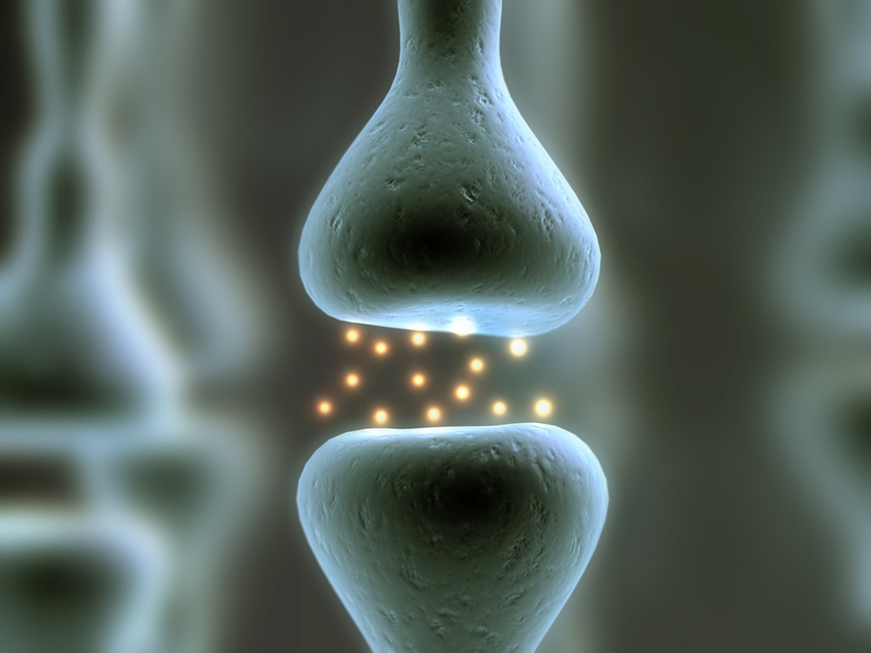

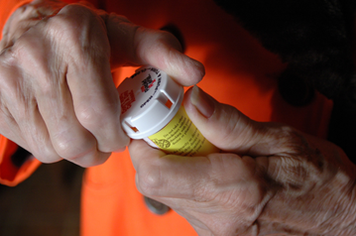
Decade of the Brain
1990 – 1999
“Now, Therefore, I, George Bush, President of the United States of America, do hereby proclaim the decade beginning January 1, 1990, as the Decade of the Brain.”
July 17, 1990
Many new medications introduced with novel mechanisms of action during this decade
Notes:
The 1990’s were a time of rapid drug development and many new medications were introduced during that time.

Slide 10
Decade of the Brain
Antidepressants
SGAs “Atypical”
1987 –Prozac (fluoxetine)
1989 – Celexa (citalopram)
1989 – Wellbutrin(bupropion)
1992 – Zoloft (sertaline)
1992 – Paxil (paroxetine)
1993 – Luvox (fluvoxamine)
1993 – Effexor (venlafaxine)
1991 – Clozaril (clozapine)
1994 – Risperdal (risperidone)
1994 – Zyprexa (olanzapine)
1995 – Seroquel (quetiapine)
2001 – GeoDon (zisprazidone)
2002 – Abilify (aripiprizole)
x
Notes:
These are the new medications that were introduced in this time frame

Slide 11
We started to notice some problems….
Estimated Weight Change at 10 Weeks on “Standard” Dose
6
13.2
5
11.0
4
8.8
3
6.6
Weight Change (kg)
4.4
2
*
Weight Change (lb)
1
2.2
0
0
-1
-2.2
-2
-4.4
-3
-6.6
*4–6 week pooled data (Marder SR et al. Schizophr Res. 2003;1;61:123-36; †6-week data adapted from Allison DB,
Mentore JL, Heo M, et al. Am J Psychiatry. 1999;156:1686-1696; Jones AM et al. ACNP; 1999.
Placebo
Quetiapine
Olanzapine
Clozapine
Ziprasidone
Aripiprazole
Haloperidol
Risperidone
Fluphenazine
Chlorpromazine
Thioridazine
Notes:
Mean Change in Weight with Antipsychotics
Antipsychotic therapy is associated with differential risk of weight gain, depending on the individual agent. A meta-analysis of standardized 10-week exposure to different antipsychotic agents compared mean weight change in kilograms and pounds. Some of the older high-potency antipsychotics, as well as some of the newer agents, are associated with relatively minimal weight gain. Haloperidol, fluphenazine, ziprasidone and aripiprazole induced a minimal weight change (under 1 kg), over this short-term exposure. Agents such as risperidone and quetiapine showed intermediate increases in weight (2 kg to 3 kg) while some of the older antipsychotics, including low-potency phenothiazines, such as chlorpromazine, and some of the newer agents, such as olanzapine and clozapine, were associated with larger increases in weight (up to and exceeding 4 kg, or approximately 9 pounds) over short-term time periods.
References
Allison DB, Mentore JL, Heo M, et al. Antipsychotic-induced weight gain: a comprehensive research synthesis. Am J Psychiatry. 1999;156:1686-1696.

Slide 12
SGA Side Effects “an epidemic within an epidemic”
Medication | Diabetes | EPS | Prolactin | QT Interval | Weight
Aripiprazole | +/- | + | +/- | +/- | +
Asenapine | + | +++ | ++ | + | ++
Clozapine | ++++ | +/- | +/- | + | ++++
Illoperidone | ++ | + | +/- | ++ | ++
Lurasidone | +/- | ++ | + | +/- | +/-
Olanzapine | ++++ | + | + | + | ++++
Paliperidone | ++ | +++ | +++ | + | +++
Quetiapine | ++ | +/- | +/- | + | +++
Risperidone | ++ | +++ | +++ | + | +++
Ziprasidone | +/- | + | + | ++ | +/-
Notes:
Compares the SGAs
EPS is Extrapyramidal Side Effects (Parkinson-like)

Slide 13
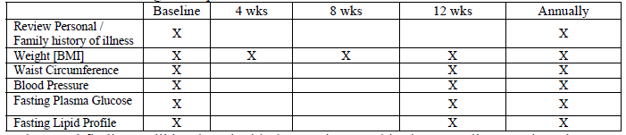
ADA/APA Screening Guidelines for SGAs
American Association of Clinical Endocrinologists, North American Association for the Study of Obesity: Consensus development conference on antipsychotic drugs and obesity and diabetes. Diabetes Care 2004; 27:596–601
Notes:
These are the recommended screening guidelines for all providers to use whenever a patient is prescribed a SGA. Psychiatric providers should be doing this already at your sites

Slide 14
Newer SGAs
Drug | Dose Range | Side Effects
Lurasidone (Latuda) | 40 – 120 mg | Drowsiness, akisthesia, no weight gain/metabolic
Asenapine (Saphris) | 20 – 80 mg | Drowsiness, no weight gain/metabolic
Iloperidone (Fanapt) | 6 – 12 mg | Dizziness, dry mouth, fatigue
Notes:
Although reporting fewer side effects still are not sure how these will fit into the regimen

Slide 15
Long-acting Injectable SGAs
Risperdal Consta every 2 weeks
Invega Sustenna monthly
Abilfy Maintena monthly
Zyprexa Relprevv monthly - Post-Injection Delirium Sedation Syndrome (PDSS) risk: 3 hour watch
Notes:
These injectables are being used for patients with compliance concerns. Once a month injections are a major focus. Problems with Relprevv and deaths – a few have been reported since went on the market

Slide 16
Clozapine (Clozaril)
SGA used in treatment resistant patients and can be life saving for those who respond
However, used as last resort due to life threatening agranulocytosis
Weekly complete blood count (CBC) x 6 months, then q 2 weeks
Only registered pharmacies may dispense and must have CBC at pharmacy or will not get drug
Absolute neutrophil count (ANC) >2
“Clozaril clinics” in some sites due to volume and monitoring
Therapeutic level ~ 200 – 400 ng/ml
Same APA/ADA screening guidelines apply due to cardiovascular (CV) risk
Notes:
Important drug but difficult to get patients to take due to blood draw and reluctance once they are informed about agranulocytosis

Slide 17

CATIE
The NIMH-funded Clinical Antipsychotic Trials of Intervention Effectiveness (CATIE) study compared the effectiveness of older (first available in the 1950s) and newer (available since the 1990s) antipsychotic medications used to treat schizophrenia. The $42.6 million public health-focused clinical trial was conducted over a five-year period at 57 clinical sites across the country.
Perphenazine Olanzapine, risperidone, ziprasidone, quetiapine
(FGA) (SGAs)
Perphenazine (the older medication) equally as effective as the other three newer medications (risperidone, quetiapine, and ziprasidone) and was as well tolerated as the newer drugs. The three newer medications performed similarly to one another. Slight clinical advantage with olanzapine. No substantial advantage of newer medications.
Notes:
Important study that did not show a significant advantage of the SGAs over the FGAs. See next slide for rationale for continued use

Slide 18
So why did we continue to use SGAs with CATIE trial results?
**Efficacy
**Less sedation/more sedation
**Patient preference
Low incidence of extra pyramidal symptoms
Low incidence of tardive dyskinesia
Cannot tolerate alternatives
Hermes, et al. Prescription of Second Generation Antipsychotics: Responding to Treatment Risk in Real World Practice, Psych Services, 2013 64 (3)
Notes:
Recent survey of psychiatrists and their reasons for giving these medications knowing the cardiovascular SE

Slide 19
Why Not Just Switch?
Switch could get weight loss, lower FBS, favorable lipid profile, right?
Problems that might occur:
rebound worsening of psychotic symptoms
side effects, such as the addition of side effects of the old and new drugs, or side effects specific to the new drug
differences in efficacy between the drugs and concerns about unequal efficacy
problems might be specific to the discontinuation of the drug or to the drug to which the patient is switched.
The strategy (sometimes called 'overlap and taper')
slow tapering of the initial antipsychotic after the new drug had been titrated to the full dose
ensures that the patient is covered with an adequate plasma level of the added drug before the former drug is discontinued
produces fewer problems during the switch than abrupt discontinuation or gradual discontinuation before starting a new drug.
Cochrane Database Syst Rev. 2010 Dec 8;(12):CD006629.
BMC Medicine 2008, 6:18

Slide 20
Mood Stabilizers
Medication | Dose | Therapeutic Level | Side Effects | Labs | Cost
Lithium | Varies – start at 300 mg hs | Active 0.8 – 1.2 Maint 0.6 – 0.8 Toxic >1.5 *narrow window | Polyuria, GI, renal, thyroid, wt, diuretics, NSAIDS | 12 hr trough TSH Cr | $4
Valproic Acid | Varies – start at 500 mg | Active 80 – 100 Maint 60 - 80 | Hepatic, wt, Platelets,GI Sedation, PCOS | 12 hr trough LFTs CBC | $4
Carbamazapine | Varies – start at 200 mg | none | Sedation, wt WBC, GI, Hepatic | 12 hr trough WBC LFTs | $4
Lamotrigine (depression) | 50 – 400 | none | Rash, slow titration | none | $$
SGAs | varies | none | See previous | See previous | $$$
Texas Medication Algorithm Project
Notes:
This slide starts the section on medication and lists the mood stabilizers used for bipolar disorder. Narrow therapeutic window with lithium so must be careful with levels. Lithium toxicity can lead to stupor and death, is treated by dialysis if needed

Slide 21
Treatment of Depression
Unipolar
Antidepressants
SGAs augmentation strategy: quetiapine, aripiprazole
*Evidence based psychotherapy is first line for some – Cognitive Behavioral Therapy (CBT) has good evidence
Bipolar Depression – mood stabilizer first
lithium
lamotrigine
quetiapine
aripiprazole
antidepressants with caution – can trigger mania, do not give without a mood stabilizer on board
**Electroconvulsive Therapy (ECT) – can be used for both
Notes:
Try to add a mood stabilizer with antidepressant benefit before trying antidepressant. ECT still an option

Slide 22
Antidepressant Categories
Selective Serotonin Reuptake Inhibitors (SSRI)
fluoxetine, paroxetine, citalopram – all $4
sertraline, escitalopram
Selective Dopamine Reuptake Inhibitors (SDRI)
bupropion
Selective Norepinephrine Reuptake Inhibitors (SNRI)
venlafaxine
duloxetine
Tricyclic Antidepressants (TCA)
Others
nortriptyline, imipramine, desipramine
amitriptyline
remeron, trazodone, vilazadone
Notes:
Drugs listed by mechanism of action – helps if you want to switch class due to lack of effect. Rule of thumb is often try 2 SSRIs and if not successful switch class

Slide 23
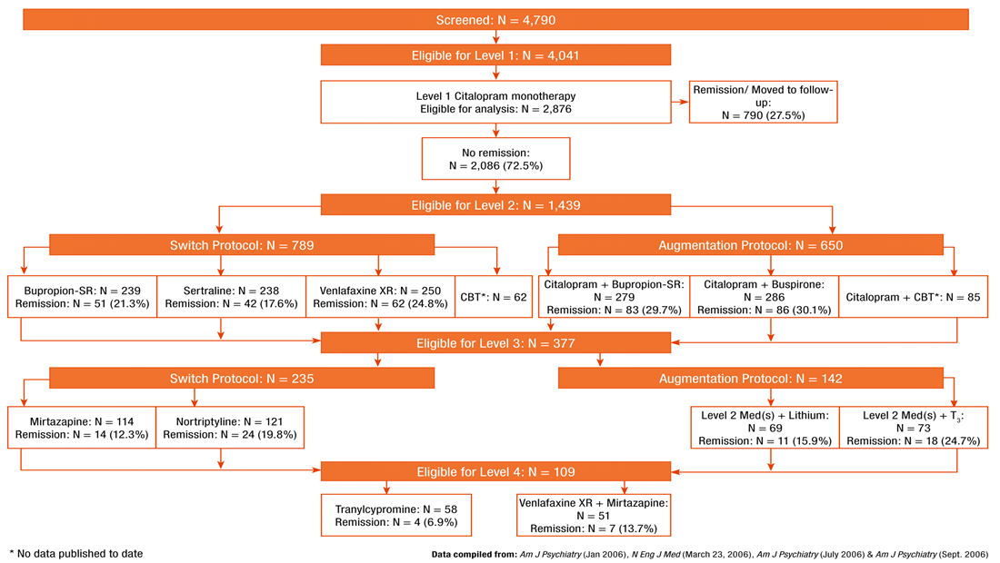
STAR*D
$35M, Six Year NIMH “Real World” Study of Antidepressant Prescribing

Slide 24

Side Effects: Antidepressants
Serotonergic (SSRIs)
insomnia
sexual side effects
weight gain
activation
nausea/diarrhea
Norepinephrine (TCAs)
blood pressure
sedation
weight gain
cardiac in overdose
Dopaminergic - bupropion
activation
insomnia
no sexual SE
no weight gain
seizure risk
SNRI
combo SSRI and TCA
nausea
weight gain
blood pressure changes
Notes:
Bupropion is very activating and can make anxiety worse. Keep this in mind if want to use it for smoking cessation

Slide 25



Approaches to Anxiety
Relaxation exercises – deep breaths
Cognitive Behavioral Therapy (CBT)
Others
Benzodiazepines –
Alprazolam (3hr half life)
lorazepam (8hr half life)
clonazepam (18hr half life)
diazepam (60hr half life)
Gabapentin – 300 – 3000 mg (weight gain, loopiness)
Buspirone
SGAs
B blockers
NOT Bupropion - can worsen anxiety
SSRIs, SNRIs (first line med)
Fluoxetine, paroxetine, sertraline, citalopram
Duloxetine, venlafaxine
Notes:
Several approaches to anxiety –deep breathing very helpful. Demonstrate deep breathing exercise. Close your eyes, breath in through your nose with a big breath, hold for a second, exhale slowly through your mouth and feel yourself relax

Slide 26
Rational Approach to Benzodiazepines
Efficacy, rapid onset make them desirable
Acute stress, fluctuating anxiety, severe panic are indications
Limit use to acute episode if possible (4 weeks max) – can become difficult to stop this though
Use in conjunction with other strategies – SSRI, therapy
Side effects include sedation, tolerance, cognitive impairment, concern with increased risk of dementia, early mortality
Base choice by half-life:
short anxiety attacks, events – alprazolam (3 hours)
sleep, intermediate coverage – lorazepam (6-8 hour)
longer term coverage – clonazepam (18 hours)
Notes:
These are sometimes restricted in mental health settings due to policies at that location. Lot of focus on trying to reduce usage in a population of patients that may have been using them for years

Slide 27
Sleep
Sleep hygiene (non-pharmacologic approach) first!
Naps common due to medication side effects and interfere with normal sleep patterns
Trazodone 25 – 200 mg
Gabapentin 300 – 900 mg
Mirtazapine 15 mg
SGAs – especially quetiapine
Benzodiazepines
Zolpidem – generic, 5 mg for women
Notes:
Sleep hygiene handouts in clinic are useful – daytime napping is a major issue

Slide 28
Obstructive Sleep Apnea (OSA)
15% of patients with schizophrenia with OSA
Common with obesity
Excessive daytime sleepiness overlaps with other symptoms of mental illness
Combination of sleep medications, sedating medications, narcotics, benzodiazepines on top of OSA a concern – don’t want to make the problem worse
Tips
Find a sleep lab willing to work with your patients
Train case managers in importance of testing to help with follow-through
Benson KL, Zarcone VP. Sleep abnormalities in schizophrenia and
other psychotic disorders. In: Oldham JM, Riba MB, eds. Review of
Psychiatry. American Psychiatric Press; 1994:677-705
Notes:
OSA common

Slide 29
Chronic Pain
SNRIs (Venlafaxine, duloxetine) – some additional benefit with chronic pain due to norepinephrine activity
Gabapentin – up to 3,000 mg – watch dizziness, weight gain, renal clearance
Narcotics are central nervous system (CNS) depressants that interfere with antidepressant action
Many people with chronic pain also experience depression so do not get antidepressant benefit
Notes:
There are other medications to use to address chronic pain

Slide 30
Polypharmacy
40% of patients with schizophrenia took 2 antipsychotics
Common: 1 or 2 antipsychotics, medication for side effects (e.g., add on quetiapine for sleep), antidepressant, anxiolytic
Reconciliation with other meds important and difficult to accomplish. Use your care/case managers, EMR
Avoid duplication: work as a team with psychiatric providers
Find non-pharmacologic interventions when possible
(Ganguly R. J Clin Psych 2004)

Slide 31
Day in the life of a psychiatric provider
49 year old female, Anxiety, citalopram 40 mg (the easy one – not SMI)
53 year old female, Bipolar I, lamotrigine 400 mg, Abilify 15 mg, chlorpromazine 300 mg, fluvoxamine 100 mg
33 year old male, Schizoaffective disorder, Invega Sustenna, sertraline 100 mg, trazodone 100 mg, trileptal 300 bid
28 year old male, Schizoaffective disorder, Invega Sustenna 234 mg, Invega 6 mg, trazodone 100 mg, Depakote 1000 mg
41 year old female, Schizophrenia, olanzapine 10 mg, Topamax 100 mg bid, trazodone 100 mg
53 year old male, Schizophrenia, Invega Sustenna, Bupropion SR 300 mg, trazodone 150 mg, citalopram 40 mg
Notes:
Example from a psychiatrist’s typical day – notice the combinations of antidepressants, antipsychotics and mood stabilizers. Trazodone is often given for sleep

Slide 32
Non Pharmacologic Approaches: Evidence Based Therapies
Cognitive Behavioral Therapy (CBT) – for residual psychotic symptoms and anxiety disorders
Dialectical Behavioral Therapy (DBT) – teaches distress tolerance skills to people with personality disorders, chronically suicidal patients
Motivational Interviewing – for health behavior change including smoking, weight loss, alcohol use, exercise
Behavioral Activation – great for patients that are “stuck”
Notes:
Many good evidence based therapies but not all sites have therapists trained in these modalities. Helpful to learn a little about these from the staff so you can use the skills to your advantage

Slide 33
Smoking

Slide 34
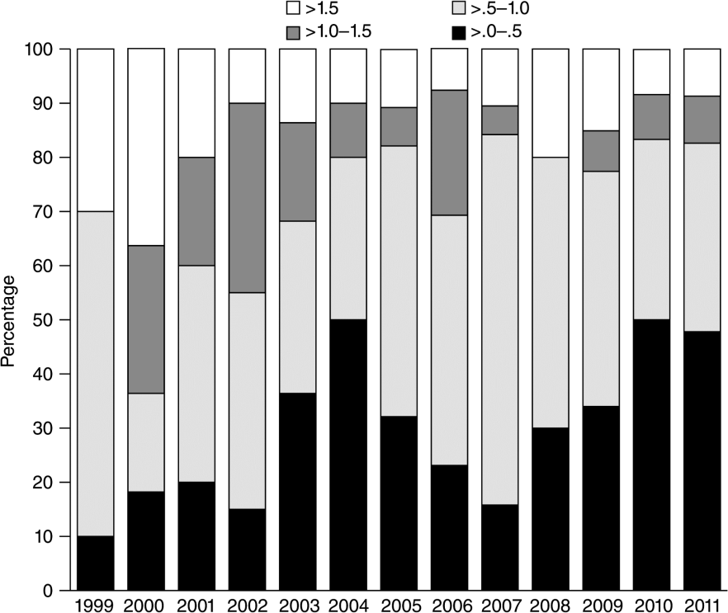
Cigarette Smoking Among Persons With Schizophrenia or Bipolar Disorder in Routine Clinical Settings, 1999–2011
Same rate, people with schizophrenia smoking fewer packs per day
Quantity of cigarettes consumed (packs per day) by year of study enrollment
Copyright © American Psychiatric Association. All rights reserved.
Psychiatric Services. 2013;64(1):44-50. doi:10.1176/appi.ps.201200143
Smoking
Notes:
Although still smoking at an alarmingly higher rate, the number of cigarettes consumed is lower in patients with schizophrenia

Slide 35
Smoking and Drug Metabolism
Increases metabolism at CP450 A12 so lowers drug level of olanzapine, clozapine
7-12 cigarettes to cause induction
Need to watch if stop smoking or go to non-smoking inpatient treatment setting
We give medications that block dopamine - smoking increases dopamine so patients note it makes them feel less “dull.” People with depression may find it helps their mood. Remember - smoking is an appetite suppressant
Smoking

Slide 36

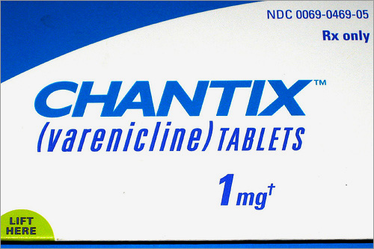



Smoking Cessation – Use your Team
2 mg/day
Watch for
Suicidal ideation
300 mg/day
Watch for
activation
21 mg/day start for most
Watch for smoking while using, may need breakthrough gum/lozenges
Psychosocial Supports
(Case Manager, Peers)
Kreyenbuhl, et al. The Schizophrenia Patient
Outcomes Research Team (PORT):
Updated treatment recommendations.
Schiz Bulletin 36: 94-103, 2010
Smoking
Notes:
Bupropion plus nicotine replacement has the best efficacy in smoking cessation

Slide 37


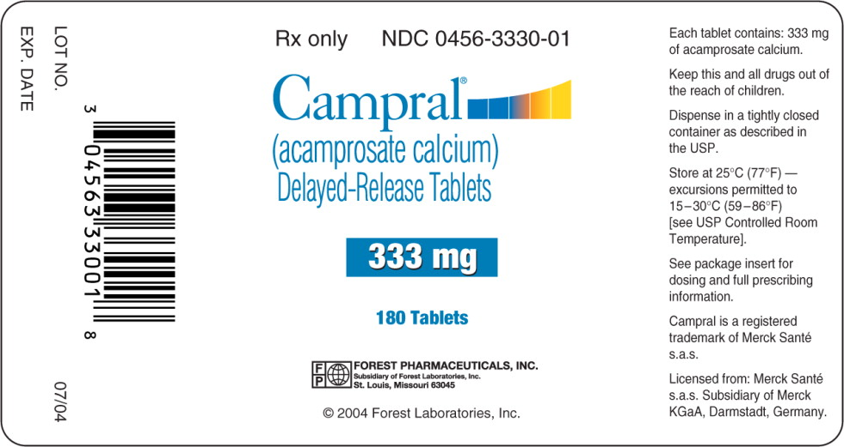
Alcohol Treatment
Double Trouble, Peer Run Groups, AA
Naltrexone - 50 – 100 mg per day
(watch hepatic functions)
Vivitrol – injectable version of Naltrexone
Campral - 333 mg, 2 tid
(renal impairment)
Antabuse - 250 mg per day
Substance Use

Slide 38
Remember Motivational Interviewing!
Substance Use
“People are generally better persuaded by the reasons that they themselves discovered than by those which have come into the mind of others.”
    17th Century French polymath Blaise Pascal – in Pensẻes
Notes:
MI is helpful – remember to elicit “Why” they want to change a behavior and “How” they want to do it

Slide 39
Working with Psychiatric Providers
Co-Management
Manage with Primary Care Consult
Each provider has their own caseload
PCP manages all medical problems
Psychiatrist manages all mental health problems
Work together to re-enforce treatment plans
Psychiatrist works with a care manager
Manages a caseload of patients for BOTH mental health and basic medical health concerns using protocols from PCP
PCP available for consultation and stepped care
Limited number of providers have this expertise
Comprehensive Management
Provider manages both medical and mental health problems
Typically dually trained psychiatrist –family physician, internist, pediatrician
All psychiatrists are responsible for “not making people sicker.”
Notes:
Can be MD, DO, Psychiatric APN or PA with psychiatric specialization. Many possibilities for psychiatrists in the care of patients. Middle box is a growing area of interest for psychiatrists and PCP consultation/education would be important to its success

Slide 40
Psychiatric Providers’ Responsibilities
Minimize: Effects of SGAs and other psychotropic medications
Screen: For illness using APA/ADA Guidelines, others
Counsel: Lifestyle modification – smoking, weight loss
Treat: Some chronic medical conditions with adequate training/consultation if desired
Notes:
Due to the iatrogenic effects psychiatric providers are to provide routine screening in addition to other interventions

Slide 41
Engage Psychiatric Providers
Shared patients, shared illnesses – they can counsel, switch meds, minimize side effects, treat – work in partnership with PCP
Patients see them as their doctor and may want their approval first before starting medications from PCP
Complications of psychiatric medications and medical comorbidities require discussion among colleagues
Tips
Staff complicated patients together
Go to medical staff meetings – be part of their team
Educate – help restore their skills in treating chronic medical problems – help them be more well-rounded medical providers
Notes:
Strategies for PCPs and psychiatric providers to work together

Slide 42
Working with Psychiatric Providers (Cont’d)
Some places have no nurses, no MAs and psychiatrists feel stressed about trying to do this all by themselves with scales and blood pressure cuffs
Can be insecure about medical skills or uncomfortable treating other medical problems: “out of my scope of practice” “not safe”
Liability concerns
Check in with each other before changing each others meds, agree on changes
May see this as intrusive meddling instead of much needed support - these are “their” patients
We’re on the same team - potential for successful partnerships!
Notes:
More strategies for dealing with psychiatric providers

Slide 43
Examples: Working with Psychiatric Providers
Psych A is community psychiatrist that has been working for the past 12 years with patients in an urban setting. She feels constrained by the 15 minute med check environment and wishes she had more time to talk with her patients and to develop a therapeutic alliance. She feels that checking vital signs, weighing the patient and talking about lifestyle changes is impossible without more staff and time for patient interaction. Her patients have a number of complex medical problems. She does not have time to call and discuss patients since she does not have a nurse or medical assistant. She has a 16 week back log for new patients.
How might a partnership with this psychiatrist improve patient care?
Notes:
As a champion for health improvement in this setting you might work to advocate for some additional assistance for the medical staff that is similar to what PCPs have (nurse, MA to do vitals)

Slide 44
Examples: continued
Psych B did a residency in internal medicine and then psychiatry. He has worked for the past 15 years as a psychiatrist and never recertified for internal medicine. He feels comfortable refilling medications for blood pressure and diabetes for his patients that don't have a PCP, however, recently he is getting concerned about the new medications and new tests coming out for treatment of HTN and DM. He feels he has no other choice, since his patients will only come to see him and no other doctor.
How could you help this psychiatrist provide better care?
Notes:
Providing educational opportunities for this doc and agreeing to be available for consultation would be helpful

Slide 45
Examples: continued pt. 2
Psych C is a CRNP working in a community behavioral health center. She sees patients who also go to a local federally qualified health center (FQHC). She admits she is frustrated that the doctors at the FQHC seem to be giving her patients clonazepam for anxiety. She refers to the docs at the FQHC as "knuckle heads" that don't know drug addicts shouldn’t be prescribed these kind of medications.
What approach could be used to find a solution to this problem?
Notes:
Providing a training on rational use of benzodiazepines for the PCPs in the FQHC might be helpful in alleviating some of these concerns

Slide 46
Examples: continued pt. 3
Psych D has managed a CTT/ACT team for 5 years. She lost four patients last year to heart attack and cancer. She became frustrated by the lack of PCPs in her area that would see her patients or take the time to manage their medical problems. She has been working with two family practice doctors to develop a working relationship. She has exchanged secure email and cell phone numbers with these providers and they talk about patient care regularly to coordinate medications and test results.
Working together for successful partnership
Notes:
An example of working on the relationships between providers

Slide 47
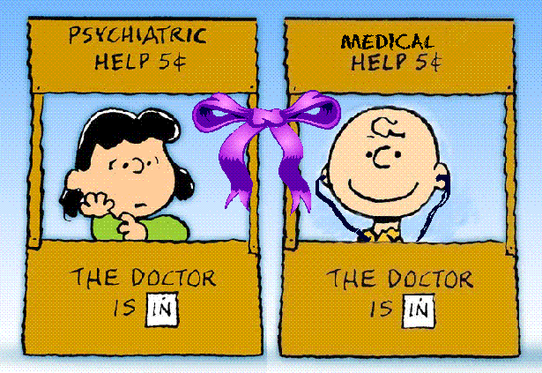
Successful PCP/Psychiatric provided partnerships
Partners in Health - Primary Care/County Mental Health Collaboration Toolkit, Integrated Behavioral Health Project (IBHP), October 2009
Notes:
Successful PCP/Psychiatric provided partnerships are crucial to improving the lives of patients with mental illnesses

Slide 48
Reflections and Discussion
What do you see as the boundaries of care with your psychiatric colleagues?
What might be a best approach to discussing care concerns, such as a patient with cardiovascular disease on olanzapine, with their psychiatric provider?
Who could you talk to if there is disagreement among the treating providers?

Slide 49
Post Test Questions
Which SGAs lead to the most weight gain?
  Olanzapine (Zyprexa) and Quetiapine (Seroquel)
  Risperidone (Risperdal)
  Aripiprazol (Abilify) and Ziprasidone (Geodon)
  Haloperidol (Haldol) and Fluphenazine (Prolixin)
Which tests are recommended by the ADA/APA guidelines for SGAs?
  Lipid Panel
  Fasting Blood Sugar
  BMI
  All the above
What percentage of people with schizophrenia smoke?
  ~30 - 40%
  ~40 - 50%
  ~70 - 80%
  ~90%
What roles do the psychiatric providers play in the medical treatment of their patients?
  Minimize risk by selection of medications
  Screen for medical complications of medications
  Counsel on lifestyle modification
  All of the above

Slide 50
Post Test Answers
Which SGAs lead to the most weight gain?
  Olanzapine (Zyprexa) and Quetiapine (Seroquel)
  Risperidone (Risperdal)
  Aripiprazol (Abilify) and Ziprasidone (Geodon)
  Haloperidol (Haldol) and Fluphenazine (Prolixin)
Which tests are recommended by the ADA/APA guidelines for SGAs?
  Lipid Panel
  Fasting Blood Sugar
  BMI
  All the above
What percentage of people with schizophrenia smoke?
  ~30 - 40%
  ~40 - 50%
  ~70 - 80%
  ~90%
What roles do the psychiatric providers play in the medical treatment of their patients?
  Minimize risk by selection of medications
  Screen for medical complications of medications
  Counsel on lifestyle modification
  All of the above

Slide 51
Resources
Marder SR et al. Schizophr Res. 2003;1;61:123-36
Allison DB, Mentore JL, Heo M, et al. Am J Psychiatry. 1999;156:1686-1696;
Jones AM et al. ACNP; 1999.
Hermes, et al. Prescription of Second Generation Antipsychotics: Responding to Treatment Risk in Real World Practice, Psych Services, 2013
Benson KL, Zarcone VP. Sleep abnormalities in schizophrenia and other psychotic disorders. In: Oldham JM, Riba MB, eds. Review of Psychiatry. American Psychiatric Press; 1994:677-705
Kreyenbuhl, et al. The Schizophrenia Patient Outcomes Research Team (PORT): Updated treatment recommendations. Schiz Bulletin 36: 94-103, 2010

Slide 52
End of Module 4

