Slide 1
Advanced Clinical Social Work Practice in Integrated Behavioral Healthcare
Module 5
Mo Yee Lee, PhD
The Ohio State University

Slide 2
Module 5
Comprehensive Assessment: Outline
Develop assessment skills building on a Bio-Psycho-Social-Spiritual perspective
Develop skills in a strengths-based assessment
Develop skills in assessing client’s self management skills
Using assessment to build therapeutic relationship

Slide 3
The context
Traditional separation of healthcare, mental health, and addiction systems
Trend of merging mental health and addiction systems at both the state and federal level
Integrated health as a movement toward integration of healthcare, mental health, and addiction systems
  Co-morbidity of health and mental health problems
  Co-morbidity of DSM:IV diagnoses
  Empirical evidence on the impact of systems collaboration and service delivery on patients/clients’ outcomes

Slide 4
Assessment: Perceptual/conceptual skills
Perceptual skills: the ability to observe
Conceptual skills: the ability to interpret observations and information in three domains
  Apply professional knowledge, theories, etc
  Understand problem context and goals
  Identify subjective experiences of both patients/clients and professionals
Notes:
4
Tomm and Wright (1979)
Perceptual skills: the ability to observe what is happening with the client
Conceptual skills: the ability to interpret those observations in three domains
knowledge and application of theoretical approaches
Diagnosis and assessment
Identification of subjective experiences of both clients and practitioner

Slide 5
Tasks and Process of Assessment
Make initial contact
Develop a collaborative therapeutic relationship
Use a bio-psycho-sociocultural-spiritual assessment: Person-in-environment
  Defining problems
  Assessing safety
  Accessing and appreciating patient/clients’ strengths
Assess systems collaboration issues and strengths
Expand awareness and perspectives
Assess goals

Slide 6
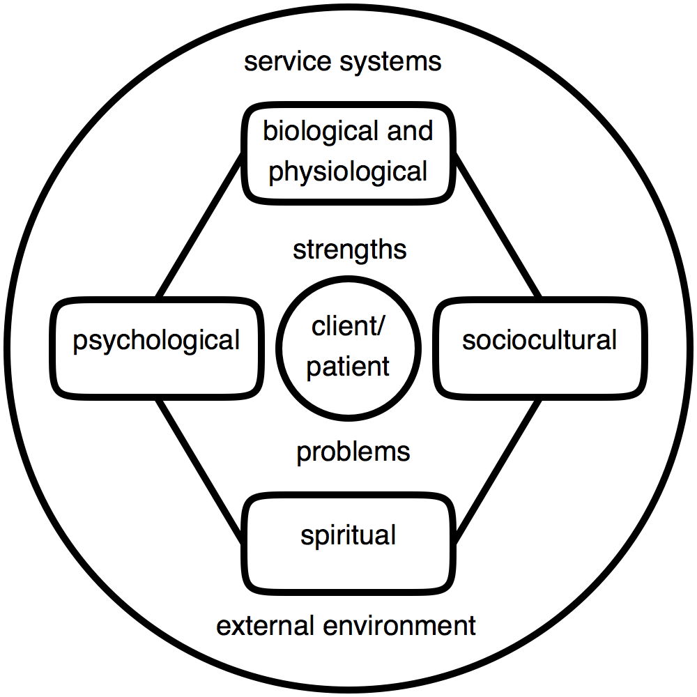
Bio-psycho-social-spiritual assessment: A Systemic Perspective

Slide 7
Guiding Principles
A systemic view: Everything is connected
Foundational importance of bio-physiological, psychological, sociocultural, and spiritual domains in relation to multiple service systems
A strengths-based perspective
Assessment as an ongoing process

Slide 8
Bio-physiological Assessment
Regular screening and tracking during psychiatric visits of the following:
  Health status
    Glucose level: high fasting blood sugar (126 mg/dL or higher), HA1c tests
    Lipid levels: High LDL cholesterol (160 mg/dL or higher) or low HDL cholesterol (40 mg/dL or less)
    Blood pressure: 140/90 or higher
    Weight: Body Mass Index
    Risk factors for heart attack and stroke
    Allergies: Food allergies, seasonal allergies
  Mobility
  Wellness
    Exercise: Exercising less than 3 days per week for at least 30 minutes?
    Nutrition
    Sleep
Ensure client has primary care physician
Communicate with primary care physician
Notes:
Simple Health Assessment Surveys available at: http://physicalhealth.bizcalcs.com/

Slide 9
Psychological Assessment
Brief screening during medical visits:
  General psychological issues
    Cognitive skills and ability e.g., thought process, problem-solving/decision making skills
    Behavioral skills
    Emotional competencies: affect regulation, capacity for relating
    Motivational factors
  Overall mental status, e.g., MSE, SCL-10R
  Depression: PHQ9 http://www.integration.samhsa.gov/images/res/PHQ%20-%20Questions.pdf
  Substance and tobacco use: e.g., NIDA Quick Screen
Stepped care
Appropriate referral if needed
Ongoing communication between PCP and BHP

Slide 10
Mental Status Examination (MSE)
Appearance: casual dress, normal grooming & hygiene
Attitude: calm and cooperative
Behavior: unusual movements or psychomotor changes
Speech: normal rate/tone/volume and without pressure
Affect: reactive and mood congruent, labile, tearful, blunted, normal range, depressed, constricted, flat
Mood: euthymic, irritable, elevated, anxious, depressed
Thought Processes: goal-directed and logical or disorganized

Slide 11
Mental Status Examination (cont’d)
Thought Content:
  Suicidal ideation: passive, active, plan?
  Homicidal ideation: passive, active, plan?
Perception: hallucinations or delusions during interview
Orientation Oriented: time, place, person, self
Memory/ Concentration: short term intact, long term intact, distractable/inattentive
Insight/Judgment: good, fair, poor

Slide 12
Sample Checklist

Slide 13
NIDA Quick Screen
NIDA Drug Screening Tool
A brief survey on alcohol, tobacco, and other substance use
On-line screening tool will:
  Tally responses
  Generate a substance involvement score
  Determine risk level
  Recommended level of intervention
  Provide additional resources for treatment.

Slide 14
NIDA Quick Screen question

Slide 15
Sociocultural Assessment
Cultural values and practices
Family relationship
  Marital status (if appropriate)
  Living arrangement
  Communication pattern
  Conflict resolution
  Satisfaction

Slide 16
Sociocultural Assessment
Social support systems
  What are the social support systems
  Frequency
  Quality
Housing situation/living arrangement
Education
Employment
Financial situation

Slide 17
Spiritual Assessment
Religious/spiritual beliefs and practices: Formal or informal
Helpful assessment tools:
  Taking spiritual history¹
  Spiritual genograms²
  Spiritual lifemap³
  Autobiographical timeline interview⁴

Slide 18
Assessing Systems Collaboration:
The Big Picture
Identify all collaborating systems including formal and informal systems
Assess beneficial collaborating patterns at the inter-systems level
Assess barriers or problem patterns at the inter-systems level

Slide 19
Assessing Systems Collaboration:
Relational elements⁵
Understand and respect each other’s professional mandates, roles, and limitations
Trust
Ongoing contacts
Availability and accessibility
Validate mutual professional concerns
Keeping each other informed without violating patient/client trust

Slide 20
Outcomes of Assessment
Problems
  Bio-psycho-sociocultural-spiritual perspective
  Problem and attempted solutions specifically and behaviorally described (SOLVABLE)
  Exceptions to the problem pattern and strengths are identified
Goals
  Desired future outcomes
  Specifically and behaviorally described (ATTAINABLE)
  Professional and the patient/client mutually agree to the described problems and goals
Treatment plan and interventions based on mutual consensus of problem and goal

Slide 21
Defining SOLVABLE problems
Patient/Client’s perspective
  Specific description of patient/client’s concern and problem
  Meaning of problem, explanatory model
  Attempted solutions
  Perceived influence/power of problems on clients
  Perceived influence/power of clients on problems
Professional
  Understanding patient/client’s understanding of problem
  Expanding patient/client’s understanding of problem
  Offering additional helpful information or new perspective
Notes:
8

Slide 22
Useful questions for understanding patient/client’s concerns and problems
Problem clarification
  What do you (or another) think is the problem?
  How is the problem for you?
  What brings you in today? In what ways can I be most helpful?
  Why do you think the problem exists? (explanatory model)
Referral Source
  Who was the person who got the idea that you need to talk to me?
  What made him or her decide that you need some help?
Previous help-seeking efforts/Attempted solutions
  What have you tried in the past that was helpful/unhelpful?
  If you’ve seen some therapists before me; what did they miss with your situation?

Slide 23
Strengths-based Assessment

Slide 24
Proper Attitude For A Strengths-base Assessment
The patient/client is the Assessor, not the Professional
Professionals provide a context for and facilitate a person to self-assess what is helpful for him or her in the recovery process
Notes:
I-FAST Workshop, NLPRA, July 19-23, 2011
24

Slide 25
Strengths-based philosophy
Patients/clients possess resources to solve their problems
A systems perspective: Because change is constant, there must be exceptions to any problem patterns
Habitual or Interactional patterns interfere with attempts to solve problems
  When liberated from these patterns, patients/clients can access dormant potentials or reconnect with strengths
  Specific problems can be brought under voluntary control
  Genetic predispositions, problem brain chemistry, and negative life experience do not make problems unsolvable
Notes:
I-FAST Workshop, NLPRA, July 19-23, 2011
25

Slide 26
Assessing strengths
Personal Strengths
  Bio-physiological
  Psychological
  Sociocultural
  Spiritual
“Strengths” of the problem/symptoms
Strengths in systems collaboration

Slide 27
Exploring the “Strengths” and Potential “Contributions” of the Problem
When was the last time that you realized that the problem was helpful to you?
If your problem has a voice, what do you think it is trying to share or communicate with you?
How might the problem be helpful to you?
If we could get rid of the problem, what might be some aspect of it that you might want to retain?

Slide 28
Tracking exceptions to identify strengths
Patient/client is the assessor, not the professional
Inquire about times when:
  The problem is absent
  The problem is less intense
  The problem is dealt with in a manner that is acceptable to the patient/client
  What is different about those times?
  Questions that allow the patient/client to specifically describe: Who, when, what, where, how

Slide 29
Useful Questions for Assessing Strengths
What has been helpful so far?
What are some of your recent successes?
What are the achievements that you are most proud of having accomplished?
What little things are you doing that make life a little better for you?
What kinds of things do people compliment you on?
When have you stopped doing something that was difficult for you to stop?
When have you made an important change in your life that was difficult to make?
When have you broken a habit that was hard to break?
What kinds of things do people compliment you on?

Slide 30
Useful self-evaluative questions
Exception questions
Outcome questions
Resilience/Coping questions
Past success
Relationship questions
Scaling questions

Slide 31
Characteristics of Attainable Goals^{6,7}
Useful: Goal is useful and meaningful to the patients/clients that they are motivated and committed to accomplish
New: The goal needs to be something different, a behavior that the patient/client has not generally done before
Regular:The goal is a behavior that the patient/client can do at least a few times a week
Positively stated: What the patient/client can do versus what they can’t do
Specific and observable
Small, feasible, attainable
Self-initiated and not dependent on the initiation of someone else
Interpersonal: When a person works on the goal, other people will be able to notice the changes and potentially be affected by the change
Goals be prioritized
Aligning patient/client, family, and larger system goals

Slide 32
Tips of useful goals
The patient/client is put in charge of determining the desired outcomes of treatment
Desired outcomes from stakeholders (e.g., psychiatrist, behavioral health consultant, children services, etc) are integrated into an overall plan of which the patient/client is in charge
A system is devised for prioritizing goals
ATTAINABLE goals
  Goals being stated in behaviorally specific language
  Goals are small and feasible
Professional can offer his or her own goals and the goals must be acceptable to the patient/client

Slide 33
Assess client’s status regarding seeking help
Customer (clients who are interested to do something different for change)
Visitor (clients who are not committed to change and are just looking around, include involuntary clients)
  Recognize and/or empathize with their dilemma
  Work with their goals
  Let clients take lead in establishing goals relevant to their perceived need
Complainant (clients who tend to see problems in others but not self, usually perceive themselves as victims and complain about other people)
  Acknowledge/compliment their helpfulness
  Enlist their help in the change process

Slide 34
Self-management and Health Outcomes Literature
Patients/clients have better health outcomes when they are able to:
Self-manage symptoms/problems
Actively engage in activities that maintain functioning and reduce health declines
Involve in treatment and diagnostic choices
Collaborate with providers
Select providers and provider organizations based on performance and quality
Successfully navigate the health care system

Slide 35
Assessing patient/client self-management skills⁸

Slide 36
Considerations
Over-assessing
  Burden patient/client with unnecessary assessment procedures, etc
  Focus on issues that are not a concern for the patient/client
  Lose alliance with patient/client
Under-assessing
  Miss important issues that need to be addressed
  Partial or narrowly focused assessment misses important components for successful outcomes
    Disconnect systems goals and service coordination

Slide 37
Using assessment to build therapeutic relationship
Therapeutic alliance⁹
  Develop bond
  Agree on problems to be addressed
  Agree on goals and objectives
  Agree on tasks to achieve goals and objectives
Assessment facilitates mutual understanding and consensus of problem, goals, and tasks between patients/clients and professionals
A strengths-based assessment provides HOPE

Slide 38
References
Bullis, R. K. 1996. Spirituality in social work practice. Washington, DC: Taylor & Francis.
Hodge, D. R. (2001). Spiritual genograms: A generational approach to assessing spirituality. Families in Society 82 (1): 35.
Hodge, D. R. (2005). Spiritual lifemaps: A client-centered pictorial instrument for spiritual assessment, planning, and intervention. Social Work 50 (1): 77–88.
Leung, P. P. Y., and Chan, C. L. W. ( 2006). The combined use of narrative and experience-near techniques in an investigation of meaning in women with breast cancer. Psycho-Oncology, 15 (1): S5
Lee, M. Y., Ng, S. M., Leung, P., & Chan, C. (2009). Integrative Body-Mind-Spirit Social Work: An empirically based approach to assessment and treatment. New York: The Oxford University Press.
Lee, M. Y., Sebold, J., Uken, A. (2003). Solution-focused treatment with domestic violence offenders: Accountability for change. New York: Oxford University Press.
Lee. M. Y., Uken. A., Sebold, J. (2007). Role of Self-Determined Goals in Predicting Recidivism in Domestic Violence Offenders. Research on Social Work Practice, 17, 30-41.
Hibbard, J. H., Stockard, J., Mahoney, E. R., & Tusler, M. (2004). Development of the Patient Activation Measure (PAM): Conceptualizing and measuring Activation in patients and consumers. Health Service Research, 39 (4), 1005-1026.
Pinsof, W. M. (1994). An integrative systems perspective on the therapeutic alliance: Theoretical, clinical and research implications. In A. Horvath & L. Greenberg (Eds.), The working alliance: Theory, research and practice (pp. 173-198). New York: Wiley.

