Slide 1
Primary Care Providers Working in Mental Health Settings:
Improving Health Status in Persons with Mental Illness
Lori Raney, MD
With: Katie Friedebach, MD; Todd Wahrenburger, MD; Jeff Levine, MD; and Susan Girois, MD

Slide 2
Disclosures
Dr. Raney: Consultant, National Council
Dr. Wahrenberger: Nothing to disclose
Dr. Girois: PBHCI Grantee
Dr. Levine: PBHCI Grantee
Dr. Friedebach: Nothing to disclose

Slide 3
Module 5
Roles for PCPs in the Behavioral Health Environment
Learning Objectives:
Understand the range of opportunities for PCP inclusion in the health care team
Appreciate the PCP’s contribution to population management strategies
Discuss the characteristics of a “best fit” PCP for working with people with serious mental illness (SMI) in public mental health settings

Slide 4
Pre Test Questions
1. What roles can PCPs play in the mental health environment?
  Direct service provider
  Educator
  Population management
  All of the above
2. Population-based care includes all the following except:
  Reviewing benchmarks and comparing the target population
  Establishing metrics of care for a clinic to follow
  Performing physical exams
  Determining clinic priorities based on data
3. PCPs best suited for working in public mental health settings would have which of the following attributes:
  Willingness to adapt to the environment
  Interest in working in teams
  Patience
  All the above

Slide 5
Overview Module 5
Direct Care
Collaboration
Population Management
Education
Leadership
Patient-Centered Medical Home

Slide 6
Principles of Effective Integrated
Behavioral Health Care
Patient Centered Team Care / Collaborative Care
Co-location is not collaboration. Team members learn to work differently.
Measurement-Based Treatment to Target
Population-Based Care
All patients tracked in a registry: no one ‘falls through the cracks.’
Evidence-Based Care
Accountable Care
Treatments are actively changed until the clinical goals are achieved.
Treatments used are evidence-based.
Providers are accountable and reimbursed for quality of care and clinical outcomes, not just the volume of care provided.
AIMS Center, 2010

Slide 7
Roles for PCPs in Community Mental Health Centers (CMHCs)
Direct Care
Chronic medical conditions
Preventive care
Collaboration
Psychiatric providers
Care managers, case managers
Population Based Care
Establishing priorities
Track outcomes, adjust care
Education
Leader
Non medical and medical staff
Patients
Champion healthcare change
Help shape system of care
Notes:
This Module will discuss each of these 5 roles

Slide 8
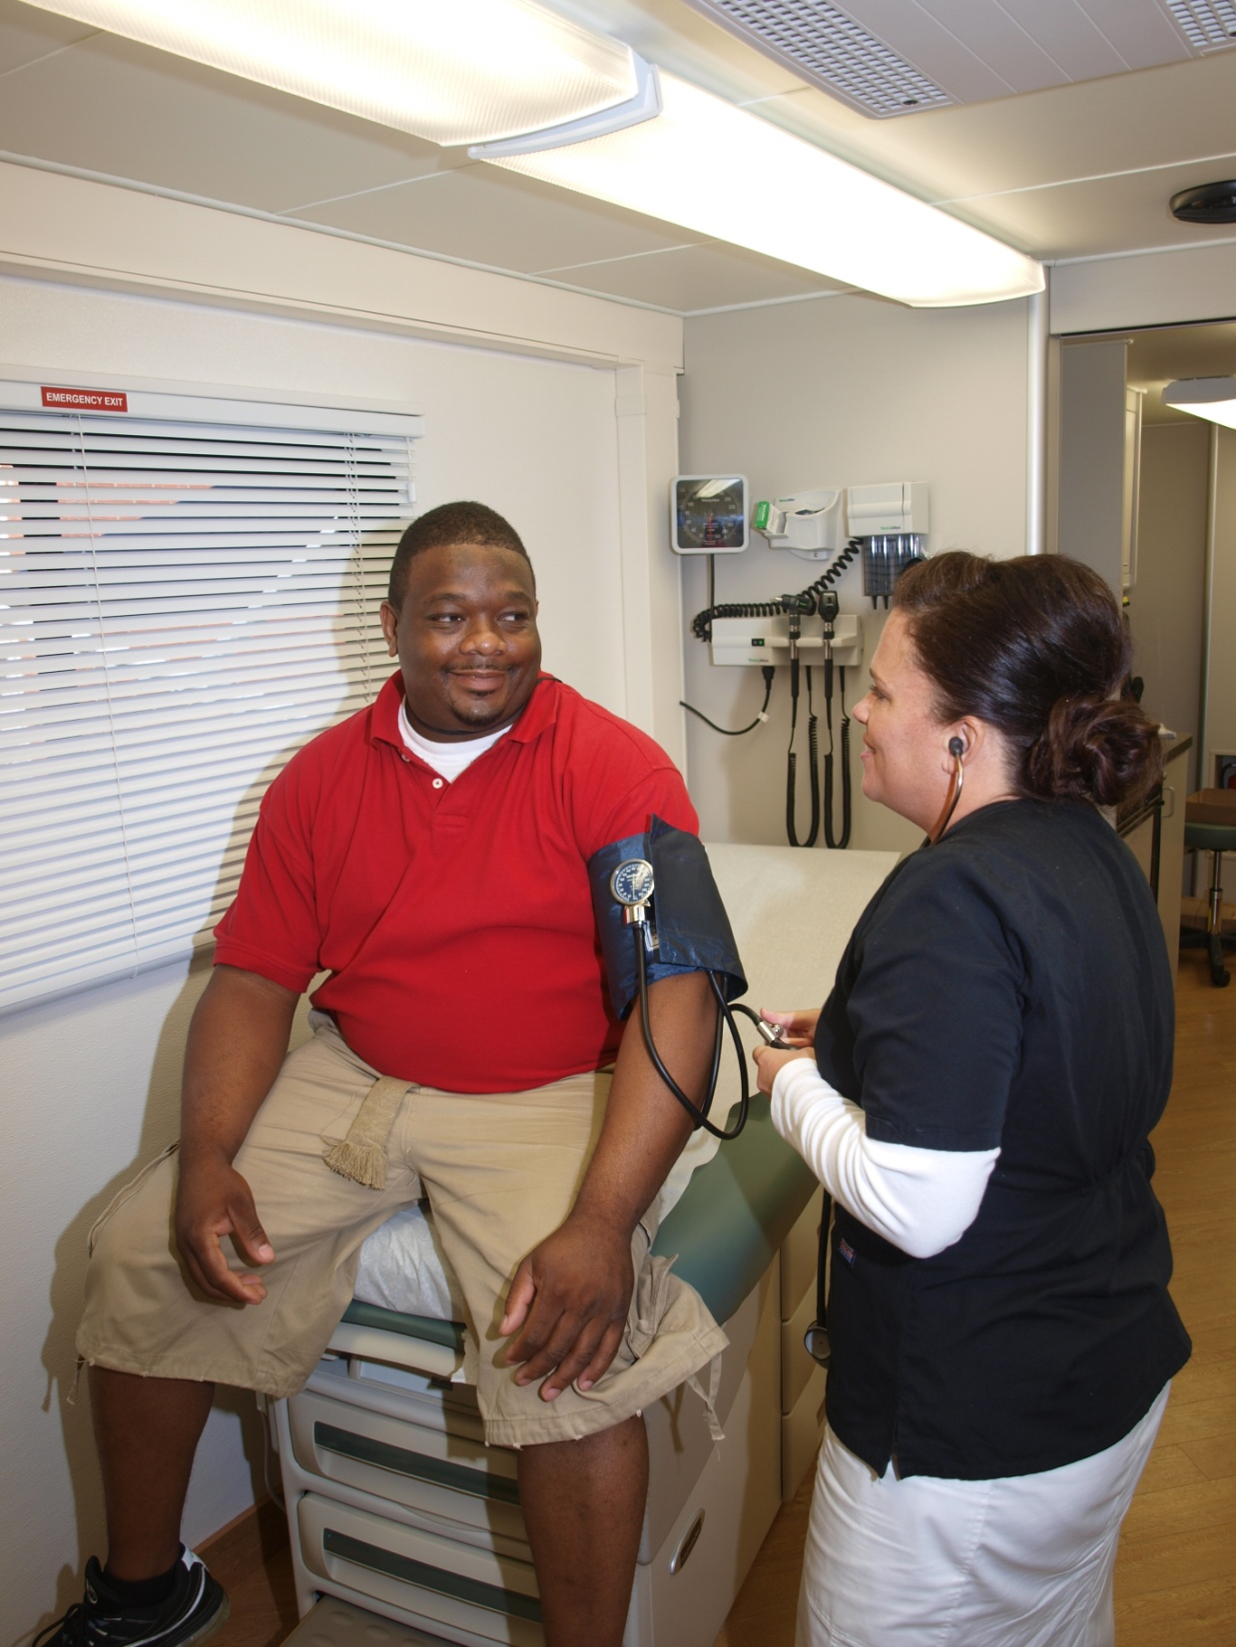
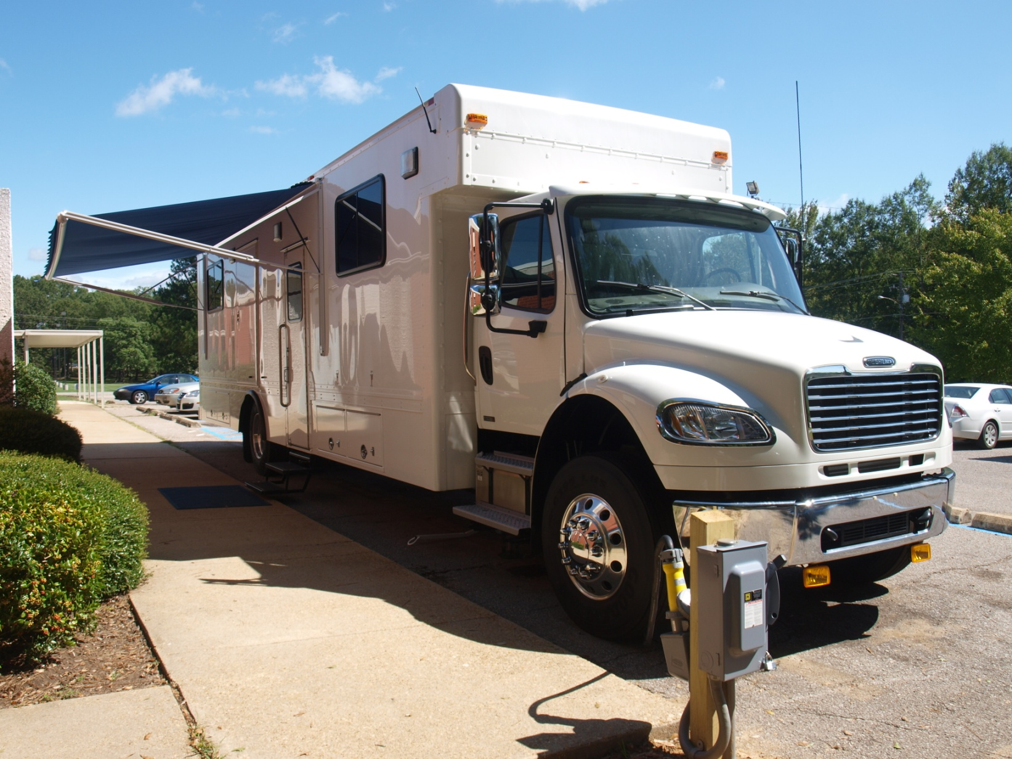
Direct Care in CMHCs
Covered in Modules 3 and 4
Mobile Van, Mississippi Region III Health Home Project
Notes:
PCPs may provide direct care for patients with SMI. In some sights (Missouri and Ohio Health Home models) PCPs are consultants only and do not examine and treat patients

Slide 9
Consultation and Collaboration
Building Partnerships for Health Improvement
Clinical team meetings with care managers, case managers, psychiatric providers, peer specialists, and others
  Identify high risk patients who need immediate attention
  Review those that are not improving and change treatment
  Patients new to the system
Influence delivery of care with administrative staff in CMHC – will need their help with directing non-medical staff
Assess the quality of care provided by others – community-based PCPs, specialists, psychiatric providers
Consult with psychiatric provider team for medical problems
Notes:
The PCP is actively involved both within the mental health setting and in outside clinics providing care to make sure quality of care standards are being met.

Slide 10


Population Management
Making a Difference For a Larger Population
“What gets measured gets done”
Metrics – HEDIS 2013 (NCQA) – pick a few for site
Benchmarking – by provider, local, state, national, etc.
Registries – to track, allows you to see specifics
Claims Data – to prioritize high utilizers, other gaps
Use data to establish priorities and then adjust approach
Denominator
Notes:
HEDIS: Health Effectiveness Data and Information Set. Applying population level data can serve to reach more people and improve overall care.

Slide 11
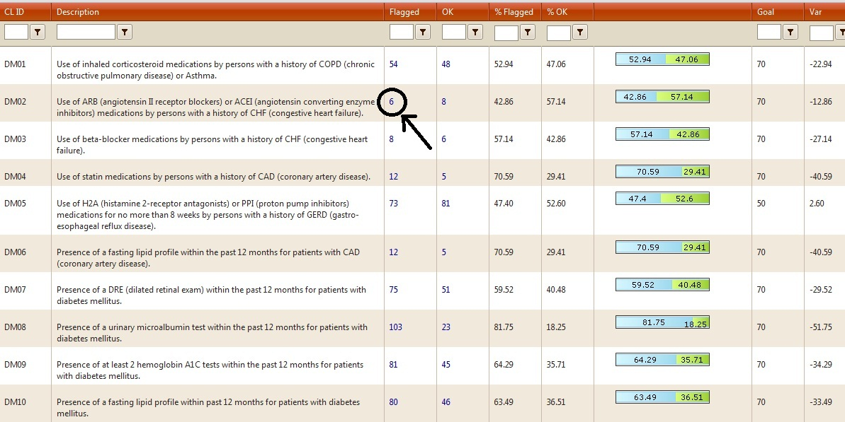
Metrics – HEDIS, 10 selected
Notes:
The Missouri Health Home project selected these 10 to track for their state to assess quality of care. In column 7 you can see what percentage of patients overall met the HEDIS measure. Reviewing this data reveals DM08 has the lowest rate of completion and could be an area of targeted effort including education if needed.

Slide 12
Metrics by Provider
 | 1 | 2 | 3 | 4
DRE | 70% | 65% | 20% | 80%
ARB/ACE | 50% | 75% | 35% | 75%
B Blocker | 45% | 63% | 59% | 63%
FLP – CAD | 61% | 88% | 74% | 77%
Albumin | 77% | 66% | 56% | 33%
HbA1c | 88% | 76% | 66% | 90%
Notes:
Here is list of HEDIS measures listed by completion rate per provider. This data can be used to target specific interventions including education by provider. Next slide shows trends

Slide 13
Metrics – Looking for Trends
 | 1 | 2 | 3 | 4
DRE | 70% | 65% | 20% | 80%
ARB/ACE | 50% | 75% | 35% | 75%
B Blocker | 45% | 63% | 59% | 63%
FLP – CAD | 61% | 88% | 74% | 77%
Albumin | 77% | 66% | 56% | 33%
HbA1c | 88% | 76% | 66% | 90%
What approach might you take given this data?
Notes:
Provider 3 and 4 have significant care gaps identified in this aggregate data. What might you do with this data?

Slide 14
Using HEDIS Indicators
Use data to discover care gaps
Identify training needs to remedy the situation
Example: First quarter focus on indicator one: Asthma – found the care gap, targeted educational efforts
  Substantially reduced percentage with care gap
    Range 22% - 62% reduction
    Median 45% reduction in care gap
Parks, 2012
Notes:
This slide summarizes the use of HEDIS measures and shows the results of statewide efforts in Missouri to close a defined gap. This included PCP notification of gaps and education. Aggregate data for all patients with asthma was used to determine gap

Slide 15
Benchmarking
The process of establishing a standard of excellence and comparing a business function or activity, a product, or an enterprise as a whole with that standard — will be used increasingly by healthcare institutions to reduce expenses and simultaneously improve product and service quality.
Radiology Management. 1994 Fall;16(4):35-9

Slide 16
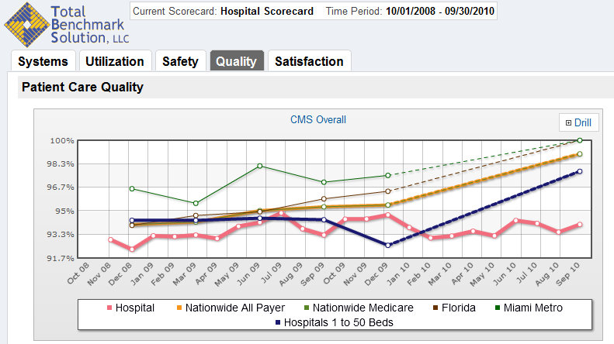
Benchmarking Example
Notes:
The pink line shows the hospital being assessed is well below many local, state and national benchmarks for patient care quality and helps set goals for improvement

Slide 17

Registries
Systematic collection of a clearly defined set of health and demographic data for patients with specific health characteristics
Held in a central database for a predefined purpose
Medical registries can serve different purposes — as a tool to monitor and improve quality of care (including risk stratification), or as a resource for epidemiological research
Journal American Medical Informatics Association 2002 Nov-Dec; 9(6): 600–611

Slide 18
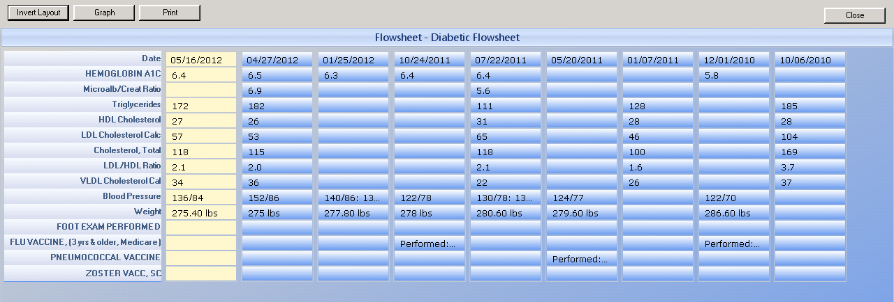
Registry Example: Diabetes
Another view of health measurements and due dates for next measurements

Slide 19
Using Data to Identify Gaps in Care
-- | ALL PROVIDERS | Provider A | Provider B | Provider C | Provider D | Provider E | All providers
DM Pt's A1C <7.0, GOAL 40% | 48% | 51% | 41% | 43% | 61% | 0% | 47%
 | 75% | 80% | 72% | 78% | 70% | 100% | --
DM Pt's A1c <9.0, GOAL 68% | 35% | 41% | 32% | 47% | 21% | 0% | --
DM Pt's, BP <130/80, GOAL 25% | 42% | 42% | 44% | 35% | 42% | 100% | 27%
DM Pt's, LDL <100 mg/dl, GOAL 36% | 7% | 9% | 3% | 4% | 9% | 100% | 0%
DM Pt's Annual Dilated Eye exam, GOAL 40% | 96% | 93% | 95% | 100% | 91% | 100% | 24%
DM Pt's Annual Foot Exam, GOAL 80% | 95% | 93% | 92% | 100% | 94% | 100% | 24%
DM Pt's Annual Nephropathy, GOAL 80% | 93% | 96% | 92% | 96% | 94% | 100% | 55%
Notes:
Areas in white show significant gaps in care. Ask the audience “Given this data where would you focus your efforts to improve these numbers”?

Slide 21
Using benchmarks and data to target educational efforts
Center Goals
Tobacco use assessment 100% of patients >18y/o
Cessation assistance 50% of tobacco users
Improve documentation
Notes:
Here’s another example of using benchmarks and data to target educational efforts. Using this data the center set the goals on the left of the slide

Slide 22
How would you use this data to improve care?
 | Goal | All Providers | PCP 1 | PCP2 | PCP 3 | PSY 1 | PSY 2
Smoking Assessment | 100% | 38% | 25% | 60% | 50% | 0% | 0%
Cessation Advised | 50% | 23% | 5% | 50% | 20% | 0% | 0%
Some History:
PSY doesn’t use the same EMR
An email announced this initiative to providers
PCP2 is the chair of the improvement committee
Notes:
Here are the results after tobacco use was identified and targeted. One PCP met the target for Cessation Advised and no one met the Assessment target.
Ask the audience what their next step might be?

Slide 23
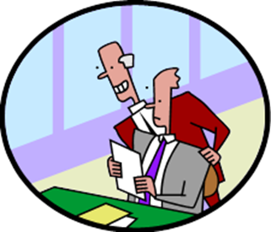
Looking over the shoulder of your colleagues
Emphasis how this supplements and does not duplicate or interfere with the care provided by others
Not looking for “good” or “bad” providers, just helping with things that were missed
Some will appreciate your help, some will tolerate it, and some may be outright hostile
“You are not in command: you are in negotiation”
Do it because the results can be gratifying, because you want to be an agent of change
Atul Gawande, MD, Big Med, New Yorker, August 2012
Notes:
Reviewing the quality of care provided by others can be a delicate area for PCPs to address but is a growing trend in healthcare. The quote is from Atul Gawande in his article about the Cheesecake Factory.

Slide 24
Targeted Education
Use outcomes to determine who needs what:
Administrators
Psychiatric providers
Case managers
Care managers
Peer specialists
Patients
Notes:
There are many potential audiences for education and the PCP can play a crucial role

Slide 25
A Shared Base of Health Literacy
Medical knowledge for non-medical staff
What are the illnesses and why should I care? What does it have to do with mental illness anyway?
  Hypertension – Systolic? Diastolic? Millimeters of Mercury? Stroke?
  Diabetes – what is that Hemoglobin A one C, foot exams?
  Dyslipidemias – I’ve heard of “good” and “bad” cholesterol but what’s the ratio business?
  Asthma – inhaled corticosteroids? How do you use that inhaler?
  Smoking – I know this is bad for you but what does NRT stand for?
  Obesity – Got it – this is bad and diet and exercise treat but what is BMI?
  Health Maintenance – You mean you want me to encourage my female patients to get Pap smears?
Notes:
An important role for PCPs is teaching non-medical staff about non-behavioral health issues. The PCP and psychiatric providers can both contribute to this process

Slide 26
Educating Psychiatric Providers
1st LINE: Thiazide Diuretics Unless have CHF, DM, Chronic Kidney Dz | HCTZ 12. 5 mg, 25 mg, 50 mg (max) Chlorthalidone 25 mg (max) | QD dosing, Check electrolytes 4-6 weeks, then q 3 mos, then annually Add second agent if partial response $ 4 list - both
2nd LINE: ACE Inhibitors 1st line for above dx | Lisinopril 5mg, 10 mg Enalapril 2.5mg, 5 mg, 10 mg, 20 mg | Start at 5-10 mg/day and titrate up to as much 40 mg per day. Check electrolytes 8-10 weeks. Stop if CR > 2.5 Once a day, dry cough, elev CR, angiodema, facial swelling, do not use in pregnancy $4 list
3rd LINE: Calcium Channel Blockers | Amlopidine 2.5 mg, 5 mg, 10 mg (max) Nifedipine LA 30 mg, 60 mg, (max 90 mg ) | Very potent, if adding as 3rd agent call PCP first - can cause peripheral edema
4th LINE: Beta Blockers | Metoprolol succinate (XL) 25, 50, 100, 200 (200 mg max) | Once a day, Do not give if pulse <55, 25 – 100 mg/day usual, can go to max 200 mg
** Remember BP 139/89 is fine for all patients | Adjust meds q 2 weeks, follow q 3-6 months once stable | If K+ falls below nl and BP responding, add 10 meq K+ up to total dose 20 mg
Notes:
Using a treatment algorithm for psychiatric providers to help update them in the treatment of some common medical problems. Some may even want to try some prescribing with this information and PCP back-up and consultation. Some psychiatric providers could use this knowledge to provide some between visit dosage adjustments with PCPs too.

Slide 27
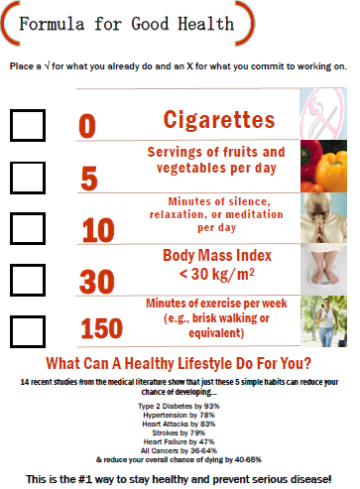
Educate Patients
American Family Physician. 2010 Sep 15;82(6):610-614
Notes:
This is a nice, colorful handout for patients

Slide 28

Leadership
You can be one of the champions for healthcare change by bringing your knowledge of general medicine into the behavioral health environment
PR, PR, PR – can be difficult sometimes to get the team to follow
Notes:
PR – Public relations . Behavioral health staff are not used to addressing other health behaviors and may be resistant to do so

Slide 29

If you build it, they will not necessarily come…
Putting co-located primary care provider in place → Very little business!
Why not?
  Separate FQHC registration a significant barrier.
  It turns out staff are needed to shepherd the transition, even in the same office suite.
  All CMHC staff didn’t have message repeated and repeated and repeated…
  What seems like a lot of CMHC patients is a trickle for the FQHC!
John Kern, MD
Notes:
Here is an example of what has occurred in one PBHCI grantee location. The need for the medical provider to step in and work to promote the program was significant and reminders of the goals was necessary to get buy-in

Slide 30
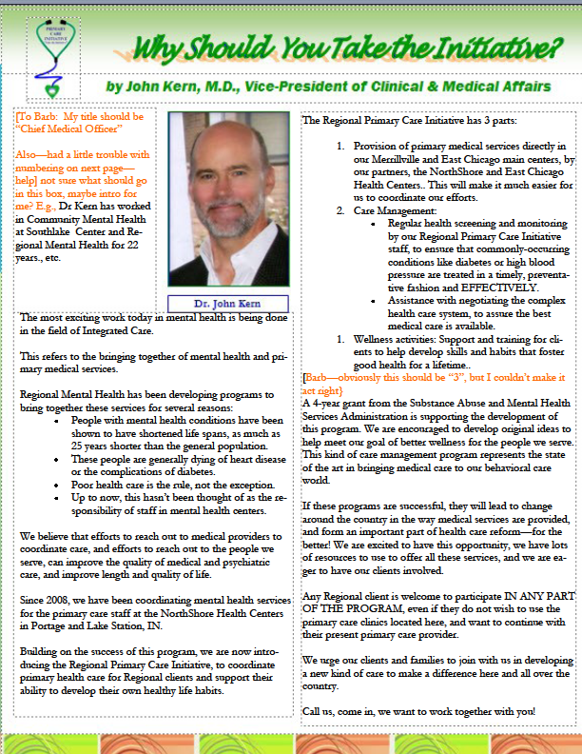
Samples
Regional Primary Care Initiative
Persons with mental illness die up to 25 years too soon due to preventable health conditions.
Regional Primary Care Initiative now offers a nationally recognized program to bring needed primary medical services to our clients, right in our Merrillville and East Chicago centers.
General medical care at the Regional office
Assistance for consumers in
  Medication management
  Healthy eating
  Stress management
  Healthy activities
  Stopping smoking
  Help negotiating the medical system
Talk to your clients and peers about engaging in this program to live longer and healthier!
Sign up today by calling Olga at (555) 219-9999
Notes:
From one PBHCI grantee site –they developed this pamphlet and distributed to all staff.

Slide 31

Leadership
Champion for improving the health status of people with serious mental illness
“Different models must be tested - the cost and suffering of doing nothing is unacceptable.”
Vieweg, et al., American Journal of Medicine. March 2012

Slide 32
PCMH in Behavioral Health Settings
Clinical Features:
Self Management Support – patient activation
Delivery System Design – teams and care management
Decision Support – evidence-based guidelines
Clinical Information Systems – health information technology (HIT), registries, reminders
Community Linkages – to community resources, peers
Notes:
Important role for PCPs in helping to meet the NCQA PCMH standards for health homes that can now be established in public behavioral settings

Slide 33
Ethical Standards for Integrated Health
5 ethical issues of particular importance to integrated health
Informed consent
Confidentiality
Relationships with patients
Relationships with colleagues
Scope of practice

Slide 34
PCPs Who Are a “Good Fit”
Flexible
Adapt well to behavioral health environment
Like working with people with mental illnesses
Enjoy being part of a team
Want to make a difference in a health disparity group
Prefer to use data to drive care, including using a “treat-to-target” approach to meet goals
Notes:
It is important to select PCPs who work well in this environment. A recent analysis of PBHCI programs showed this was one of the major challenges to implementation.

Slide 35
PCP Best Suited for This Work
“A seasoned/experienced, confident provider who may not fully understand but isn't frightened or put off by issues of mental illness…folks fitting this description have functioned very well in behavioral health-based primary care clinics.”
PBHCI grantee, Colorado

Slide 36
Reflections and Discussion
Is this for me? People with SMI?
Population-based care: What about the 25? Make a difference for a larger population
Humility, discipline, and teamwork essential
Exciting work. “Collaborative care can change you in ways you never imagined.”
Psychiatric providers need your help
Can make practicing primary care more rewarding, extend competence into new areas

Slide 37
Population Management Exercise

Slide 38
Your Population
Notes:
This can be distributed as a handout for small groups to discuss. Evaluate this data, comparing it to the national benchmarks on the next page

Slide 39
National Benchmarks
Notes:
Compare your data to national benchmarks

Slide 40
Performance Improvement Plan
Select the measurement you will target first
What is your goal?
How often will you report progress to your team?
3 areas of your NCQA-certified PCMH you will leverage to meet your goal?
Notes:
Have each group do the exercise above. The last item is helpful if anyone is trying to get health home certification and can be omitted if no one in the group is doing this

Slide 41
Developing Goals Using Data
Center Goals
Tobacco use assessment 100% of patients >18y/o
Cessation assistance 50% of tobacco users
Improve documentation
Notes:
Next exercise: Your center took their data and developed these goals

Slide 42
Data from Goal Attempts
 | Goal | All Providers | PCP 1 | PCP2 | PCP 3 | PSY 1 | PSY 2
Smoking Assessment | 100% | 38% | 25% | 60% | 50% | 0% | 0%
Cessation Advised | 50% | 23% | 5% | 50% | 20% | 0% | 0%
Some History:
*PSY doesn’t use the same EMR
*An e-mail was sent out to announce this initiative to providers
*PCP2 is the chair of the Improvement Committee
Notes:
This slide shows the data from the attempts to reach the goals from the previous slide (and in the left hand column)

Slide 43
Performance Improvement Plan (Cont’d)
How will you present this information to providers? Blinded or unblinded? Why?
What things may be contributing to your performance in this measurement?
What three steps will you take first to improve this measurement?
Notes:
Go through these questions based on the previous slide

Slide 44
Post Test
1. What roles can PCPs play in the mental health environment?
  Direct service provide
  Educator
  Population management
  All of the above
2. Population-based care includes all the following except:
  Reviewing benchmarks and comparing the target population
  Establishing metrics of care for a clinic to follow
  Performing physical exams
  Determining clinic priorities based on data
3. PCPs best suited for working in public mental health settings would have which of the following attributes:
  Willingness to adapt to the environment
  Interest in working in teams
  Patience
  All the above

Slide 45
Post Test Answers
1. What roles can PCPs play in the mental health environment?
  Direct service provide
  Educator
  Population management
  All of the above
2. Population-based care includes all the following except:
  Reviewing benchmarks and comparing the target population
  Establishing metrics of care for a clinic to follow
  Performing physical exams
  Determining clinic priorities based on data
3. PCPs best suited for working in public mental health settings would have which of the following attributes:
  Willingness to adapt to the environment
  Interest in working in teams
  Patience
  All the above

Slide 46
Resources
Kopes-Kerr, C. “Formula for Good Health” American Family Physician. 2010 September; 82(6): 610-614
Benson, HR. “An Introduction to Benchmarking in Healthcare” Radiology Management. 1994 Fall;16(4):35-9
Arts, D. et al, “Defining and Improving Data Quality in Medical Registries: A Literature Review, Case Study, and Generic Framework” Journal of American Medicine Informatics Association. 2002 November-December; 9(6): 600–611
Gawande, A. “Big Med” New Yorker. August 2012
Vieweg, W. et al., “Coordinated Medical and Psychiatric Care in Schizophrenia” American Journal of Medicine. 2012 March; 125(3): 219-220

Slide 47
End of Module 5

Slide 48
Quote from PCP Consultant - Missouri
“The HCH (Health Care Home) has very much become part of the culture now. It is fascinating to attempt to apply baseline medical care on a population based scale. Mainly, I believe our clients benefit from our efforts, which is the way I measure the program.”
PCP Consultant - Missouri

