Slide 1
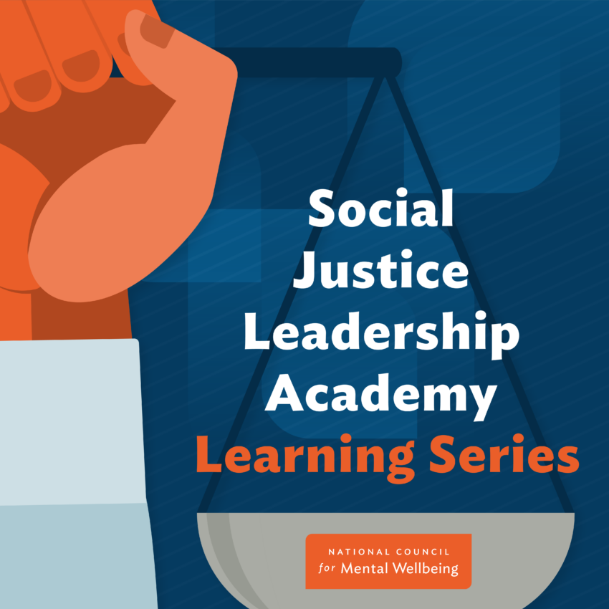
April 2022:
Foundations of Social Justice and Organizational Change

Slide 2
Agenda
Introductions
Why Is This Important?
Leaving In Action
Systemic Challenges
SJLA Overview: Competencies, Curriculum, Workbook, Webinars
Coming Next in SJLA Learning Series
Opportunities for Change
1.
2.
3.
4.
5.
6.
7.
Notes:
Flannery:
Welcome
Agenda for today:
1. Introduce today's facilitators
2. Talk about why we at the National Council for Mental Wellbeing feel this work is important, and hear from you all about why this work is important to you
3. Give an overview of the Social Justice Leadership Academy program. 4/5. Jeanne will present on core principles of social justice, the relationship between equity and mental wellbeing, and how to address barriers to creating lasting change.
6. We’ll highlight some upcoming events in the SJLA learning series
7. We’ll close with some next steps and activities you all can take to further your learning today.
We will be sharing these slides with you all following the session.

Slide 3


Facilitator Introductions
Jeanne Supin, MA
President, CEO
Watauga Consulting
Flannery Peterson
Director, Practice Improvement
The National Council for Mental Wellbeing
Notes:
Jeanne / Flannery introduce selves

Slide 4
Why Is This Important To You?
https://www.menti.com/
Notes:
Jeanne

Slide 5
SJLA Learning Series Overview
Competencies
Event Series
Curriculum
Additional Learning: Workbook & Learning Community
Notes:
Flannery:
So now that we've heard about why social justice is important to you, I wanted to take a moment to talk about why this is important to us.
Empowering health care leaders to better understand health disparities, systemic racism, and the social determinants is critical to facilitating change. Social Justice Leadership Academy (SJLA) is a multi-level knowledge and awareness applied curriculum to support leaders in understanding injustices and inequities. Leaders are engaged and supported through a dynamic curriculum that helps them to examine their role in creating and facilitating injustices and inequities and how to translate this knowledge into effecting change at the interpersonal and intrapersonal levels. This ultimately helps create equitable practice and policy change within mental health and substance use treatment organizations.
The SJLA program is currently three-pronged and consists of the SJLA Learning Series, which we have launched today and will mostly be discussing and the SJLA Workbook and Learning Community, which we talk about briefly in a few moments.

Slide 6
SJLA Learning Series Overview
Competencies
  The Social Action Leadership Transformation (SALT) Model components informed the development and structure of the SJLA Workbook and Learning Series.
Notes:
Flannery:
To advance justice and dismantle systemic inequities, leadership development must include a focus on the role of the individual leader in creating a better society through one’s own actions, behaviors and decisions. Therefore, when developing the SJLA Learning Series curriculum, we looked to the Social Action Leadership and Transformation (SALT) Model, which was developed by the National Institute for Transformation and Equity and the National Center for Institutional Diversity at the University of Michigan.
The SALT model lays out elements of a socially conscious, equitable leadership framework, which you’ll see in the columns at the top of the graphic:
Capacity for Empathy
Critical Consciousness
Commitment to Justice
Equity in Purpose
Value of Collective Action
Controversy with Courage
Coalescence
The Learning Series leadership competencies, which are on the left side of the graphic, were developed in alignment with the SALT Model elements to ensure the application of the knowledge, skills, abilities, and behaviors learned to facilitate change at the individual, interpersonal, organizational and community level to achieve justice. The Learning Series' seven leadership competencies are grounded in anti-racism and include: collaboration, self-awareness, empathy & integrity, influence & communication, accountability thru action, change management, data informed decision making. These reflect core competencies we believe we all need to understand, develop, and demonstrate in order to drive change and be leaders in this space.

Slide 7
SJLA Learning Series Overview
Competencies
Event Series
  Free, 12-month virtual learning series
  Presentations, workshops, office hours
  Register via National Council website
Curriculum
Additional Learning: Workbook & Learning Community
Notes:
Flannery:
The Learning Series is a free, 12 month series of virtual learning events where we will have a wide range of presenters, topics, and formats, all aimed at building the core competencies we just saw.
While we would love for you all to attend every event, we recognize everyone has competing priorities, tight schedules, and their own mental wellbeing to nurture so that might not be possible. We will be recording each main event and posting them to our website throughout the year. However, we plan to build in interactive components to the learning events, like follow-up office hours, so we encourage you to register and attend when you can!
You can find registration details posted on the National Council website, through the National Council newsletters, and by signing up for the SJLA listserv.

Slide 8
SJLA Learning Series Overview
Competencies
Event Series
Curriculum
  Structural & Systemic Biases
  Stigma, Shame, and Discrimination
  Trauma
  Suicide Prevention
  Criminal Justice Reform
  Leadership Principles
  Assessing racial equity in your organization
  Change Management
  New topics and learning events will be announced via email newsletter and on our website
Additional Learning: Workbook & Learning Community
Notes:
Flannery:
These are some of the proposed topics we will be addressing in future months.
We don’t plan on events building on one another in the sense that if you miss one event, you won’t have the context you need for others,
At the same time, these topics don’t live in silos, so we are working to create a curriculum that builds on shared principles across all these topics. Our goal is that when you finish the SJLA learning series, you come away with a personal toolkit of knowledge and skills that you can use in your day-to-day work, for advocacy, and to champion change within your organizations.

Slide 9
SJLA Learning Series Overview
Competencies
Event Series
Curriculum
Additional Learning: Workbook & Learning Community
  SJLA Workbook
  Self-guided learning
  Background of social justice in mental health and substance use treatment
  90+ pages of Interactive lessons, tools, and exercises
  Available for purchase on the National Council website
  Learning Community
  Platform for SJLA Learning Series attendees to share knowledge, learnings, and best practices (details forthcoming).
Notes:
Flannery:
We’d mentioned that the Learning Series is part of a broader SJLA program.
Another key component of the program is the SJLA Workbook, which is a digital resource that provides educational background, as well as tools and exercises, around a lot of the topics we’ll also be addressing in the SJLA Learning Series.
The SJLA Workbook can be purchased on our website. While it’s certainly not required reading if you want to attend the SJLA Learning Series events, we encourage people who might want to take their learning the next step further to check out the SJLA Workbook.
In the coming months we’ll also be developing a learning community platform that can serve as a hub for sharing knowledge and best practices between people participating in the SJLA Learning Series.

Slide 10
What is Social Justice?
Equal rights and equitable opportunities for all.
Core principles of social justice:
Access
Rights
Participation
Equity
Notes:
Jeanne

Slide 11
Intrapersonal
Interpersonal
Institutional
Community
Systemic
Notes:
Jeanne
Workbook, p. 21

Slide 12
Problems
No Social Justice = No Mental Wellbeing
Inequalities, Inequities
Piece-Meal, Transactional or Inauthentic Change
Notes:
Jeanne

Slide 13
Access:
None, Limited, Barricaded
Wealth, education, housing, safety
Health, services and supports
Jobs, careers, aspirations, full-potential
Identity, belonging, community, representation
Do all have easy access to quality, integrated, successful care at your organization with people who inspire belonging and hope?
Notes:
Jeanne

Slide 14
Rights:
None, Stripped, Ignored
Body sovereignty, family integrity
Voting, economic, community
School – to -- prison pipeline
Freedom to move, associate, speak, love, believe, do
Self-determination, recognized as best expert on own health and wellbeing
Do you actively expand and protect all rights of your clients, communities and staff?
Notes:
Jeanne

Slide 15
Participation:
None, Sidelined, Ignored
Community, economy, power-structures
Plans, choices, decisions
Health and wellbeing designs, service, supports
Organizational options, decisions
Do you actively engage your clients, communities and staff in meaningful designs and decisions about services and support?
Notes:
Jeanne

Slide 16
Inequities:
All levels, Compounded, Cumulative
Formal, legal, policy
Cultural, normed, practical
Lack of early opportunities limits later opportunities
Options, decisions
Do you actively connect with, recruit, mentor, engage, support clients, communities, staff who are historically marginalized?
Notes:
Jeanne

Slide 17
No Real Change:
None, Limited, Surface, Transactional
Laws, policies, practices without enforcement
Not data driven
Performative platitudes, training, rules, goals without accountability
Ignoring the multiple levels necessary for real change
Do you lead transformational change at all levels – self, interpersonal, institutional, community, systemic?
Notes:
Jeanne

Slide 18
Solutions for Mental Wellbeing
Social Justice
Equity
Transformational Change
Notes:
Jeanne

Slide 19
Social Justice
Access
Rights
Participation
Notes:
Jeanne

Slide 20
Equity
Anti-Supremacy
Laws, Policies, Goals
Norms, Culture, Behavior
Notes:
Jeanne

Slide 21
Change that
Transforms
Down, Mid, Upstream
Formal, Adaptive, Emergent
Holistic, Lasting
Notes:
Jeanne

Slide 22
Coming Next in the SJLA Learning Series:
SJLA Learning Series Office Hours:
April 28, 1:00 – 2:00pm ET
Opportunity for further discussion of concepts introduced in today’s session. All attendees of today’s learning event are welcome to attend. Register here.
Learning Event 2: Structural and Systemic Biases
May 16, 1:00 – 2:30pm ET
Join Dr. Portia Newman of Chartis Just Health Collective for a discussion on the topic of bias, discrimination, and stigma at the personal, organizational, and community levels. We will discuss how conscious and unconscious biases shape our daily thoughts and actions, and how bias paired with power creates social injustices.
Register here.
Learning Event 3: Structural & Systemic Inequities in Mental Wellbeing
June 27
Join Victor Armstrong, MSW, North Carolina DHHS Chief Health Equity Officer, for a discussion on the topic of how systemic inequities rooted in race, gender, ethnicity, age, and class have created lasting and damaging health disparities. We will discuss the barriers to wellbeing faced by those in marginalized communities and what we can do on personal and organizational levels to dismantle unjust systems and structures.
Registration details forthcoming.
Notes:
Flannery:
Here we have a couple of the upcoming events in the SJLA learning series.
Later this week we’ll be having Office Hours with Jeanne. We’re planning on this being a smaller group so there can be more interactive workshop activities and discussion about some of the things we’ve presented on today. We’ll likely be capping registration on this event to help make it more interactive, so we’d appreciate you only registering if you plan to attend, so someone else doesn’t get blocked out from registering.
On May 16 we’ll be having our 2nd learning series event where we’ll be discussing bias, how it’s formed, and it’s impact on a variety of levels, like personal bias, societal bias, organizational bias, and community bias.
On June 27 we’ll have our 3rd learning series event where we’ll talk about how bias has created and perpetuated inequity in our healthcare systems. We’re still finalizing timing for this event, so please stay tuned and we’ll share registration details as soon as we can.

Slide 23

Leave In Action
Why are you joining the SJLA Learning Series community?
What will meaningful participation and success look like for you?
Explore your own cultural identity:
  How do you understand yourself as a cultural being?
  What experiences shaped that cultural identity?
  How does your cultural identity shape and benefit your work?
Interview any colleague using the same cultural identity questions
Notes:
Jeanne

Slide 24
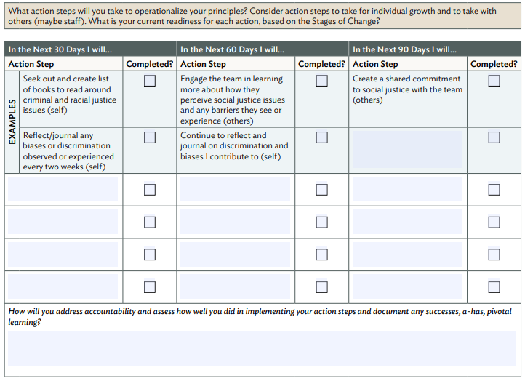
Create an Action Plan:
This action plan template and other tools can be found in the SJLA Workbook
Notes:
Flannery:
This is an excerpt from the SJLA Workbook. We encourage all of us to use tools like this as we go through this journey of building our skills and knowledge.
Creating a personal action plan is a really powerful tool to help yourself set goals for your personal and professional development in this space, and to also to hold yourself accountable.

Slide 25

Questions?

Slide 26
Closing
https://www.menti.com/
(What one word describes your commitment?)
Notes:
Jeanne

