Slide 1
For the trainer:
Please note this slide deck is not a train the trainer presentation with fully developed scripts and exercises. These slides and accompanying notes are offered as suggestions. Slides may be used separate from the slide deck and in a different order than how they are currently presented.
If slides are used, please use the citation below and maintain all original citations found on the slides.
National Council for Behavioral Health. Fostering Resilience and Recovery: A Change Package for Advancing Trauma-Informed Primary Care. 2019.

Slide 2
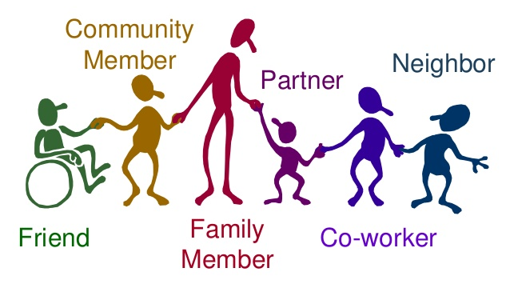
Engaging Families and Support Networks

Slide 3

Overview
Who, Why, How, When and Where
What Does this Mean in a Trauma-informed Primary Care Organization
Identify Ways to Engage Families and Support Networks
Notes:
Determine why, who, how and when to engage people with lived experience
Consider the implications of HIPAA and dual relationships on your teams
Take the next steps to fully incorporate the voice of lived experience in a meaningful way throughout your organization
Be able to identify ways to engage parents and youth with lived experience in meaningful involvement in their service planning and the organization's implementation of trauma-sensitive practices

Slide 4




Family and Support Networks
Having a Voice
Finding a Connection
Building Bridges
Navigating Systems
Notes:
Having a Voice
Advocating
Helping the parents find the right words to communicate needs
Supporting behind the scenes
Listening
Finding a Connection
Connecting to family in a relatable way
Affirming Parents and caregivers for the valuable roles that the play
Empathy
Meeting with the parent or caregivers where they feel most comfortable
Exploring the families culture to enhance and strengthen the family
Building Bridges
Role modeling
Speaking up when the parent and team members are not acting in the best interest the client or family unit.
Parents are the experts
Promoting out of the box thinking in a team approach
Help parents find natural supports and community and recreational resources
Navigating Systems
Navigating and Education and walking families though using different systems partners.
Helping parents understand the laws –school, judicial systems, and developmental disability.
Attending appointments and helping parents understand and get the most out of meetings
Understanding the child’s diagnosis, best practice therapeutic approaches

Slide 5

Where Can We Include their Voices
  Patient – Centered Care – including planning, health behavior change, etc.
  Policy and procedures committees
  Key standing committees
  Task forces
  Workgroups
  New staff interviewing and hiring panels
  Councils
  Advisory and agency boards

Slide 6

How Do We Use the Voice
Direct services with client
Advocacy
Welcoming and orienting new patients/families to the organization
Involvement in orientation and training
Bring their voice to the table with your partners
Notes:
Direct services such as leading and co-leading groups
Advocacy such as participating in service planning at the request of the consumer
Welcoming and orienting new consumers/families to the organization
involvement in orientation and training of all new and existing staff in trauma-informed care and services

Slide 7

Formal Systems
Purpose:
  Continuously gathering family and support network feedback
  Identify problem areas
  Make improvements as needed
  Support your efforts to listen to your patient

Slide 8

Tips for Sharing Information
People may not give you useful feedback unless:
You make it easy for them
You make it comfortable for them
You focus on the service attributes most important to them
Notes:
How to make sure that people feel valued for their input:
Use the input we receive.
Use a variety of methods to gain feedback—written, phone, in person. Options for ways to respond to the same tool. Seeking their comfort level. Use email, text and mail.
Ask one step questions, not complicated multiple steps.
Use the families first language to communicate whenever possible
Use common language, not professional acronyms.

Slide 9

Steps to Engagement

Slide 10

Step 1: Who?
  Anyone who the patient identifies as family, whether biological or not
  Anyone who provides support to the patient
  Anyone who the patient is willing to provide consent for the provider to involve in care

Slide 11

Step 2: Psychoeducation
Trauma and its impact
Client diagnosis psychoeducation
How can family or support network be helpful in the health change behavior process
Notes:
Step 2: Provide the following psychoeducation to the consumers (Note: this time is not billable)
Psychoeducational information on dual relationships and document this conversation in the course of a therapy session or treatment engagement.
Trauma, it’s impact and the limitless possibilities of recovery
HIPAA and agree to uphold the organization’s policies surrounding compliance.
Background information on TIC, why the organization is pursuing TIC, why the team is looking to add consumers, purpose of meetings, frequency of meeting and expectations.

Slide 12


Step 3: Discuss…Determine…Document
Discuss and document provider and patient’s determination related to HIPAA

Slide 13

Step 4: Acknowledgements
Recognize that the person is likely a volunteer and look for ways to appreciate their value

Slide 14

Step 5: Maintain Communication
Maintain an open and transparent dialogue with the family or support network about their comfort in inclusion in the treatment team and what they need to feel safe and open in the process.

Slide 15


