Slide 1
For the trainer:
Please note this slide deck is not a train the trainer presentation with fully developed scripts and exercises. These slides and accompanying notes are offered as suggestions. Slides may be used separate from the slide deck and in a different order than how they are currently presented.
If slides are used, please use the citation below and maintain all original citations found on the slides.
National Council for Behavioral Health. Fostering Resilience and Recovery: A Change Package for Advancing Trauma-Informed Primary Care. 2019.

Slide 2
Trauma in the Context of Culture

Slide 3
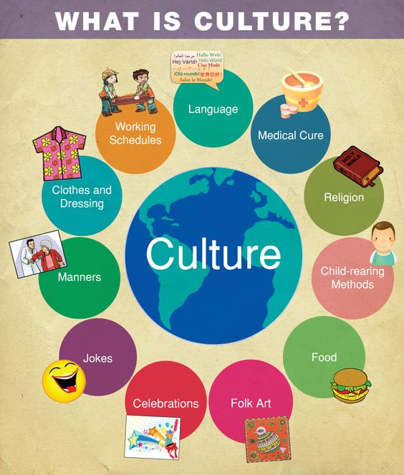
"Culture is the communication and interaction guide of a group of individuals"
-Sockalingam, 2019
Notes:
A critical component of infusing TIC into our daily work begins with understanding culture. Culture impacts every aspect of our lives, including how actions are perceived, how and if services are accessed, how people respond to interventions etc. Culture is the shared values, traditions, arts, history, folklore, and institutions of a group of people that are unified by race, ethnicity, nationality, language, religious beliefs, spirituality, socioeconomic status, social class, sexual orientation, politics, gender, age, disability, or any other cohesive group variable.” Culture is applicable to all people. It is active and dynamic. It is multi-layered and is viewed as thick, thin or compartmentalized. It exists at both the conscious and unconscious levels and structures our perceptions and shapes our behavior. It is a total way of life.

Slide 4
Culture
The shared values, traditions, arts, history, folklore, and institutions of a group of people that are unified by race, ethnicity, nationality, language, religious beliefs, spirituality, socioeconomic status, social class, sexual orientation, politics, gender, age, disability, or any other cohesive group variable.”
-Singh, 1998

Slide 5
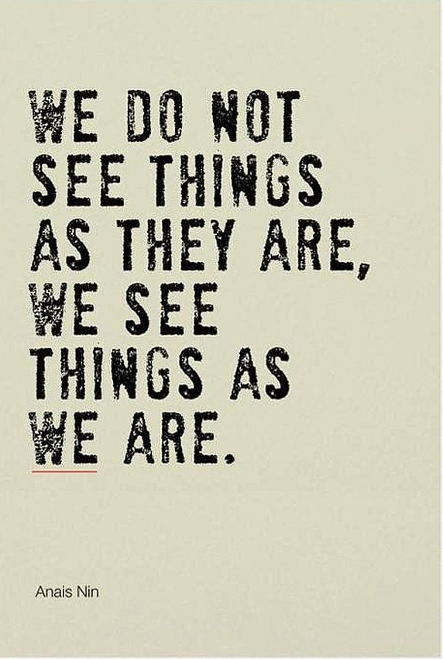
Notes:
Culture is not just about what we see. We generally judge what a person’s culture is by what we see, their dress, age, gender, language, race, ethnicity or physical characteristics. What we know is that under what we can see are important parts of our culture, like our eye behavior, facial expressions, sense of self, notions of modesty, concept of cleanliness, rules for social interaction, child rearing practices, decision-making processes, approaches to problem solving, concept of justice and perceptions of and beliefs about mental health, health, illness and disability, just to name a few. Think about yourself. If this is the definition of culture, how many cultural groups do you belong to? On a piece of paper, write down 5 cultural groups that you belong to that impact how you see things in the world. Now cross off number 2 and 4. Would you be willing to erase these perspectives from your life? Of course not. When we ask people to respond and behave according to our expectations and cultural beliefs, we are asking them to cross out parts of them. Culture informs when “it” is labeled to be a problem, who the appropriate helper should be, what the helper should do and what the goal of help should be. We need to ensure that we are honoring someone’s perspective in their life journey.
According to the National Center of Cultural Competence, Individuals and groups have many different cultural orientations to life that impact how things are, including things like past, present and future orientation, inner-directed vs. outer directed, achievement vs. ascription, or universalism vs. particularism. All of these different orientations effect how someone perceives communication, behaviors, and symptoms they may face. Other factors that influence diversity among individuals and groups can be internal or external. Examples included in internal factors are things like family constellation, literacy, education, health beliefs and practices, religion and spiritual views, political orientation. Examples included in external factors include institutional biases, racism and discrimination, intergroup relations, group and community resiliency, natural networks of support, political climate and community demographics. These are not all of the internal and external factors, but just think about how each of these things impacts how you think, believe and act.
Examine cultural values of time:
What does it meant to be “on time?”
How do you feel/react when someone arrives late to an appointment? Why?

Slide 6
Cultural Responsiveness
Cultural Humility is another way to understand and develop a process-oriented approach to competency.
  “The ability to maintain an interpersonal stance that is other-oriented (or open to the other) in relation to aspects of cultural identity that are most important to the [person]”
    Hook et al, 2013
Three factors guide a person toward cultural humility:
  Lifelong commitment to self-evaluation and self-critique
  Desire to fix power imbalances where none ought to exist
  Aspiring to develop partnerships with people and groups who advocate for others
  -Tervalon & Murray-Garcia, 1998
Notes:
Who here has heard of cultural competence? For those who have not, cultural competence, according to Cross et. al, requires that organizations have a clearly defined, congruent set of values and principles and demonstrate behaviors, attitudes, policies, structures and practices that enable them to work effectively cross-culturally. There are five elements of cultural competence according to the National Center on Cultural Competence. Acknowledge cultural differences, understand your own culture, engage in self-assessment, acquire cultural knowledge and skills and view behavior within a cultural context. Now for agencies that serve MANY different cultures and practitioners who serve many different people, being COMPETENT in all cultures you serve can be an impossible feat.
Cultural Humility is another way to understand and develop a process-oriented approach to competency. It has three factors that guide a person.
The first aspect is a lifelong commitment to self-evaluation and self-critique (Tervalon & Murray-Garcia, 1998). Underlying this piece is the knowledge that we are never finished — we never arrive at a point where we are done learning. Therefore, we must be humble and flexible, bold enough to look at ourselves critically and desire to learn more. When we do not know something, are we able to say that we do not know? Willingness to act on the acknowledgement that we have not and will not arrive at a finish line is integral to this aspect of cultural humility as well. Understanding is only as powerful as the action that follows.
The second feature of cultural humility is a desire to fix power imbalances where none ought to exist (Tervalon & Murray-Garcia, 1998). Recognizing that each person brings something different to the table helps us see the value of each person. When practitioners interview clients, the client is the expert on his or her own life, symptoms and strengths. The practitioner holds a body of knowledge that the client does not; however, the client also has understanding outside the scope of the practitioner. Both people must collaborate and learn from each other for the best outcomes. One holds power in scientific knowledge, the other holds power in personal history and preferences
Finally, cultural humility includes aspiring to develop partnerships with people and groups who advocate for others (Tervalon & Murray-Garcia, 1998). Though individuals can create positive change, communities and groups can also have a profound impact on systems. We cannot individually commit to self-evaluation and fixing power imbalances without advocating within the larger organizations in which we participate. Cultural humility, by definition, is larger than our individual selves — we must advocate for it systemically.

Slide 7
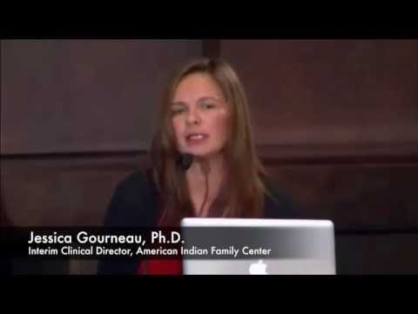
https://www.youtube.com/watch?v=AWmK314NVrs
Notes:
https://www.youtube.com/watch?v=AWmK314NVrs
Discussion Questions:
1. What messages might promote or reinforce negative cultural stereotypes? 2. Do you see or are you aware of positive messages about culture? How might these influence a resiliency responses to historical trauma? 3. How might emotional repression of elders impact social-emotional development of children? What does this look like in a family? 4. How have the historical traumas that peoples have experienced in cultural clashes influenced the valuing of individuals vs. families? 5. When there’s a historically unequal relationship between individuals and groups of people, how does that impact client-professional relationships? How can we address the underlying hurt and pain to break down barriers of communication? 6. What messages does the experience of the colored water fountain tell children about the importance of similarities and differences of skin color? How might this story be used to provide an opportunity for others to learn about microaggressions?

Slide 8
Historical Trauma
Who is Impacted by Historical Trauma
  American Indians/First Nations Peoples
  Immigrants
  People of Color (including African-Americans/Blacks)
  Families Living in Poverty
Manifestations of Historical Trauma
  People may begin to internalize the views of the oppressor and perpetuate a cycle of self-hatred that manifests itself in negative behaviors
  Emotions such as anger, hatred, and aggression are self-inflicted, as well as inflicted on members of one’s own group
Notes:
American Indians/First Nations Peoples: This population has been exposed to generations of violent colonization, assimilation policies and general loss. Current manifestations include high rates of suicide, homicide, domestic violence, child abuse, alcoholism and other social problems
Immigrants: Forced migration may be the result of conflict, natural disaster, famine, development projects and policies, or nuclear and chemical disaster (Forced Migration Online, 2012). These various populations may have been exposed to discrimination, racism, forced assimilation/acculturation, colonization and genocide
African-Americans/Blacks: This population has been exposed to generations of discrimination, racism, race-based segregation and resulting poverty. Members of this population may have been exposed to microaggressions, which are defined as “events involving discrimination, racism and daily hassles that are targeted at individuals from diverse racial and ethnic groups.” (Michaels, 2010). Examples of stressors include slavery, colonialism, imperialism. Current manifestations include mistrust of police and medical systems; lack of self-worth and self-hatred. There is a significant history of atrocities against African Americans that contribute to suspicion and paranoia regarding seeking physical and mental health services. Reasons for the fear include: slave labor, forced migrations, stolen property, dehumanization, mass incarceration, torture, medical experimentation, discrimination, race riots, police brutality, racial profiling, lynchings, mass murder and long-lasting psychological effects on survivors and descendants.
Impoverished communities: Poverty can lead to family stress, child abuse and neglect, substance abuse, mental health challenges and domestic violence (Wilson 2005). Poor individuals and families are not evenly distributed across communities or throughout the county. Instead, they tend to live near one another, clustering in certain neighborhoods and regions. This concentration of poverty results in higher crime rates, underperforming public schools, poor housing and health conditions, as well as limited access to private services and job opportunities (Kneebone, Nadeau, & Berube, 2011). Poverty in these communities is frequently intergenerational. The lack of access to services, increased exposure to violence and higher risk of victimization that exist in these communities often results in a much greater potential for experiencing trauma and re-traumatization among residents thtn in communities that are not areas of concentrated poverty. Examples of stressors include hunger, porr or inadequate housing, lack of access to health care and community crime. Current manifestations include domestic violence, child abuse and substance abuse (Wilson, 2005)

Slide 9
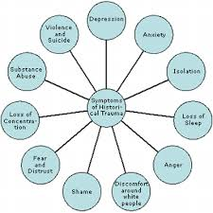
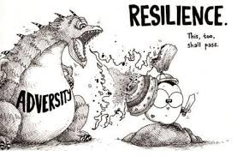

Slide 10
Immigrant Children
1 in 4 children in the US lives in an immigrant family (18.4 million children)
30% of immigrant children live below the FPL compared to 19% of US-born children
Immigrant children are 2x more likely to be uninsured
Non-citizen populations access mental health services only 0.1 times a year
Undocumented children have even greater externalizing problems than US-born or immigrant children with legal documentation
Diana MTK Autin, Strengthening immigrant children's mental health: together we can! Juntos, Podemos! [Power Point slides]. Retrieved from: https://www.state.nj.us/njsncc/documents/presentation/d_autin_strength_immigrant_children_mh.pdf

Slide 11
Serving Immigrant Children
Immigrant children may have traumatic experiences prior to reaching the US
  May have been separated from family members for extended periods
  May have lost family members due to violence, famine, etc., in their country of origin
  May have personally faced poverty, hunger, drought, violence, sexual trafficking, exposure to war, natural disasters
  May not have had access to medical or mental health care prior to arriving in the US
  Parent more likely to be low-income even if they were professionals in their country of origin
  More likely to live in sub-standard conditions
Diana MTK Autin, Strengthening immigrant children's mental health: together we can! Juntos, Podemos! [Power Point slides]. Retrieved from: https://www.state.nj.us/njsncc/documents/presentation/d_autin_strength_immigrant_children_mh.pdf

Slide 12
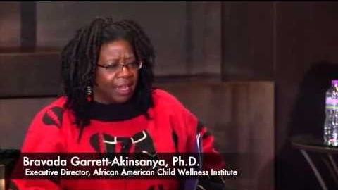
Historical Trauma Perpetuated Today
Microaggressions are everyday experiences of discrimination, racism, and daily hassles that are targeted at individuals from diverse racial and ethnic groups (Evans-Campbell, 2018). Health disparities, substance abuse, and mental illness are all commonly linked to experiences of historical trauma (Michaels, Rousseau, and Yang, 2010).
https://www.youtube.com/watch?v=sjJUQlodh0g
Notes:
Discussion Questions:
1. In what ways do you see the psychological effects of historical trauma or microaggressions in your work with children and families? 2. In what ways do patterns of discipline, eating, etc. born out of historically traumatic experiences continue to play out in families today? How can these be understood and addressed in sensitive and healing ways? 3. How might the forced breakup of families impact a person’s identity, feelings of belonging, and connection to community? 4. How does language impact people’s views of what is good and bad? How do long-standing terms contribute to the development of children’s identities?

Slide 13
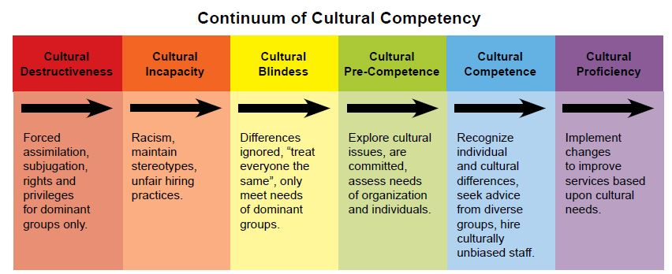
National Center for Cultural Competence, Goode, 2004
Notes:
Cultural destructiveness is characterized by attitudes, policies, structures, and practices within a system or organization that are destructive to a cultural group.
Cultural incapacity is the lack of capacity of systems and organizations to respond effectively to the needs, interests and preferences of culturally and linguistically diverse groups. Characteristic include but are not limited to: institutional or systemic bias; practices that may result in discrimination in hiring and promotion; disproportionate allocation of resources that may benefit one cultural group over another; subtle messages that some cultural groups are neither valued nor welcomed; and lower expectations for some cultural, ethnic, or racial groups.
Cultural blindness is an expressed philosophy of viewing and treating all people as the same. Characteristics of such systems and organizations may include: policies that and personnel who encourage assimilation; approaches in the delivery of services and supports that ignore cultural strengths; institutional attitudes that blame consumers - individuals or families - for their circumstances; little value placed on training and resource development that facilitate cultural and linguistic competence; workforce and contract personnel that lack diversity (race, ethnicity. language, gender, age etc.); and few structures and resources dedicated to acquiring cultural knowledge.
Cultural pre-competence is a level of awareness within systems or organizations of their strengths and areas for growth to respond effectively to culturally and linguistically diverse populations. Characteristics include but are not limited to: the system or organization expressly values the delivery of high quality services and supports to culturally and linguistically diverse populations; commitment to human and civil rights; hiring practices that support a diverse workforce; the capacity to conduct asset and needs assessments within diverse communities; concerted efforts to improve service delivery usually for a specific racial, ethnic or cultural group; tendency for token representation on governing boards; and no clear plan for achieving organizational cultural competence.
Cultural Competence
Systems and organizations that exemplify cultural competence demonstrate an acceptance and respect for cultural differences and they:
Create a mission statement for your organization that articulates principles, rationale, and values for cultural and linguistic competence in all aspects of the organization.
Implement specific policies and procedures that integrate cultural and linguistic competence into each core function of the organization.
Identify, use, and/or adapt evidence-based and promising practices that are culturally and linguistically competent.
Develop structures and strategies to ensure consumer and community participation in the planning, delivery, and evaluation of the organization’s core function.
Implement policies and procedures to recruit, hire, and maintain a diverse and culturally and linguistically competent workforce.
Provide fiscal support, professional development, and incentives for the improvement of cultural and linguistic competence at the board, program, and faculty and/or staff levels.
Dedicate resources for both individual and organizational self-assessment of cultural and linguistic competence.
Develop the capacity to collect and analyze data using variables that have meaningful impact on culturally and linguistically diverse groups.
Practice principles of community engagement that result in the reciprocal transfer of knowledge and skills between all collaborators, partners, and key stakeholders.
Cultural Proficiency
Systems and organizations hold culture in high esteem, use this a foundation to guide all of their endeavors, and they:
Continue to add to the knowledge base within the field of cultural and linguistic competence by conducting research and developing new treatments, interventions, and approaches for health and mental care in policy, education, and the delivery of care.
Develop organizational philosophy and practices that integrate health and mental health care.
Employ faculty and/or staff, consultants, and consumers with expertise in cultural and linguistic competence in health and mental health care practice, education, and research.
Publish and disseminate promising and evidence-based health and mental health care practices, interventions, training, and education models.
Support and mentor other organizations as they progress along the cultural competence continuum.
Develop and disseminate health and mental health promotion materials that are adapted to the cultural and linguistic contexts of populations served.
Actively pursue resource development to continually enhance and expand the organization’s capacities in cultural and linguistic competence.
Advocate with, and on behalf of, populations who are traditionally unserved and underserved.
Establish and maintain partnerships with diverse constituency groups, which span the boundaries of the traditional health and mental health care arenas, to eliminate racial and ethnic disparities in health and mental health
National Center for Cultural Competence (Goode, 2004)

Slide 14
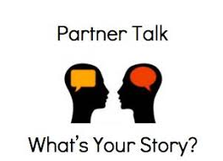
Cross-Cultural Communication Activity
Notes:
Culture shapes status, relationships, and social behaviors with regard to every aspect of life, i.e. justice for individual vs. group harmony or willingness to question authority. People from various backgrounds communicate and process information differently (rational vs. intuitive, linear vs. circular, abstract vs. concrete or time-bound or not)
Cross Cultural Communication Activity - “Partner Talk” Objective: For participants to recognize that people communicate differently, based mostly from cultural context. Audience: Medium- to large-size groups Length: 15 to 25 minutes total (7-10 minutes for partner dialogue; 10-15 minutes for group discussion of activity) Instructions: • Participants may remain in their seat, unless sitting alone. In that event, they will need to sit with another participant. 3 • Pass out one slip of paper to each person, in A-B-C-D order of slips (1st person gets Group A slip, 2nd person get Group B slip, 3rd person gets Group C slip, 4th person gets Group D slip. Keep in that order until each person has received a slip). • As you are passing out slips, ask participants to silently read their instructions, but do not share what is written on the slip with anyone. • Each member of Group A will partner with a member of Group B; Group C members will partner with Group D members. • If there are an odd number of participants, a helper will need to participate. • Partners will have 7-10 minutes to learn more about each other, based on what is on their slip of paper. • As a guide, you may post examples of questions partners could ask each other. • Once you have reconvened, ask a volunteer from Group A to read their instructions aloud. After they have read their instructions, ask a Group B volunteer to discuss how they were impacted by Group A’s behavior. Repeat for Groups B through D. • Participants may then discuss how being unaware of differences in cross-cultural communication style may hinder the helping process. • Ask group how the knowledge gained from the activity can be translated into specific enhancements or changes in their work with others. Group A (Follow directions outlined below) • Avoid eye contact when speaking to your partner • Do not show any emotion or react to your partner when he or she is speaking Group B (Follow directions outlined below) • Sit/stand approx. 6 inches closer to your partner than you normally would • Use gestures often when you are speaking Group C (Follow directions outlined below) • Speak more loudly than you normally would and interrupt your partner fairly often • Initiate conversation by asking a lot of questions (include very personal ones) Group D (Follow directions outlined below) • Speak more softly than you normally would and don’t interrupt your partner • Silently count to six before responding • Don’t initiate conversation or ask questions

Slide 15
Culturally-Sensitive Trauma-Informed Care
Helping to restore a sense of safety for the child and family through trust-building
Recognizing cultural variation in the subjective perception of trauma and traumatic stress responses
Working within and through the family structure to promotion emotional and social support and utilization of coping resources
Understanding the role of beliefs in the interpretation of trauma and the recovery process
Attending to the distress of the child or family, in the way that THEY define it
Culturally-Sensitive Trauma-Informed Care. (n.d.). Retrieved from https://www.healthcaretoolbox.org/cultural-considerations/culturally-sensitive-trauma-informed-care.html text
Notes:
As in all pediatric care, Culturally-Sensitive Trauma-Informed Care requires attention to be paid to a child's and family's values and beliefs about health and illness. What's unique is that attention must also be paid to cultural variations in the child's and family's experience of and response to trauma.
Research suggests that although there is a universal biological response to trauma, cultural factors can influence the biopsychosocial experience of trauma and subsequent traumatic stress reactions. Ethnocultural factors play an important role in an individual's vulnerability to, and experience and expression of traumatic stress, as well as one's response to trauma treatment.
A Culturally-sensitive, trauma-informed care provider can help traumatized children and families by:
Recognizing cultural variation in the subjective perception of trauma and traumatic stress responses
Understanding perceptions of traumatic stress and the role of beliefs:
Research suggests that it is NOT the objective severity of the trauma, but how it is experienced by the child or parent that determines traumatic stress responses.
Cultural differences can exist in the perception and interpretation of the trauma event, the meaning given to the traumatic event and beliefs about control over the event.
Viewed through a cultural lens, a child's or family's subjective perceptions of the trauma experience can sometimes be quite different from a provider's.
For example, some cultures interpret illness and other trauma events as punishment, a test or rite of passage, or a special message.
The way a child or family interprets the meaning of the trauma will influence subsequent distress, reactions, and ways of coping.
Cultural differences can also exist in beliefs about if, when, and how to resolve traumatic stress symptoms, and about help-seeking and utilization of supportive resources outside their community
Remembering that some interpretations may differ from your own, it is best to ask children and families about what the trauma means to them, and incorporate those beliefs into assessment and treatment.
Restoring safety and re-establishing trust
Trauma erodes a child's or family's sense of physical and emotional safety; promoting trust rebuilds it.
When a trauma occurs, children's and families' global beliefs about safety, vulnerability, responsibility, control, and appropriate ways of coping play a significant role regarding how the trauma impacts them.
Initially, many traumatized children and families can feel physically unsafe and emotionally vulnerable; they may have a difficult time trusting others or accepting help as a result.
Viewed through a cultural lens, some groups are less likely to trust health care providers with the details of the trauma, their symptoms, or treatment recommendations.
In these instances, providers should take a step back to assess how their helping role is perceived. Providers should also try to connect the family with resources they trust – including other types of professionals and traditional healers.
Safety and trust is established not only through words, but through actions.
Providers' cultural awareness and sensitivity help to create provider-patient interactions that build trust and promote optimal patient communication and adherence.
Beyond the words providers choose, some cultures are highly sensitive to nonverbal communication – including eye contact, tone of voice, facial expressions, body language and touch.
Culturally appropriate communication practices have been shown to result in higher levels of perceived trust and increased reporting of information.
Attending to distress
Significant cultural variations exist in a child's or family's expression of distress.
Pain, fear, worry, or hyperarousal are sometimes expressed somatically. Traumatic stress reactions can be extremely subdued, can appear to be over-magnified, or can even mimic psychotic reactions. Often, family and cultural factors combine to define what is considered an appropriate reaction to illness or trauma.
Some families and cultural groups are less comfortable responding to personal questions about emotional distress. They may think that being distressed means that there is something mentally wrong.
What providers can do:
Provide psychoeducation about common, universal reactions to trauma.
Understand emotional reactions by asking about and responding to specific behaviors (sleep and eating patterns, jitters, etc.).
Listen to and incorporate the child's or family own terms for what they are experiencing into discussions and treatment planning.
Working within and through the family structure
Some families and cultural groups have distinct customs about who makes decisions and how they are communicated.
These customs may lead to limitations on the child's or other family members' involvement in discussions and decisions.
Incorporating extended family and kinship networks, as well as other types of healing professionals and practices that the child and family view as helpful, may positively impact assessment and treatment.

Slide 16

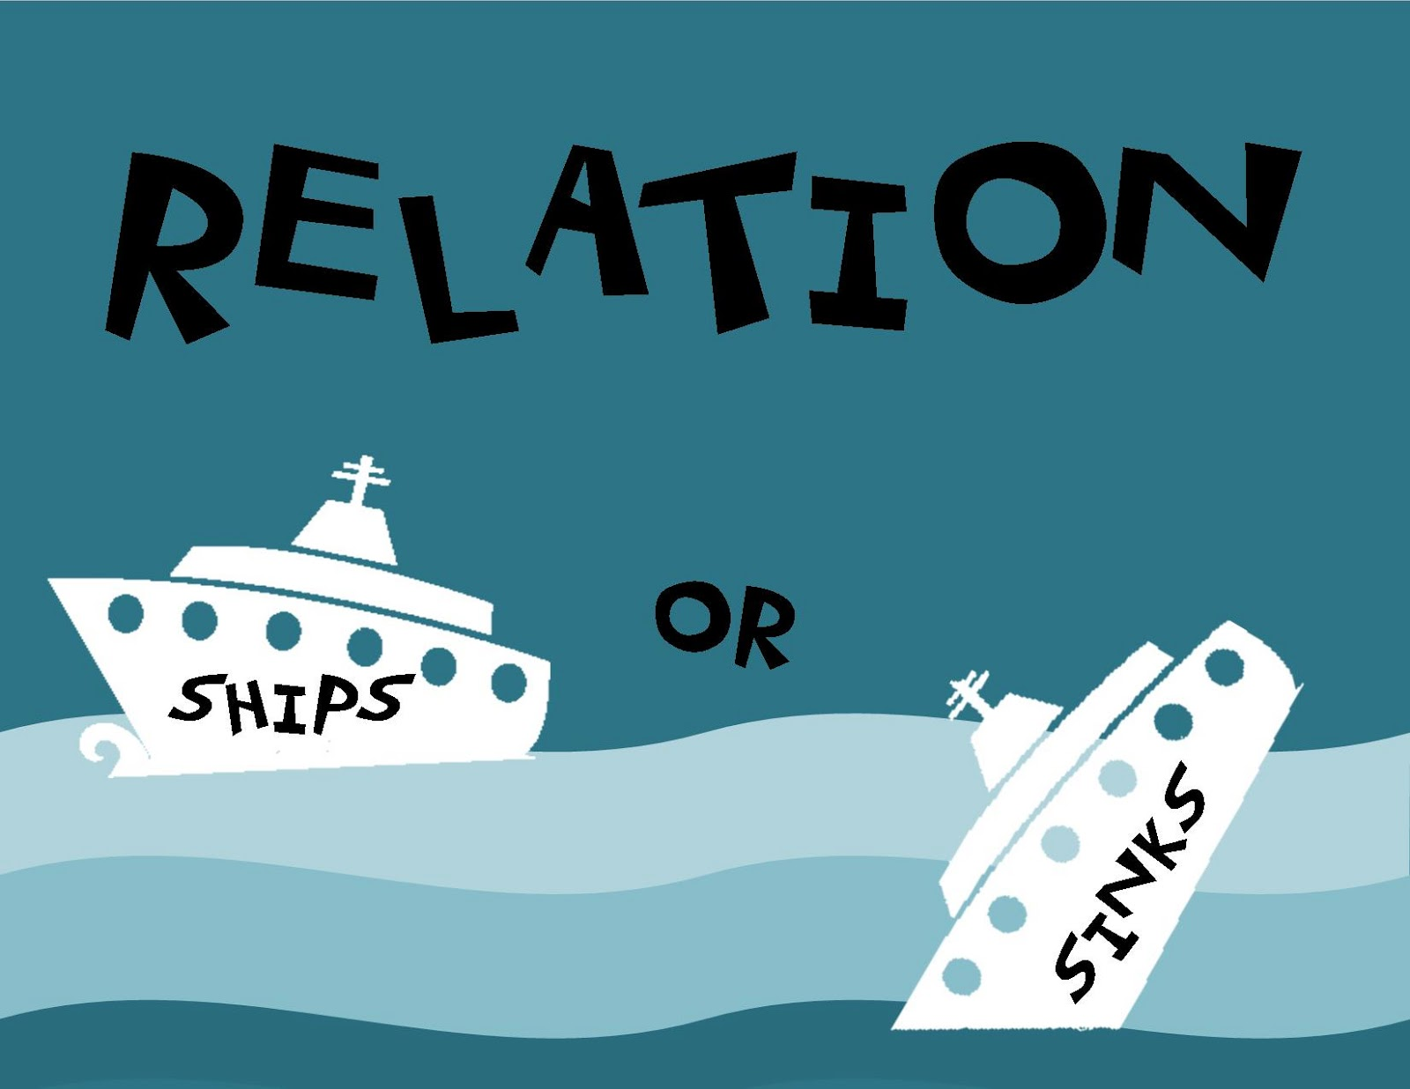

Considerations in providing Culturally-Sensitive TIC
Notes:
What considerations should I keep in mind in providing Culturally-Sensitive Trauma-Informed Care?
View RELATIONSHIPS through a Culturally-Sensitive Trauma-Informed lens
Understand your role as a provider within this family's world.
Gain a better understanding of the roles and dynamics within this family.
Consider and facilitate the inclusion of others (extended family, clergy, healers) when treating patients.
View ASSESSMENT through a Culturally-Sensitive Trauma-Informed lens
The manifestation and expression of psychological states differ depending on personal, familial, and cultural beliefs and practices.
Listen to and use the family's own terms during assessment and treatment planning
Trust in / comfort with the provider has been shown to be associated with increases in patient disclosure in some cultural groups.
View TREATMENT through a Culturally-Sensitive Trauma-Informed lens
Healing comes in many different forms; your ideas, beliefs, and values may differ from the family's.
Be sure you have integrated the family's understanding of diagnosis, prognosis, and healing into your treatment planning.
Consider each family's resources and barriers to help-seeking and utilization of supportive services within the community.

Slide 17
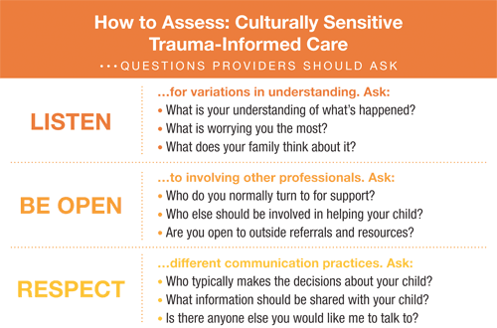
Culturally-Sensitive Trauma-Informed Care. (n.d.). Retrieved from https://www.healthcaretoolbox.org/cultural-considerations/culturally-sensitive-trauma-informed-care.html
Notes:
Tips for Providers:
Families may attribute distress to culturally specific beliefs. Consider somatic/behavioral presentations of distress. Listen for and use the family’s own terms. Attend to distress in the way the family defines it.
Families may have distinct traditions for decision-making and communication. Ask about decision-making practices in advance. Respect parents’ wishes regarding what their child should know. Be open to involving other healing professionals and customs.
Families may be reluctant to seek help outside their cultural community. Connect families with community resources they trust. Be sensitive to the family’s fear about immigration and legal status. Show respect by working within and through the family structure.

Slide 18
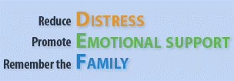
Culturally-Sensitive Trauma-Informed Care. (n.d.). Retrieved from https://www.healthcaretoolbox.org/cultural-considerations/culturally-sensitive-trauma-informed-care.html
Notes:
The D-E-F protocol is a practical tool to guide trauma-informed pediatric care. The D-E-F framework helps health care professionals identify what they can do, within their own scope of practice, to address and prevent traumatic stress responses
D – Distress – assess and manage pain, ask about fears and worries and consider grief and loss
E – Emotional Support – who and what does the patient need now? Barriers to mobilizing existing supports?
F – Family – assess parents or siblings and others distress, gauge family stressors and resources and address other needs.

Slide 19
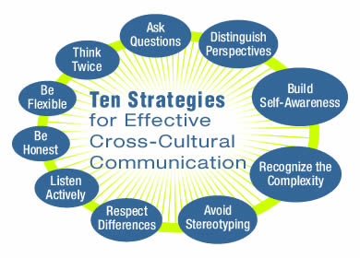
Jordan Erikson, Cultural communication, retrieved from: jordanerickson@weebly.com
Notes:
Every culture has its own set of tacit assumptions and tendencies when it comes to face-to-face interactions, and trying to get your point across effectively can sometimes be difficult. Even when a language barrier doesn’t exist, cross-cultural communication can be challenging. Here are our top ten tips for effective cross-cultural communication:
1. Maintain etiquette
Many cultures have specific etiquette around the way they communicate. Before you meet, research the target culture, or if time allows, do some cross cultural training. For example, many cultures expect a degree of formality at the beginning of communication between individuals. Every culture has its own specific way of indicating this formality: ‘Herr’ and ‘Frau’ in Germany, reversing family and given names in China and the use of ‘san’ in Japan for men and women etc. Be aware of these familiarity tokens and don’t jump straight to first name terms until you receive a cue from the other person to do so.
2. Avoid slang
Not even the most educated non-native English speaker will have a comprehensive understanding of English slang, idioms and sayings. They may understand the individual words you have said, but not the context or the meaning. As a result you could end up confusing them or at worst, offending them.
3. Speak slowly
Even if English is the common language in a cross cultural situation it’s not a good idea to speak at your normal conversational speed. Modulating your pace will help, as will speaking clearly and pronouncing your words properly. Break your sentences into short, definable sections and give your listener time to translate and digest your words as you go. But don’t slow down too much as it might seem patronising. If the person you’re speaking to is talking too quickly or their accent is making it difficult for you to understand them, don’t be afraid to politely ask them to slow down too.
4. Keep it simple
In a cross cultural conversation there’s no need to make it harder for both of you by using big words. Just keep it simple. Two syllable words are much easier to understand than three syllable words, and one syllable words are better than two syllable words. Say “Please do this quickly” rather than “Please do this in an efficacious manner.”
5. Practice active listening
Active listening is a very effective strategy for improving cross cultural communication. Restate or summarize what the other person has said, to ensure that you have understood them correctly, and ask frequent questions. This helps build rapport and ensures that important information doesn’t get missed or misunderstood.
6. Take turns to talk
Make the conversation flow more freely by taking it in turns to speak. Make a point and then listen to the other person respond. Particularly when people are speaking English as their second language it’s better to talk to them in short exchanges rather than delivering a long monologue that might be difficult for them to follow.
7. Write things down
If you’re not sure whether the other person has understood you properly, write it down to make sure. This can be particularly helpful when discussing large figures. For example, in the UK we write a billion as 1,000,000,000 but in the USA, it’s written as 1,000,000,000,000.
8. Avoid closed questions
Don’t phrase a question that needs a ‘yes’ or ‘no’ answer. In many cultures it is difficult or embarrassing to answer in the negative, so you will always get a ‘yes’ even if the real answer is ‘no’. Ask open-ended questions that require information as a response instead.
9. Be careful with humour
Many cultures take business very seriously and believe in behaving professionally and following protocol at all times. Consequently they don’t appreciate the use of humour and jokes in a business context. If you do decide to use humour make sure it will be understood and appreciated in the other culture and not cause offence. Be aware that British sarcasm usually has a negative effect abroad.
10. Be supportive
Effective cross cultural communication is about all parties feeling comfortable. In any conversation with a non-native English speaker, treat them with respect, do your best to communicate clearly and give them encouragement when they respond. This will help build their confidence and trust in you.

