Slide 1
For the trainer:
Please note this slide deck is not a train the trainer presentation with fully developed scripts and exercises. These slides and accompanying notes are offered as suggestions. Slides may be used separate from the slide deck and in a different order than how they are currently presented.
If slides are used, please use the citation below and maintain all original citations found on the slides.
National Council for Behavioral Health. Fostering Resilience and Recovery: A Change Package for Advancing Trauma-Informed Primary Care. 2019.

Slide 2
Trauma and its Impacts

Slide 3
What is Trauma?
three key elements
Definition (SAMHSA Experts 2012) includes
Individual trauma results from an , series of events, or set of circumstances that is by an individual as overwhelming or life-changing and that has profound on the individual’s psychological development or well-being, often involving a physiological, social, and/or spiritual impact.
event
experienced
effects
Notes:
According to the Substance Abuse and Mental Health Services Administration, trauma has three key components: it is an EVENT or set of circumstances, that is EXPERIENCED directly or indirectly as overwhelming or life-changing, that has profound EFFECTS on said individual’s well-being, psychological development or has physiological, social and/or spiritual impact. So what are some things that you can think of that may fit this definition?
Events and circumstances may include the actual or extreme threat of physical or psychological harm or severe life-threatening neglect for a child that imperils healthy development. These events and circumstances may occur as a single occurrence or repeatedly over time. Witnessing an event, such as domestic, community or school violence, also can qualify as a traumatic event.
The individuals experience of these events or circumstances helps to determine whether it is a traumatic event. A particular event may be experienced as traumatic for one individual and not another. How the individual labels, assigns meaning to, and is disrupted physically and psychologically by an event will contribute to whether or not it is experienced as traumatic.
The long-lasting adverse effects of the event are a critical component of trauma. These adverse effects may occur immediately or may have a delayed onset. The duration of the effects can be short to long term. In some situations, the individual may not recognize the connection between the traumatic events and the effects.

Slide 4
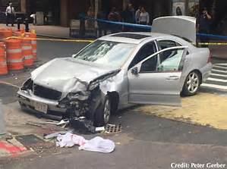

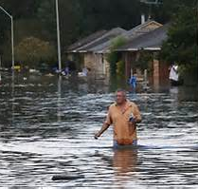

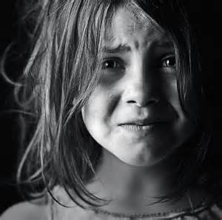
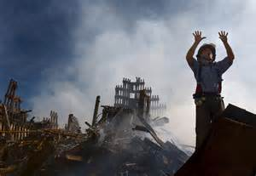
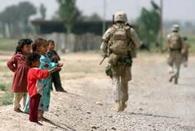
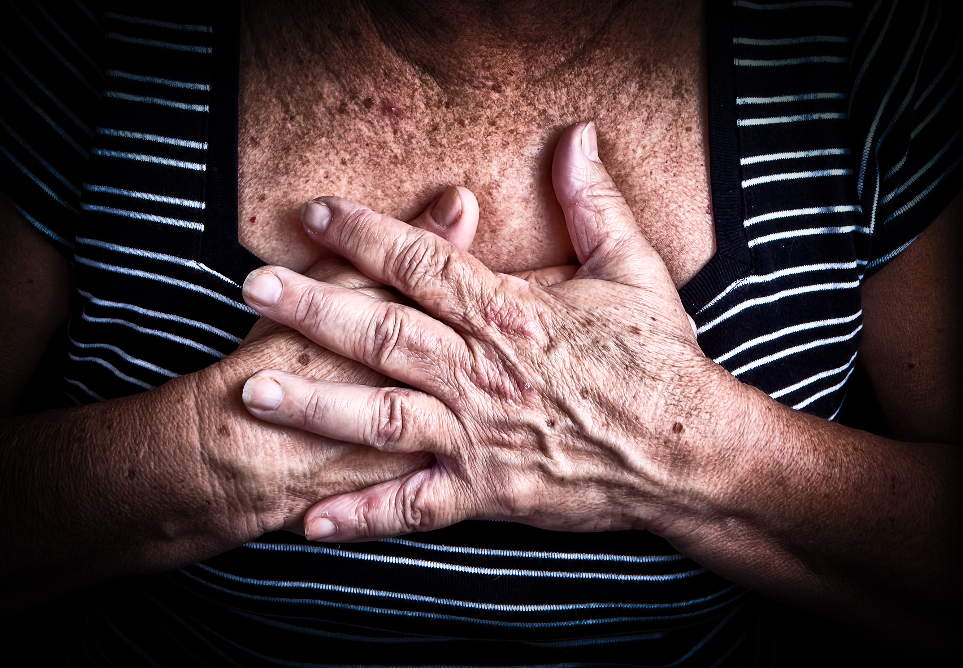
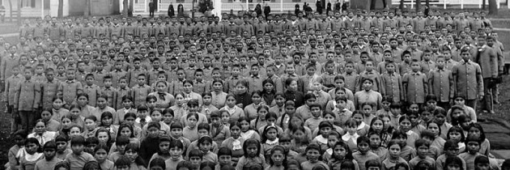
Notes:
Here are some common traumatic events that we often see in the lives of the people we serve.
Child maltreatment and complex trauma
Serious accident or illness
Natural or man made disasters
Medical traumas
War, terrorism, political violence
Victim/witness to domestic, community and school violence
Traumatic grief/separation, significant loss
Historical and generational trauma
These are just a few of the categories of trauma. However, trauma, much like crisis, is subjective. If someone experiences something as traumatic, it is traumatic, whether you or anyone else views it the same way.

Slide 5
Historical Trauma
“Cumulative emotional and psychological wounding, over the lifespan and across generations, emanating from massive group trauma experiences.”
Yellow Horse Brave Heart, 2003
Rethinking Historical Trauma: Narratives of Resilience, Aaron R. Denham, 2008
Historical Trauma and Cultural Healing, University of Minnesota Extension http://www.extension.umn.edu/family/cyfc/our-programs/historical-trauma-and-cultural-healing/
Notes:
One type of trauma that is often overlooked is intergenerational, historical or cumulative trauma. This is trauma experienced by a specific cultural group or collective community. With these types of traumatic events, the trauma is held personally and passed on across generations. Even those who did not personally experience the trauma are affected generations later. What are some examples of intergenerational or historical trauma that you can think of?
We use the word cumulative here to describe these events because they are continue today. For many populations these traumas are not in the past but are very current.

Slide 6
Intergenerational and Historical Traumatic Events
Genocides
Slavery
Pandemics
Massacres
Prohibition or destruction of cultural practices
Discrimination/Systemic prejudice
Forced relocation
Notes:
Here’s a list of them….genocide, slavery, pandemics, massacres, prohibition or destruction of cultural practices, discrimination or systemic prejudices and forced relocation.
For Native Americans and Black Americans, systemic trauma often converges with historical trauma in the bias they experience when dealing with institutions like government and police.

Slide 7



Trauma Shapes our Beliefs
Identity
Worldview
Spirituality
Notes:
Now let’s talk about the effects of trauma on individuals. First, trauma shapes our beliefs. It impacts the way we view our world, our spirituality and ourselves. It creates a feeling of being unworthy, a feeling of being unsafe, a feeling of intense fear and the need for power and control.

Slide 8

Typical Development
I live in a predictable & benevolent world
Trauma
People want to hurt me
I am worthwhile
I am hopeful & optimistic about my future
I have the ability to impact & change my life
I am not safe
I am afraid
No one will help me
I am not good/smart/ worthy enough for people to care about me
It will never get better
I need to establish personal power & control
Notes:
Trauma can cause an individual to believe they live in a world which is not safe. An individual who has been impacted by trauma may feel constantly under threat and see enemies everywhere.

Slide 9

Positive
Negative
Increased appreciation of life
Greater perceived closeness to God
Increased sense of purpose in life
Enhanced spiritual well-being
Loss of Faith
Diminished participation in religious or spiritual activities
Changes in belief
Feelings of being abandoned or punished by God
Loss of meaning and purpose for living
Notes:
Spirituality is a personal experience with many definitions. Spirituality might be defined as "an inner belief system providing an individual with meaning and purpose in life, a sense of the sacredness of life, and a vision for the betterment of the world." Other definitions emphasize "a connection to that which transcends the self." The connection might be to God, a higher power, a universal energy, the sacred, or to nature. Researchers in the field of spirituality have suggested three useful dimensions for thinking about one's spirituality:
Beliefs
Spiritual practices
Spiritual experiences
Evidence suggests that trauma can produce both positive and negative effects on the spiritual experiences and perceptions of individuals For example, depression and loneliness can lead to feelings of abandonment and loss of faith in God. These effects may change as time passes and a person moves further away from the acute phase of trauma recovery. On the positive side, some individuals experience increased appreciation of life, greater perceived closeness to God, increased sense of purpose in life, and enhanced spiritual well-being even following devastating events such as disasters and rape. For others, trauma can be associated with loss of faith, diminished participation in religious or spiritual activities, changes in belief, feelings of being abandoned or punished by God, and loss of meaning and purpose for living.

Slide 10

“People, especially if suffering from depression, lacking in confidence, etc. extremely, often view themselves far more negatively than would be objectively warranted.”
-David Hosier
Notes:
Children learn their self-worth from the reactions of others, particularly those closest to them. Caregivers have the greatest influence on a child’s sense of self-worth and value. Abuse and neglect make a child feel worthless and despondent. A child who is abused will often blame him- or herself. It may feel safer to blame oneself than to recognize the parent as unreliable and dangerous. Shame, guilt, low self-esteem, and a poor self-image are common among children with complex trauma histories.

Slide 11

The Amazing Brain

Slide 12
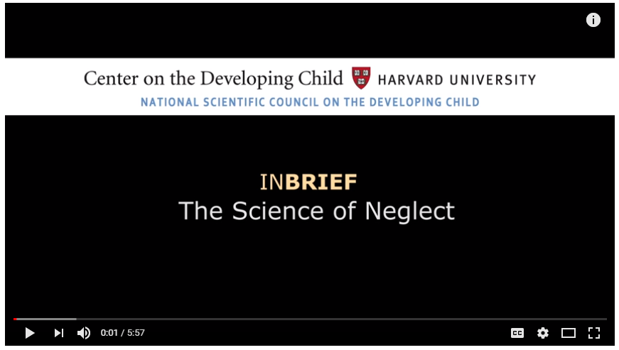
The Science of Neglect
https://www.youtube.com/watch?v=bF3j5UVCSCA
Notes:
https://www.youtube.com/watch?v=bF3j5UVCSCA
Neurological impact of one kind of trauma.

Slide 13
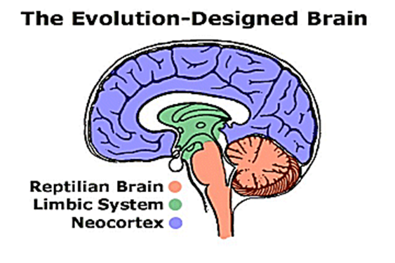
Impact of Trauma on Brain Development
Typical Development
Developmental Trauma
Cognition
Cognition
Social/ Emotional
Regulation
Social/ Emotional
Regulation
Survival
Survival
Notes:
The amygdala (the brain’s threat detection center) can become overactive, engaging in a constant program of looking for, seeing and assessing threat. This will cause you to feel intensely anxious, vulnerable and fearful.
The hippocampus (the brain’s center for processing memories) can become underactive. Rather than consolidating and then placing memories in the outer layer of the brain for long-term storage, memories get hung up in a present-day loop. The result: You will experience and re-experience intrusive, disturbing and uncomfortable recollections.
The cortex (the brain’s center for executive control) becomes interrupted by survival-oriented instincts from deep inside your inner brain. These instincts overrule logical thinking, diminish cognitive processing and decrease your ability to inhibit behavior. Even when you try to refrain from addictive behavior you will experience an unstoppable urge to engage in it.
Biological:
The upper part of the brain is the prefrontal cortex. It regulates judgment, decision making, moral reasoning, planning, impulse control, cause & effect thinking, comprehension skills, information processing, self awareness and self esteem, delay of gratification, and many other functions that involve rational thinking.
The lower part of the brain mobilizes the body for action (i.e., fight or flight response) when danger is perceived and overrides the upper part of the brain.
When a child perceives or is on watch for danger persistently (i.e., constant state of “yellow alert”), this causes higher and prolonged levels of cortisol to be present in the bloodstream, resulting in toxic stress, and the prefrontal cortex may be underdeveloped. The result doesn’t just change brain functioning; it can actually change the brain structurally.
The typical child spends little time focused on survival and can devote most of her/his waking time to cognition and social-emotional functioning. For a child who has experienced developmental trauma, the triangle can become inverted with the majority of the brain’s attention focused on survival, leaving little left for cognition.
Use the “fist” model of the brain. Kids who have been through trauma and are doing the pattern matching, will over-identify danger due to sensory matches (voice, smell (strongest), touch, facial expressions)

Slide 14
Use Dependent Development
The more a neural system is activated, the more that system changes to reflect that pattern of activation
Dr. Bruce D Perry, 2004‐2015
Notes:
Systems in the brain that get repeatedly activated will change and the systems in the brain that don’t get activated will become underdeveloped. Just like a muscle, the more a brain system like the stress response network gets “exercised,” the more it changes and the more risk there is of altered functioning. At the same time, the less the cortical regions, which usually control and modulate stress, are used, the smaller and weaker they get.
Dr. Perry says – exposing a person to chronic fear and stress is like weakening the braking power of a car while adding a more powerful engine: you’re altering the safety mechanisms that keep the machine from going dangerously out of control.

Slide 15
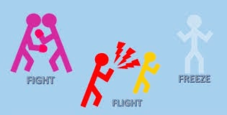
Survival Mode Response
Notes:
When a traumatic event happens, we innately either fight, flight or freeze. Who here has ever been in a car accident? When it first happened, what was your immediate response? Did you freeze? Want to fight whoever hit you? Or want to leave as quickly as possible? All of the above reactions are normal. When we get scared, our body naturally wants to protect us and takes over. It is one of our survival skills, much like breathing (which we do without thinking).

Slide 16
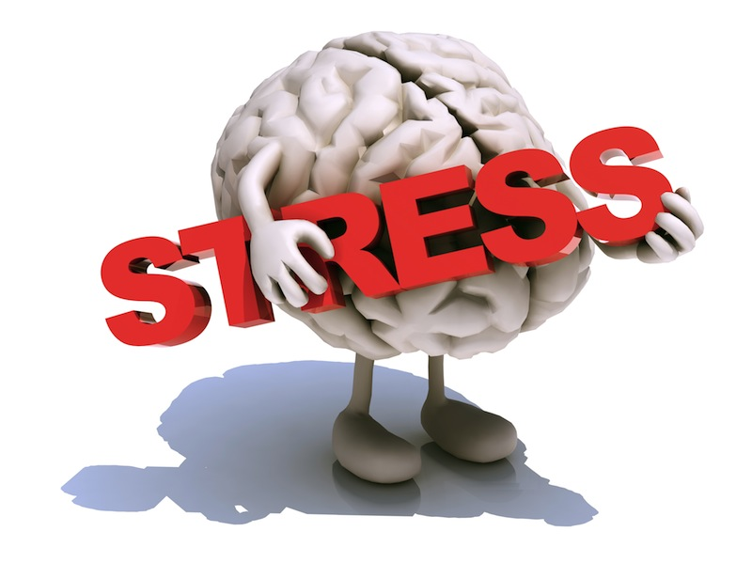
Survival Mode Response
  Inability to
  Respond
  Learn
  Process
Notes:
Under stress, a brain goes to “Fight, flight or freeze” mode and our ability to respond, learn and process is severely compromised.
15

Slide 17
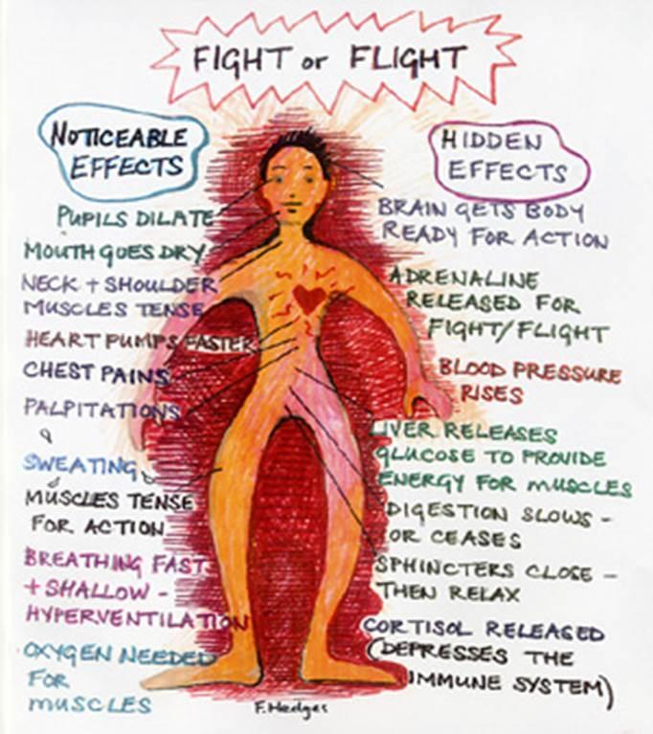
Trauma’s Impact
on the Body
Notes:
Stress is a normal part of life, and so is our response to it. The physiological response to stress is hardwired into all of us and is evolution’s way of keeping us alive. In times of stress, our heart beats faster, our blood pressure increases, and adrenaline and cortisol (the stress hormone) surge through our system to make us stronger, faster, more alert and more powerful versions of our normal selves. In short, the physiological changes that come with stress are to give us the physical resources to deal with whatever might break our stride.
But – the stress response was only ever meant to happen for brief periods of time. In the right doses, the cortisol (the stress hormone) that surges through the body in times of stress will help us to perform at our peak. When the cortisol is turned on and off quickly, it energizes, enhances certain types of memory, and sets the immune system to go.
In a chronically stressful environment, the body’s stress response is always on – there is very little relief from the surge of chemicals and the increase in heart rate and blood pressure. When this happens, the stress becomes toxic and can cause dramatic changes in the brain and body – but there are ways to heal.
This pictures highlights the common noticeable and hidden effects when the “fight, flight, freeze" is activated.

Slide 18
Impact of Trauma on Behavior Triggers
External reminders of traumatic event
  Smell
  Sound
  Sight
  Touch
  Taste
Internal reminders of traumatic event
  Emotions
  Thoughts
Notes:
Triggers can be positive or negative—apple pie cooking, smell of turkey at Thanksgiving, burning leaves in the fall, flowers in the spring, a fresh rain. But when triggers are paired with negative emotions, they become negative triggers that will connect to that negative emotion. The body will feel all the sensations that were felt at the time of the event connected to the trigger. An example, the smell of a certain flower can be positive. However, when it is smelled at a funeral of someone you love, the feelings of grief can become associated with the smell of the flower thus it becoming a negative trigger for you. Unfortunately it is not possible to know all of the things that may trigger someone.
However, we can assist people in learning what their triggers are and developing strategies for working with them.

Slide 19

What’s Sitting in the Room from Trauma
Difficulty concentrating
Anger
Defiance
Fear
Aggression
Difficulty forming relationships
Low self-esteem
Disrupted Mood
Physical Illness
Guilt
Avoidant behavior
Sleep problems
Dissociation
Perfectionism
Persistent irritability
Traumatic grief
Sensory sensitivity
Shame
Hyperarousal
Trauma re-enactment
Depression
Inattention
Mistrust
Regressive behavior
Need to control
Notes:
These are the kinds of seen and unseen burdens people bring into the room with them when they have been traumatized.
Children with trauma histories may have problems thinking clearly, reasoning, or problem solving. They may be unable to plan ahead, anticipate the future, and act accordingly. When children grow up under conditions of constant threat, all their internal resources go toward survival. When their bodies and minds have learned to be in chronic stress response mode, they may have trouble thinking a problem through calmly and considering multiple alternatives. They may find it hard to acquire new skills or take in new information. They may struggle with sustaining attention or curiosity or be distracted by reactions to trauma reminders. They may show deficits in language development and abstract reasoning skills. Many children who have experienced trauma have learning difficulties that may require support in the academic environment.

Slide 20

Results in Vicious Loop
Notes:
Ultimately, trauma can lead to a vicious loop. When coping with trauma, some, without the necessary coping and resilience skills, cope negatively, which can put them in vulnerable positions to experience additional traumatic events.
Our view of self also impacts this vicious loop. Trauma survivors who believe they are not worthy of love or happiness may struggle to keep themselves out of harms way.

Slide 21
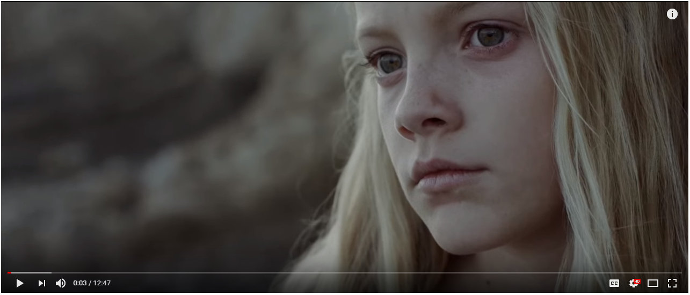
https://www.youtube.com/watch?v=lOeQUwdAjE0
Notes:
This video may be hard for some to watch. If so, please feel free to take care of yourself in whatever way you need to. In this video, keep in mind everything we have talked about thus far.
Double click picture
So what did you all see in the video?
Themes to point out if not seen:
She feels helpless, dependent (I am not worthy)
She stated that if she pushes hard enough all promises from people will come back unfulfilled (No one is safe)
She was at school and in foster homes and was still abused (No place is safe)
When she tried to take her little brother with her (Trying to gain control and keep control and homeostasis)
The dress triggered a reaction (the smallest things can trigger someone and we won’t know why)

Slide 22

With a table partner discuss the content discussed:
Do you see any of these things reflected in individuals you serve?
What have you done that has helped any of these individuals be more successful?
Notes:
Pick a table partner and discuss these two questions.

