Slide 1
Trauma-Informed Physical Examination: Practicing Sensitivity
Notes:
-This slide remains projected as students take a seat in the lecture hall. Verbally prompt students to complete the TIC Pre-Session Survey (Appendix D).
-Introduce yourself to the audience and explain the schedule for the session (1 hour didactic lecture followed by 2 hours of practice in small-group split sessions).
-Consider asking students to quietly think about a time when they, as patients, felt uncomfortable during a physical exam, or if there was a time when they witnessed a patient’s discomfort. The following didactic is geared at identifying language and behaviors that providers can utilize during the physical exam to create a more comfortable, patient-centered experience.

Slide 2
This work is licensed under a Creative Commons Attribution-Noncommercial Share Alike License (http://creativecommons.org)

Slide 3
Objectives
Define trauma and trauma-informed care
Describe key principles of performing a physical examination in a manner that is sensitive to all patients, particularly those with a history of trauma
List specific examples of trauma-informed language and behaviors that can be utilized during the physical examination
Practice performing vital signs using a trauma-informed approach

Slide 4
Trauma
SAMHSA (the 3 Es):
“Individual trauma results from an event, series of events, or set of circumstances that is experienced by an individual as physically or emotionally harmful or life threatening and that has lasting adverse effects on the individual’s functioning and mental, physical, social, emotional, or spiritual well-being.”
Notes:
-There are many definitions of trauma. Here is a simple and inclusive one from the Substance Abuse and Mental Health Services Administration (SAMHSA), a pioneer in the field of trauma-informed care.

Slide 5
Trauma
A variety of experiences may qualify as traumatic. Examples can include:
Physical abuse
Psychological abuse
Sexual assault
Intimate partner violence
Adverse childhood experiences
Neglect
Loss
War and conflict
Poverty
Racism
Community violence
Discrimination
Medical trauma
Natural disasters
Notes:
-Note the common nature of these experiences. Trauma is prevalent in our communities (amongst both patients and providers) and can be defined more broadly than the gunshot wounds we see in the trauma bay of the ER, for example.

Slide 6
Trauma
89% of people living in the U.S. have experienced at least one traumatic event in their lifetime¹
Trauma has been associated with chronic mental and physical health conditions such as substance use, depression, diabetes, and cardiovascular disease² as well as an increase in mortality³
Victims of trauma feel a deprived sense of safety, autonomy, and trust, which can affect their relationship with the healthcare system and their providers
Notes:
-Enhancing patient safety, autonomy and trust are cornerstones of the trauma-informed care movement.

Slide 7
Trauma-Informed Care
An organizational structure and treatment framework that involves understanding, recognizing, and responding to the effects of all types of trauma
Emphasizes physical, psychological and emotional safety for patients and providers, and helps survivors rebuild a sense of control and empowerment
Principles can be applied universally to all clinical interactions
Notes:
-It is important to note that trauma-informed principles can be applied to all clinical encounters, even when patients’ trauma histories are not known. The strategies discussed today are founded in high quality communication and patient-centered approaches to care.

Slide 8
Trauma-Informed Care
A trauma-informed program, organization, or system:
Realizes
Realizes the widespread impact of trauma and understands potential paths for recovery
Recognizes
Recognizes signs and symptoms of trauma in patients, families, staff, and others involved in the system
Responds
Responds by fully integrating knowledge about trauma into policies, procedures and practices
Resists
Seeks to actively resist re-traumatization
Notes:
-These are the “4 R’s” of a trauma-informed program, organization, or system, published by SAMHSA.

Slide 9
Physical Examination
Establish trust, reinforce care
Exposure to shame, vulnerability
Safe, comfortable experience for all patients, including those with a history of trauma
GOAL
Notes:
-The physical exam is a standard component of most medical encounters and is often required to arrive at a diagnosis and treatment plan. While it can help to establish trust between provider and patient, the physical exam also has the potential to cause unintentional harm.

Slide 10
Patient Quotes
I’m just a little jumpy when people come close to me.
I blanked out during the exam. I don’t know what happened. I’m not sure what the doctor did or didn’t do.
The doctor was lingering way too long when touching me.
Notes:
-These are real quotes from Veteran survivors of military sexual trauma (MST) that were reported to a counselor after appointments with their primary care physicians.
-Our goal is to learn and practice behaviors that can minimize the risk of patients feeling this way and instead encourage a trusting, therapeutic relationship between provider and patient

Slide 11
What Does Trauma Look Like?
Cannot assume who has experienced traumatic stress. The best way to identify trauma exposure is to ask!
Signs of trauma may include:
Avoidance of procedures (Pap smear, colonoscopy, dental care)
Vague, generalized symptoms (chronic headache, pelvic pain)
Appearing nervous or distracted during visit
Non-adherence to treatment
Notes:
-In most circumstances, we cannot tell with certainty which patients have or have not experienced trauma unless we ask (consider adverse childhood experiences, witnessed threatened assaults, etc.).
-Patients should be asked about trauma during the social history for a new patient encounter, and then as appropriate at future visits.

Slide 12
Trauma-Informed Physical Exam
Before
Set the stage for a sensitive exam
During
Perform a sensitive exam
After
Provide sensitive closure
Notes:
-The framework provided in today’s presentation is divided into 3 parts: providing trauma-informed care before, during, and after the physical exam.

Slide 13
Notes:
-This framework is intended to be a helpful guide and resource that can be adapted for use in a variety of clinical settings, specialties, and encounters.
-Encourage students to be mindful, deliberate, and compassionate in their examination of patients. While most health care professionals have good intentions, performing a trauma-informed physical exam is not always inherent--it is a learned skill.

Slide 14
Before the Exam

Slide 15
Before the Exam
Check non-verbals
Set an agenda
Make it standard
Identify concerns
Ask about comfort
Offer chaperone

Slide 16
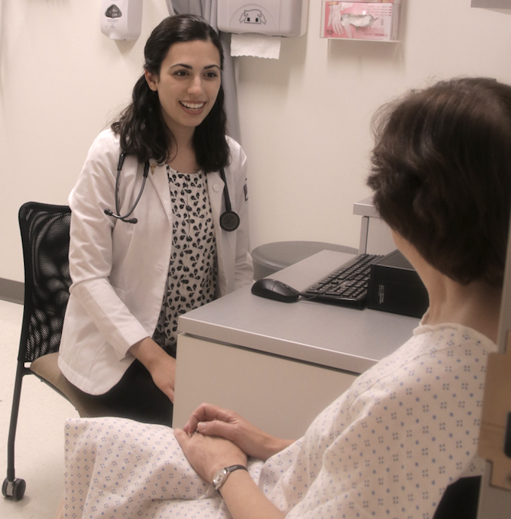
Before the Exam
Check non-verbals
Set an agenda
Make it standard
Identify concerns
Ask about comfort
Offer chaperone
Notes:
-Consider asking students to name components of effective non-verbal communication prior to moving to the next slide.

Slide 17
Non-Verbals
Speak clearly, slowly, and at an appropriate volume
Appear engaged, pleasant and calm
Maintain appropriate eye contact
Sit/stand at eye level with the patient
Avoid sudden movements
Keep hands outside of pockets
Pay attention to patient cues (i.e. tensing muscles, fidgeting, breathing quickly, flushing, crying, trembling, appearing distracted or spaced out)

Slide 18
What Should I Do If…
If the patient exhibits or vocalizes discomfort, pause the exam
Speak in a calm, caring manner
Avoid sudden movements
Reassure patient that they are safe
Remind patient where they are
Explain what you are doing and why
Offer water, a washcloth, and/or an additional drape
Consider changing environment (e.g. move to a different room)
Notes:
Students should be encouraged to collaborate with their supervisor(s) if/when a patient expresses discomfort. It may be appropriate not only to pause the exam, but to discontinue the exam entirely.

Slide 19
What Should I Do If…
Do you have difficulty when someone touches your knees?
You seem anxious. Is there something you are uncomfortable with?
I’m noticing that you are tensing up. Is there something I should know?
Notes:
-These are sample phrases one might use and adapt if a patient demonstrates discomfort during the physical exam.

Slide 20
Before the Exam
Check non-verbals
Set an agenda
Make it standard
Identify concerns
Ask about comfort
Offer chaperone
I’d like to transition to the physical exam. We will be doing a pulmonary exam today, so I will be listening to the lungs. This exam should take about 5 minutes.
Notes:
-Many of the following slides contain a blue speech bubble. These speech bubbles provide practical, sample phrasing for students that further elucidate the bullet point addressed in each slide. Consider identifying a student in the front row of the lecture hall who can read these speech bubbles aloud upon prompting.

Slide 21
Before the Exam
Check non-verbals
Set an agenda
Make it standard
Identify concerns
Ask about comfort
Offer chaperone
This is something that I do with all of my patients who come in with symptoms of a cold.
Notes:
-The exam is not being done “just because”, for no reason, or for this patient only.

Slide 22
Before the Exam
Check non-verbals
Set an agenda
Make it standard
Identify concerns
Ask about comfort
Offer chaperone
Are there questions or concerns we should address before the exam?
Notes:
-This gives patients an opportunity to disclose trauma and an open space to voice concerns.

Slide 23
Before the Exam
Check non-verbals
Set an agenda
Make it standard
Identify concerns
Ask about comfort
Offer chaperone
Is there anything I can do to make you more comfortable?

Slide 24
Before the Exam
Check non-verbals
Set an agenda
Make it standard
Identify concerns
Ask about comfort
Offer chaperone
Would you like anyone else to be present for the exam?
Notes:
-Many institutions mandate the presence of a chaperone for a female patient undergoing a breast, genital or pelvic exam. While this may be for a number of reasons, consider the fact that many male and transgender patients have also experienced and/or witnessed sexual violence.
-While there are specific components of the physical exam that are generally considered sensitive (e.g. rectal exam), we are not always able to predict what may be triggering for an individual.

Slide 25
During the Exam

Slide 26
During the Exam
Attend to draping and modesty
Introduce exam components
Explain why
Ask permission
Stay within eyesight
Respect personal space
Use simple, clinical language
Check in
Use professional touch
Be efficient

Slide 27
During the Exam
Attend to draping and modesty
Introduce exam components
Explain why
Ask permission
Stay within eyesight
Respect personal space
Use simple, clinical language
Check in
Use professional touch
Be efficient
In order for me to do an accurate exam of the lungs, I’ll need to listen with my stethoscope directly on the skin.

Slide 28
During the Exam
Attend to draping and modesty
Introduce exam components
Explain why
Ask permission
Stay within eyesight
Respect personal space
Use simple, clinical language
Check in
Use professional touch
Be efficient
I’m going to leave the room and allow you to change. Please remove the shirt, and you can keep the bra on. Here’s a gown for you to wear; it opens in the back. I’ll be back in a few minutes. I’ll knock before I come in.

Slide 29
Draping and Modesty
Give clear, specific instructions
Refer to the “gown” (what the patient wears) and the “drape” (the sheet over their lap)
If possible, provide fabric gowns in a variety of sizes, as patients feel this preserves their dignity more than paper gowns
Patient moves their own gown and/or drape when possible
Allow patients to wear clothing on body parts that are not being examined (e.g. keep pants on for an ankle exam)
For a limited exam, consider asking patient to move their clothing rather than disrobing (e.g. patient lifts back of shirt up to reveal a skin lesion on the lower back)

Slide 30
Draping and Modesty
Privacy when undressing (may use curtain and/or door)
Expose only the minimum body surface area required at any given time
Do not assume that all men are comfortable baring a full chest
Provide tissues as needed following a pelvic or rectal examination where lubrication is used
Patient re-dresses privately once exam is finished
Knock before re-entering the room, ensuring an affirmative patient response before opening the door (e.g. “all set”)

Slide 31
During the Exam
Attend to draping and modesty
Introduce exam components
Explain why
Ask permission
Stay within eyesight
Respect personal space
Use simple, clinical language
Check in
Use professional touch
Be efficient
I am now going to listen to the lungs, using my stethoscope.
Notes:
-See Slide 46 on trauma-informed language for an explanation of why “the lungs” is used here instead of “your lungs”.

Slide 32
During the Exam
Attend to draping and modesty
Introduce exam components
Explain why
Ask permission
Stay within eyesight
Respect personal space
Use simple, clinical language
Check in
Use professional touch
Be efficient
This is important because we need to see if you have pneumonia, which is an infection of the lungs.

Slide 33
During the Exam
Attend to draping and modesty
Introduce exam components
Explain why
Ask permission
Stay within eyesight
Respect personal space
Use simple, clinical language
Check in
Use professional touch
Be efficient
May I open the gown from the back slightly, in order to get a better listen to the lungs?
Notes:
-Ask permission when moving draping and/or clothing, if the patient is unable to do it themselves.

Slide 34
During the Exam
Attend to draping and modesty
Introduce exam components
Explain why
Ask permission
Stay within eyesight
Respect personal space
Use simple, clinical language
Check in
Use professional touch
Be efficient
I’m going to stand at your side.

Slide 35
Stay Within Eyesight
Notes:
-In the first photo, the examiner stands behind the patient to listen to the posterior chest wall. The patient cannot see where the examiner is or what they are doing.
-In the second photo, the examiner stands at the patient’s side, within their peripheral view, and can still access the posterior lung fields with the stethoscope. It is important to note that the following techniques still allow the provider to accurately gather data from the exam, while also giving the patient a sense of ease and control.

Slide 36
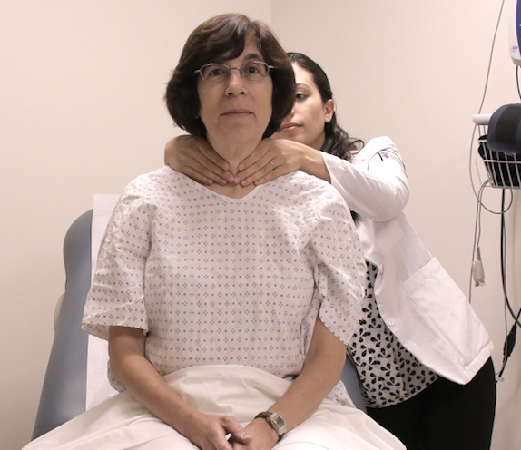
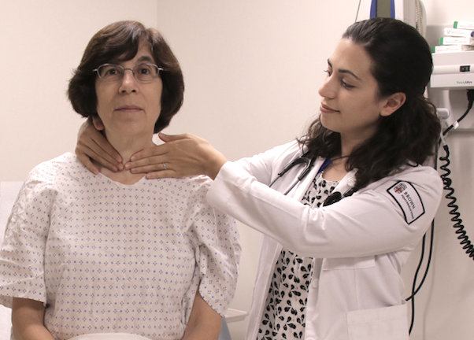
Stay Within Eyesight
Notes:
-The first photo demonstrates a traditional method of thyroid examination, with the examiner standing behind the patient, her fingers fully wrapped around the patient’s neck. This can suggest the act of strangulation.
-In the second photo, the examiner stands at the patient’s side, within her line of vision, and has her fingers fully extended on the neck.

Slide 37
Stay Within Eyesight
Notes:
-Having the patient completely supine puts them in a subordinate position and can trigger memories of prior abuse.

Slide 38
Stay Within Eyesight
Notes:
-Consider instead having the head of the exam table elevated to 30 degrees, and offer the patient a mirror for the things they cannot see.

Slide 39
During the Exam
Attend to draping and modesty
Introduce exam components
Explain why
Ask permission
Stay within eyesight
Respect personal space
Use simple, clinical language
Check in
Use professional touch
Be efficient

Slide 40
Respect Personal Space
Notes:
-In this photograph, the examiner is pressing against the patient’s knees and is directly in front of the patient’s line of vision. Listening to the anterior chest wall can instead be accomplished by standing at the patient’s side, as demonstrated in Slide 35.

Slide 41
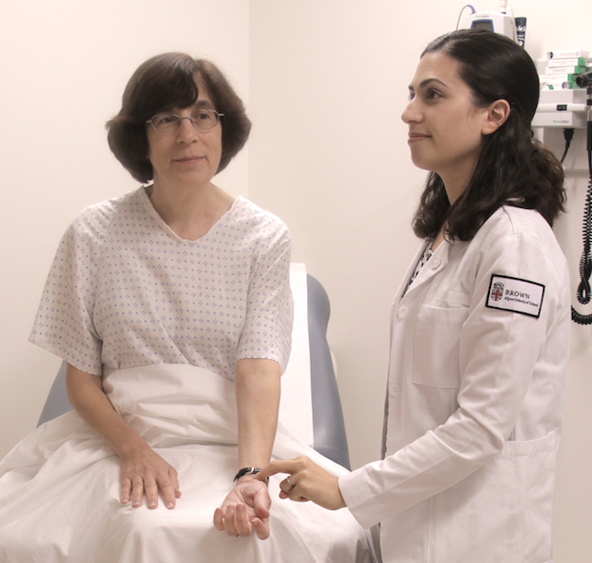
Respect Personal Space
Notes:
-When checking the patient’s pulse in a seated position, the patient’s arm should be extended to rest on their knee or on the exam table, to avoid having the examiner’s hand too close to the groin.

Slide 42
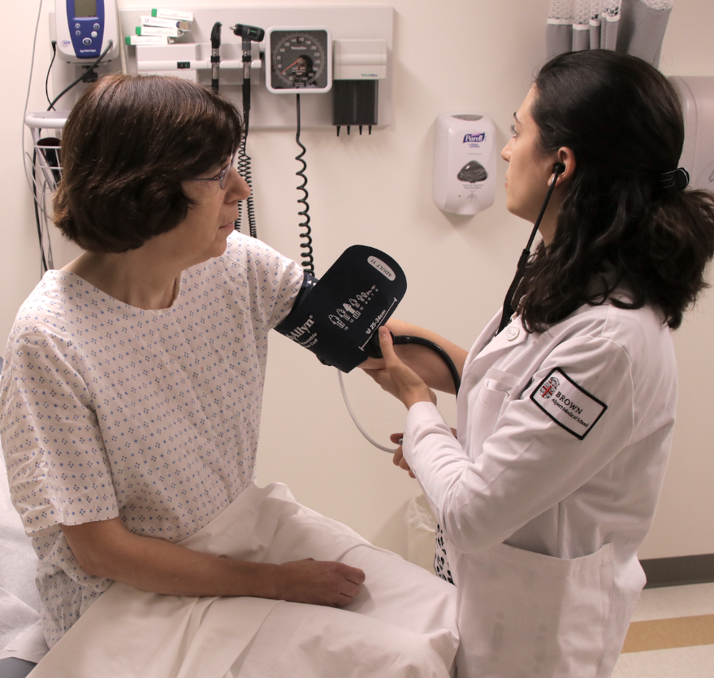
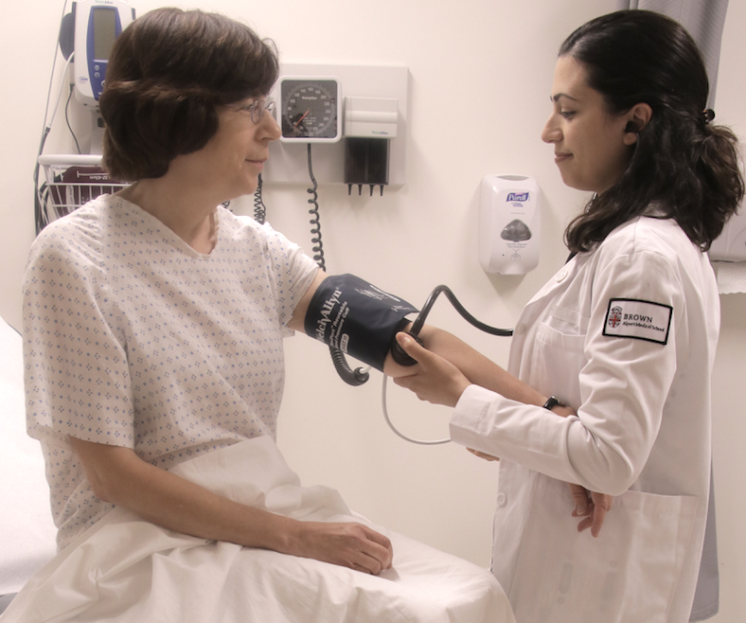
Respect Personal Space
Notes:
-In the first photo, the examiner is standing in front of the patient, pressing against their knees, while the patient leans to keep their arm extended around the examiner’s body.
-In the second photo, the examiner stands at the patient's side and fully supports the patient's arm under her own.

Slide 43
Respect Personal Space
Notes:
-Avoid blocking the exit door of the examination room when possible.

Slide 44
During the Exam
Attend to draping and modesty
Introduce exam components
Explain why
Ask permission
Stay within eyesight
Respect personal space
Use simple, clinical language
Check in
Use professional touch
Be efficient
With the mouth open, take some deep breaths in and out.

Slide 45
Simple, Clinical Language
Easy to understand
Avoids medical jargon
Cautious with imagery; you never know what might be triggering
Avoids all possible sexual connotation
Minimizes power differential between patient and provider
Accommodates patients who speak other languages
Word choice is professional, not personal
Notes:
-Using trauma-informed language can be a difficult skill to master. The slides that follow provide specific examples of common phrasing that may be triggering or uncomfortable for some patients, paired with a suggestion for a more trauma-informed alternative.

Slide 46
Simple, Clinical Language
“Your” | “The”
“Butt” | “Bottom”
“Bed” | “Exam table”
“Provocative tests” | “Additional tests”
Notes:
-Regarding the example in the first row, consider the difference between hearing “Now I want to look at your penis”, versus, “I will now inspect the penis”. “The” suggests that the penis is an anatomic body part that the provider will examine for medical reasons. “The” helps to make the sentence more clinical and professional, less personal.

Slide 47
Simple, Clinical Language
“Normal” | “Healthy”
“Stirrups” | “Foot rests”
“That looks good” | “That looks healthy”
Notes:
-Using gender-inclusive terminology such as “healthy” vs. “normal” can be particularly useful during the pelvic exam.

Slide 48
Simple, Clinical Language
“I want to” | “I am going to”
“Look at” | “Inspect”
“Feel”, Touch” | “Examine”, “Evaluate”

Slide 49
Simple, Clinical Language
“Don’t let me” | “Resist this motion”
“Push me away” | “Push forward”
“Push my finger out” | “Bear down”
“Put up your arms like you’re going to fight” | “Bend the elbows”
Notes:
-These phrases, or phrases like them, are commonly used to provide instructions to patients during the neurologic exam. Consider referring to the motion itself, rather than offering potentially aggressive imagery between examiner and patient.

Slide 50
Simple, Clinical Language
“Pretend you’re at the beach” | “Some find it helpful to a deep, relaxing breath”
“Relax. Relax. Relax!” | “Allow the knees to relax”
Notes:
-We cannot assume what imagery may be soothing for an individual, as traumatic experiences may be associated with a variety of places, people, and/or objects.
-The second example highlights patients’ autonomy and control over their own body parts.

Slide 51
Simple, Clinical Language
“For me” | (nothing)
“Swallow for me” | “I’m going to place my hands on the neck to examine the thyroid. When you can, please swallow.”
Notes:
-The phrase “for me” is commonly used by healthcare professionals and trainees when giving instructions to patients. This phrase can enhance the power differential between provider and patient and can sometimes even be sexually suggestive (e.g. “hop on the bed for me”, “take off your shirt for me”). It is best to avoid this phrase altogether.

Slide 52
During the Exam
Attend to draping and modesty
Introduce exam components
Explain why
Ask permission
Stay within eyesight
Respect personal space
Use simple, clinical language
Check in
Use professional touch
Be efficient
How are you doing?
Notes:
-Check in with the patient periodically and as needed.

Slide 53
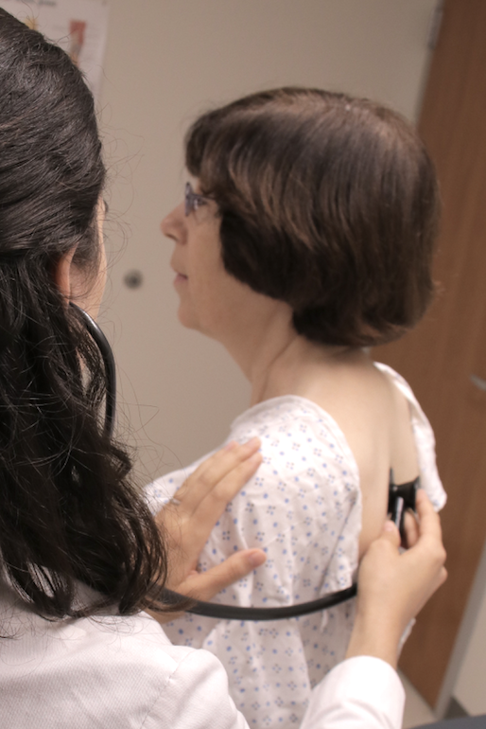
During the Exam
Attend to draping and modesty
Introduce exam components
Explain why
Ask permission
Stay within eyesight
Respect personal space
Use simple, clinical language
Check in
Use professional touch
Be efficient
Notes:
-Providers have a variety of preferences and practices when it comes to professional touch in the context of the physical exam. Some prefer to check the patient’s pulse while auscultating the heart. Some prefer to keep a hand on the shoulder when examining the back. See the following slide for some suggestions about professional touch.

Slide 54
Professional Touch
Consider a firm touch on the shoulder when...
reaching behind a patient (e.g. to grab an otoscope) so they still know where you are
Auscultating the posterior lung fields, to avoid surprise of touch
Prior to an internal vaginal/rectal exam: “You’re going to feel my hand on the thigh/buttocks”
Prepare patients for different sensations:
“This is a tuning fork that will feel like a vibration”
”The speculum may feel cold”

Slide 55
During the Exam
Attend to draping and modesty
Introduce exam components
Explain why
Ask permission
Stay within eyesight
Respect personal space
Use simple, clinical language
Check in
Use professional touch
Be efficient
That concludes the exam. I’m going to step out now, and you can get dressed. I’ll be back in a few minutes so that we can discuss your results and come up with a plan together. I’ll knock before I come in.
Notes:
-It is typically best to discuss results with patients after the physical exam is concluded, with the patient dressed in their normal clothes and seated in a regular chair. This encourages a more comprehensive conversation with both parties fully present, focused and engaged.

Slide 56
Be Efficient
Inform patient how long an exam will take beforehand
Avoid keeping BP cuff inflated for too long, as it can resemble a restraint
Take breaks during any exam where mouth is in fixed, open position, to avoid triggering memories of prior abuse
Ask the patient to show you a genital lesion; taking time to find it yourself may take too long and can be uncomfortable for patient and provider

Slide 57
After the Exam

Slide 58
After the Exam
Express thanks
Discuss results
Ask for questions

Slide 59
After the Exam
Express thanks
Discuss results
Ask for questions
(Knock knock). All set?

Slide 60
After the Exam
Express thanks
Discuss results
Ask for questions
Thanks very much for coming to this appointment and for helping me perform a thorough physical exam.

Slide 61
After the Exam
Express thanks
Discuss results
Ask for questions
The lungs sound clear, which is good news. You do not need a chest x-ray, and you do not have pneumonia.

Slide 62
After the Exam
Express thanks
Discuss results
Ask for questions
(Alternatively). I did hear some crackling noises over the right side of the lungs. We sometimes hear this in patients with pneumonia. I’ll discuss this with my mentor. We might get a chest x-ray, just to be sure.

Slide 63
After the Exam
Express thanks
Discuss results
Ask for questions
What questions do you have?
Notes:
-”What questions do you have?” is a more open-ended version of asking, “Do you have any questions?” It suggests to patients that you expect them to have questions and that you welcome them at this time. Couple this with maintaining eye contact and an open body posture.

Slide 64
BEFORE the exam:
Check non-verbals
Set an agenda
Make it standard
Identify concerns
Ask about comfort
Offer chaperone
DURING the exam:
Attend to draping and modesty
Introduce exam components
Explain why
Ask permission
Stay within eyesight
Respect personal space
Use simple, clinical language
Check in
Use professional touch
Be efficient
AFTER the exam:
Express thanks
Discuss results
Ask for questions
Copyright 2017 Elisseou

Slide 65
Questions?

