Slide 1
For the trainer:
Please note this slide deck is not a train the trainer presentation with fully developed scripts and exercises. These slides and accompanying notes are offered as suggestions. Slides may be used separate from the slide deck and in a different order than how they are currently presented.
If slides are used, please use the citation below and maintain all original citations found on the slides.
National Council for Behavioral Health. Fostering Resilience and Recovery: A Change Package for Advancing Trauma-Informed Primary Care. 2019.

Slide 2
Responding to Crisis in a Trauma-Informed Manner

Slide 3
What is Trauma?
Definition (SAMHSA Experts 2012) includes
three key elements
event
Individual trauma results from an , series of events, or set of circumstances that is by an individual as overwhelming or life-changing and that has profound on the individual’s psychological development or well-being, often involving a physiological, social, and/or spiritual impact.
experienced
effects
Notes:
According to the Substance Abuse and Mental Health Services Administration, trauma has three key components: it is an EVENT or set of circumstances, that is EXPERIENCED directly or indirectly as overwhelming or life-changing, that has profound EFFECTS on said individual’s well-being, psychological development or has physiological, social and/or spiritual impact. So what are some things that you can think of that may fit this definition? (allow the group to provide some examples and confirm or ask for clarity if you do not understand what they are talking about).
Events and circumstances may include the actual or extreme threat of physical or psychological harm or severe life-threatening neglect for a child that imperils healthy development. These events and circumstances may occur as a single occurrence or repeatedly over time.
The individuals experience of these events or circumstances helps to determine whether it is a traumatic event. A particular event may be experienced as traumatic for one individual and not another. How the individual labels, assigns meaning to, and is disrupted physically and psychologically by an event will contribute to whether or not it is experienced as traumatic. Traumatic events by their very nature set up a power differential where one entity has power over another. They elicit a profound questions of why me? The individuals experience of these events or circumstances is shaped in the context of this powerlessness and questioning. Feelings of humiliation, guilt, shame, betrayal or silencing often shape the experience of the event.
The long-lasting adverse effects of the event are a critical component of trauma. These adverse effects may occur immediately or may have a delayed onset. The duration of the effects can be short to long term. In some situations, the individual may not recognize the connection between the traumatic events and the effects.

Slide 4
Survival Mode Response
Inability to
Respond
Learn
Process
Notes:
Under stress, a brain goes to “Fight, flight or freeze” mode and our ability to respond, learn and process is severely compromised.
3

Slide 5
What’s Sitting in the Room from Trauma
Difficulty concentrating
Anger
Defiance
Fear
Aggression
Difficulty forming relationships
Low self-esteem
Disrupted Mood
Physical Illness
Guilt
Avoidant behavior
Sleep problems
Dissociation
Perfectionism
Persistent irritability
Traumatic grief
Sensory sensitivity
Shame
Hyperarousal
Trauma re-enactment
Depression
Inattention
Mistrust
Regressive behavior
Need to control
Notes:
These are the kinds of seen and unseen burdens people bring into the room with them when they have been traumatized. Children with trauma histories may have problems thinking clearly, reasoning, or problem solving. They may be unable to plan ahead, anticipate the future, and act accordingly. When children grow up under conditions of constant threat, all their internal resources go toward survival. When their bodies and minds have learned to be in chronic stress response mode, they may have trouble thinking a problem through calmly and considering multiple alternatives. They may find it hard to acquire new skills or take in new information. They may struggle with sustaining attention or curiosity or be distracted by reactions to trauma reminders. They may show deficits in language development and abstract reasoning skills. Many children who have experienced trauma have learning difficulties that may require support in the academic environment.

Slide 6
We need to have…
UNIVERSAL
Notes:
We need to presume the clients we serve, and the staff we serve next to, have a history of traumatic stress and exercise “universal expectations” by creating systems of care that are trauma-informed. ​
​
What are some behaviors we might use when we universally expect everyone to have a trauma history? ​
​

Slide 7
Principles of a Trauma-Informed Approach
Safety
Trustworthiness and Transparency
Collaboration and mutuality
Empowerment
Voice and choice
Respect for cultural, historical and gender differences
(Fallot 2008, SAMHSA, 2012)
6
Notes:
We need to infuse trauma-informed principles into every interaction and all policies, practices and procedures
Safety: throughout the organization, staff and the people they serve feel physically and psychologically safe; the physical setting is safe and interpersonal interactions promote a sense of safety.
Trustworthiness and transparency: organizational operations and decisions are conducted with transparency and the goal of building and maintaining trust among clients, family members, staff, and others involved with the organization. Trauma-informed peer support and mutual self-help are key vehicles for establishing safety, building trust, enhancing collaboration, and maximizing empowerment.
Collaboration and mutuality: there is true partnering and leveling of power differences between staff and clients and among organizational staff from direct care staff to administrators; there is recognition that healing happens in relationships and in the meaningful sharing of power and decision-making. The organization recognizes that everyone has a role to play in a trauma-informed approach; one does not have to be a therapist to be therapeutic.
Empowerment: throughout the organization and among the clients served, individuals’ strengths are recognized, built on, and validated and new skills developed as necessary. The organization fosters a belief in resilience and in the ability of individuals, organizations, and communities to heal and promote recovery from trauma; builds on what clients, staff and communities have to offer rather than responding to their perceived deficits.
Voice and choice: the organization aims to strengthen the clients’, family members’, and staff’s experience of choice and recognize that every person’s experience is unique and requires an individualized approach. The organization addresses cultural, historical, and gender issues; the organization actively moves past cultural stereotypes and biases, offers gender responsive services, Promotes the value of cultural connections, and recognizes

Slide 8
Notes:
Remember, trauma-informed care is about EVERYONE! Everyone is included. Everyone plays a part.

Slide 9
What inhibits caregivers from being trauma responsive?

Slide 10
Notes:
As professionals who provide care it is helpful to be reminded of Viktor Frankl's poignant statement, "What is to give light must endure burning...“ Quality care, as we know, requires empathy which means exposing ourselves to the trauma and suffering of those whom we are seeking to assist. For treatment and services to be effective for the long haul, professionals will need to maintain active personal self-care--but equally important is the less frequently discussed necessity for organizations to create effective structures of care for staff.

Slide 12
What might be causing the behavior?
Internal or external cause or stimuli
we have little control over
An unmet need
Loss of personal power and need for control
External activating stimuli in the environment
Internal activating stimuli such as intense anxiety or fear
Notes:
We need to be curious about what might be causing escalated behavior

Slide 13
Strategies for preventing escalation
Remain respectful and non judgmental
Seek to gather more information
How can I help? What do you need?
Actively listen for the unmet need
Reflect and clarify to be sure you understand
Allow for silence
Allow expression of emotions
Always empower

Slide 14
Empathy
The ability to understand and share the feelings of another
Notes:
We need to practice empathy.

Slide 15
Get Curious
Not Furious
Notes:
What do you need? What happened to you? How can I help?

Slide 16
Motivational interviewing (MI)
is a collaborative conversation style
for strengthening a person’s own
motivation and commitment to change.
-Miller & Rollnick, 2012
Notes:
Motivational Interviewing is an effective intervention for responding to someone who is in a crisis.

Slide 17
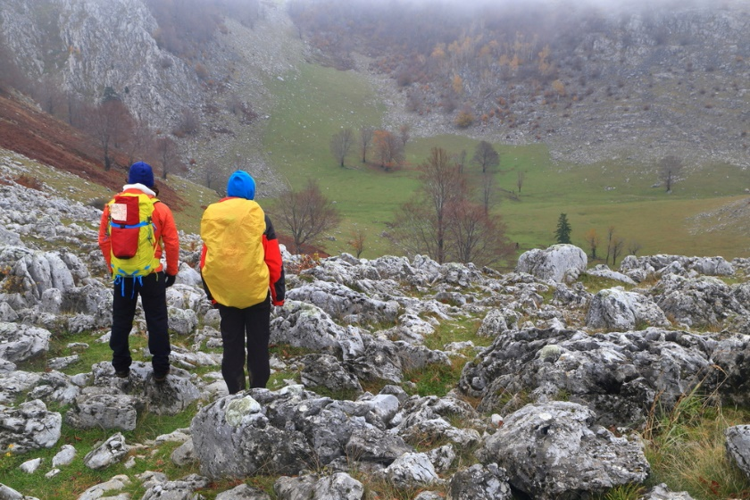
The MI Process
Engaging
Focusing
Evoking
Planning
Resistance …or discrepancy?

Slide 18
The Spirit of Motivational Interviewing
Partnership
Evocation
Compassion
Autonomy
Notes:
The Spirit of Motivational Interviewing
Compassion & Partnership – may or may not seem like a crisis to us. Meet them where they are.
Autonomy - Telling people what they can expect, so they still feel a sense of control.
Evocation – Asking permission

Slide 19
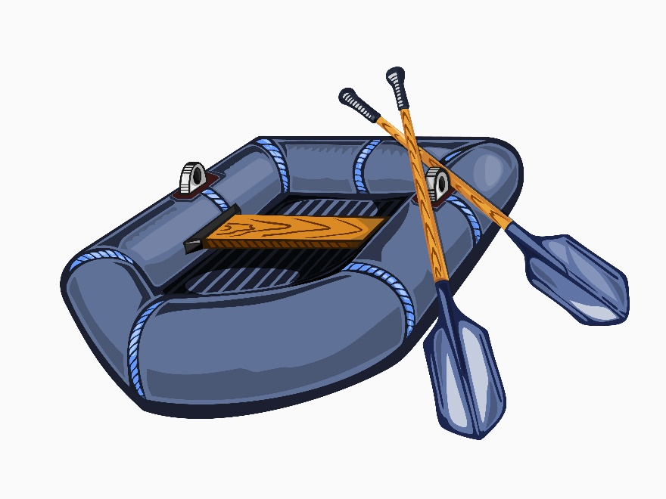
Skill | Examples | Crisis considerations
Open-Ended Inquiry | What are you feeling right now? How have you been coping? | Broad questions may be too vague. One question at a time. Avoid “why”.
Affirmations | You’ve been persistent in finding a solution. Forgiveness is important to you. | Builds protective factors. Growth mindset.
Reflections | You’re really frustrated with the process. A lot of things have happened and you want to be able to trust again. | Developing insight. Pause to allow processing.
Summary | Sometimes the stress is too much. It’s been really hard to stay sober and you want your kids back. Where should we go from here? | Invite client to give summary.

Slide 20
Arousal Continuum
Adapted from Dr. Bruce Perry’s The Boy Who Was Raised as a Dog
Internal State
Cognitive Style
Regulating Brain Region
Dissociative Continuum
Arousal Continuum
Sense of Time
CALM
ABSTRACT
NEOCORTEX Cortex
REST
REST
EXTENDED FUTURE
ALERT
CONCRETE
CORTEX Limbic
AVOIDANCE
VIGILANCE
DAYS HOURS
ALARM
EMOTIONAL
LIMBIC Midbrain
COMPLIANCE Robotic
RESISTANCE Crying
HOURS MINUTES
FEAR
REACTIVE
MIDBRAIN Brainstem
DISSOCIATION Fetal Rocking
DEFIANCE Tantrums
MINUTES SECONDS
TERROR
REFLEXIVE
BRAINSTEM Autonomic
FAINTING
AGGRESSION
NO SENSE OF TIME
Notes:
Brain functions are state dependent. So, our level of arousal is dependent on our internal state. In Dr. Bruce Perry’s book “The Boy Who was Raised as a Dog,” he explains the internal states as such:
When we are calm, we can think abstractly, if we are on the dissociative or arousal continuum, we are at rest and can think about our extended future.
Most people are in a state of Alert when they are at work. In this state, we think concretely. The cortex regulates our behavior in this state. If you happen to fall on the dissociative continuum, you may avoid things in this state. If you fall on the arousal continuum, you may be vigilant.
The next level is that of alarm. In this state our cognitive style is more emotional as the limbic or midbrain is regulating our behavior. For those on the dissociative continuum, you may see robotic compliance. For those on the arousal continuum, you may see resistance and crying. In this state, the persons sense of time is only hours or minutes.
The next level is that of fear. In this state, people are very reactive. Their midbrain is regulating their behavior. You may see dissociation or defiance and tantrums in this state. At the moment that someone is in the state of fear, fight flight or freeze kicks in . They are in survival mode and can only think through the next few minutes or seconds, as they are only interested in protecting themselves from the imminent danger.
The last level is that of terror. In this state, people are reflexive. The brainstem is regulating. You may see fainting or aggression. People in this state have NO SENSE OF TIME. So asking them to think about the consequences of their action or trying to intervene at this exact moment is a waste of your breath. The way to intervene when someone is in the state of terror is to have them try to move to move to a more regulated state.

Slide 21
TI-MI Applications
24-year-old Male
Scheduled Out patient Treatment each week, inconsistent attendance
Diagnosis: Anxiety D/O and Marijuana Dependence
No family contact
Couch surfing since lost apartment 2 months ago
Lost job 3 months ago due to losing temper with customer
Shows up at clinic demanding to talk to PCP on Wed at 1pm, missed Tues appt
Girlfriend broke up with him this morning
Notes:
Give examples of what this person might say or think in the different states in the arousal continuum.

Slide 22
Discuss a case example
Practice using MI Spirit and skills.
How do these strategies support the principles of trauma informed care?

