Slide 1
For the trainer:
Please note this slide deck is not a train the trainer presentation with fully developed scripts and exercises. These slides and accompanying notes are offered as suggestions. Slides may be used separate from the slide deck and in a different order than how they are currently presented.
If slides are used, please use the citation below and maintain all original citations found on the slides.
National Council for Behavioral Health. Fostering Resilience and Recovery: A Change Package for Advancing Trauma-Informed Primary Care. 2019.

Slide 2
Trauma and the Connection to Health and Addictions

Slide 3
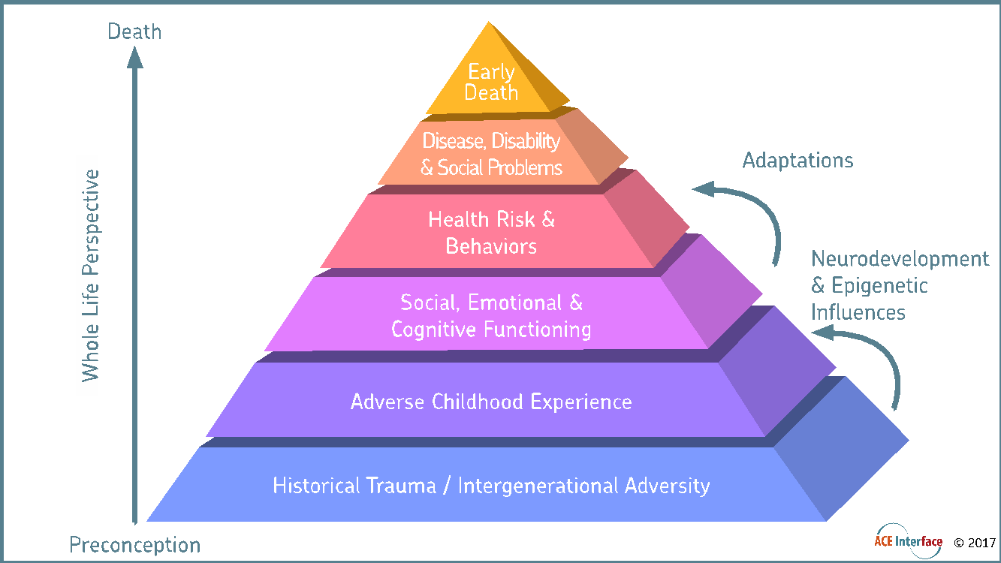
The Adverse Childhood Experience Study- Behavioral Heath at the Foundation of all Health
Over 17,000 adults studied from 1995-1997
Almost 2/3 of participants reported at least one ACE
Over 1/5 reported three or more ACEs, including abuse, neglect, and other types of childhood trauma
Major links identified between early childhood trauma and long-term health outcomes,
Including increased risk of many chronic illnesses and early death
Notes:
In the mid-1990s the Center for Disease Control and Prevention and Kaiser Permanente partnered to do a study. They screened over 17000 adults, mostly middle-class, college-educated, employed, Caucasians, for 10 adverse childhood experiences also called ACEs before the age of 18. They were looking to see if there was a correlation between these childhood experiences and the negative health outcomes that they were seeing in their population. What they found was that almost 67% of the individuals screened had experienced at least one ACE and over 20% had experienced three or more ACEs before the age of 18.

Slide 4
Adverse Childhood Experiences
Child physical abuse
Child sexual abuse
Child emotional abuse
Physical neglect
Emotional neglect
Mentally ill, depressed or suicidal person in the home
Drug addicted or alcoholic family member
Witnessing domestic violence against the mother
Loss of a parent to death or abandonment, including abandonment by divorce
Incarceration of any family member

Slide 5
Dose-Response Relationship: More ACEs = More Disease
Response gets bigger
Dose gets bigger
Notes:
What the ACE Study found is there is a dose-response relationship between the ACE score and many health outcomes across the lifespan, including smoking, obesity and heart disease. The more adverse events in childhood, the more the chance of poor health outcomes in adulthood. If you give your car a bigger dose of gas, you can drive more miles. When the population has a bigger dose of adverse childhood experience, there is more disease. And when the population has a bigger dose of disease, there is earlier death. Those with three or more ACEs are said to die 25-35 years earlier than the general population.

Slide 6
Higher ACE Score Increases Smoking
6 of 100 people with 0 ACEs smoke
11 of 100 people with 3 ACEs smoke
17 of 100 people with 7 ACEs smoke
Notes:
This slide helps us to understand how the dose-response relationship between ACEs and smoking really works.
Imagine 100 people who are all ACE-free. 6 of them smoke. You can think of these as the people who will smoke whether or not there are ACEs in the world. Their smoking may be caused by genetics, or access to cigarettes, or learning to smoke young because the adults around them smoke. These are also the people who tend to quit when presented with information about the dangers of smoking.
Now imagine 100 people who have each had THREE ACEs. 11 of these individuals smoke. As you can see, the risk of smoking increases with ACEs.
Now imagine 100 people with SEVEN ACEs. 17 of these individuals smoke. The risk accumulates as the ACE score increases. The portion of smoking that is attributable to ACEs is tied to this change in risk.

Slide 7
ACEs and Adult Alcohol Use Disorder
0
1
2
3
4+
Notes:
A 500% increase in adult alcoholism is directly related to adverse childhood experiences.
Two thirds of all alcoholism can be attributed to adverse childhood experiences

Slide 8
https://www.ted.com/talks/nadine_burke_harris_how_childhood_trauma_affects_health_across_a_lifetime?utm_campaign=tedspread&utm_medium=referral&utm_source=tedcomshare

Slide 9
Life-Long Health Outcomes Linked to ACEs
Intimate partner violence—perpetration & victimization
Liver disease
Lung cancer
Obesity
Self-regulation & anger management problems
Skeletal fractures
Suicide attempts
Work problems—including absenteeism, productivity & on-the-job injury
Alcohol, tobacco & other drug addiction
Auto-immune disease
Chronic obstructive pulmonary disease & ischemic heart disease
Depression, anxiety & other mental illness
Diabetes
Multiple divorces
Fetal death
High risk sexual activity, STDs & unintended pregnancy
Centers for Disease Control and Prevention. Adverse Childhood Experiences (ACEs).
Retrieved from http://www.cdc.gov/nccdphp/ace/pyramid.htm
Notes:
Here’s a list of potential life-long physical, mental and behavioral health outcomes that have been linked to ACEs.

Slide 10
13 of every 30 students in a classroom will have toxic stress from 3 or more Adverse Childhood Experiences (ACEs)
ACEs Too High, 2012, May 31. Massachusetts, Washington State lead U.S. trauma-sensitive school movement. Retrieved from https://acestoohigh.com/2012/05/31/massachusetts- washington-state-lead-u-s-trauma-sensitive-school-movement/
Notes:
Here’s a study that took the ACEs data and applied it to children. In the state of Washington, they found that 13 of every 30 students in a classroom have toxic stress from 3 or more ACEs.

Slide 11
Adverse Childhood Experiences
The #1 Chronic Health Epidemic
in the United States
“The impact of ACEs can now only be ignored as a matter of conscious choice. With this information comes the responsibility to use it.”
-Anda and Brown, CDC
Notes:
It is now being stated that ACEs are the number one chronic health epidemic in the United States.

Slide 12
“If you knew how excruciatingly uncomfortable it is to live in my own skin, you would understand why I do not want to be present in my body and in this world.”
- Anonymous
Notes:
Some version of this statement is, unfortunately, a heartbreakingly common thought often expressed by someone coping with addiction. It is also heartbreakingly common among those with unresolved trauma. Research continues to show that both trauma and addiction create an internal war fueling physical, psychological, emotional, and spiritual chaos. When trauma and addiction intersect, a person becomes tangled in a self-perpetuating cycle that must be fully and holistically addressed in order to allow healing from such pain and discord.

Slide 13
Trauma is a risk factor for Substance Abuse
Substance Abuse is a risk factor for Trauma
Notes:
Trauma as a risk factor for substance abuse According to the self-medication hypothesis of substance abuse, people develop substance abuse problems in an attempt to manage distress associated with the effects of trauma exposure and traumatic stress symptoms.
Substance abuse as a risk factor for trauma Numerous epidemiological studies have found that, for many adolescents (45%–66%), substance use disorders precede the onset of trauma exposure.
Trauma may cause an individual to develop an addiction that relieves intense feelings and pain, and individuals who are abusing substances may more often put themselves in harms way which leads to increased incidences of trauma.
To more fully explore this link between trauma and addiction, it can be helpful to first develop a working definition of what constitutes addiction and trauma. What is your definition of addiction?

Slide 14
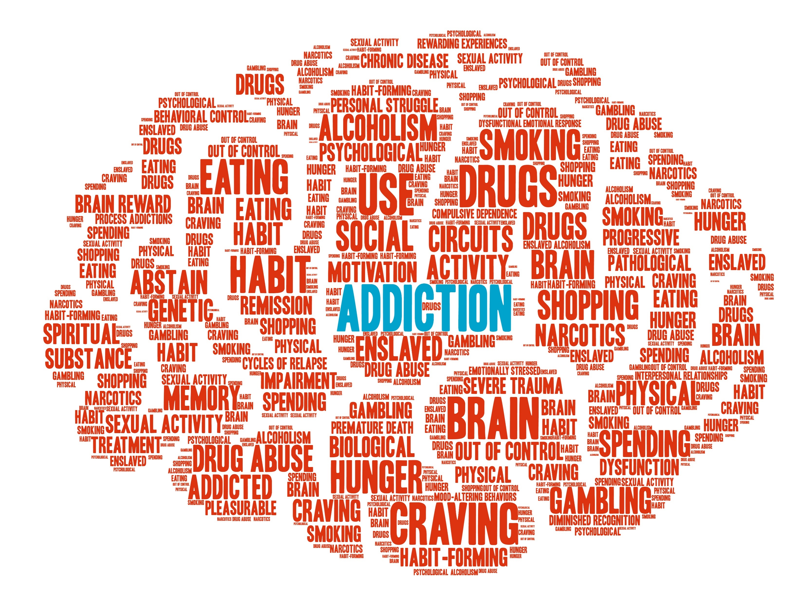
Gabor Mate’s Definition of Addiction
Any behavior that is associated with:
Craving and temporary relief
Long-term negative consequences
That a person is unable to give up
Early emotional loss is the template for all addictions

Slide 15
Addiction and the Brain
As Gabor Mate notes in his book, In the Realm of Hungry Ghosts, those with substance use disorder
“self-medicate to sooth their emotional pain – but more than that, their brain development was sabotaged by their traumatic experiences.”
-Mate, Gabor, MD. (2010). In the Realm of the Hungry Ghosts. Berkley, CA: North Atlantic Books. Print. page 203.

Slide 16
Shame is the intensely painful feeling or experience of believing that we are flawed and therefore unworthy of love and belonging – something we’ve experienced, done, or failed to do makes us unworthy of connection.
-Brene Brown
Notes:
Shame is the intensely painful feeling or experience of believing that we are flawed and therefore unworthy of love and belonging – something we’ve experienced, done, or failed to do makes us unworthy of connection. Brene Brown

Slide 17
“An addict needs shame
like a man dying of thirst needs salt water.”
-Terrence Real
Notes:
As a note, we are moving away from using the term “addict”, but instead using terminology such as “an individual who experiences addiction.” We leave this quote as is, but it is important to note the term “addict” can be unhelpful.

Slide 18
What can we do?
Medications
Recovery coaches
Technology
Prioritize the relationship
Seek ways to build connection
Embrace compassion instead of punishment

Slide 19
https://www.youtube.com/watch?v=PY9DcIMGxMs
Notes:
We are now going to watch a video that gives a different perspective of addictions.
Thoughts? What do you think about his perspective?
https://www.youtube.com/watch?v=PY9DcIMGxMs

