Slide 1
For the trainer:
Please note this slide deck is not a train the trainer presentation with fully developed scripts and exercises. These slides and accompanying notes are offered as suggestions. Slides may be used separate from the slide deck and in a different order than how they are currently presented.
If slides are used, please use the citation below and maintain all original citations found on the slides.
National Council for Behavioral Health. Fostering Resilience and Recovery: A Change Package for Advancing Trauma-Informed Primary Care. 2019.

Slide 2
Compassion in our Work and our World Secondary Traumatic Stress and Staff Self-Care

Slide 3
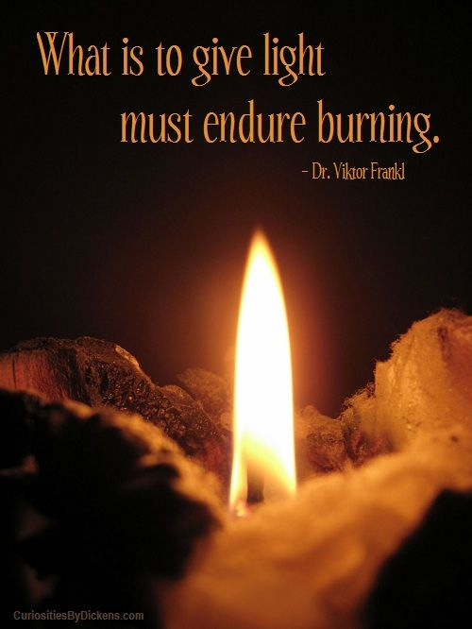
Notes:
As professionals who provide care it is helpful to be reminded of Viktor Frankl's poignant statement, "What is to give light must endure burning...“ Quality care, as we know, requires empathy which means exposing ourselves to the trauma and suffering of those whom we are seeking to assist. For treatment and services to be effective for the long haul, professionals will need to maintain active personal self-care--but equally important is the less frequently discussed necessity for organizations to create effective structures of care for staff.

Slide 4
Staff and Providers
Often have their own traumatic histories
Seek to avoid re-experiencing their own emotions
Respond personally to others’ emotional states
Perceive behavior as personal threat or provocation
Notes:
We have to remember that the ACEs Study and all the other research about trauma, does not distinguish between client and staff. Therefore all of the data we have seen (67% of population had at least 1 ACE before the age of 18, etc) includes everyone, the people we serve and the people we serve next to.

Slide 5
Work Force Concerns
Compassion Fatigue
Secondary Traumatic Stress
Vicarious Trauma
Burnout
Notes:
Secondary Trauma or traumatic stress refers to the presence of PTSD symptoms caused by at least one indirect exposure to traumatic material. Some of the symptoms include nightmares, bad memory, insomnia, hopelessness, no focus, irritability, shame, etc.
Compassion fatigue is a less stigmatizing way to describe secondary trauma and can be used interchangeably with STS.
Vicarious trauma refers to changes in the inner experience of the staff member resulting from empathic engagement with a traumatized client. It focuses on the covert cognitive changes that occur following cumulative exposure to another person’s traumatic material.
Burnout is characterized by emotional exhaustion, depersonalization and a reduced feeling of personal accomplishment. While it is also work-related, burnout develops as a result of general occupational stress. The term is not used to describe the effects of indirect trauma exposure specifically.

Slide 6
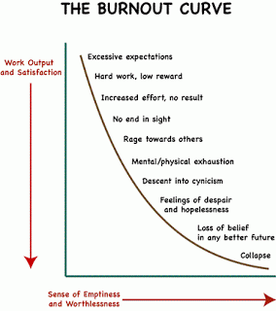
Source: Adapted from Coyote, C. (2006). Slow leadership. Retrieved May 25, 2018 from https://sites.google.com/site/teacherburnoutandresources/home​
Notes:
individuals who are experiencing workplace burnout frequently experience the following:
Every day seems to be a ”bad” day
Reduced empathy towards those you serve
General apathy towards work or home life
Exhaustion all the time
The majority of the day is spent on tasks that are either mind-numbingly boring or, in contrast, overwhelming
Nothing makes a difference
The problem with the burnout curve is that it is extremely hard to climb back up, once you have slipped down.

Slide 7
Is “burnout” an ethical problem?
Notes:
The answer to this question is yes. In all human service work, the core ethic is to do no harm. If we are cynical, unfocused, etc, we are not able to provide our best selves and quality service to our clients and in doing so may cause harm. So it is our responsibility to check in with ourselves and our co-workers regarding where they are on that burnout curve and to hold each other accountable as well.

Slide 8
Warning Signs
Thinking the worst in every situation
Reacting disproportionately
Never taking a vacation
Forgetting why you do your job
Decreased performance
Constantly not getting enough sleep
Increased arguments with your family
Decreased social life

Slide 9
Compassion Resilience
Compassion Satisfaction
The ability to maintain our physical, emotional and mental well-being while responding compassionately to people who are suffering
The ability to experience pleasure from doing the work
Notes:
Compassion satisfaction, which is what we want staff to experience, refers to the positive feelings derived from competent performance as a professional. It is characterized by positive relationships with colleagues and the conviction that ones work makes a meaningful contribution to patients and society.

Slide 10
Building Resilience - Individual and Organizational
Expectations
Boundary Setting
Staff Culture
Self-Care
Realistic ones for yourself
Realistic ones for others
Know what you want/can say ‘yes’ to
Connecting with colleagues in a way that heals & helps
Mind
Spirit
Strength
Heart
https://compassionresiliencetoolkit.org/
Notes:
There are 4 steps in the process of building compassion resilience listed on this slide.
Know and understand their own expectations as well as those of colleagues and the broader system.
Set and maintain healthy personal and system-wide boundaries.
Create a culture of compassionate resilience that is embedded in all aspects of their work.
Practice self-care to prevent and minimize compassion fatigue within themselves.
Each of these steps is described fully in the Compassion Resilience Toolkit where you will also find activities to dig deeper into each area.

Slide 11
Individual
Organization
Mind
Body
Spirit
Strength
Colleague relationships
Organizational compassion
Community collaboration
https://compassionresiliencetoolkit.org/
Notes:
Personal self-care occurs within an organization’s culture and system. Employees self-care impacts the culture just as the culture impacts their personal wellness.
Working on the organization’s wellness is imperative to increasing the compassion resilience and wellness of each of the employees. On this slide are the components of personal and system wellness.
To create and maintain healthy employees and a healthy system all of the areas need to be addressed.

Slide 12
Unclear, hidden or unrealistic expectations drive compassion fatigue
https://compassionresiliencetoolkit.org/

Slide 13
Understanding your expectations
What positive role do expectations play?
What impact have your unrealistic self-expectations had on your well-being?
What has the impact been of others’ unrealistic expectations of your capacity?
How do you assess if expectations are set at a helpful, aspirational level?
https://compassionresiliencetoolkit.org/
Notes:
Section 5 of the Compassion Resilience Toolkit explores the role of expectations in our ability to remain strong in our compassion without over or under committing ourselves.

Slide 14
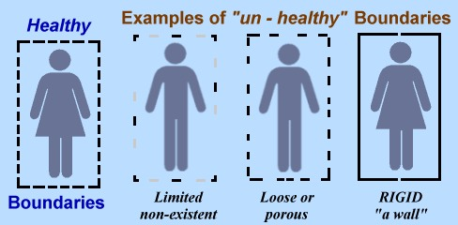
Boundaries - What’s OK and What’s Not OK
Source: Kristi Holl, How Healthy Are Your Boundaries? Retrieved 11/1/2019 from https://www.kristiholl.com/how-healthy-are-your-boundaries/​
Notes:
Signs of poor boundaries:
Too close
Avoid conflict
Victimhood
Distant
Behavior and Beliefs in Relationships that Might be Signs of Ignored/Unestablished Boundaries:
Too close – total dependence, “I need your approval and support 100% of the time.”
Avoid conflict - “If I ignore it, it will go away eventually.”
Victimhood – Identify self as the victim, “I have no power.”
Distant – Due to past real or perceived violations, one is fiercely independent, “I dare you to come close!” or shies away from openness with others
Invisibility – Not wanting to be seen or heard so that boundaries are not violated
(revised from livestrong.com/article/14718-building-healthy-boundaries/)
Three Types of Boundaries:
Permeable – A boundary is set but there is very little reinforcement of the boundary. For most of us, having overly permeable boundaries will allow unwanted emotional and mental assault from others and may mean that we are letting too much of ourselves out, limiting our privacy and self-care.
Rigid – These are the boundaries that you reinforce at all costs. Too rigid boundaries do not allow us to be open to new ideas or perspectives and can often keep us in the dark and unapproachable.
Flexible – Flexible boundaries are firm and clear yet open to new ideas and resources when needed. They are also sufficiently closed to protect us from harm

Slide 15
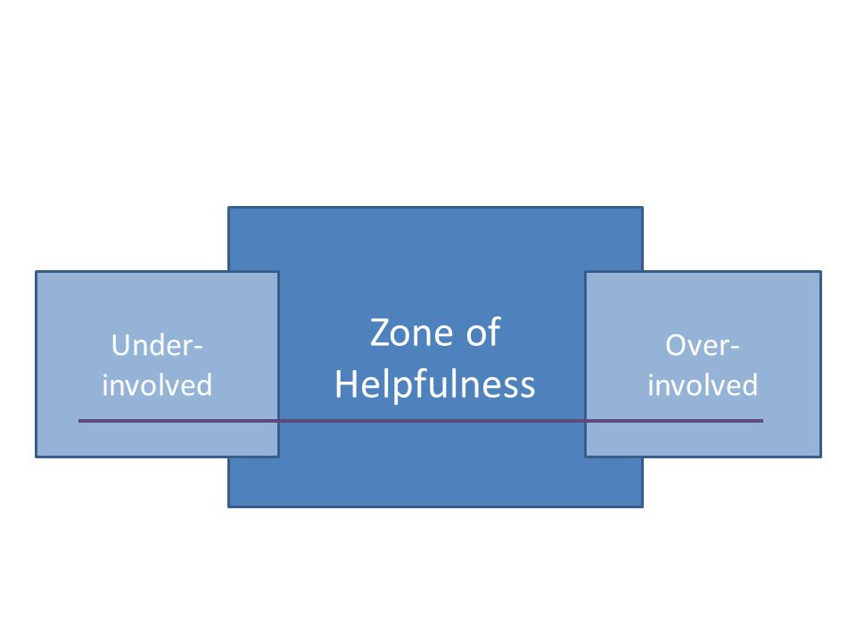
Compassionate Boundary Setting
https://compassionresiliencetoolkit.org/
Notes:
Begin by brainstorming the attitudes and behaviors at your organization that you believe fit into three categories-
those that show a lack of involvement in the work,
those that are important to the mission and well-being of the organization,
those that show over-involvement in the work.
Focus more on behaviors than attitudes- ask yourself for example, “What behavior would demonstrate this attitude?”

Slide 16
Tips for Setting Compassionate Boundaries
Know what you want to say “Yes” to in your life (values and priorities).
Be proactive. Have “meetings” to discuss boundaries. Structure offers safety for both sides.
Just say it! Don’t make them guess. Use simple and direct language.
Reinforce by pointing out the violations IN THE MOMENT.
Give explanations that are specific, relevant to the other person, and offer shared solutions.
Back up your boundary with action. If you give in, you invite people to ignore your needs.
https://compassiocnresiliencetoolkit.org/
Notes:
Go over points on slide.
Give some examples based on the behaviors they identify as helpful:
Example: Helpful Behavior (what they want to say YES to) – Welcoming clients when they come into the building. Boundary – I prioritize my focus on being present when I am in the hallways above all other options. Stating the boundary in the moment - “I’d like to discuss this when we get to the meeting room because I like to focus on welcoming our visitors. Will that work for you?” Possible organizational policy that would support this shared boundary – Keep work and personal conversations to a minimum when in the hallways. Use our offices and staff break areas for such conversations.

Slide 17
Set a boundary with a colleague that complains too much about what you cannot control:
“I am working on showing up with good energy for my clients, I find that talking too much about what I can’t control makes that hard for me. Let’s switch topics.”
https://compassiocnresiliencetoolkit.org/
Notes:
Script:
What’s okay and what’s not okay. Boundaries are about respect.:
Division between our personal and professional selves/thoughts and those of our students, parents, and colleagues/policies of our school, among many other possible distinctions.
Mindful of professional responsibilities
Treating students with respect—in the middle of the zone of helpfulness
Accepting school police
Persons impacted by trauma have little understanding of what a boundary is.
Need to communicate in a proactive manner.
Examples of simple and direct language for boundaries
To set a boundary with a colleague that complains too much about what you cannot control:
“I am working on showing up with good energy for my students, I find that talking too much about what I can’t control makes that hard for me. Let’s switch topics.”
To set a boundary with someone who takes more ideas/assistance than they give:
“I wouldn’t be here if it weren’t for the collaboration I have had with other teachers. I am happy to offer you advice and want to be sure that I also learn a few tricks from you. I’d love to know how you approached _________.”
To set a boundary with someone who seems to always share bad news:
“I am making it a priority to find things to laugh about this year. Humor and positivity are how I make it through the year in good shape! I need you to bring some funny stuff along with the bad news. Want to hear what made me laugh yesterday?”
To set a boundary with an angry person:
“I cannot think when your voice is so loud. I will need to talk to you later if you cannot soften your voice.”
To say no to extra commitments:
“Although our schoolwide goals for the year are important to me, I need to decline your request for me to volunteer in order to honor my family’s needs.”
To set a boundary with someone who is critical without your permission:
“It’s not Ok with me that you comment on my teaching practices without my permission or request, I’d like to ask you to stop.”
To buy yourself time when making decisions:
“I find I make my best decisions when I have time to think them through; I’ll need a day to think on it.”
What drains your energy? How can you address that in a way that helps others understand?

Slide 18
Empathy
The ability to understand and share the feelings of another
Notes:
We need to practice empathy with each other.

Slide 19
Boundary language examples
To respond to angry patient:
“I want to work with you to figure this out. It will be hard if our brains are not calm enough to think. How about we take a 5 minute break?”
To say no to extra commitments:
“Although our team goals are really important to me, I need to discuss what can come off my plate or what I can do in a different manner in order to take on anything new. I am working on how to balance my family’s needs and my workload.”
https://compassionresiliencetoolkit.org/
Notes:
Further examples…

Slide 20
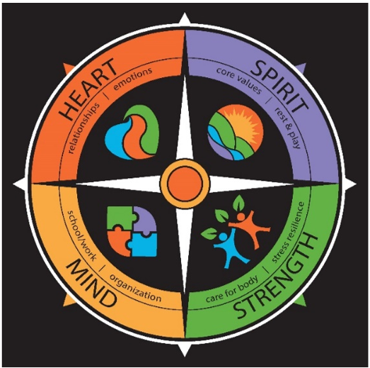
Compass Model of Wellness
Individual Self-Care
https://compassionresiliencetoolkit.org/
Notes:
Julie
Mind
Work/School - the ability to get the most out of educational, volunteer, and employment opportunities
This area of wellness focuses on having meaningful work to do (or schooling, if we are a student). All of us have unique gifts and talents. We will find our work to be most meaningful when we feel that we are actively engaging our gifts and talents to make a positive impact. Working in a setting that supports and celebrates our work adds to our sense of well-being.
The other factor that will influence our wellness in this area is what is often referred to as work-life balance. If we find that our work is consistently taking over too much of our personal time, we, or others we are close to, may become exhausted and resentful.
Fatigue in this area of wellness usually shows up in either doing work that we do not feel makes good use of our gifts and talents, or because work has taken over our personal lives and we find ourselves feeling resentful toward our work.
Resilience in this area of wellness comes from being able to find a balance of time and focus between meaningful work and our personal life.
_____
Organization - the ability to manage time, priorities, money, and belongings
This area of wellness has to do with how we manage our time, our money, our priorities, and our “stuff.” Disorganization can both cause us to feel stressed and it can be a symptom of stress as well. Teachers see this first hand in their students, and the same good habits of organization that serve students well, also serve adults well. Given the number of books on organizing clutter that are best sellers, it appears that being organized is a challenge for most of us these days.
Fatigue in this area of wellness can show up in any of the following ways: being chronically late for appointments, forgetting to pay bills, forgetting or being
late for assignments, and having an excessively messy work or home environment.
Resilience in this area of wellness is characterized by being well organized regarding our time, money, environment, and priorities. We don’t overcommit or
over-schedule ourselves and we follow through on plans and assignments. And we regularly make time in our lives to be organized.
Spirit
Core Values - the development of a personal value system that supports your sense of meaning and purpose
Our core values are those values, ideals, and beliefs that are at the center of our identity. Our core values serve as an inner compass that guide us in the important decisions that we make, including the career we choose and the people we choose to commit to as friends and family.
Core values are not just relevant in our personal lives, they are also important in our work lives. It is not uncommon to find businesses, organizations, and schools that publicly state the core values that guide their mission, the reasons they do what they do. Again, these core values serve as a compass for guiding important decisions.
Fatigue in this area of wellness will occur whenever we find ourselves acting or living in ways that are contrary to our core values. We will also become fatigued if we find ourselves working in systems whose core values are at odds with our personal core values.
Resilience in this area of wellness is experienced when we are living and working in alignment with our core values. When the direction we are headed in aligns with our inner compass, we will experience an overall sense of well-being
Rest & Play - the ability to balance work and play to renew oneself
There is a wonderful story about two lumberjacks cutting down trees all day using an old fashioned, two-handed saw. They push and pull the saw all day until by mid-afternoon they find that their efforts are no longer producing results. While they were able to cut through trees with ease in the morning, they now can’t make any progress at all. Suddenly the problem becomes clear. They have been so focused on working so hard that they never took a break to sharpen their saw. As they discovered, it’s impossible to cut down a tree with a dull saw.
Like the saw in this story, we can become dull when we work too hard or do not stop to rest and renew ourselves on a consistent basis. Like the two lumberjacks, we can easily get so focused on all the “trees” that need to be cut in our lives, that we completely forget the importance of rest and play as ways to sharpen our saw.
Fatigue in this area of wellness often shows up as being chronically tired and irritable from working too many hours and never being able to turn work off, even when not at work.
Resilience in this area of wellness comes from engaging in activities that are truly re-creative of our bodies and our spirits, those activities that sharpen our saws.
Strength
Stress Resilience - the ability to deal positively with the challenges of life
Viktor Frankl, an Austrian psychiatrist who survived the Holocaust, wrote in his best-selling book, Man’s Search for Meaning, “Between stimulus and response there is a space. In that space is our power to choose our response. In our response lies our growth and our freedom.”
Frankl makes the point that what he learned from his time in a concentration camp is that no matter how bad things are around us, nothing can ever take away the fact that we still have a choice about how we will respond.
Research shows that one of the most important factors in being resilient in the face of significant stress is having a supportive community of people to lean on. When it comes to facing stress, it seems that one of the most important responses we can choose is to turn to others for support rather than trying to go it alone.
Fatigue in this area of wellness usually shows up when we find ourselves facing stress alone, isolated from others. At such times we are much more likely to react to stress rather than respond, which can actually have the effect of increasing our stress.
Resilience in this area of wellness is highly correlated with our ability to ask for help from others and to create emotional space and perspective where we can respond to our stress in ways that are productive.
Care for Body - the ability to build healthy habits around your physical well-being and to end unhealthy habits
Most of us are well aware of what it takes to take good care of our bodies, of our physical wellness. Doing those things, is of course, a different matter! Making consistently good decisions about our diet, exercise, and sleep, while not easy, will always pay off as we find ourselves with increased energy.
Stress can cause anyone to make bad choices in regard to their physical wellness. At such times fast food or an extra drink can seem like just the comfort we need. The paradox is that we quickly find that such short term comfort produces long term discomfort in our physical wellness.
Fatigue in this area of wellness shows up as literal physical fatigue. We may find it hard to get out of bed in the morning and hard to get through the day. Our bodies will always tell the truth about how we are treating them.
Resilience in this area of wellness will show up as increased vitality and energy. It’s not about perfection when it comes to caring for our bodies. Just a basic and consistent practice of eating well, getting a moderate amount of exercise, and consistently getting a good night’s sleep will pay large dividends in our physical wellness.
Heart
Relationships - the ability to create and maintain healthy connections with others
Few things affect the quality of our lives more than the quality of our relationships. When our wellness in this area is high we experience trust, integrity, honesty, commitment, and kindness in our relationships.
Like all areas of wellness, relationships—both work and personal—need tending on a regular basis. Our relationships are like a garden. When we water them they grow and flourish. When we neglect them, they wilt. All relationships have challenges at times. Healthy relationships are ones that face those challenges, and if necessary, seek help to overcome them.
Fatigue in this area of wellness can show up as increased conflict in one or more of our important relationships. If we find ourselves pulling away from others and failing to nurture important relationships, that is probably a sure sign of fatigue.
Resilience in this area of wellness is seen in having a variety of relationships, both personal and work-related, that are mutually satisfying. These relationships are life giving to us and are characterized by trust, integrity, honesty, commitment, and kindness.
Emotions - the ability to express your emotions and receive others’ emotions in a healthy way
Our emotional wellness is high when we are able to do the following:
Feel and express the full range of emotions in a healthy manner
Adapt comfortably to change
Recognize when we are not handling emotions well
Recognize when we are “stuck” emotionally and asking for help to get unstuck
Understand the emotional “wake” we leave behind in our interactions with others
Maintain a sense of humor, keep a positive outlook on life, and not take ourselves too seriously
Fatigue in this area of wellness can manifest itself when we find ourselves chronically stuck in feelings of anxiety, sadness, irritability, or grief. While everyone feels these emotions at times, if we are feeling chronically stuck or shut down then we will benefit from seeking help from a mental health professional.
Resilience in this area of wellness means that we are able to feel and express the full range of emotions. While we may experience sadness or anxiety, these feelings pass, and we also equally feel joy and happiness. We have a sense of humor and avoid taking ourselves, and life itself, too seriously.

Slide 21
https://compassionresiliencetoolkit.org/
Notes:
The Compass Model of Wellness is found in the Compassion Resilience Toolkit

Slide 22
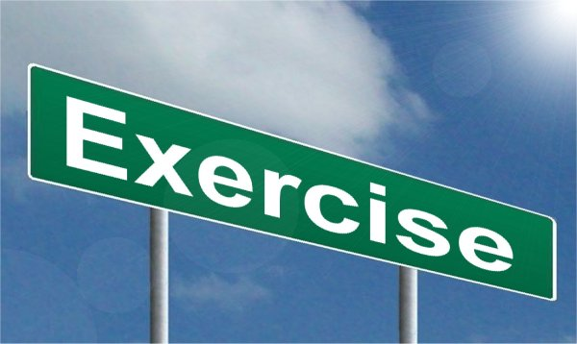
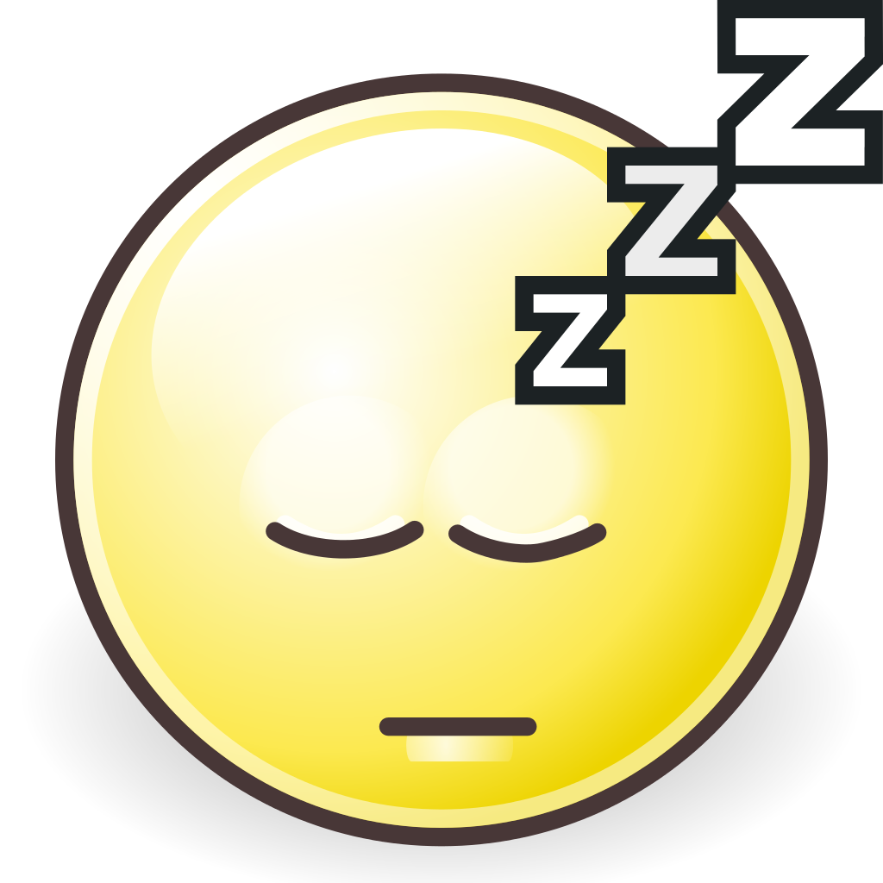
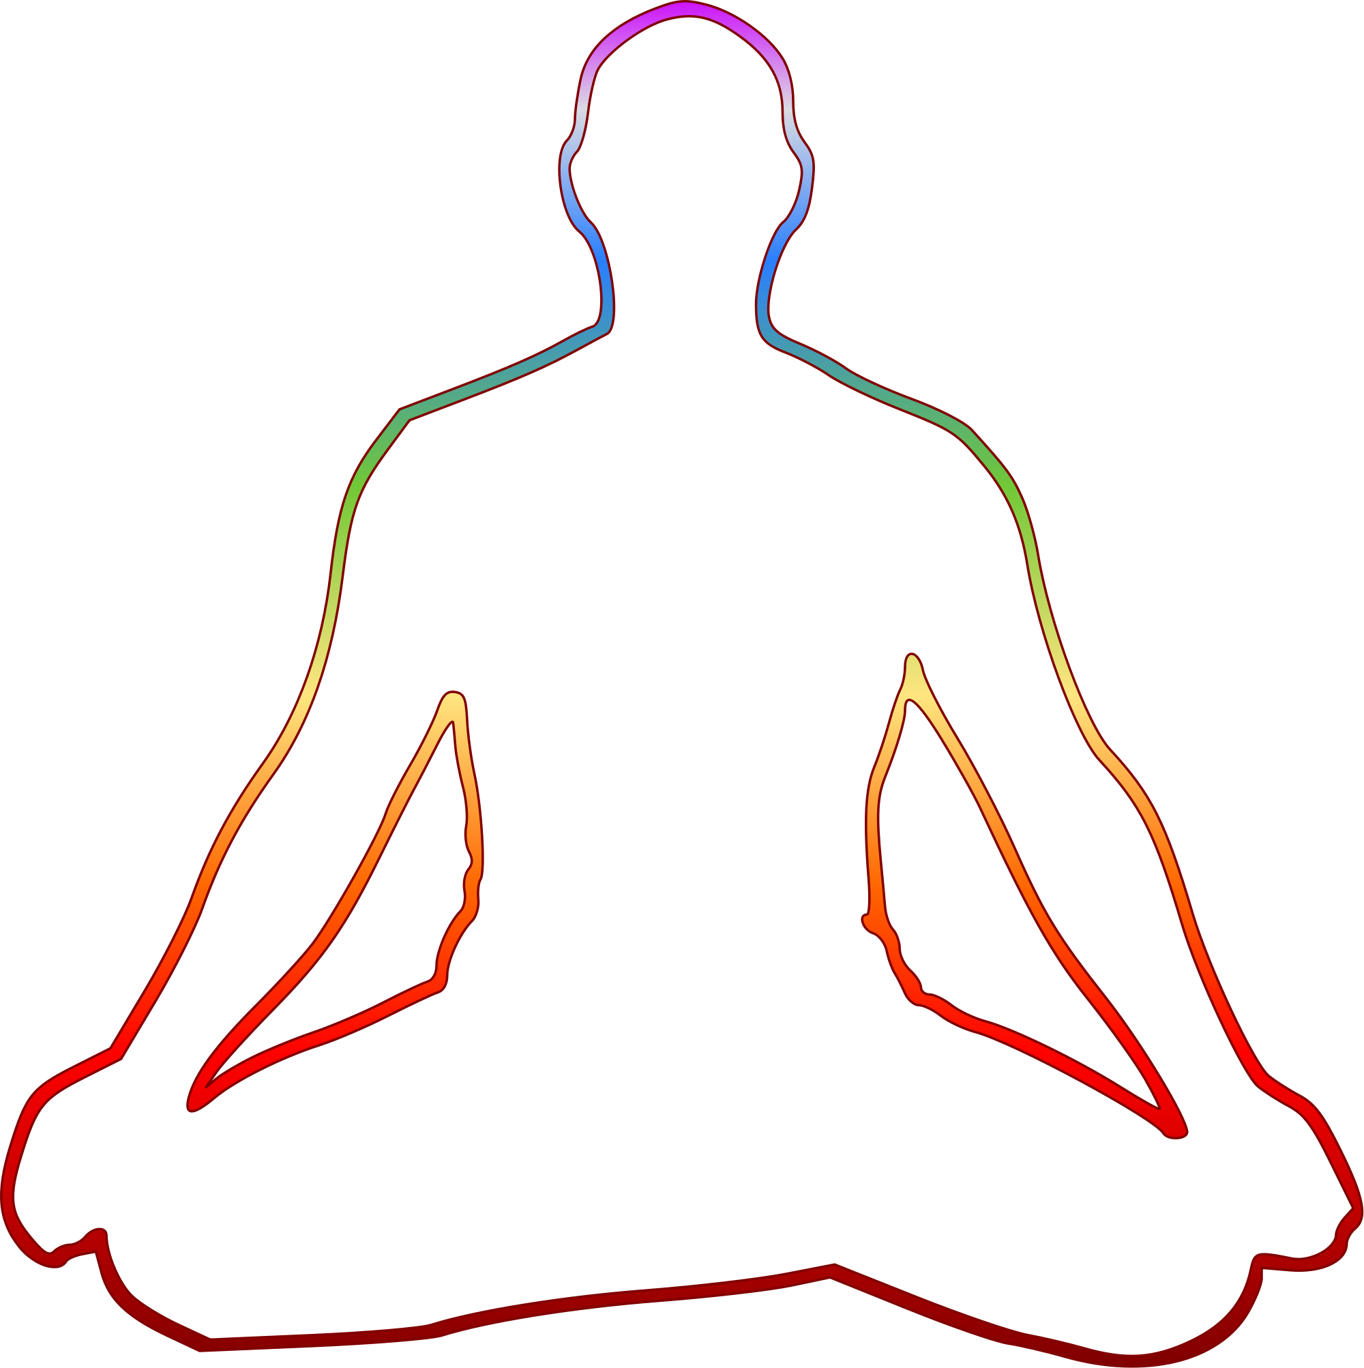
The Importance of Care for the Body
Notes:
Care for the body
Exercise
Eat healthy foods
Practice good sleep hygiene
Use mind body practices, such as yoga and meditation
Nurture healthy relationships

Slide 23
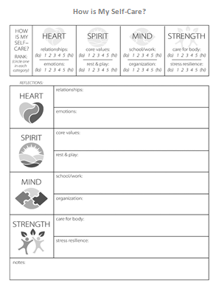
Compassion Resilience Reflection
How is my Self-Care?
https://compassionresiliencetoolkit.org/
Notes:
This reflection tool can be found in the Compassion Resilience Toolkit

Slide 24
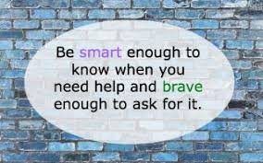
Asking for Help

Slide 25
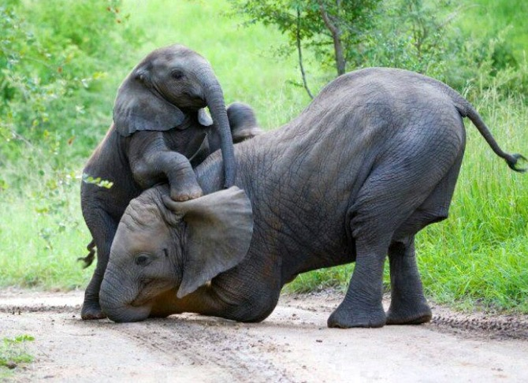
A Break for our SPIRIT
When do you feel most alive, most like yourself? What are you doing?
What or with whom are you surrounded?
Notes:
Ask participants to talk in pairs about what they are doing when they feel most alive – most like themselves. After 2 minutes, bring them back and discuss these points:
Raise you hand if you shared a situation of being at work (most will not)
Think about what that means for how well we know our colleagues
Think of when you feel most alive at work
When you go home form your work day, do you have a tendency to share what happened in your day that left you feeling most alive or what was most draining?

Slide 26
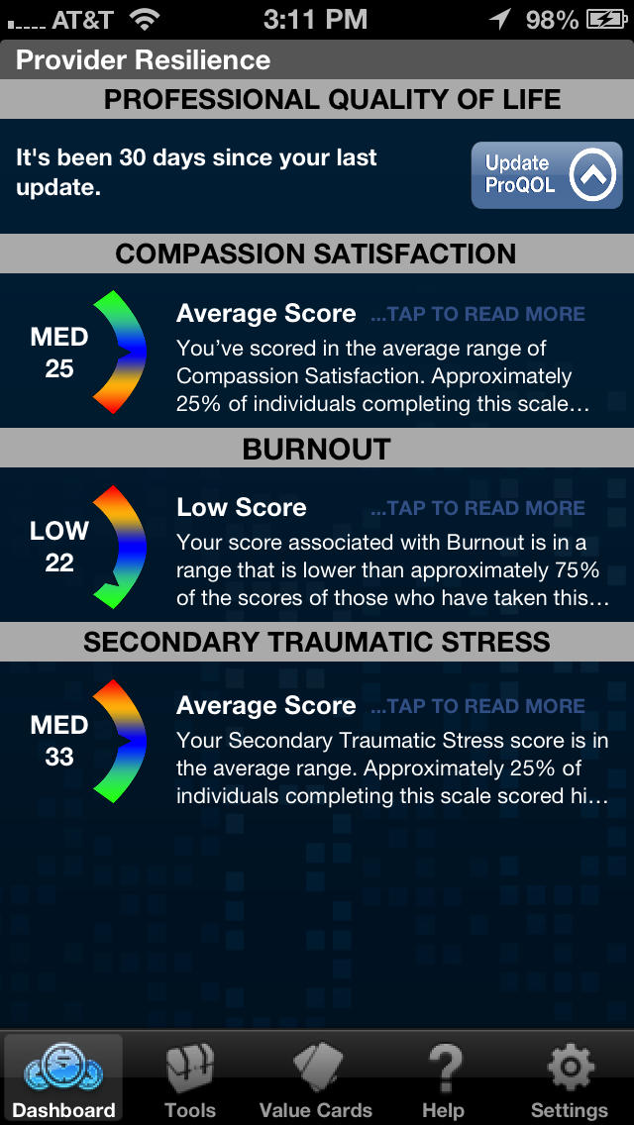
Provider Resilience App

