Slide 1
For the trainer:
Please note this slide deck is not a train the trainer presentation with fully developed scripts and exercises. These slides and accompanying notes are offered as suggestions. Slides may be used separate from the slide deck and in a different order than how they are currently presented.
If slides are used, please use the citation below and maintain all original citations found on the slides.
National Council for Behavioral Health. Fostering Resilience and Recovery: A Change Package for Advancing Trauma-Informed Primary Care. 2019.

Slide 2
Infusing Trauma into our Daily Work

Slide 3
We need to have
UNIVERSAL
Notes:
We need to presume the clients we serve, and the staff we serve next to, have a history of traumatic stress and exercise “universal expectations” by creating systems of care that are trauma-informed.
What are some behaviors we might use when we universally expect everyone to have a trauma history?

Slide 4
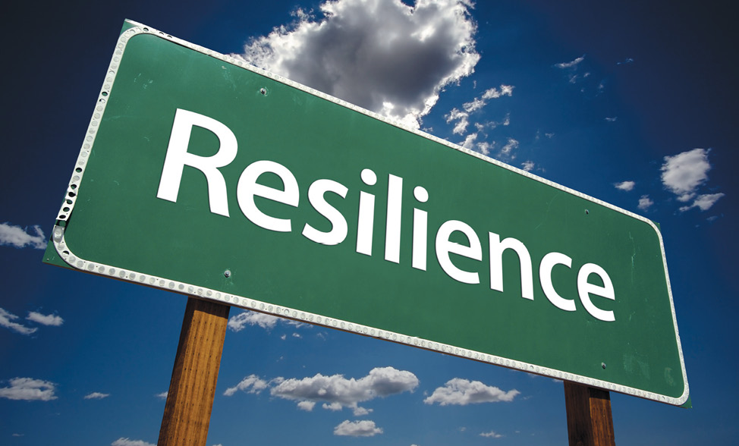
Ability to adapt well to stress, adversity, trauma or tragedy
Notes:
Another way to infuse trauma-informed care into your daily work is to promote resilience. Resilience is the process of adapting well in the face of adversity, trauma, tragedy, threats or significant sources of stress. It means "bouncing back" from difficult experiences.
Resilience involves behaviors, thoughts and actions that can be learned and developed in anyone. A combination of factors contributes to resilience. Many studies show that the primary factor in resilience is having caring and supportive relationships within and outside the family. Relationships that create love and trust, provide role models and offer encouragement and reassurance help bolster a person's resilience.

Slide 5
Defining Resilience
1. Emotional regulation: The ability to control our emotions, attention, and thus our behavior
2. Impulse control: The ability to manage expression of our feelings
3. Accurate identification of the cause of adversity
4. Self-efficacy: The sense that we can solve problems and succeed
5. Realistic optimism: Being positive about the future and realistic
6. Empathy: Able to read others behavior, to understand their states, and build relationship
7. Reaching out: The continued drive to take on more challenges and opportunities
Notes:
Shorthand definition: the capacity to recover from difficulties. But resilience really is comprised of a specific set of skills as noted on this slide.

Slide 6
Risk Factors
ACE’s
Poverty
Racism
Intergenerational trauma
Lack of support
Isolation
Hopelessness
Difficulty regulating emotions
Poor self-confidence
Poor problem solving skills
Protective Factors
Optimism
Faith
Sense of meaning
Self-efficacy
Flexibility
Emotional regulation
Empathy
Close relationships
Spirituality
Effective problem solving
Notes:
There are risk factors and protective factors to resilience, all listed on the slide. Our jobs in our daily work is to build the protective factors as much as possible and mitigate the risk factors.

Slide 7
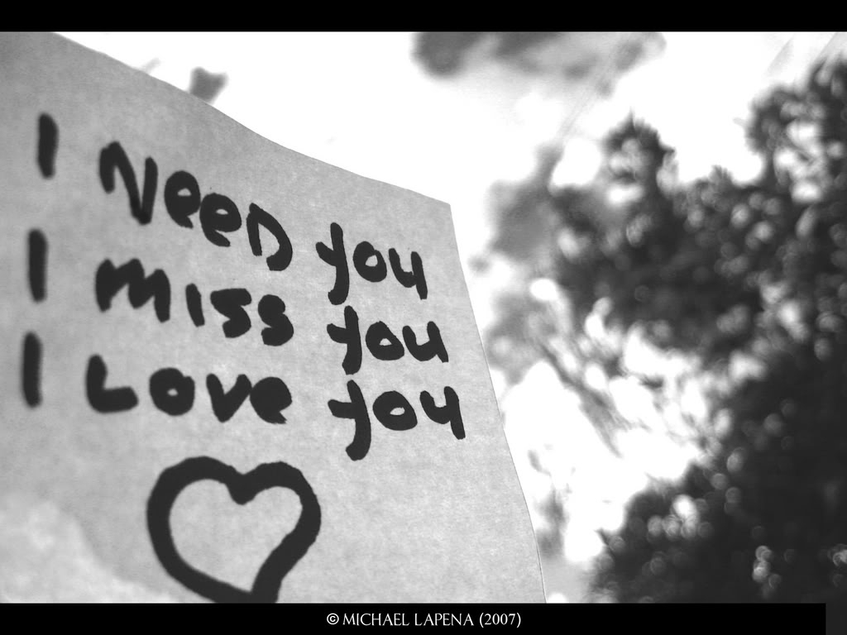
Promoting Resilience Involves Teaching

Slide 8
Language Matters
Vocabulary reinforces feelings and beliefs
Helps guide behavior
Leads to greater options for acting
Allows us to be able to recognize resilience in self/others
Notes:
The vocabulary of resilience is more than a set of words, it is a set of tools to use in promoting resilience. We help others identify resilient behavior… they use the vocabulary to reinforce those feelings and beliefs that support resilience and to guide their own behavior. The more concepts they understand, the greater their options for acting in ways that meet the crises in their lives with strength and hope. People who learn the vocabulary are better able to recognize resilience in themselves and others. They become increasingly aware of how to promote it.

Slide 9
Three Statements of Resilience
I Have…
a recognition of what is available
I Am…
a recognition of my value
I Can…
a recognition of mastery, sense of the future
-Strengthening the Human Spirit by Edith Grotberg, Ph.D., 1995
Notes:
Here are three statements of resilience that we can provide to our clients and communities to help them learn the language of resilience. Take a moment to create statements of resilience for yourself.

Slide 10
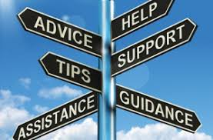
I Have (external supports)
People around me I trust and who love me, no matter what
People who set limits for me so I know when to stop before there is danger or trouble
People who show me how to do things right by the way they do things
People who want me to learn to do things on my own
People who help me when I am sick, in danger, or need to learn
Safety and security are the CORE of resilience.
Notes:
The I Have Statement is about Identifying, recognizing and acknowledging external supports.

Slide 11
I Am (internal, personal strengths)
A person people can like and love
Glad to do nice things for others and show my concern
Respectful of myself and others
Willing to be responsible for what I do
Sure things will be all right
Notes:
The I am statements are about Identifying, recognizing and acknowledging our internal strengths.

Slide 12
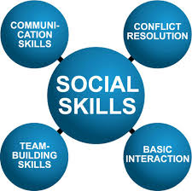
I Can (social/interpersonal skills)
Talk to others about things that frighten me or bother me
Find ways to solve problem that I face
Control myself when I feel like doing something not right or dangerous
Figure out when it is a good time to talk to someone or to act
Find someone to help me when I need it
Notes:
The I Can statements are about Identifying, recognizing and acknowledging those things we can do to feel better and create a better future for ourselves. This is about mastery and a sense of the future.

Slide 13
Build Relationships
Honor voice and choice
Partner with people
Request feedback
Ensure comfort
“Keep the Human in Human Services”
-Dr. Pat Deegan
Notes:
Putting the Human Back in Human Services: https://www.youtube.com/watch?v=HSQJ_3UUF8Y – Show this video clip from Dr. Pat Deegan and have a brief discussion.

Slide 14
ACTIVELY
Notes:
One of the most important things you can do in your daily work is close your mouth. Talk less. Listen more. Listen to the stories. Engage with people. Many cries for help and much information is shared in listening, even if you are listening to silence. Be more attentive to what others are trying to tell you. Listen to their words and actions.

Slide 15
One-on-One Policy
Notes:
Providing a patient the opportunity to meet with only his or her provider in a private area to discuss confidential matters, is an essential step for implementing a trauma-informed approach. Kaiser Permanente found a 100% increase in identifying domestic violence among patients after implementing a one-on-one screening policy that was implemented with patients at each visit (Carlson, 2012). While patients might find comfort in having their family and friends join them for their medical visit, it is important that all patients have an opportunity to meet with their provider alone.

Slide 16
Notes:
Where as we have focused on compliance for many years, payers and systems alike are moving towards focusing on value. They want to know that what they are paying for is making a difference. Value is defined as quality (i.e outcomes and patient experience) vs the cost to payers (direct and indirect costs). So in our daily work, we need to shift our thinking from checking boxes to doing what is best to increase outcomes and patient experience in the most efficient and cost-effective ways. We have to ensure that the patient experiences are positive, safe, and that we are activating our patients to take ownership and leadership in their journeys. This requires a change for staff and leadership. As funders are looking at new payment models, it will no longer be about volume of services, but about the value of services.
We cannot overlook or ignore our administrative tasks – these will remain critical for our funders, even with the increased focus on value. But we must ensure that even when we are checking a box, we are looking for the connection to the person being served, and the potential impact in the moment.

Slide 17
Universal Education
Post-card size handouts
Pamphlets
Posters
Notes:
“I give these to all of my patients.”
Universal education provides easy to understand information to all patients usually through post-card sized handouts, pamphlets, or posters. Providing universal education materials offers an opportunity to inform patients, families, staff, and partners on trauma and its impacts, and offers an opportunity for patients to initiate a conversation about trauma. A simple postcard sized handout with information about trauma, its impacts, and the services and resources available for individuals can be a valuable tool. Futures Without Violence offers a range of free digital and hard copy universal education materials. Educational materials should also disclose the limits of confidentiality (for example, mandatory reporting laws). Providers can educate and empower patients by normalizing the information on the card by stating, “I give these to all of my patients.” All universal education materials should provide support and information on how to access resources and services (Chamberlain & Levenson, 2016).

Slide 18
Daily Translation of TIPC Principles
Be patient and persistent
Convey respect
Be validating and affirming
Read clients’ needs and respond accurately
Set realistic expectations and goals
Provide ongoing choices and supports
Know your role
Follow through with what you say you will do
Provide consistency; minimize surprises
Notes:
Ultimately the best way to infuse trauma-informed approaches into your daily work are these nine things. 1. Be patient and persistent. Understand that people are not necessarily going to open up immediately about their past traumas. Be persistent in being there and listening. It helps to establish safety and security. It builds trust. 2. Convey respect. You have to give respect to get it. As we have discussed, you may see behavior from survivors that you deem disrespectful. Continue to be even-keeled and be respectful in your responses and interactions. 3. Validate and affirm them and their feelings. Do not take things personally. Many times it is not about you. You are just the current target. 4. Read the clients needs and respond accurately. Many times what is being presented is not the underlying issue. Our job as professionals is to read between the lines, see what they need and respond accordingly. 5. Set realistic expectations and goals. Do not push harder than you should but also be realistic in your discussions regarding their goals. Do not set them up for failure by setting their goals out of their reach. 6. Provide ongoing choices and supports. Remember this is their life and their journey. Make sure that they are driving the bus by choosing what services and supports they receive, who they receive them from and when they receive them. Provide ongoing choices with information regarding the consequences of each choice. You may not like their choices or think their choices are for the best, but remember, it is their life journey to choose. 7. Know your role. You are there to help and guide them, not to do things for them. Know the limits of the role you play and stay in it. 8. Follow through with what you say you will do. In order to build trust and safety, you have to be a person of your word. Follow through with what you say you are going to do and if something happens that you were unable to do something, be transparent. Admit it. It is okay for you to be human as well. Lastly, provide consistency and minimize surprises. There is nothing worse than surprises to make a survivor feel unsafe and less secure. Surprises may trigger the human stress response, therefore retraumatizing clients.

Slide 19
Notes:
One way to engage staff and clients is to ask them what hurts and helps. These questions can be asked about relationships, physical environment and attitudes and beliefs.
We are going to practice. Take 6 post it notes. Write relationship helps, relationship hurts, physical environment helps, physical environment hurts, attitudes and beliefs hurts and attitudes hurts. Now write down things regarding relationship or treatment that helps and hurts for each of those three. Then put your sticky notes on the big pieces of paper that have the same titles around the room.

Slide 20
The importance of relationships
WHAT HURTS?
Interactions that are humiliating, harsh, impersonal, disrespectful
critical, demanding,
judgmental
WHAT HELPS?
Interactions that express kindness, patience, reassurance, acceptance, and listening
Frequent use of words like PLEASE and THANK YOU

Slide 21
The importance of the physical environment
WHAT HURTS?
Congested areas that are noisy
Poor signage that is confusing
Uncomfortable furniture
Separate bathrooms
Cold non-inviting colors and paintings/posters on the wall
WHAT HELPS?
Comfortable, calming, and private treatment and waiting.
Furniture is clean and comfortable
No wrong door philosophy
Integrated restrooms
Messages conveyed throughout that are positive and hopeful

Slide 22
The importance of our attitudes and beliefs
WHAT HURTS?
Asking questions that convey the idea that there is something wrong with the person
Judgments and prejudices based on cultural ignorance
Regarding a person’s difficulties only as symptoms of a mental health, substance use or medical problem
WHAT HELPS?
Asking questions for the purpose of understanding what harmful events may contribute to current problems
Understanding the role of culture in trauma response
Recognizing that symptoms are often a person’s way of coping with trauma or are adaptations

Slide 23
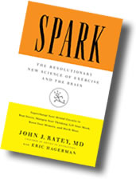
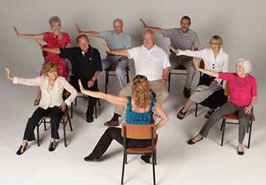
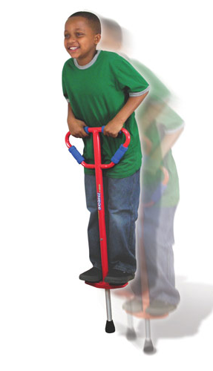
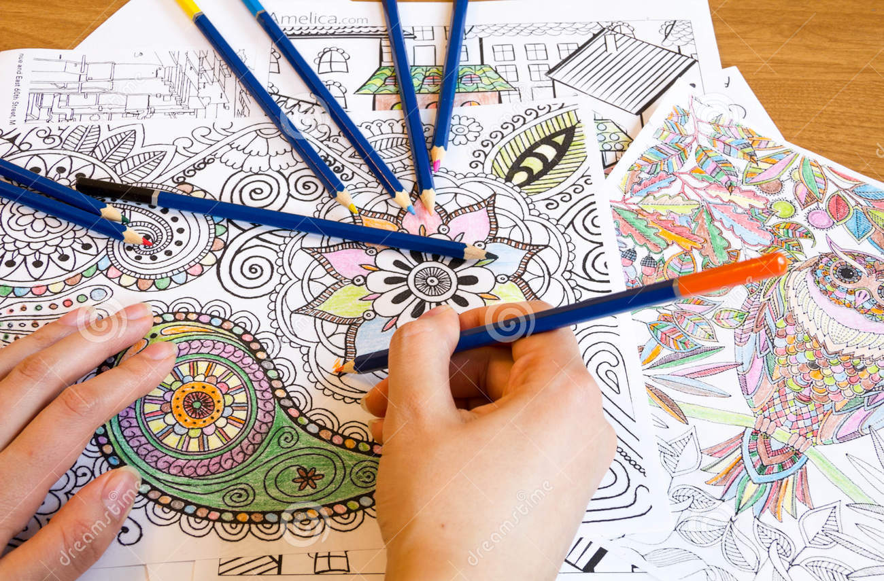
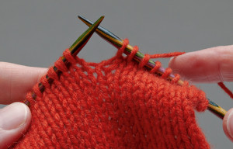
Understand the Mind/Body Connection
Notes:
Another way to infuse trauma-informed care into your daily work is to understand the mind/body connection. Our mind often calms by doing something physically with the body to ground us and let us know that we are not in imminent danger. Examples include music, dancing, exercise, putting a pet, drumming, playing on a pogo stick, reading, crocheting, etc. All of these things can be used with individuals who have experienced trauma or are in the middle of the human stress response. Take a minute and think of how you calm yourself when you are upset. Do you pet your cat, listen to music, pray, journal? What are some ways that you connect your mind and body?

Slide 24
Grounding Techniques
Grounding techniques can help:
Keep someone in the present
Reorient a person to the here-and-now and in reality
A person manage overwhelming feelings or intense anxiety
Someone to regain their mental focus from an often intensely emotional state

Slide 25
Grounding Exercise
Hold a pillow, stuffed animal or a ball
Place a cool cloth on your face, or hold something cool such as a can of soda
Listen to soothing music
Put your feet firmly on the ground
FOCUS on someone’s voice or a neutral conversation
5-4-3-2-1 Game
Notes:
Name 5 things you can see in the room with you
• Name 4 things you can feel (“chair on my back” or “feet on floor”)
• Name 3 things you can hear right now (“fingers tapping on keyboard” or “tv”)
• Name 2 things you can smell right now (or, 2 things you like the smell of)
• Name 1 good thing about yourself

