Slide 1
For the trainer:
Please note this slide deck is not a train the trainer presentation with fully developed scripts and exercises. These slides and accompanying notes are offered as suggestions. Slides may be used separate from the slide deck and in a different order than how they are currently presented.
If slides are used, please use the citation below and maintain all original citations found on the slides.
National Council for Behavioral Health. Fostering Resilience and Recovery: A Change Package for Advancing Trauma-Informed Primary Care. 2019.

Slide 2
Introduction to a Diversity, Equity, and Inclusion Initiative

Slide 3
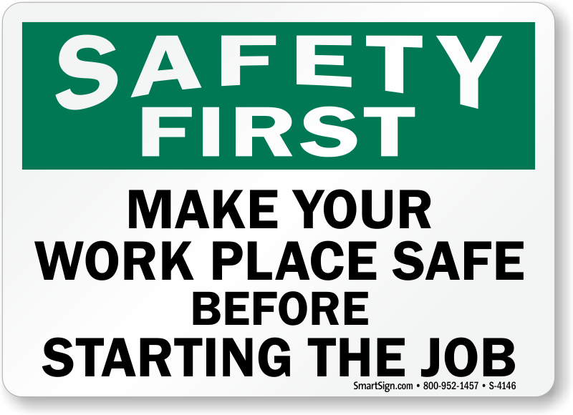
Covenant of Safety
What does safety look like for you?
What do you need to safe on this team to have open, honest, sometimes difficult conversations?

Slide 4
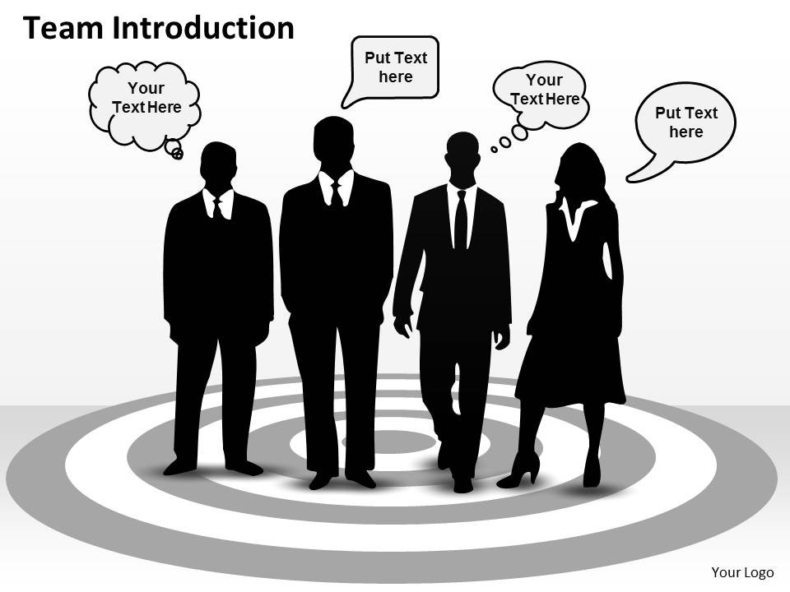
Introductions
Provide a quick overview of yourself
Name
Title
Positive word about yourself that starts with the first letter of your first name
Share what you hope to take away from today
Share one or two things you would like others to know about the organization’s DEI journey from your perspective

Slide 5
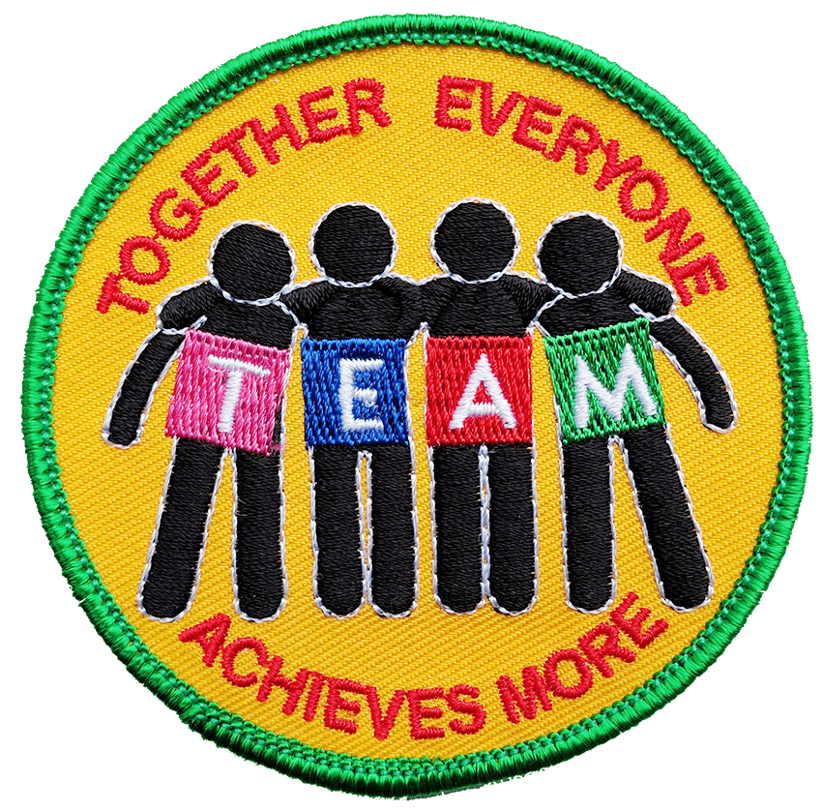
The Role of TEAM in Creating a Climate of Change

Slide 6
Who Needs to Be on the DEI Team?
Organizational leadership
Cross-section of departments and levels of staff
 |  |  |  |  |  |  | CEO
 |  |  |  |  |  | Chief | Chief | Chief | Chief
 |  |  |  | Director | Director | Director | Director | Director | Director | Director | Director
 |  |  | Manager | Manager | Manager | Manager | Manager | Manager | Manager | Manager | Manager | Manager
 |  | Supervisor | Supervisor | Supervisor | Supervisor | Supervisor | Supervisor | Supervisor | Supervisor | Supervisor | Supervisor | Supervisor | Supervisor
Staff | Staff | Staff | Staff | Staff | Staff | Staff | Staff | Staff | Staff | Staff | Staff | Staff | Staff | Staff | Staff
Notes:
We talk a lot about this at the beginning of the process, but please know that you can access and change your CIT membership at any time.
You need a format to identify team members for committee or CIT– cross section representation, for example, one Director from X dept and one Manager from Y dept– Director represents X Dept and all Directors (and needs to be communicating with both outside of meetings to properly represent), Manager represents all Managers and all of Y dept and needs to be in communication with both groups outside of meetings to properly represent and communicate progress and initiatives

Slide 7
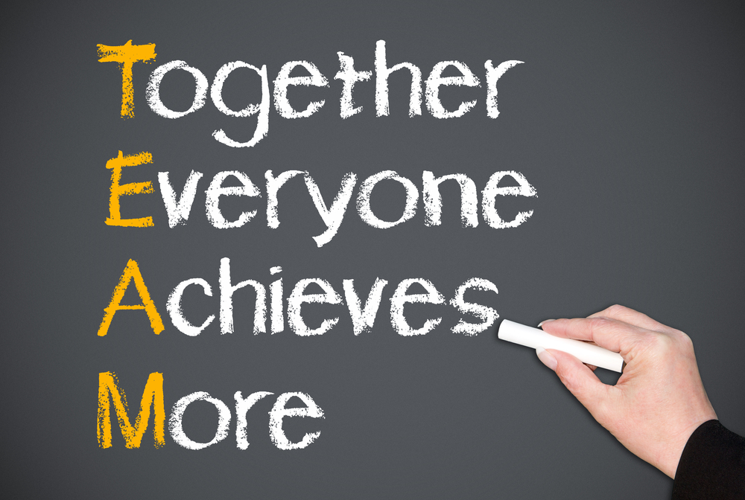
DEI Team …
Builds relationships over time
Promotes a positive, growth focused atmosphere
Builds healthy, cohesive teams, and
Develops quality improvement and the successful implementation of consensus- and evidence-based practices
Center for Substance Abuse Treatment 2007

Slide 8
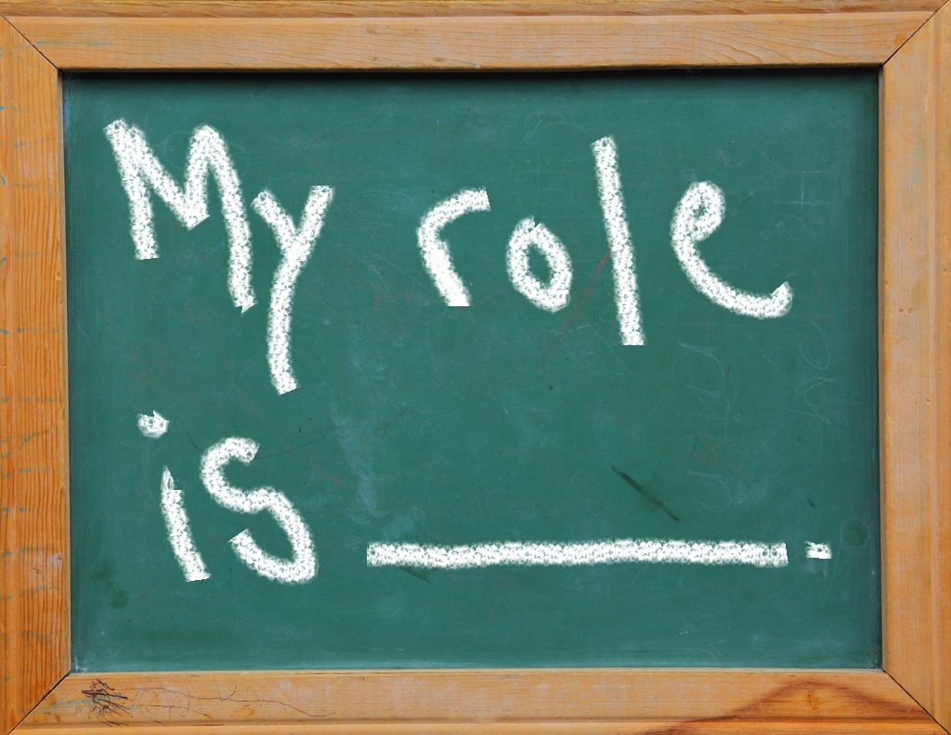
Roles
Agency Oversight Representative
Team Lead
Communicator
Task Master
Note-Taker
Subject Matter Expert
Notes:
We recommend that you identify and assign roles to your CIT members.
Agency oversight representative - Reports to larger Agency/organization what committee is doing and represent Agency/Big picture needs to committee
Team lead - Runs team process, is overall accountable for progress
Communicator - communicates committee information to larger agency and other appropriate teams, and oversees committees overall communicating for buy-in process
Task master - Internal team member who keeps agenda and tasks on schedule, meetings on time, team focus to deliverables
Note taker - Meeting note taker, agenda keeper, this can easily rotate
SME– researcher of pertinent information for committee

Slide 9
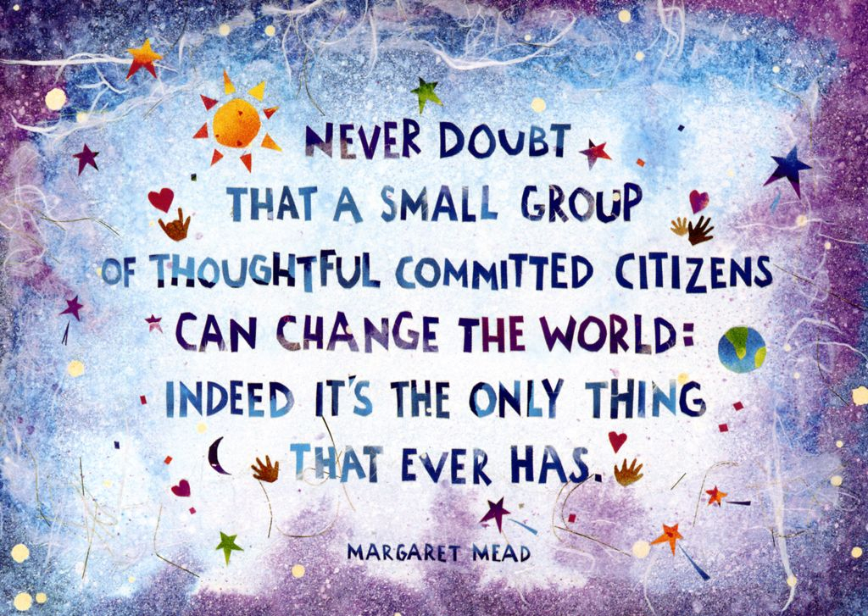
Building a Great Team
Understanding team developmental stages
Understanding the major dysfunctions of a team
Reflecting on areas of dysfunction
Improving team functioning and the role of leadership
Notes:
So, after membership and roles, we want to look at other components to building a great team.

Slide 10
Four Stages of Group Development
Tuckman, Bruce (Spring 2001). "Developmental Sequence in Small Groups'" (PDF). Group Facilitation: A Research and Applications Journal: 71–72. Retrieved 2 December 2015.
Notes:
One of the most influential studies in this area is Bruce Tuckman's (1965). He proposed the four-stage model called 'Tuckman's Stages for a Group,' which states that the ideal group decision-making process should occur in four stages:
1. Forming 2. Storming 3. Norming 4. Performing
Tuckman maintained that these phases are all necessary and inevitable in order for the team to grow, to face up to challenges, to tackle problems, to find solutions, to plan work, and to deliver results.

Slide 11
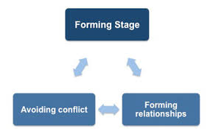
Stage One: Forming
Characteristics of stage 1 teams:
Members tend to be tentative and polite and to have little conflict
Critical skills and activities:
Need to identify their purpose
Develop group norms
Identify group processes
Define roles
Build relationships and trust
Role of facilitator/leader:
Usually need a strong leader who can help the team go through its forming activities
Notes:
At this stage, members usually have positive expectations about the TI initiative, although they may harbor some anxiety about other members, and the work ahead. There is often confusion about what you need to do, but this is put aside as people are excited about the opportunity and promise of the work.
At this point it is about building relationships within the group and clarifying the team's mission.
It may seem that very little is actually being accomplished in this stage. But, as relationships is at the core of all of this work, a lot is being accomplished if you are focusing on building consensus and purpose (vision), developing your group norms and processes, and defining roles.

Slide 12
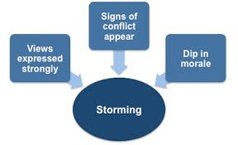
Stage 2: Storming
Group characteristics:
Tend to exhibit increased conflict, less conformity and “jockeying” for power
Critical skills and activities:
Learn how to resolve conflict
Clarify their roles, power, and structure
Build consensus through re-visiting purpose
Role of leader(s):
Leaders and other team members who are willing to identify issues and resolve conflict.
Notes:
As it relates to TIC, it is important to continue to remind members that this is a process, an evolution, that will take years.
Identify and celebrate success
Revisiting purpose – always go back to your sense of urgency, and your consensus. Why did we form this in the first place? What success are we seeing that tells us we cannot go back to how it was before
Often this stage involves the question – where do we start? Using tools that you have available to you, and building consensus, is important in this part of the process
During this second stage, team members will feel more able to express and question opinions, and there will be more internal conflict, and perhaps a dip in morale.
The team will beginning to address the differences between their initial perceptions and the reality of the situation that they have been formed to address. This will cover issues such as what problems they are really supposed to solve, how they will function independently and together, and what leadership model they will accept.
As your team members begin to negotiate the work assignments and express their views on the best way to achieve the task outcome disagreements will arise – hopefully this will be the case.
Team storming, whilst it may be contentious and unpleasant, is a necessary step for your team to become a cohesive whole, not as an enormous irritation to be dismissed. If you try to bulldoze through this stage in your team's development you may find it becomes a permanent state, resulting in low morale and lack of productivity.
Setting group norms for your meetings and the work outside of meetings, giving your team and members permission to be vulnerable and address conflict will be important.

Slide 13
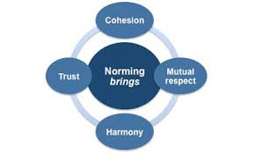
Stage 3: Norming
Group characteristics:
Demonstrate an improved ability to complete tasks, solve problems, resolve conflict
Critical skills and activities:
Engage in more sophisticated problem-solving and decision-making
Continue the use of effective strategies for conflict resolution and
Take greater levels of responsibility for their roles
Role of leader(s):
Less directive, team members feel empowered, and multiple leaders emerge
Notes:
You now understand, and are comfortable with, the nature of this work – it is not always about checking boxes, but about how behavior and language is changing.
You are able to identify successes and celebrate them. you have a better sense of how to develop and implement complicated action plans, such as developing a complex staff training process.
You have become more comfortable with understanding that working in one Domain will definitely impact work in another domain
Team members are learning more about each other and how they will work together and are developing tools such as a problem-solving process, a code of conduct, a set of team values, and measurement indicators.
Your team is truly developing a sense of team pride, and you will see evidence of increased productivity as skills develop. The team arrive at decisions that are more in line with their purpose rather than from a position of compromise.

Slide 14
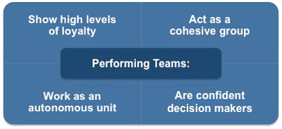
Stage 4: Performing
Group characteristics:
Flexible approach to roles and structures depending on the task at hand.
Able to evaluate its effectiveness and
Views conflict as an opportunity.
Energetic, creative, and fun!
Critical skills and activities:
High expectations for their performance.
Often use sub-groups as well as the large group for decision-making and task completion.
Recognize the need to ensure that all members are in agreement with the role and purpose of sub-groups.
Role of Leader:
Everyone is sharing in leadership.
Notes:
You understand the nature of the work – and are at peace with its ongoing evolution, that nothing is really ever done, or you don't really ever arrive.
Subgroups are well in place – you are regularly disseminating the work
You are starting to embed the principles and lens into everytingn that is done, and understand yoru group's task is as much about what you do, as it is about what happens outside of yoru tema – in the meetings, interactions, practices across your organization.
Now your team has reached the final stage of its development and can now bring real benefits to you and the organization. Your team members are now competent, autonomous, and able to handle the decision-making process without supervision.
Your team has been accomplishing work at every stage, but it is at this 'performing' stage that work is accomplished most effectively. Morale is high and the general atmosphere is positive. Team members' attitudes are characterized by positive feelings and eagerness to be part of the team.
Members are confident about the outcome, enjoy open communication, exhibit high energy, and disagreement is expected and allowed as long as it is channelled through means acceptable to the team. Leadership within the team is often shared and tasks are delegated within the team, which makes the overall decision-making process operate more easily than at earlier stages.
As a manager, once your team is operating at this level then your role becomes one of overseer and delegator. You are no longer involved in day-to-day activities and the team's relationships with each other emulate the high degree of trust and loyalty you show in your relationship with the team.
Another key task you will perform at this stage is one of monitoring your team's relationships and performance to ensure that the group dynamics remain positive and productive. This is because changes in the dynamics of the group can result in high-performing teams reverting to earlier team-building stages.
For example, a change in leadership may cause the team to revert to 'storming' as the new people challenge the existing norms and dynamics of the team.
Whilst Tuckman's model has been extremely influential in terms of improving peoples' understanding of how group dynamics change as a team becomes a cohesive group, it is not readily transferable to the world of work.
In the more than fifty years since Tuckman's research many others have related group dynamics to the place of work. It is the model of J. Richard Hackman that is frequently referred to when one is responsible for designing and managing work groups. This Team Development Checklist shows you the behaviors your team requires you to exhibit during its four-stage development.

Slide 15
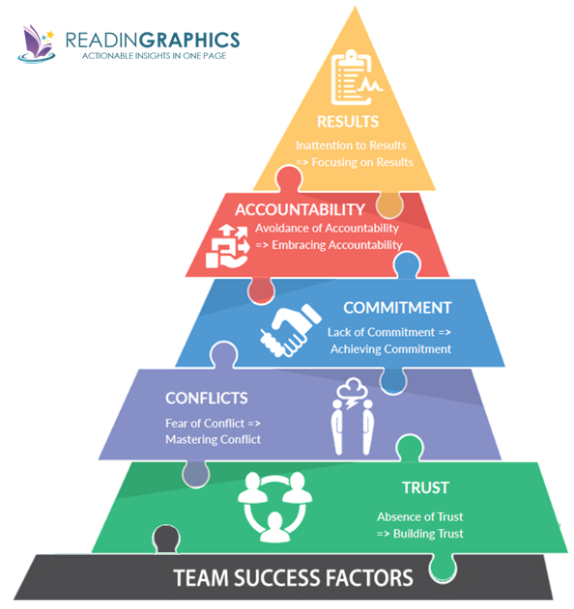
5 Dysfunctions Teams May Experience
“The Five Dysfunctions of a Team “ and “ Overcoming The Five Dysfunctions Of A Team” by Patrick Lencioni
Notes:
Now I wanted to take a few minutes to talk through common dysfunctions of a team.

Slide 16
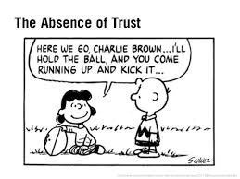
1. Absence of Trust
We want to be invulnerable
Therefore, we do not expose our weaknesses
Thus, we are not honest
It is impossible to build trust without honesty
In many cases, we are almost conditioned to “keep our guard up”
In our society exposing weakness is frowned upon
Notes:
Trust happens in small pieces over time. it goes hand in hand with vulnerability. If we are not willing to be vulnerable, we cannot generate trust.

Slide 17
Members of trusting teams . . .
Admit weakness and mistakes
Ask for help
Accept questions and input about their areas of responsibility
Give one another the benefit of the doubt before arriving to a negative conclusion
Take risks in offering feedback and assistance
Appreciate and tap into one another’s skills and experiences
Focus time and energy on important issues, not politics
Offer and accept apologies without hesitation
Look forward to meetings and other opportunities to work as a group
Notes:
Have a belief that everyone is doing the best they can
If you are finding that trust is an ongoing challenge

Slide 18
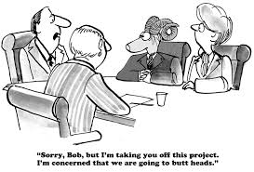
2. Fear of Conflict
If trust is not present, people will not engage one another
Artificial harmony
Important decisions will not be made
People become angry
Conflict can be good
If it is ideologically based
If it avoids personality-focused, mean-spirited attacks
Teams generally avoid this to spare one another’s feelings

Slide 19
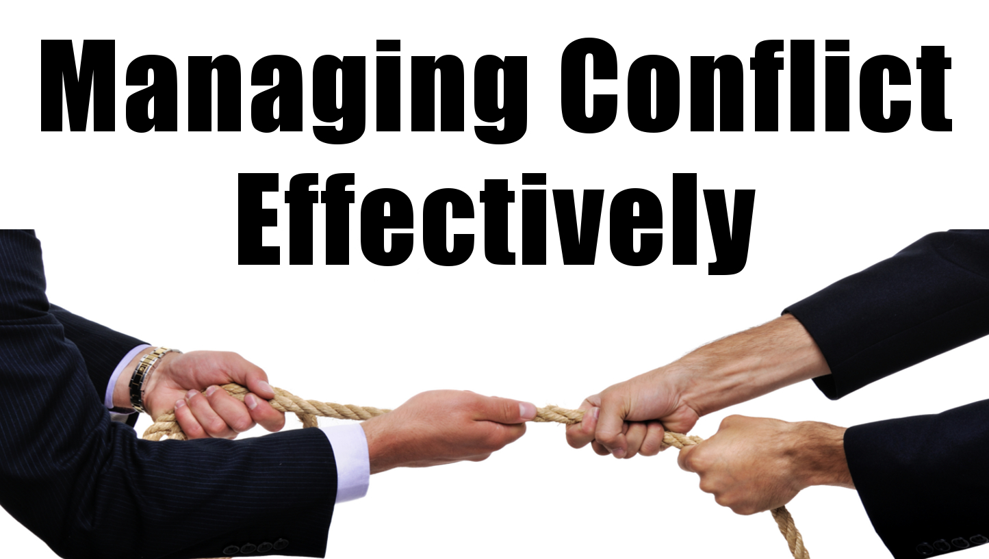
Teams that manage conflict…
Have lively interesting meetings
Extract and explore the ideas of all team members
Solve real problems quickly
Minimize politics
Put critical topics on the table for discussion

Slide 20
3. Lack of Commitment
People become ambiguous
People will not buy-in if they do not have an opportunity to weigh-in
Failure to achieve buy -in from the “first team” filters down
The two greatest causes are:
Desire for consensus
The need for certainty
Notes:
There will be a lack of ongoing certainty in this work. The field is very new, and no one has arrived yet. So, those who do best on these teams are ok with ambiguity, and trust the process.

Slide 21
Reflection: Lack of Commitment
Ask yourself:
Do we know what each member of the team is working on and how they contribute to the collective efforts to promote trauma-informed care?
Do team members leave meetings feeling confident that each team member is completely committed to the purpose and goals of creating a trauma informed care organization even in the presence of initial disagreements and conflicting perspectives?
Do team members end meetings with next step tasks that are clear and action oriented? No one leaves with nothing to do.
Does the leader model commitment by organizing meetings, setting an agenda, promoting action, and moving the team to resolve differences and acting towards a specific goal?
What can we add?

Slide 22
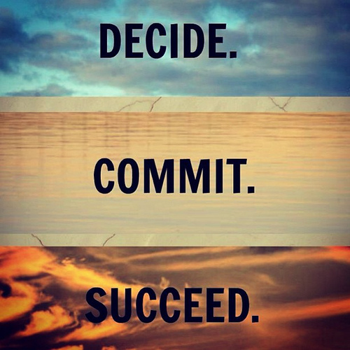
A team that commits…
Creates clarity around direction and priorities
Aligns the entire team around common objectives
Develops an ability to learn from mistakes
Take advantage of opportunities
Move forward without hesitation
Change direction without hesitation or guilt

Slide 23
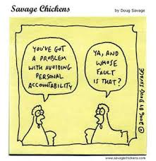
4. Avoidance of Accountability
People do this to avoid uncomfortable situations
This is really difficult in peer-to-peer situations
No buy-in, no accountability
You need team members willing to call their peers on performance or behaviors that might hurt the team
The closer the team members, the greater the danger
Notes:
Back to trust – we build the ability build trust and hold each other accountable over time.

Slide 24
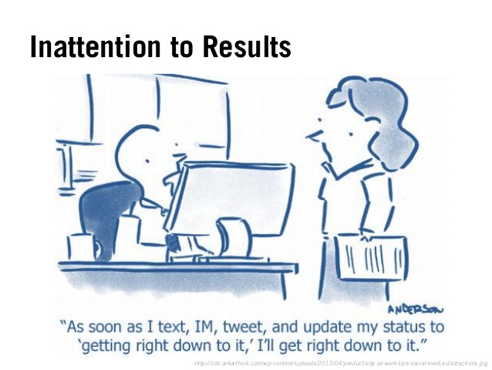
5. Inattention to Results
Not having a way to keep track of accomplishments and areas that have not been successful.
Not establishing goals and progress in a way that is measurable?
Failing to select and measure process and outcome indicators?
Failing to gather ongoing
feedback from clients, staff and
leadership.
Notes:
Both qualitative and quantitative data contribute to understanding how this work is progressing.

Slide 25
Finding Time
Meet over a meal
Pick the same time each week/month
Meet even if everyone can't attend
Ask leadership for coverage
What other ideas are working for your team?
Notes:
This is the biggest challenge we hear. Sometimes, however, lack of meeting can be connected to the many challenges we just discussed, and be couched as no one has time. If you are sure your lack of meeting is not connected to any of the above challenges, than you need to be as creative as possible and ask leadership for support.

Slide 26
If Your Experience Feels Like….
Vision | Skills | Incentives | Resources | Action Plan | What is Created
(missing) | Have | Have | Have | Have | Confusion
Have | (missing) | Have | Have | Have | Anxiety
Have | Have | (missing) | Have | Have | Gradual Change
Have | Have | Have | (missing) | Have | Frustration
Have | Have | Have | Have | (missing) | False Starts
Have | Have | Have | Have | Have | CHANGE
Notes:
Grounlund and James believe that the components in blue, across the top, are necessary components for managing complex change. And they outline what the results are when one or more of these components is missing.

Slide 27
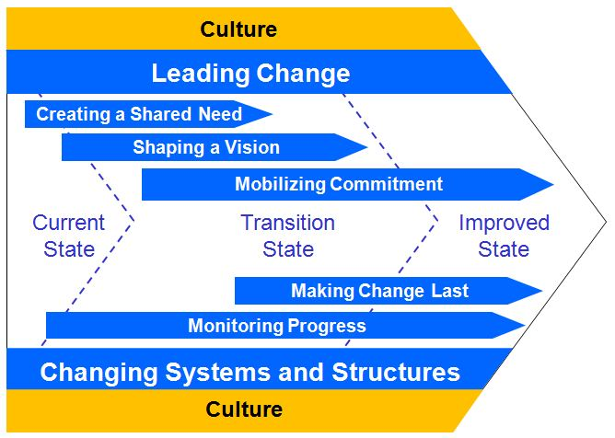
Major Accelerations of Change:
Do not happen in a vacuum
Are relational; utilizing people’s insights, creativity, imagination, and wisdom
Happen when a group of people come together and learn together and dare to think new thoughts and then pass them on
Have a common goal that resonates for the majority
GE’s Change Acceleration Process (CAP) Model Overview, retrieved from https://birdsongdyer.wordpress.com/2010/09/03/ges-change-acceleration-process-cap-model-overview/

Slide 28
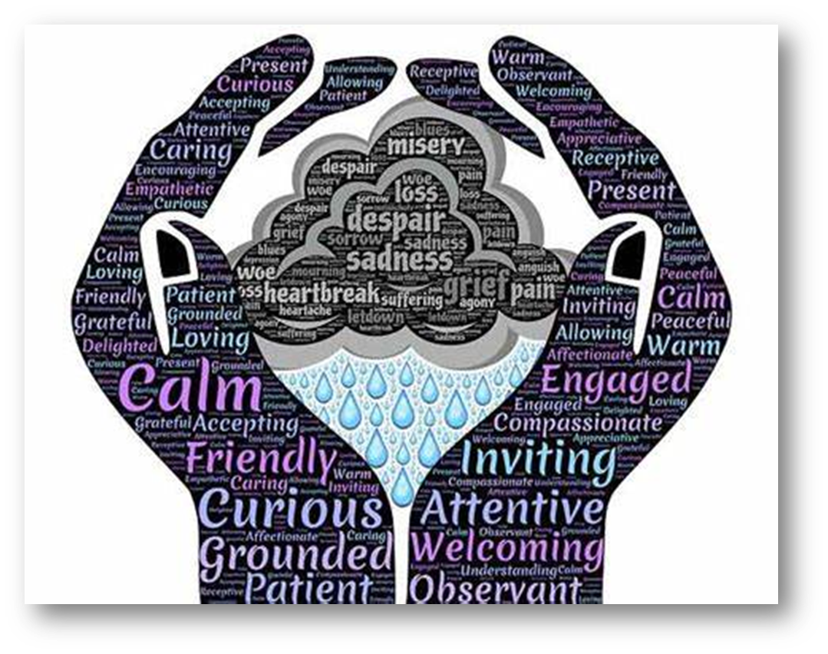
A Culture of Compassion

Slide 29
Safe and Nurturing Environment
Safety
Trustworthiness and Transparency
Voice Choice and Empowerment
Collaboration and Mutuality
Peer Support and Mutual Self-help
Cultural, Historical and Gender Issues
Notes:
In addressing the 8 dimensions of wellness, a trauma-informed organization or community must ensure that all actions and decision-making are made through the TIC Principles, which according to SAMHSA are safety, trustworthiness and transparency, collaboration and mutuality, empowerment, voice and choice and addressing cultural, gender and historical issues.

Slide 30
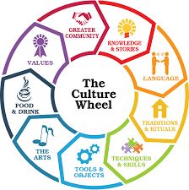
Culture is…the shared values, traditions, arts, history, folklore, and institutions of a group of people that are unified by race, ethnicity, nationality, language, religious beliefs, spirituality, socioeconomic status, social class, sexual orientation, politics, gender, age, disability, or any other cohesive group variable. Singh, 1998
Culture is…the communication and interaction guide of any cohesive group of people Sockalingam, 2019
Notes:
A critical component to infusing TIC into our daily work begins with understanding culture. Culture impacts every aspect of our lives, including how actions are perceived, how and if services are accessed, how people respond to interventions etc. Culture is the shared values, traditions, arts, history, folklore, and institutions of a group of people that are unified by race, ethnicity, nationality, language, religious beliefs, spirituality, socioeconomic status, social class, sexual orientation, politics, gender, age, disability, or any other cohesive group variable.” Culture is applicable to all people. It is active and dynamic. It is multi-layered and is viewed as thick, thin or compartmentalized. It exists at both the conscious and unconscious levels and structures our perceptions and shapes our behavior. It is a total way of life.

Slide 31
Cultural Humility
Lifelong commitment to self-evaluation and self-critique
Desire to fix power imbalances where none ought to exist
Aspiring to develop partnerships with people and groups who advocate for others
Another way to understand and develop a process-oriented approach to competency.
“the ability to maintain an interpersonal stance that is other-oriented (or open to the other) in relation to aspects of cultural identity that are most important to the [person]”
Hook et al, 2013
-Tervalon & Murray-Garcia, 1998
Notes:
Who here has heard of cultural competence? For those who have not, cultural competence, according to Cross et. Al, requires that organizations have a clearly defined, congruent set of values and principles and demonstrate behaviors, attitudes, policies, structures and practices that enable them to work effectively cross-culturally. There are five elements of cultural competence according to the National Center on Cultural Competence. Acknowledge cultural differences, understand your own culture, engage in self-assessment, acquire cultural knowledge and skills and view behavior within a cultural context. Now for agencies that serve MANY different cultures and practitioners who serve many different people, being COMPETENT in all cultures you serve can be an impossible feat. So I contend that cultural humility is the way in which to approach the work. Cultural Humility is another way to understand and develop a process-oriented approach to competency. It has three factors that guide a person.
The first aspect is a lifelong commitment to self-evaluation and self-critique (Tervalon & Murray-Garcia, 1998). Underlying this piece is the knowledge that we are never finished — we never arrive at a point where we are done learning. Therefore, we must be humble and flexible, bold enough to look at ourselves critically and desire to learn more. When we do not know something, are we able to say that we do not know? Willingness to act on the acknowledgement that we have not and will not arrive at a finish line is integral to this aspect of cultural humility as well. Understanding is only as powerful as the action that follows.
The second feature of cultural humility is a desire to fix power imbalances where none ought to exist (Tervalon & Murray-Garcia, 1998). Recognizing that each person brings something different to the proverbial table of life helps us see the value of each person. When practitioners interview clients, the client is the expert on his or her own life, symptoms and strengths. The practitioner holds a body of knowledge that the client does not; however, the client also has understanding outside the scope of the practitioner. Both people must collaborate and learn from each other for the best outcomes. One holds power in scientific knowledge, the other holds power in personal history and preferences
Finally, cultural humility includes aspiring to develop partnerships with people and groups who advocate for others (Tervalon & Murray-Garcia, 1998). Though individuals can create positive change, communities and groups can also have a profound impact on systems. We cannot individually commit to self-evaluation and fixing power imbalances without advocating within the larger organizations in which we participate. Cultural humility, by definition, is larger than our individual selves — we must advocate for it systemically.
The Southern Poverty Law Center (2018) suggests that whatever strategies an organization uses should:
Address both institutional and individual sources of prejudice and discrimination in the organization;
Seek to influence the behavior of individuals, including their motivation and capability to influence others, and not be limited to efforts to increase knowledge and awareness;
Deal with the dispositions and behavior of all racial and ethnic groups involved;
Include clients and staff who reflect the racial, ethnic and linguistic diversity present in the organization and should be structured in such a way as to ensure cooperative, equal-status roles for persons from different groups;
Have the support and participation of those with authority and power;
Involve children and new entrants to the organizations and they should be continually encouraged and reinforced;
Be part of a continuing set of activities that are valued and incorporated throughout the organization;
Examine similarities and differences across and within racial and ethnic groups, including differences related to social class, gender and language;
Expose the inaccuracies of myths that sustain stereotypes and prejudices;
Include the careful and thorough preparation of those who will implement and provide opportunities for adapting methods to different parts of the organization; and
Be based on thorough analyses of the needs of the clients and staff and on continuing evaluation of outcomes, especially effects on behavior.

Slide 32
Cultural Humility
TheLinkBetweenWorlds.com

Slide 33
We need to have
UNIVERSAL
Notes:
One way to be culturally humble is to asssume universal expectations. We need to presume the clients we serve, and the staff we serve next to, have a history of traumatic stress and exercise “universal expectation” by creating systems of care that are trauma-informed.
What are some behaviors we might use when we universally expect everyone to have a trauma history?
Using respect and kindness in every interaction

Slide 34
Notes:
One of the most important things you can do in your daily work is close your mouth. Talk less. Listen more. Listen to the stories. Engage with people. Many cries for help and much information is shared in listening, even if you are listening to silence. Be more attentive to what others are trying to tell you. Listen to their words and actions.

Slide 36
Language Matters
Vocabulary reinforces feelings and beliefs
Helps guide behavior
Leads to greater options for acting
Allows us to be able to recognize resilience in self/others
Notes:
Another thing we need to be careful of while teaching and promoting resilience is our language. The vocabulary of resilience is more than a set of words, it is a set of tools to use in promoting resilience. We help others identify resilient behavior… they use the vocabulary to reinforce those feelings and beliefs that support resilience and to guide their own behavior. The more concepts they understand, the greater their options for acting in ways that meet the crises in their lives with strength and hope. People who learn the vocabulary are better able to recognize resilience in themselves and others. They become increasingly aware of how to promote it.

Slide 37
Build Relationships
Honor voice and choice
Partner with people
Request feedback
Ensure comfort
“Keep the Human in Human Services”
-Dr. Pat Deegan
Notes:
Incorporate cultural practices into the work, cultural competence training, individualized care, asking the individual what can I start doing, stop doing, do more of, seek feedback from the clients and get their opinions and ideas, include people in the planning of services and programs to ensure they are culturally relevant and ensure comfort and do not retraumatize people. Ann Masten, leading researcher on resilience (Masten 2001. Ordinary magic: Resilience processes in development. Amer. Psychologist 56, 227-238.
Putting the Human Back in Human Services: https://www.youtube.com/watch?v=HSQJ_3UUF8Y – Show this video clip from Dr. Pat Deegan and have a brief discussion.

Slide 38
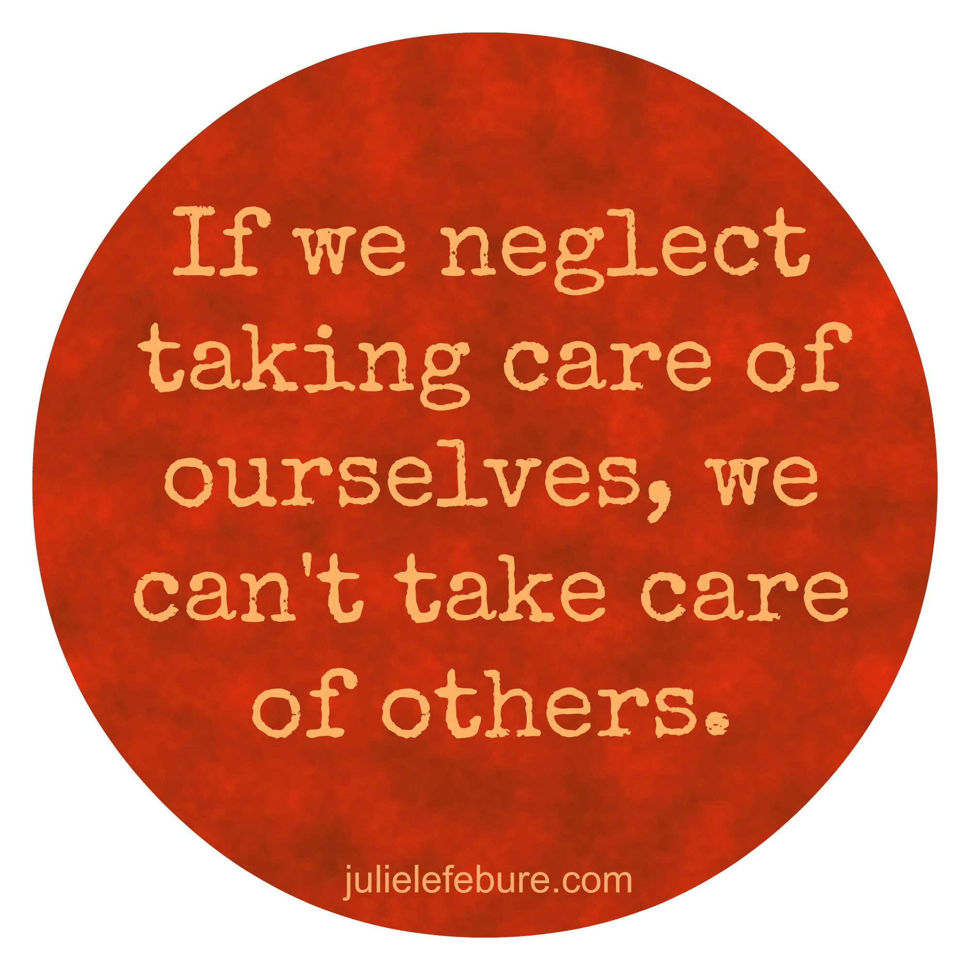
Take Care of Ourselves and Promote Staff Wellness
Notes:
The first step to creating a culture of compassion is to prioritize wellness at the individual level both personally and professionally. Prevention is the most effective way to address compassion fatigue. It is important for professionals to individually reflect on their wellbeing and identify the areas that need to be strengthened. By strengthening body, mind and spirit, they can prevent long-lasting and debilitating compassion fatigue. Ongoing efforts to remain healthy are critical to prepare for the daily challenge of working with so many people impacted by trauma.
There are many components of self-care. Some of the most critical include good sleep, nutrition, exercise, supportive relationships, and self reflection. It is imperative that those of us who work closely with people impacted by trauma prioritize our self-care, and create and implement plans to ensure that our personal needs are met.
Fortunately, there are proven ways to prevent the perils of burnout. If you make a conscious effort to recognize its warning signs, you may be able to avoid burnout completely, or at least stop its effects. Here are a list of things that front line workers can do to fight burnout. Additionally, these activities can be supported and encouraged by supervisors.
Create a Satisfaction Inventory - Go through and make an inventory of all of your personal and work duties and environment that is presently satisfying. Consider factors such as scheduling, flexibility, wages, and benefits. The list should include the things you enjoy. The process of writing this list will help you think deeply about the things that are working right in your current position helping people.
Start the Day with a Relaxing Ritual - Instead of jumping out of bed as soon as you wake up, spend time meditating, writing in your journal, or reading something that inspires you. A simple thing to do is to start each day with 10 diaphragmatic breaths – also known as deep breathing or belly breathing; and differs from shallow the breaths that expand the chest.
Adopt Healthy Eating, Exercising, and Sleeping Habits - When you eat right, engage in regular physical activity, and get plenty of rest, you have the energy and resilience to better deal with life’s hassles and demands. It helps you feel better! Make sure to take the time for these three essential items; and consume fruits and vegetables each day, strive for 150 minutes of aerobic activity each week, and aim for 8 hours of sleep each night.
Take Daily Breaks from Technology - Set a time to stay off of social media networks, and shut off your laptop, phone, and other electronic devices. Instead, pick up a book, take a walk, try deep breathing or meeting with friends.
Nourish Your Creative Side - Try something new like a fun project, or resume a favorite hobby. There are no rules about what to choose as long as it has nothing to do with your work!
Humor - Laughter really is the “best medicine” - actually triggering the release of endorphins! Numerous studies have documented laughter’s ability to lower blood pressure, reduce stress, and boost immune system. Take time each day to read jokes, watch funny YouTube videos or try switching up your usual diet of horror flicks for comedies!

Slide 39
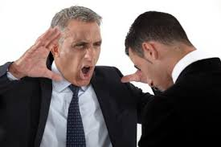
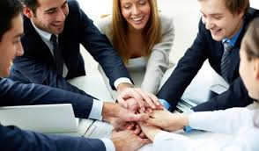
Safety through Vulnerable Collaboration
Physical
Emotional/Psychological
Social
Moral
Opportunities for collaboration without punishment for failure
Notes:
Move through pictures– first two pictures are not safe, last two are where we want to be– as mentioned in previous section, what opportunities are we setting up or losing depending on this first step of establishing a strong collaboration or team. We need to recognize that when we reach out to others to set up a collaboration or committee by virtue of reaching out we are acknowledging that we lack a skill or strength to make a project or outcome successful and that makes us vulnerable to the perception that we know everything. We are stronger together and therefore must overtly recognize our vulnerability and embrace it to ensure positive outcomes and collaboration cohesion. If we engage in a collaboration or committee from a “know it all” perspective we set up a “no win” situation and mixed message related to needs and abilities– and therefore we will fail from the beginning. Being vulnerable in our collaborations creates a “win win” and as we’ll see in Patrick’s Lencioni’s 5 Team Dysfunctions, we must start with Vulnerability to gain trust.

Slide 40
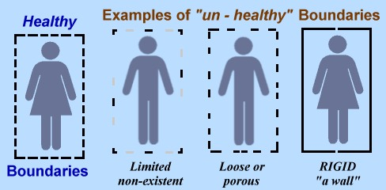
Boundaries
“Without boundaries, you will act, sleep, work, groan, feel used and fulfill basic responsibilities rather than make choices to live and love fully, to work hard and nobly, to fulfill your purpose and to contribute passionately to your world.” (Black, J. and Enns, G, Better Boundaries: Owning and Treasuring Your Life. Oakland, CA. Raincoat Books)
Notes:
Signs of poor boundaries:
Too close
Avoid conflict
Victimhood
Distant
Behavior and Beliefs in Relationships that Might be Signs of Ignored/Unestablished Boundaries:
Too close – total dependence, “I need your approval and support 100% of the time.”
Avoid conflict - “If I ignore it, it will go away eventually.”
Victimhood – Identify self as the victim, “I have no power.”
Distant – Due to past real or perceived violations, one is fiercely independent, “I dare you to come close!” or shies away from openness with others
Invisibility – Not wanting to be seen or heard so that boundaries are not violated
(revised from livestrong.com/article/14718-building-healthy-boundaries/)
Three Types of Boundaries:
Permeable – A boundary is set but there is very little reinforcement of the boundary. For most of us, having overly permeable boundaries will allow unwanted emotional and mental assault from others and may mean that we are letting too much of ourselves out, limiting our privacy and self-care.
Rigid – These are the boundaries that you reinforce at all costs. Too rigid boundaries do not allow us to be open to new ideas or perspectives and can often keep us in the dark and unapproachable.
Flexible – Flexible boundaries are firm and clear yet open to new ideas and resources when needed. They are also sufficiently closed to protect us from harm
Compassionate Boundaries Reflection – Compassion Resilience Toolkit - https://compassionresiliencetoolkit.org/healthcare/a-toolkit-for-healthcare/

Slide 41
Daily Translation of a Culture of Compassion
Be patient and persistent
Convey respect
Be validating and affirming
Read each others’ needs and respond accurately
Set realistic expectations and goals
Provide ongoing choices and supports
Know your role
Follow through with what you say you will do
Provide consistency; minimize surprises
Notes:
Ultimately the best way to infuse trauma-informed approaches into your daily work are these nine things. 1. Be patient and persistent. Understand that people are not necessarily going to open up immediately about their past traumas. Be persistent in being there and listening. It helps to establish safety and security. It builds trust. 2. Convey respect. You have to give respect to get it. As we have discussed, you may see behavior from survivors that you deem disrespectful. Continue to be even-keeled and be respectful in your responses and interactions. 3. Validate and affirm them and their feelings. Do not take things personally. Many times it is not about you. You are just the current target. 4. Read the clients needs and respond accurately. Many times what is being presented is not the underlying issue. Our job as professionals is to read between the lines, see what they need and respond accordingly. 5. Set realistic expectations and goals. Do not push harder than you should but also be realistic in your discussions regarding their goals. Do not set them up for failure by setting their goals out of their reach. 6. Provide ongoing choices and supports. Remember this is their life and their journey. Make sure that they are driving the bus by choosing what services and supports they receive, who they receive them from and when they receive them. Provide ongoing choices with information regarding the consequences of each choice. You may not like their choices or think their choices are for the best, but remember, it is their life journey to choose. 7. Know your role. You are there to help and guide them, not to do things for them. Know the limits of the role you play and stay in it. 8. Follow through with what you say you will do. In order to build trust and safety, you have to be a person of your word. Follow through with what you say you are going to do and if something happens that you were unable to do something, be transparent. Admit it. It is okay for you to be human as well. Lastly, provide consistency and minimize surprises. There is nothing worse than surprises to make a survivor feel unsafe and less secure. Surprises may trigger the human stress response, therefore retraumatizing clients.

Slide 42
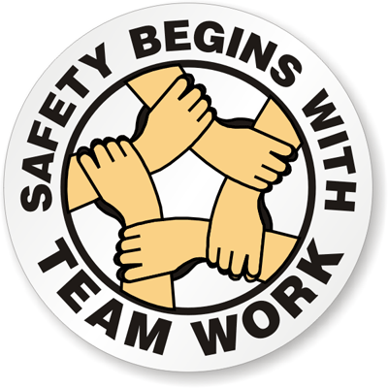
Safe and Nurturing Environment

Slide 43
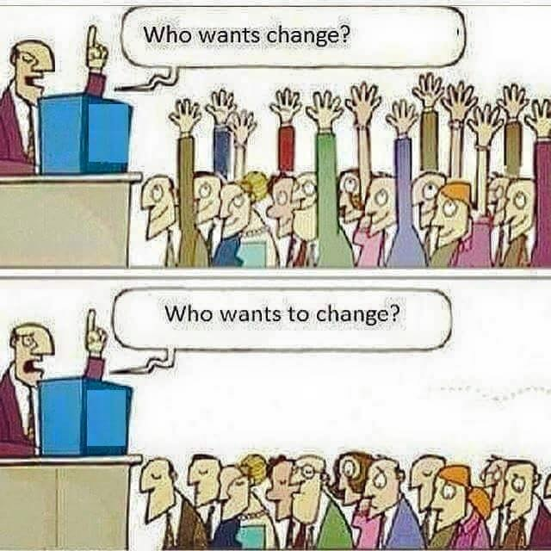
Notes:
We need to create a mutually respectful interpersonal climate that fosters safety, trust, choice, collaboration, and empowerment
“Mistakes made here often.”

Slide 44
What contributes to a safe, nurturing and thriving work environment & culture?
Describe your vision of the most positive work environment for you to be able to be your best self in your job. Share it with your group.
As a group, create a consensus list of behaviors and attitudes that support a positive staff culture
Write the list on the easel paper and put it on the wall
VALUES
BEHAVIOR
BELIEFS
CULTURE
PRACTICES
CUSTOMS
https://compassionresiliencetoolkit.org/healthcare/a-toolkit-for-healthcare/
Notes:
Exercise is taken from the Compassion Resilience Toolkit https://compassionresiliencetoolkit.org/healthcare/a-toolkit-for-healthcare/
Describe your vision of the most positive work environment for you to be able to be your best self in your job. What staff behaviors and attitudes would lead to such an environment? As you listen to each other, review the list of helpful behaviors and attitudes from the Zone of Helpfulness activity in Section 6 of the Compassion Resilience Toolkit
Identify when the helpful behaviors on the list match what staff is saying about staff culture (circle or star them). Expand the list with more behaviors that they believe are important to have a staff culture in which they would want to work. 2. Create a separate consensus list of behaviors and attitudes that support a positive staff culture. 3. Individually reflect, then discuss what boundaries a staff member might want to have to support the helpful behaviors. 4. Discuss how to set these boundaries using the tips from the Compassionate Boundary Setting section of the toolkit. Be sure to discuss the hesitance we have in proactively setting and addressing boundary issues with colleagues. 5. Discuss what has happened to you in your life that has impacted your ability to contribute to a positive work culture. 6. Come prepared to the whole staff meeting with your consensus list of behaviors to support a positive staff culture written on flip chart paper. These will be used to write your organization’s Positive Staff Culture Contract.

Slide 45
Create a Strengths-Based Environment
Incorporate the principles of recovery-oriented systems and trauma-informed care
Shift the focus away from a deficit-based view of clients and staff
Encourage individuals to identify personal strengths and skills
When confronted with challenges in practice, solicit individual’s ideas about how he/she may have done things differently.
Notes:
Mind-set/heart-set: PACE – parallel’s with STCCE

Slide 46
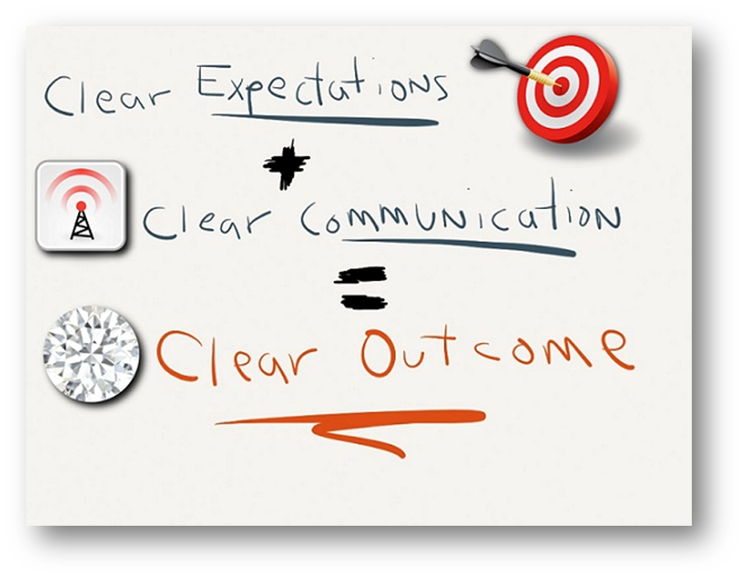
Clear & High Expectations
Expect quality
Define it
Talk about it
Recognize and praise it
Encourage it
Build it from strengths
Assume people want to grow, even if they don’t know how
Expect lots of mistakes and learn from them
What gets in the way of clear and high expectations?
Notes:
It’s ok to expect a lot. It’s the spirit in which you present it and demonstrate it. Don’t give energy to the negative. Feed the positive.

Slide 47
“Most people won’t really listen or pay attention to your point of view until they become convinced that you’ve heard and appreciated theirs.”
-M Nichols
Notes:
Reflective listening can be a difficult skill to master. One reason is that it requires “decentering.” That is, the other person becomes the center of attention and there is no attempt made to influence his or her perception of reality or what he or she is saying. Their report is accepted as given.
The goal when one uses this skill is to listen, know and understand the meaning of what the person is saying. The listener tries to be a mirror reflecting back what the listener has heard. This can be accomplished in a variety of ways: you can simply repeat what the person has said, highlighting or underlining their own words. “You said keeping fit is important to you”.
Or, you can provide short mini-summaries of what you heard and understood the speaker was saying. “So, what you are saying is that you are quite motivated to exercise regularly, though since your job situation changed, it’s been harder to find the time”.
Non-verbally, behaviors that convey attention, like eye-contact and leaning forward, an open posture and avoidance of judgmental expressions or postures facilitate reflective listening.

Slide 48
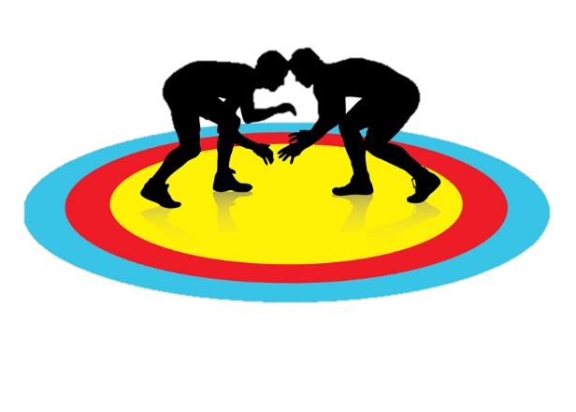
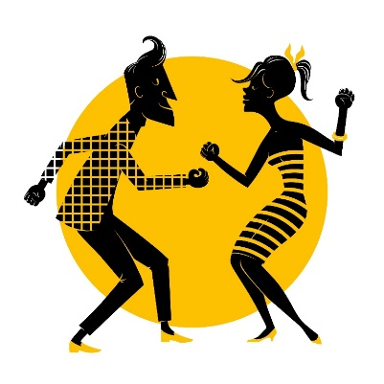
Who Would You Rather Work With?
Defensive
Oppositional
Argumentative
Disengaged
Passive
Powerless
Unable to change
Open
Cooperative
Listening
Engaged
Active
Empowered
Hopeful

Slide 49
"Affirmations are
our mental vitamins,
providing the supplementary positive thoughts we need
to balance the barrage
of negative events and thoughts we experience daily.“
—Tia Walker
Notes:
Tia Walker, born in Palo Alto, CA, first book, The Inspired Caregiver, came from a desire to honor the unsung heroes of the world, caregivers, and her dear friend Peggi's vision to share their joint experiences with others. Having experienced her mom's death at 49 and father who died at 59, Tia is well aware of being thrust into a caregiving role unexpectedly. When not writing, Tia's an accomplished business consultant, specializing in creating sustainability using entrepreneurial approaches for non profits. She is a public speaker, facilitator of women's groups, healthy lifestyle advocate and proud mother of three sons. She devotes countless hours to charitable causes and loves to facilitate retreats worldwide and now calls Santa Barbara, CA, home.

Slide 50
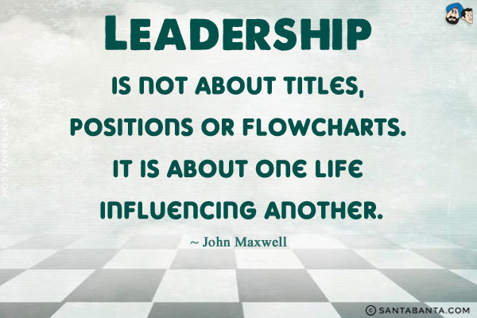
There is true partnering and leveling of power differences between staff and clients and among organizational staff from direct care staff to administrators. There is recognition that healing happens in relationships and in the meaningful sharing of power and decision-making. The organization recognizes that everyone has a role to play.
Collaboration and Mutuality

Slide 51
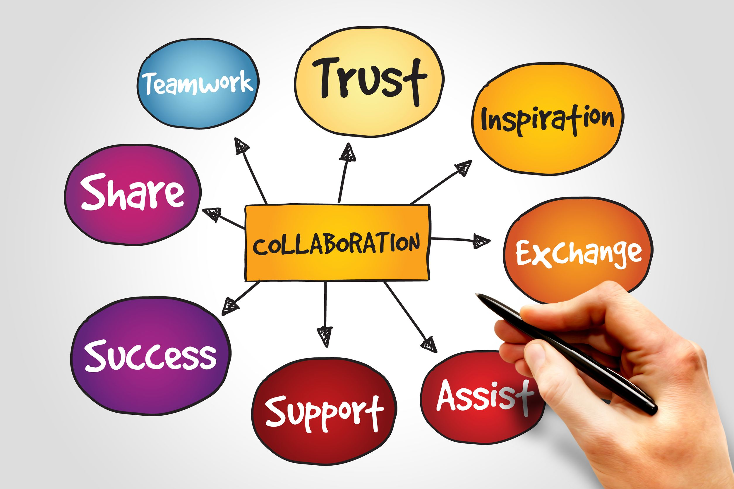
Teamwork Makes Dreams Work
Collaboration involves:
Awareness
Motivation
Self-synchronization
Participation
Mediation
Reciprocity
Reflection
Engagement
Collaboration relies on openness and knowledge sharing but also some level of focus and accountability on the part of the business organizations
Notes:
Awareness – We become part of a working entity with a shared purpose
Motivation – We drive to gain consensus in problem solving or development
Self-synchronization – We decide as individuals when things need to happen
Participation – We participate in collaboration and we expect others to participate
Mediation – We negotiate and we collaborate together and find a middle point
Reciprocity – We share and we expect sharing in return through reciprocity
Reflection – We think and we consider alternatives
Engagement – We proactively engage rather than wait and see
Managers are the Number 1 way that people feel supported by their organization. (Forbes)
90% of employees believe that decision-makers should seek other opinions before making a final decision. (Salesforce)
88% agree that a culture of knowledge-sharing correlates to high employee morale and job satisfaction. (Oscar Berg)
88% believe collaboration accelerates decision making. (Next Plane)
75% of employers rate team work and collaboration as “very important.” (Queens University)
Women are 66% more likely than men to help others in need – an action that typically costs more time and energy than sharing knowledge and expertise. (Oscar Berg)
60% of respondents have experienced change in their way of thinking due to collaborations. (Oscar Berg)
56% pointed out collaboration-related measure as the factor that will have the greatest impact on their organization’s overall profitability. (Oscar Berg)
56% of respondents said that they were happier when they collaborated. (Oscar Berg)
53% are confident that collaborations are having a positive and tangible impact on their organization. (Oscar Berg)
Compared to two decades ago, the time managers and employees spend on collaborative activities has ballooned by 50% or more. (Oscar Berg)
Over 50% of employees and managers identify time saved completing tasks as a benefit of collaboration.
49% of Millennials support social tools for workplace collaboration. (Queens University)
33% of organizations are using social collaboration tools across all departments. 50% of those surveyed expect that number to increase in 2017. (Next Plane)
30% want to collaborate more, with women slightly more collaborative than men. (Oscar Berg)
Men are 36% more likely to share knowledge and expertise than women. (Oscar Berg)
WHY IT IS OR ISN’T WORKING
97% of employees and executives believe lack of alignment with a team impacts the outcome of a task of project. (TINYpulse)
86% of employees and executives cite lack of collaboration or ineffective communication for workplace failures. (Salesforce)
Less than 50% say that their organizations discuss organization issues truthfully and effectively. (Salesforce)
40% of employees believe that decision makers “consistently failed” to seek another opinion. (Salesforce)
40% of organizations lack a collaboration strategy altogether. (Dimension Data)
39% of employees believe that people in their organization don’t collaborate enough (Professional Service Centre)
20% to 35% of value-added collaborations typically come from only 3% to 5% of employees. (Oscar Berg)
20% of organizational “stars” don’t contribute to the success of their colleagues after they have hit their own numbers and earned kudos for it. (Oscar Berg)
Only 18% of employees get communication evaluation at their performance review. (Queens University)
People tend to lie more when collaborating on a joint effort when they believe it will result in a better outcome for both, if they engage in collusion. (Oscar Berg)
People primed to think of themselves in an organizational context (e.g., co-worker) felt less motivated to reciprocate and did reciprocate less than those in an otherwise parallel personal (e.g., friend or acquaintance) situation. Organizational contexts reduce people’s obligation to follow the moral imperative of the norm of reciprocity. (Oscar Berg)

Slide 52
Mutuality is the Key to Healthy Relationships
4 Essential Ways to Building Mutuality:
Make sure people feel cared about and appreciated
Honor your word
Consider how your decisions and behaviors affect or benefit each other
Always be there for each other

Slide 53
Purpose:
Create human connections that empower compassionate giving and receiving
Skills:
Observation vs. evaluation
Feeling vs. thinking
Connecting
Requesting
Notes:
Nonviolent Communication (NVC) is sometimes referred to as compassionate communication. Its purpose is to:
create human connections that empower compassionate giving and receiving
create governmental and corporate structures that support compassionate giving and receiving.
NVC involves both communication skills that foster compassionate relating and consciousness of the interdependence of our well being and using power with others to work together to meet the needs of all concerned. This approach to communication emphasizes compassion as the motivation for action rather than fear, guilt, shame, blame, coercion, threat or justification for punishment. In other words, it is about getting what you want for reasons you will not regret later. NVC is NOT about getting people to do what we want. It is about creating a quality of connection that gets everyone’s needs met through compassionate giving. The process of NVC encourages us to focus on what we and others are observing separate from our interpretations and judgments, to connect our thoughts and feelings to underlying human needs/values (e.g. protection, support, love), and to be clear about what we would like towards meeting those needs. These skills give the ability to translate from a language of criticism, blame, and demand into a language of human needs -- a language of life that consciously connects us to the universal qualities “alive in us” that sustain and enrich our well being, and focuses our attention on what actions we could take to manifest these qualities. Nonviolent Communication skills will assist you in dealing with major blocks to communication such as demands, diagnoses and blaming. In CNVC trainings you will learn to express yourself honestly without attacking. This will help minimize the likelihood of facing defensive reactions in others. The skills will help you make clear requests. They will help you receive critical and hostile messages without taking them personally, giving in, or losing self-esteem. These skills are useful with family, friends, students, subordinates, supervisors, co-workers and clients, as well as with your own internal dialogues.
NVC offers practical, concrete skills for manifesting the purpose of creating connections of compassionate giving and receiving based in a consciousness of interdependence and power with others. These skills include:
Differentiating observation from evaluation, being able to carefully observe what is happening free of evaluation, and to specify behaviors and conditions that are affecting us;
Differentiating feeling from thinking, being able to identify and express internal feeling states in a way that does not imply judgment, criticism, or blame/punishment;
Connecting with the universal human needs/values (e.g. sustenance, trust, understanding) in us that are being met or not met in relation to what is happening and how we are feeling; and
Requesting what we would like in a way that clearly and specifically states what we do want (rather than what we don’t want), and that is truly a request and not a demand (i.e. attempting to motivate, however subtly, out of fear, guilt, shame, obligation, etc. rather than out of willingness and compassionate giving).
These skills emphasize personal responsibility for our actions and the choices we make when we respond to others, as well as how to contribute to relationships based in cooperation and collaboration.

Slide 54
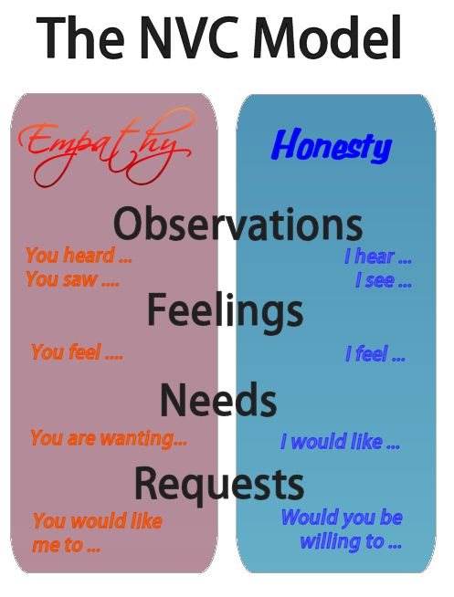
Center for Nonviolent Communication
Notes:
The basic model for NVC is really quite straightforward and simple. It is a process that combines four components with two parts. While the four components are specific ideas and actions that fit into the form and the model of NVC, the two parts provide a solid foundation for NVC as well as for living nonviolently. They are the basis for Marshall’s ideas of giving and receiving from the heart. These brief definitions will be expounded further in the sections below:
Four Components
Observation: Observation without evaluation consists of noticing concrete things and actions around us. We learn to distinguish between judgment and what we sense in the present moment, and to simply observe what is there.
Feeling: When we notice things around us, we inevitably experience varying emotions and physical sensations in each particular moment. Here, distinguishing feelings from thoughts is an essential step to the NVC process.
Needs: All individuals have needs and values that sustain and enrich their lives. When those needs are met, we experience comfortable feelings, like happiness or peacefulness, and when they are not, we experience uncomfortable feelings, like frustration. Understanding that we, as well as those around us, have these needs is perhaps the most important step in learning to practice NVC and to live empathically.
Request: To make clear and present requests is crucial to NVC’s transformative mission. When we learn to request concrete actions that can be carried out in the present moment, we begin to find ways to cooperatively and creatively ensure that everyone’s needs are met.
Two Parts
Empathy: Receiving from the heart creates a means to connect with others and share experiences in a truly life enriching way. Empathy goes beyond compassion, allowing us to put ourselves into another’s shoes to sense the same feelings and understand the same needs; in essence, being open and available to what is alive in others. It also gives us the means to remain present to and aware of our own needs and the needs of others even in extreme situations that are often difficult to handle.
Honesty: Giving from the heart has its root in honesty. Honesty begins with truly understanding ourselves and our own needs, and being in tune with what is alive in us in the present moment. When we learn to give ourselves empathy, we can start to break down the barriers to communication that keep us from connecting with others.
From these four components and two parts, Marshall has created a model for life enriching communication that can be highly effective in solving conflict with our family members, with our friends, with our coworkers, and with ourselves. The basic outline of the model is the following:
The NVC model has two sides, empathetically listening and honestly expressing. Both sides use the four steps of the model: observations, feelings, needs, requests. First, we observe what is actually happening in a situation: what are we observing others saying or doing that is either enriching or not enriching our life? The trick is to be able to articulate this observation without introducing any judgment or evaluation—to simply say what people are doing that we either like or don't like. Next, we state how we feel when we observe this action: are we hurt, scared, joyful, amused, irritated? And thirdly, we say what needs of ours are connected to the feelings we have identified. An awareness of these three components is present when we use NVC to clearly and honestly express how we are.
The fourth component—a very specific request: "Would you be willing to put your socks in your room or in the washing machine?" This fourth component addresses what we are wanting from the other person that would enrich our lives or make life more wonderful for us.
Thus, part of NVC is to express these four pieces of information very clearly, whether verbally or by other means. The other part of this communication consists of receiving the same four pieces of information from others. We connect with them by first sensing what they are observing, feeling, and needing; then we discover what would enrich their lives by receiving the fourth piece—their request.
As we keep our attention focused on the areas mentioned, and help others do likewise, we establish a flow of communication, back and forth, until compassion manifests naturally: what I am observing, feeling, and needing; what I am requesting to enrich my life; what you are observing, feeling, and needing; what you are requesting to enrich your life . . .
When we use this process, we may begin either by expressing ourselves or by empathically receiving these four pieces of information from others. Although we will learn to listen for and verbally express each of these components in Chapters 3–6, it is important to keep in mind that NVC is not a set formula, but something that adapts to various situations as well as personal and cultural styles. While I conveniently refer to NVC as a "process" or "language," it is possible to experience all four pieces of the process without uttering a single word.
The essence of NVC is in our consciousness of the four components, not in the actual words that are exchanged.

Slide 55
Feedback
Feedback should ONLY:
Enhance job performance
Be about quality care and not personal attacks
Lead to ongoing personal and professional development
Reduce stress
Help improve interpersonal relationships
Develop a healthy organizational climate
Notes:
Can be positive or negative as long as it is helpful to the staff to understand what is or isn’t working.
Should be specific so staff will understand how to modify behavior

Slide 56
What do I/We need to….
Keep Doing
Change Doing
Start Doing
Stop Doing
Notes:
Becoming a trauma-informed organization ultimately requires that we continue to ask what do we need to stop doing, start doing and do more of.
Activity: In your group tables, we want you to take 10-15 minutes to write down what you need to stop doing, start doing and do more of as an organization or as a community (depends on who you are presenting to) to become a more wellness-oriented, trauma-informed organization/community. –
At the end of the activity, have each table give one start, one stop and one do more of.
The facilitator will need to collect the information, type it up and send back to the group as part of the follow-up email.

Slide 57
Intergenerational (Historical) Trauma
“Cumulative emotional and psychological wounding, over the lifespan and across generations, emanating from massive group trauma experiences.”
Yellow Horse Brave Heart, 2003
Rethinking Historical Trauma: Narratives of Resilience
Aaron R. Denham, 2008
Historical Trauma and Cultural Healing, University of Minnesota Extension http://www.extension.umn.edu/family/cyfc/our-programs/historical-trauma-and-cultural-healing/
Notes:
One type of trauma that is often overlooked is that of intergenerational or historical trauma. Intergenerational or Historical trauma is a multigenerational trauma experienced by a specific cultural group or collective community. According to Yellow Horse Brave Heart it is a collective, cumulative emotional wounding across generations resulting from a cataclysmic event. With these types of traumatic events, the trauma is held personally and passed on across generations. Even those who did not personally experience the trauma are affected generations later. What are some examples of intergenerational or historical trauma that you can think of?

Slide 58
Intergenerational/Historical Trauma Events
Genocides
Slavery
Pandemics
Massacres
Prohibition/destruction of cultural practices
Discrimination/Systemic prejudice
Forced relocation
Notes:
Here’s a list of them….genocide, slavery, pandemics, massacres, prohibition or destruction of cultural practices, discrimination or systemic prejudices and forced relocation.
For Native Americans and Black Americans, systemic trauma often converges with historical trauma in the bias they experience when dealing with institutions like government and police.
Some resources use historical trauma, intergenerational trauma and systemic trauma interchangeably however they are semantically different. All three incorporate the presence of trauma symptoms in groups even if they were not physically present for the trauma.
Historical Trauma: collective psychological and emotional responses to trauma across generations shared by a group of people who identify with one another by affiliation or circumstance.
Transgenerational trauma: trauma transferred from first generation trauma-event survivors to the next generation.
These all overlap and occur within groups that share an identity. Generally, those groups are oppressed by dominant culture.
“Systemic traumas may deprive the individual of important developmental assets and deactivate this important part of his/her social development.”

Slide 59
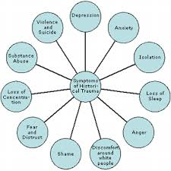
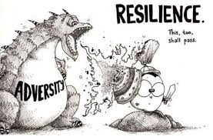
Intergenerational/Historical Trauma Effects
Notes:
Negative Effects:
Positive Effects:
Resilience – the ability to become strong, healthy or successful again after something bad happens
Adaptive survival behaviors – increased religious/spiritual coping
Evolutionary enhancements – the strong survive
Adaptive African-American Cultural Factors:
Spirituality, religious involvement
Strong kinship bonds
Role flexibility
Communalism
Rich affectivity, verve
Keeping it real

Slide 60
Historical Trauma Perpetuated Today
Microaggressions are everyday experiences of discrimination, racism, and daily hassles that are targeted at individuals from diverse racial and ethnic groups (Evans-Campbell, 2008). Health disparities, substance abuse, and mental illness are all commonly linked to experiences of historical trauma (Miachels, Rousseau, and Yang, 2010).
Notes:
Discussion Questions:
1. In what ways do you see the psychological effects of historical trauma or microaggressions in your work with children and families? 2. In what ways do patterns of discipline, eating, etc. born out of historically traumatic experiences continue to play out in families today? How can these be understood and addressed in sensitive and healing ways? 3. How might the forced breakup of families impact a person’s identity, feelings of belonging, and connection to community? 4. How does language impact people’s views of what is good and bad? How do long-standing terms contribute to the development of children’s identities?

Slide 61
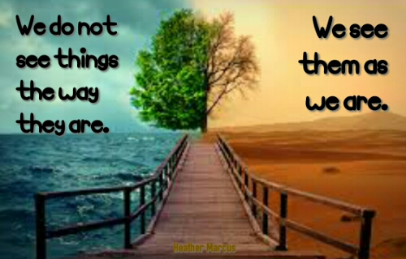
Trauma Shapes Our Beliefs
Worldview
Spirituality
Identity

Slide 62
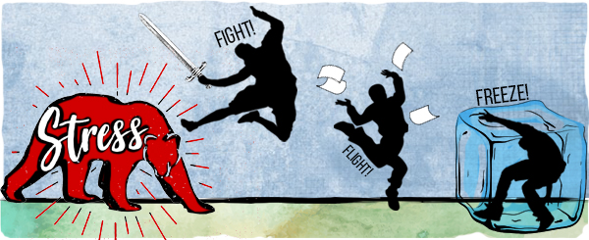
Survival Mode Response
Notes:
When a traumatic event happens, we innately either fight, flight or freeze.

Slide 63
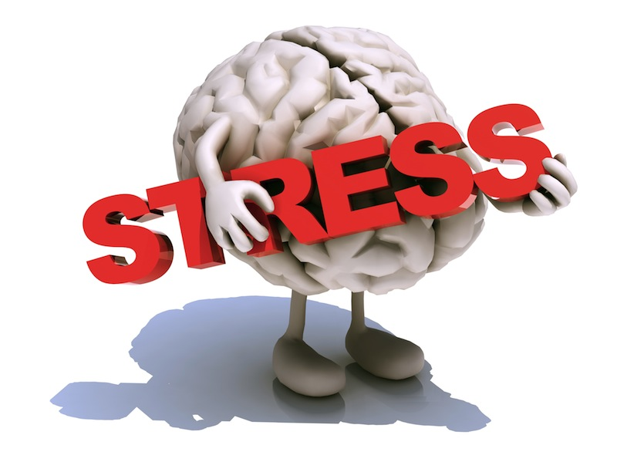
Survival Mode Response
Inability to
Respond
Learn
Process
Notes:
Under stress, a brain goes to “Fight, flight or freeze” mode and our ability to respond, learn and process is severely compromised.
62

Slide 64
Impact of Trauma on Behavior Triggers
External reminders of traumatic event
Smell
Sound
Sight
Touch
Taste
Internal reminders of traumatic event
Emotions
Thoughts
Notes:
Triggers can be positive or negative—apple pie cooking, smell of turkey at Thanksgiving, burning leaves in the fall, flowers in the spring, a fresh rain. But when triggers are paired with negative emotions, they become negative triggers that will connect to that negative emotion. The body will feel all the sensations that were felt at the time of the event connected to the trigger. An example, the smell of a certain flower can be positive. However, when it is smelled at a funeral of someone you love, the feelings of grief can become associated with the smell of the flower thus it becoming a negative trigger for you. Unfortunately it is not possible to know all of the things that may trigger someone.
However, we can assist people in learning what their triggers are and developing strategies for working with them.

Slide 65
What’s Sitting in the Room from Trauma
Disrupted Mood
Regressive behavior
Perfectionism
Fear
Anger
Difficult concentrating
Defiance
Aggression
Difficulty forming relationships
Low self-esteem
Physical Illness
Avoidant behavior
Sleep problems
Dissociation
Guilt
Persistent irritability
Sensory sensitivity
Inattention
Trauma re-enactment
Depression
Need to control
Hyper arousal
Mistrust
Shame
Traumatic grief
Notes:
These are the kinds of seen and unseen burdens people bring into the room with them when they have been traumatized.
Children with trauma histories may have problems thinking clearly, reasoning, or problem solving. They may be unable to plan ahead, anticipate the future, and act accordingly. When children grow up under conditions of constant threat, all their internal resources go toward survival. When their bodies and minds have learned to be in chronic stress response mode, they may have trouble thinking a problem through calmly and considering multiple alternatives. They may find it hard to acquire new skills or take in new information. They may struggle with sustaining attention or curiosity or be distracted by reactions to trauma reminders. They may show deficits in language development and abstract reasoning skills. Many children who have experienced trauma have learning difficulties that may require support in the academic environment.

Slide 66
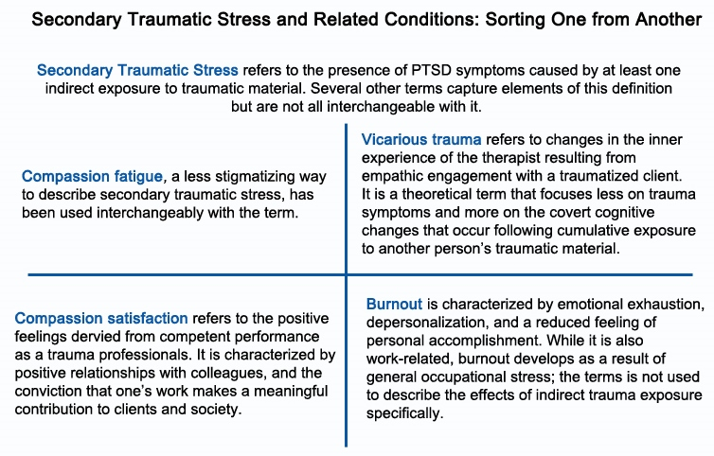
Notes:
Secondary Trauma or traumatic stress refers to the presence of PTSD symptoms caused by at least one indirect exposure to traumatic material. Some of the symptoms include nightmares, bad memory, insomnia, hopelessness, no focus, irritability, shame, etc. Compassion fatigue is a less stigmatizing way to describe secondary trauma and can be used interchangeably with STS. Vicarious trauma refers to changes in the inner experience of the staff member resulting from empathic engagement with a traumatized client. It focuses on the covert cognitive changes that occur following cumulative exposure to another person’s traumatic material.
Example: A young clinician has a great support system and many friends that she is extremely close to. After years of working with children in the child welfare and juvenile justice systems and hearing details of their traumatic experiences, she becomes pregnant. Once the child is born, she refuses to allow any of her friends or support system near her child, as she is now concerned about what may happen to her child.
Compassion satisfaction, which is what we want staff to experience, refers to the positive feelings derived from competent performance as a trauma professional, which everyone is. It is characterized by positive relationships with colleagues and the conviction that ones work makes a meaningful contribution to clients and society.
Burnout is characterized by emotional exhaustion, depersonalization and a reduced feeling of personal accomplishment. While it is also work-related, burnout develops as a result of general occupational stress. The term is not used to describe the effects of indirect trauma exposure specifically.

Slide 68
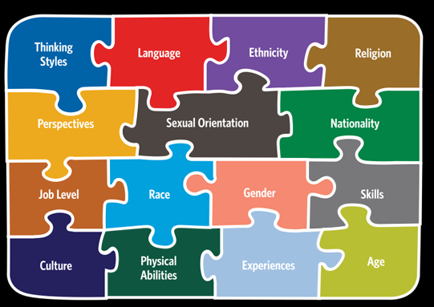
Components of Diversity

Slide 69
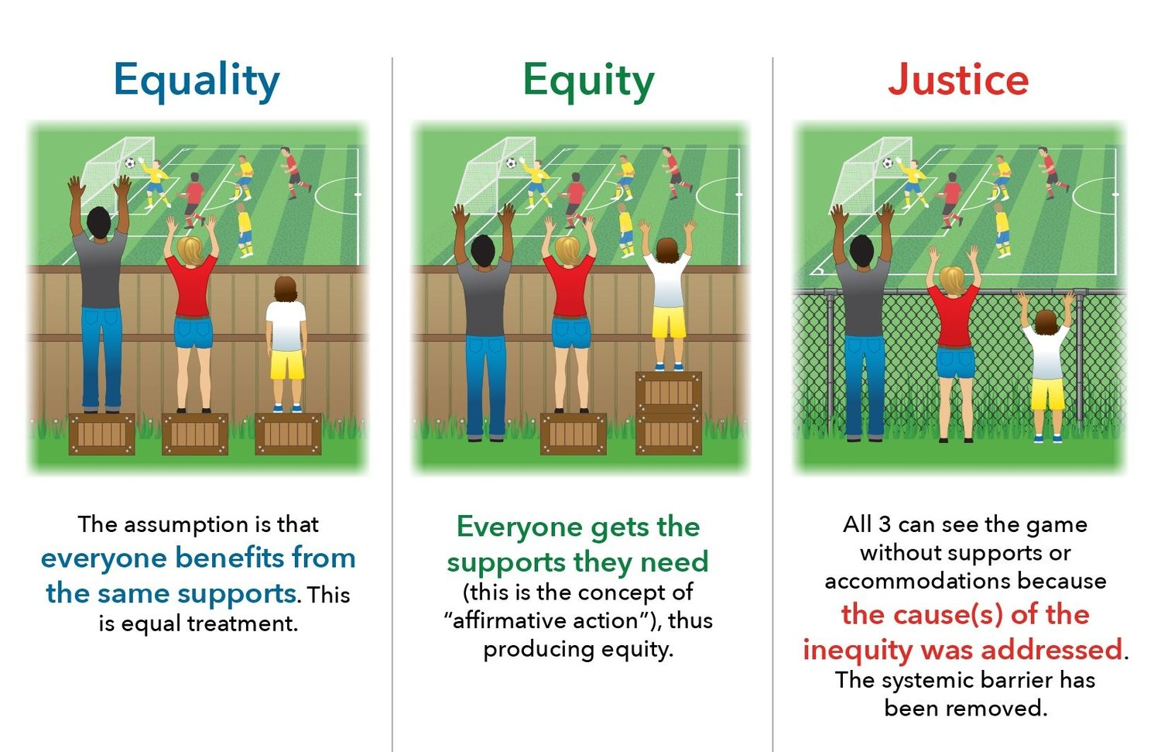

Slide 71
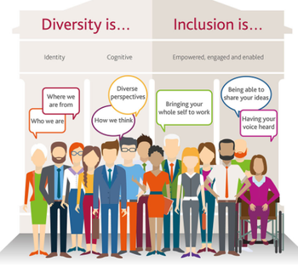

Slide 72
Recognize our Humanity
We’re all just trying to survive.
We frequently observe misplaced coping strategies.
We are all part of the problem therefore we can all be part of the solution.

