Slide 1
For the trainer:
Please note this slide deck is not a train the trainer presentation with fully developed scripts and exercises. These slides and accompanying notes are offered as suggestions. Slides may be used separate from the slide deck and in a different order than how they are currently presented.
If slides are used, please use the citation below and maintain all original citations found on the slides.
National Council for Behavioral Health. Fostering Resilience and Recovery: A Change Package for Advancing Trauma-Informed Primary Care. 2019.

Slide 2
Trauma-Informed Supervision

Slide 3

What factors contribute to a person’s satisfaction with their work?

Slide 4

Workforce Wants
Reasonable compensation
Ability to do excellent work
Professional and personal balance
Healthy relationships
Chance to grow
Sense of meaning
Fabulous Rock Star Bosses

Slide 5
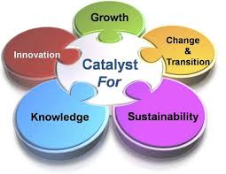
Supervisors are the Catalyst
“Walk the Walk” as a way to “Teach the Talk”
Power of Influence
Visibility
Teaching Opportunity

Slide 6
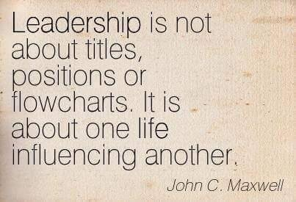

Slide 7

Supervision: Why Is It Important?
The work demands support
Mitigates risk of burn out and vicarious trauma
Enhances the commitment of staff to the organization and the work
Strengthens the competency of both supervisor and supervisee

Slide 8
Supervision Aligns with Principles and Practices of TIC
Growth: Mutual professional development process designed to reinforce and enhance the skills and knowledge of both parties
Safety: Drives out fear and drives in trust
Respect: Language, tone and body language demonstrates value for each person’s integrity and worth
Control: Relationship recognizes different levels of responsibility without exertion of dominance and power
Transparency: Interactions are honest without hidden agendas
Support: Recognition that all individuals working in human services are at risk for emotional exhaustion, depersonalization and lack of accomplishment and meaning

Slide 9

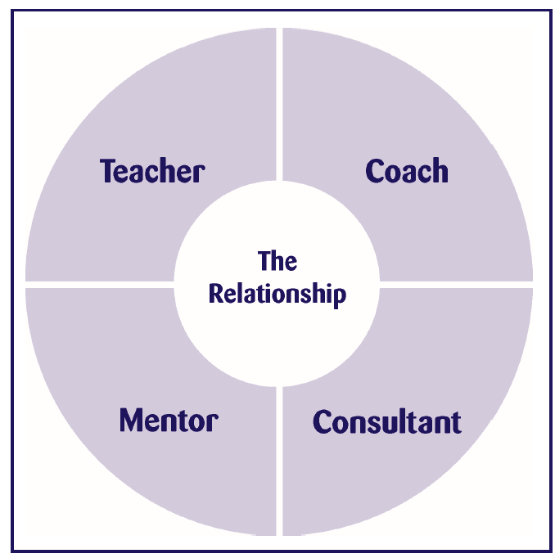
Your Vital Role: Many Hats
Notes:
Effective supervisors observe, mentor, coach, evaluate, inspire, & create an atmosphere that promotes self-motivation, learning, & professional development. They build teams, create cohesion, resolve conflict, & shape agency culture, while attending to ethical & diversity issues in all aspects of the process.

Slide 10

With a table partner discuss the following:
Pick two roles of a supervisor listed on the last slide, define each role.
Can or do you move fluidly between different roles?
What are the barriers to doing so at your setting?
Why might finding a balance between the roles be essential for supervising work with patients that may have experienced trauma?
What does the term “developing a colleague through supervision” mean to you?

Slide 11
What Supervisors Need to Know
Beyond Management: Understanding the Integrated role of modern supervision
    How supervisors support organizational change?
    The impact of change on the workforce?
Understanding the principles and practices of trauma-informed care adds value to the supervisory process
Process of burnout in staff AND leadership
Secondary and vicarious trauma matters
Promote job commitment and satisfaction
Role of supervisors as mentors and coaches
What effective supervisors do

Slide 12


Traditional, Management-Focused Supervision
Modern Supervision

Slide 13
Modern Supervision: Integrating Leadership and Management
Management Functions
Coping with complexity
Order and consistency
Procedures and policies
Staffing (roles and responsibilities)
Documentation
Fiscal viability
Risk management
Leadership functions
Coping with change
Adapting to shifting conditions, expectations and environments
Anticipating changes
Initiating changes
Notes:
Leadership
Setting a direction to meet new challenges
Develop a vision for the future
Engage others in developing strategies to successfully meet changing conditions
Management
Establish daily, weekly and monthly goals
Steps/actions team members need to take
Organize meetings to insure needed steps and actions take place
Allocate human and other resources to meet goals
Order and consistency
Procedures and policies
Staffing (roles and responsibilities)
Documentation
Fiscal viability
Risk management
Control and problem solve
Monitor and identify deviations
Confront people who are not meeting expectations

Slide 14
TIC: Basic Assumptions
Symptoms are adaptations.
Trauma shapes the survivor’s basic beliefs about identity, world view, and spirituality or meaning-making.
Using a trauma framework, the effects of trauma can be addressed within mental health (and substance use) treatment systems.
When worker and client share a trauma perspective, they can collaborate.
Workers need support from one another, including respect, information, connection, and hope.
Working with survivor clients affects the person of the helper, too.
-Saakvitne, et al., 2000

Slide 15

Six Principles of Interaction
Principles of Interaction
Always Empower, Never Disempower
Provide Unconditional Positive Regard
Maintain High Expectations
Check Assumptions, Observe, and Question
Be a Relationship Coach
Provide Guided Opportunities for Helpful Participation

Slide 16

Practicing the Six Principles
Find a partner at your table.
Together choose a scenario
Discuss the scenario and identifying the impact of vicarious trauma on the staff member.
Apply the 6 principles to the case—which are the most important to use?
Notes:
Part I: In preparation for this activity:
Create short scenarios about students, staff or clients with challenges. Include enough of the back story to help people understand some of the reasons behind the individual’s difficulties, behaviors and decisions. Print these out for participants and include these questions at the end of each scenario:
What traumatic event(s) did this person experience?
What specific strategies from the 6 Principles handout can you use to help this person?
What are you currently doing that provides support?
What vicarious trauma is the staff person experiencing when working with this person?

Slide 17
Reflective Supervision
Reflective supervision supports professional development through promoting understanding of what the worker brings to the situation that can help or hinder the change process.
Reflective supervision promotes and supports the development of a relationship-based organization.
Zero to Three, Three Building Blocks of Reflective Supervision, retrieved on 11/1/19 from https://www.zerotothree.org/resources/412-three-building-blocks-of-reflective-supervision
Notes:
Reflective supervision/consultation is a distinctive form of competency-based professional development. Reflective supervision/consultation is distinct from administrative supervision and clinical supervision due to the shared exploration of the parallel process. That is, attention to all of the relationships is important. It is critical to understand how each of these relationships affects the other. Of additional importance, reflective supervision/consultation relates to professional and personal development within one’s discipline by attending to the emotional content of the work and how reactions to the content affect the work. Finally, there is often greater emphasis on the supervisor/consultant’s ability to listen and wait, allowing the supervisee to discover solutions, concepts and perceptions on his/her own without interruption from the supervisor/consultant.
Reflective Supervision and Consultation: References and Suggested Resources
Bernstein, V. (2002-03). Standing Firm Against the Forces of Risk: Supporting Home Visiting and Early Intervention Workers through Reflective Supervision. Newsletter of the Infant Mental Health Promotion Project (IMP). Volume 35, Winter 2002 to 2003. 22003.
Bertacchi, J. & Gilkerson, L. (2009). How can administrative and reflective supervision be combined? In S. Heller & L. Gilkerson [Eds.] A Practical Guide to Reflective Supervision. (pp. 121-131). Washington D.C: ZERO TO THREE
Bertacci, J. & Coplon, J. (1992). The professional use of self in prevention. In Fenichel, E. (Ed.). Learning Through Supervision and Mentorship to Support the Development of Infants, Toddlers and their Families: A Source Book. pp. 84-90. Washington, D.C.: ZERO TO THREE
Center for Mental Health Services, Substance Abuse and Mental Health Services Administration and Services, U.S. Dept. of Health and Human Services. (2000). Early childhood mental health consultation (monograph). Washington, DC: National Technical Assistance Center for Children’s Mental Health, Georgetown University Child Development Center.
Eggbeer, L., Mann, T. & Seibel, N. (2007). Reflective supervision: Past, present, and future. ZERO TO THREE, Vol. 28, No. 2. ( November, 2007)
Fenichel, E. (Ed.). (1992). Learning Through Supervision and Mentorship to Support the Development of Infants, Toddlers and their Families: A Source Book. Washington, D.C.: ZERO TO THREE.

Slide 18
Objectives of Reflective Supervision
Establish a trusting relationship
Be emotionally present
Listen, teach, guide, nurture and support
Apply integration of emotion and reason
Foster reflective process for worker
Attend to how reactions to the content affect the process
Allow time for personal reflection

Slide 19



Building Blocks of Reflective Supervision
Notes:
The three building blocks to reflective supervision are Reflection, Collaboration and Regularity. Every level of the organization must be engaged in order for time to be regularly dedicated to RS. This commitment to RS is essential: not only must the supervisor/supervisee prioritize it, but its scheduled time must take precedence even over client visits if it is to be maintained and flourish as a method of staff reflection and development. A focus on caseload alone, or pressure on supervisors to increase productivity to the exclusion of supervision time, leads to shortchanging reflective practice
In order for RS to work, supervisees must be able to trust that the information they share is private that the work they do in supervision is part of a professional growth process. This is facilitated by setting aside time and private space for supervision In settings where the supervisory approach has been less relational and more administrative, it may take time to build the kind of trust necessary for effective reflective supervision

Slide 20
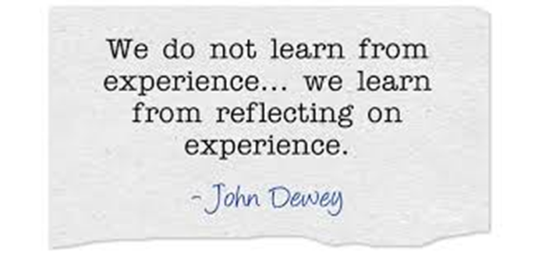
Notes:
Requires foundation of honesty and trust
Allows for people to do their best thinking
Environment is characterized by safety, calmness, and support
Working through complex emotions in a “safe place” allows the supervisee to manage the stress she experiences on the job. It also allows the staff person to experience the very sort of relationship that she is expected to provide for infants, toddlers, and families. It allows individuals to make mid-course corrections in work performance that feel natural, unforced, and generated from within.

Slide 21
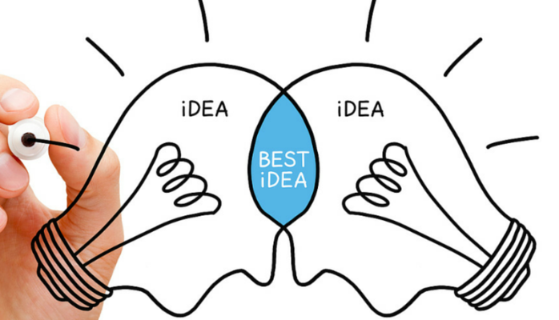
Notes:
Emphasizes sharing the responsibility and control of power, which is derived from knowledge—about children and families, the field, and oneself in the work. While sharing power is the goal of collaboration, it does not exempt supervisors from setting limits or exercising authority. These responsibilities remain firmly within the supervisor’s domain. Collaboration does, however, allow for a dialogue to occur on issues affecting the staff person and the program.
Allows staff to express interest in taking on new tasks and to exercise some control over the terms and conditions of their work
Offers supervisors the chance to learn from, as well as teach, staff.
Allows supervisors to recognize opportunities to share responsibility and decision-making and, in so doing, cultivate leadership talent from within.

Slide 22
Times to Pause and Reflect
Labeling/ dehumanizing language
Sarcasm
Sugar-coating
Avoidance
Loss of Empathy

Slide 23
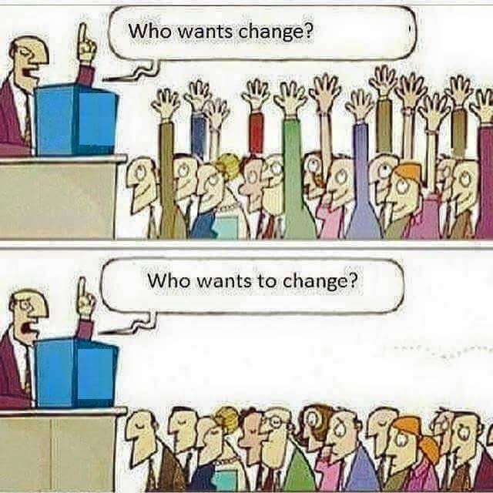
Notes:
We need to create a mutually respectful interpersonal climate that fosters safety, trust, choice, collaboration, and empowerment
“Mistakes made here often.”

Slide 24
Creating a Strengths-Based Environment
Parallel the principles of recovery-oriented systems and trauma-informed care in supervision.
Shift the focus away from a deficit-based view of clients and staff
Encourage the individual to identify personal strengths and skills
When confronted with challenges in practice, solicit individual’s ideas about how he/she may have done things differently.

Slide 25

Clear & High Expectations
Expect quality
  Define it
  Talk about it
  Recognize and praise it
  Encourage it
Build it from strengths
Assume people want to grow, even if they don’t know how
Expect lots of mistakes and learn from them
What gets in the way of clear and high expectations?
Notes:
It’s ok to expect a lot. It’s the spirit in which you present it and demonstrate it. Don’t give energy to the negative. Feed the positive. More people actually want to be there and want to do well.
Clear expectations and giving supervisee’s the chance to use their strengths every day at work are the most predictive of what the best leaders do.
Assumptions and the curse of knowledge – when something makes sense to you – privy to info bc a supervisor, or an 11 year old with video games!
Everyone knows how to use Google calendar
Sending emails over the weekend sets a culture even if you tell staff they don’t need to respond over the weekend
Specific deadlines vs “asap” or being cc’d on emails as FYI or expect action to be taken

Slide 26

Day-to-Day Expectations
Support staff right away, from the beginning
Carefully manage workloads
Help them manage time, calendars, schedule, deadlines
Help them prioritize
Nurture healthy work life and personal balance.
Policy and Procedures
Structure
Notes:
Start from the beginning giving your staff meaningful and clear support and direction. Especially when they first start work. This is particularly critical for any staff who are new to your organization or new to the workforce.
Clear expectation example: Treating clients with respect and that looks like – person first language, collaborative documentation, etc.

Slide 27

Most people won’t really listen
or pay attention to your point of view
until they become convinced
that you’ve heard and appreciated theirs.
-M Nichols
Notes:
Reflective listening can be a difficult skill to master. The other person becomes the center of attention and there is no attempt made to influence his or her perception of reality or what he or she is saying.

Slide 28

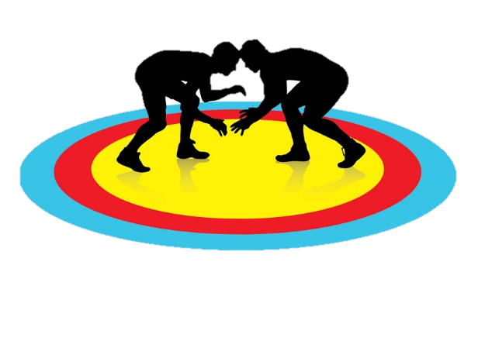
Who Would You Rather Work With?
Defensive
Oppositional
Argumentative
Disengaged
Passive
Powerless
Unable to change
Open
Cooperative
Listening
Engaged
Active
Empowered
Hopeful

Slide 29

What is Your View?
Deficit | Competence
Insight & knowledge is lacking Telling | Capacity to change is within Asking and listening
Notes:
Patient capacity vs incapacity
When clients are viewed primarily from a deficit perspective (e.g., being in denial; lacking insight, knowledge, and skills), it makes little sense to spend time eliciting their own wisdom. This is a clinician-centered approach.

Slide 30

"Affirmations are our mental vitamins,
providing the supplementary positive thoughts we need to balance the barrage
of negative events and thoughts we experience daily.“
—Tia Walker

Slide 31

Attributes of Successful Changers
Accepting
Adaptable
Alert
Ambitious
Assertive
Brave
Careful
Committed
Considerate
Creative
Patient
Persistent
Reasonable
Reliable
Steady
Strong
Thorough
Trusting
Truthful
Willing
Determined
Eager
Faithful
Flexible
Focused
Forgiving
Hopeful
Ingenious
Mature
Open
Notes:
Have participants circle words from this list. Then: “Tell me about a time you were _____”
Easier than asking “what are your strengths?”

Slide 32

Strengths-Based Questions to Prompt Change
What would need to happen for you to want to make this change? (Desire)
How would you approach it? (Ability)
What are the three best reasons for you? (Reason)
What’s most important to you? (Need)
What could you do differently? (Commitment)
What might be your next step? (Action)

Slide 33

“Yeah, but…”
Reflect back both sides of the ambivalence
Some days it’s hard to do this work,
and you want to do all you can to support your clients in their recovery.
Notes:
This is more than just a simple reflection as it points out ambivalence if the client has started bringing this out. “I want to be more productive but I’m just too depressed to even get out of bed.”
Double sided reflection should connect the “sustain talk” (it’s too hard, I can’t do it, etc) with the “change talk” (I want to feel better, I wish things were different, I could, etc) by using AND instead of BUT which gives equal value to both sides of the argument.

Slide 34

Collaboration and Mutuality
There is true partnering and leveling of power differences between staff and clients and among organizational staff from direct care staff to administrators. There is recognition that healing happens in relationships and in the meaningful sharing of power and decision-making. The organization recognizes that everyone has a role to play in a trauma-informed approach.
Notes:
Every employee
Is educated about TIC
Understands they play a critical role in creating a safe and trusting, healing environment
Is embraced as a critical piece in accomplishing this vision

Slide 35

Balint Groups
Often used in the medical profession to review cases but can be used in clinical group supervision
6 – 12 clinicians or staff members meet to “review” cases.
  Allow them to create their own solutions
Helps curb some of the negative effects of caregiving by normalizing the feelings of the caregiver and helping them understand what is happening to the caregiver to evoke the feelings.

Slide 36

Non-violent Communication
Purpose:
  Create human connections that empower compassionate giving and receiving
  Create governmental and corporate structures that support compassionate giving and receiving
Skills:
  Observation vs. evaluation
  Feeling vs. thinking
  Connecting
  Requesting
Notes:
Nonviolent Communication (NVC) is sometimes referred to as compassionate communication. Its purpose is to:
create human connections that empower compassionate giving and receiving
create governmental and corporate structures that support compassionate giving and receiving.
NVC involves both communication skills that foster compassionate relating and consciousness of the interdependence of our well being and using power with others to work together to meet the needs of all concerned.
This approach to communication emphasizes compassion as the motivation for action rather than fear, guilt, shame, blame, coercion, threat or justification for punishment. In other words, it is about getting what you want for reasons you will not regret later. NVC is NOT about getting people to do what we want. It is about creating a quality of connection that gets everyone’s needs met through compassionate giving.

Slide 37

Non-violent Communication (NVC) Overview
Conflicts arise from miscommunication over our human needs
  Use of coercive or manipulative language that aims to induce fear, guilt, shame, etc.
These "violent" modes of communication, when used during a conflict, divert the attention of the participants away from clarifying their needs, their feelings, their perceptions, and their requests, thus perpetuating the conflict.
  -From the work of Marshall Rosenberg, Ph.D.
Notes:
Nonviolent Communication is the integration of 4 things:
Consciousness: a set of principles that support living a life of empathy, care, courage, and authenticity
Language: understanding how words contribute to connection or distance
Communication: knowing how to ask for what we want, how to hear others even in disagreement, and how to move toward solutions that work for all
Means of influence: sharing “power with others” rather than using “power over others”

Slide 38
NVC Assumptions
All human beings share the same needs
Our world offers sufficient resources for meeting everyone's basic needs
All actions are attempts to meet needs
Feelings point to needs being met or unmet
All human beings have the capacity for compassion
Human beings enjoy giving
Human beings meet needs through interdependent relationships
Human beings change
Choice is internal
The most direct path to peace is through self-connection

Slide 39
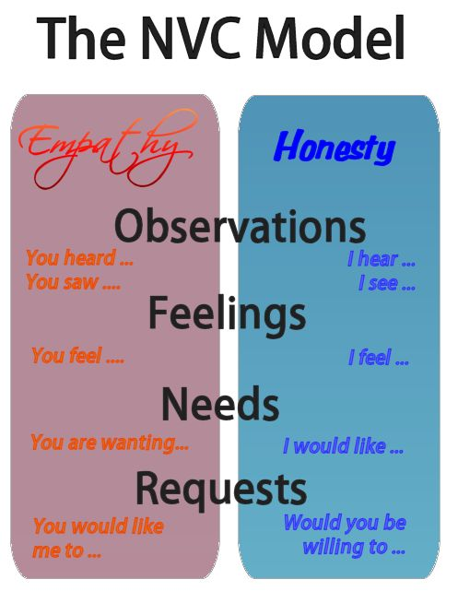
Center for Nonviolent Communication

Slide 40
Outline of the Model
When I see that______________
I feel ______________
because my need for ________________ is/is not met.
Would you be willing to__________________?

Slide 41
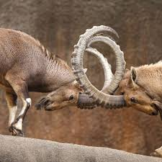
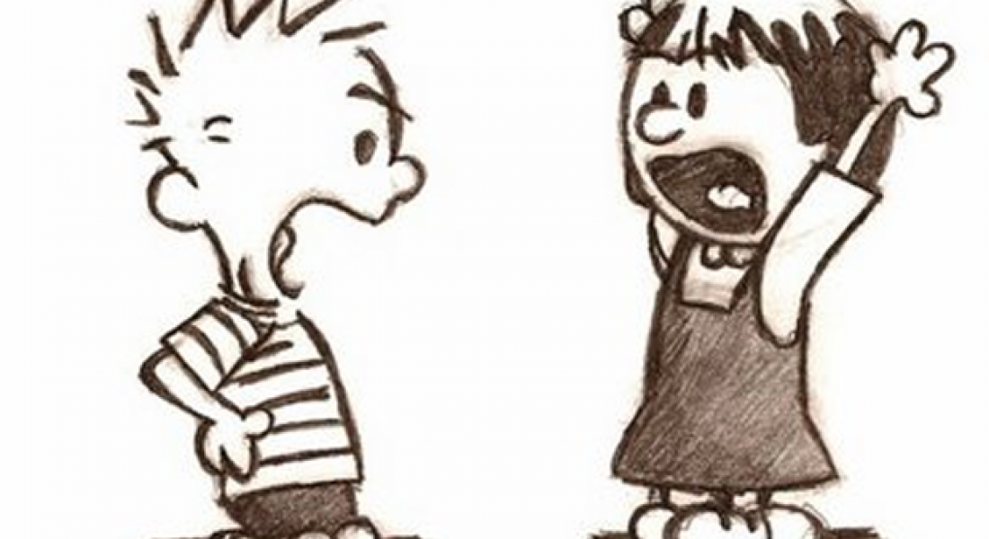
Conflict
Success depends on your ability to distinguish observations from judgments

Slide 42

The Motivational Interview Sandwich
  1. Elicit
  Would you like to hear more about …? What do you know about…?
  2. Advise
  That’s partially correct…In addition…
  3. Elicit
  What do you think?
  How, if at all, has this impacted your thinking?
https://www.integration.samhsa.gov/clinical-practice/motivational-interviewing

Slide 43
Feedback should:
Be about quality care and not personal attacks
Lead to ongoing personal and professional development
Reduce stress
Help improve interpersonal relationships
Develop a healthy organizational climate
Enhance job performance

Slide 44

Power of Positive Reinforcement
Reinforce specific behavior
Use immediate reinforcement
Reward small, incremental achievements
Use intermittent reinforcement
Notes:
Rewards Based Environment

Slide 45





Types of Rewards
Verbal Praise
Written Praise
Symbolic Rewards
Other Ideas?
Notes:
Evidenced/Specific Feedback

Slide 46
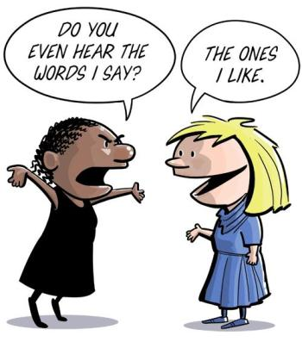
Paired Discussion
Notes:
Paired exercise. Describe a conflict you have with someone (personal or professional) to your partner. First person Walk through the TEACH steps and role play out how you might engage them in conflict resolution. Second person, use the MI Sandwich technique in your role play to resolve conflict.

