Slide 1
Certified Community Behavioral Health Clinic Overview

Slide 2
Acknowledgements and Disclaimer
This publication was made possible by Grant Number 1H79SM085856 from the Substance Abuse and Mental Health Services Administration (SAMHSA). Its contents are solely the responsibility of the authors and do not necessarily represent the official views, opinions or policies of SAMHSA or the U.S. Department of Health and Human Services (HHS).

Slide 3
What is a CCBHC?
The Certified Community Behavioral Health Clinic (CCBHC) is an integrated community behavioral health model of care that aims to improve service quality and accessibility. CCBHCs do the following:
Provide integrated, evidence-based, trauma-informed, recovery-oriented and person-and-family-centered care.
Offer the full array of CCBHC-required mental health, substance use disorder (SUD) and primary care screening services.
Have established collaborative relationships with other providers and health care systems to ensure coordination of care.
Notes:
SPEAKER NOTES
The Certified Community Behavioral Health Clinic model is designed to ensure access to coordinated comprehensive behavioral health care. CCBHCs are required to serve anyone who requests care for mental health or substance use, regardless of their ability to pay, place of residence, or age. That includes developmentally appropriate care for children and youth. CCBHCs must meet standards for the range of services they provide, and they are required to get people into care quickly. An important feature of the CCBHC model is that it requires having crisis services that available 24 hours a day, 7 days a week. CCBHCs are also required to provide a comprehensive array of behavioral health services so that people who need care are not caught trying to piece together the behavioral health support they need across multiple providers. In addition, CCBHCs must provide care coordination to help people navigate behavioral health care, physical health care, social services and the other systems they are involved in.

Slide 4
CCBHC Criteria Program Requirements
1. Staffing
2. Availability and Accessibility of Services
3. Care Coordination
4. Scope of Services
5. Quality and Other Reporting
6. Organizational Authority, Governance and Accreditation
Staffing plan driven by local needs assessment.
Licensing and training to support service delivery.
Standards for timely and meaningful access to services, outreach and engagement.
24/7 access to crisis services, treatment planning and acceptance of all patients regardless of ability to pay.
Care coordination agreements across services and providers.
Defining accountable treatment team, health information technology and care transitions.
Nine required services, as well as person-centered, family-centered and recovery-oriented care.
21 quality measures, a plan for quality improvement and tracking of other program requirements.
Consumer representation in governance.
Appropriate state accreditation.
Note: This presentation contains a summary of selected CCBHC certification criteria. To view the full criteria: https://www.samhsa.gov/sites/default/files/programs_campaigns/ccbhc-criteria.pdf
Notes:
SPEAKER NOTES
SAMHSA developed criteria for certifying CCBHCs in compliance with the statutory requirements outlined under Section 223 of the Protecting Access to Medicare Act (PAMA) which helped states establish CCBHCs. These criteria, which establish a basic level of service at which a CCBHC should operate, fall into six key program areas:
Staffing – Staffing plan must be driven by local needs assessment and should ensure the staffing model (both clinical and non-clinical) is appropriate for serving the consumer population in terms of size and composition and providing the types of services the CCBHC is required to and proposes offering. The clinic must meet state licensing and credentialing requirements and outline staff training requirements – including to ensure culturally competent and linguistically appropriate care.
Availability and Accessibility of Services – CCBHC standards for accessibility and availability of services include providing crisis management services 24 hours a day -- delivered within three hours – and providing new consumers with an initial screening that identifies routine screening needs. [WHO] must receive an initial evaluation within 10 business days, and no patient may be rejected for services or limited in services on the basis of their ability to pay or place of residence
Care Coordination – CCBHCs must coordinate care for consumers across settings and providers to ensure seamless transitions for patients across the full spectrum of health services, including acute, chronic and behavioral health needs. This includes partnerships with: (i) Federally-qualified health centers (and as applicable, rural health clinics) to the extent such services are not provided directly through the CCBHC. (ii) Inpatient psychiatric facilities and substance use detoxification, post-detoxification step-down services and residential programs. (iii) Other community or regional services, supports and providers, including schools, child welfare agencies and juvenile and criminal justice agencies and facilities, Indian Health Service youth regional treatment centers, state-licensed and nationally accredited child placing agencies for therapeutic foster care service, and other social and human services. (iv) Department of Veterans Affairs medical centers, independent outpatient clinics, drop-in centers, and other facilities. (v) Inpatient acute care hospitals and hospital outpatient clinics.
Scope of Services – The nine required services that a CCBHC must either provide directly or through a designated collaborating organization are covered on the next slide. All services must reflect person- and family-centered, recovery-oriented care, be respectful of the individual consumer’s needs, preferences and values, and ensure both consumer involvement and self-direction of services received. Services for children and youth must be family-centered, youth-guided and developmentally appropriate.
Quality and Other Reporting – Under the CCBHC Medicaid Demonstration, there are 21 CCBHC quality measures that clinics and states must report on, and the CCBHC is required to have a plan for quality improvement. SAMHSA grantees have different reporting requirements than CCBHCs operating under state CCBHC programs, including completion of the National Outcomes Measures (NOMs) tool with clients, reporting quarterly on Infrastructure Development, Prevention and Mental Health Promotion (IPP) metrics and annual reporting. CCBHC grantees may also be required to report on the CCBHC quality measures.
Organizational Authority and Governance – CCBHCs must ensure board members are representative of the individuals being served by the CCBHC in terms of demographic factors such as geographic area, race, ethnicity, sex, gender identity, disability, age and sexual orientation, and in terms of types of disorders. The CCBHC will incorporate meaningful participation by adult consumers with mental illness, adults recovering from substance use disorders, and family members of CCBHC consumers, either through 51% of the board being families, consumers or people in recovery from behavioral health conditions, or through a substantial portion of the governing board members meeting this criteria and other specifically described methods for consumers, people in recovery and family members to provide meaningful input to the board about the CCBHC’s policies, processes, and services.
CCBHCs must adhere to any applicable state accreditation, certification, and/or licensing requirements.

Slide 5
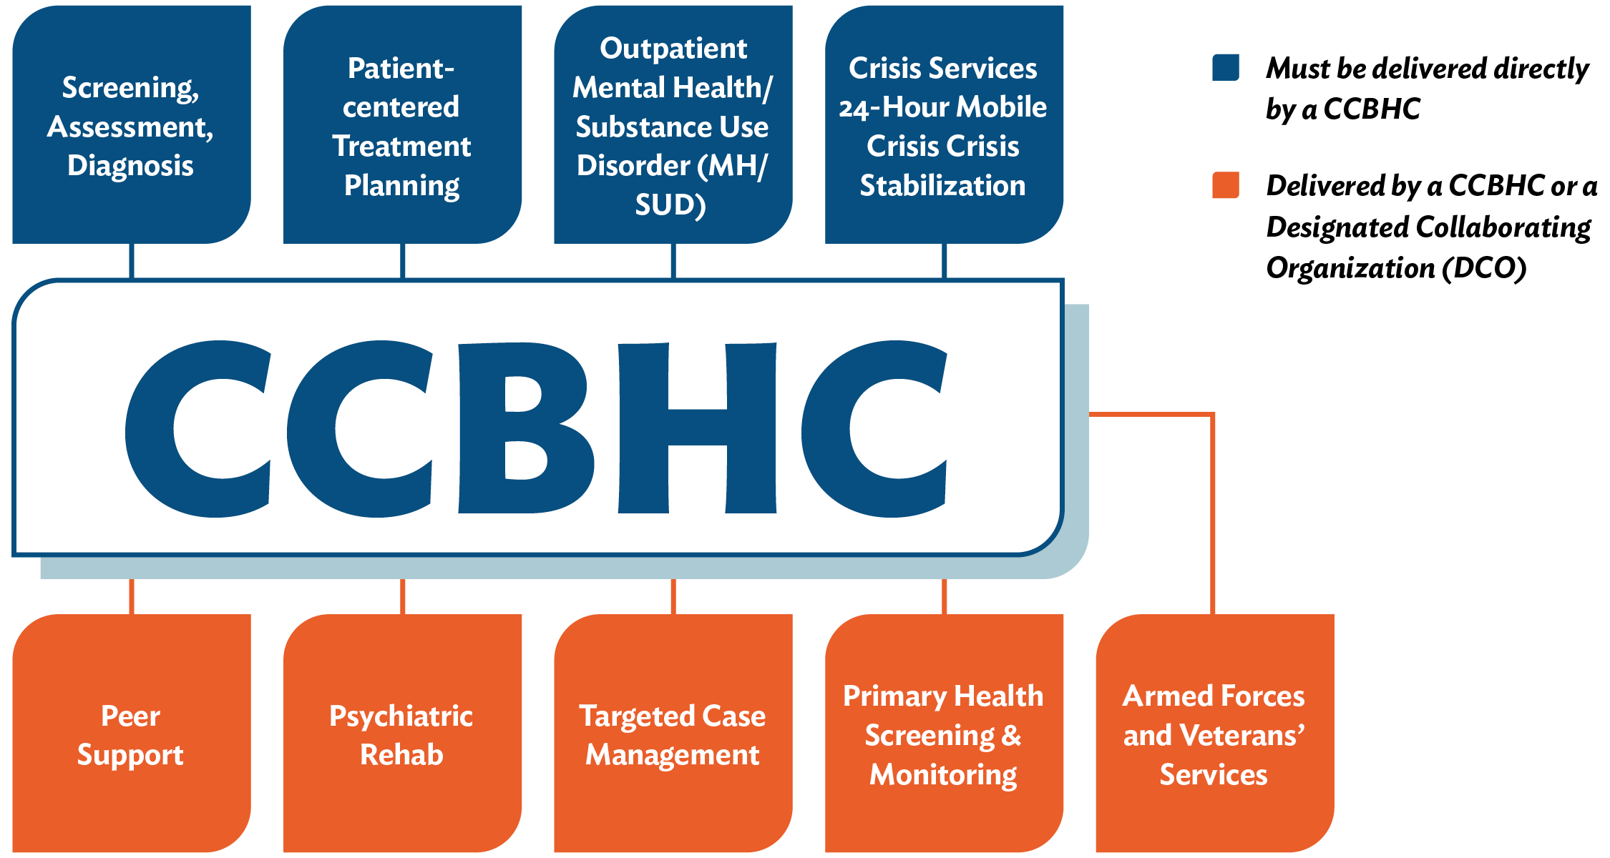
Scope of Services 4.a – 4.k
Notes:
SPEAKER NOTES
CCBHCs are required to provide the following services: Services in blue must be provided directly by the CCBHC. Services in green can be provided directly by the CCBHC themselves or by a designated collaborating organization (DCO). An exception to this is if the CCBHC is operating in a state with a state sanctioned crisis system – in this setting CCBHCs can also engage with the state system as a designated collaborating organization for crisis services.
A DCO is an entity not under the direct supervision of the CCBHC that the CCBHC engages in a formal relationship to deliver specific services under the same requirements as the CCBHC. The CCBHC maintains clinical responsibility for the services provided for CCBHC consumers by the DCO.

Slide 6
The CCBHC Landscape
CCBHC Medicaid Demonstration
State-run program
Clinics are certified as CCBHCs by the state
Clinics receive a prospective payment (PPS)
SAMHSA CCBHC Expansion Grants
SAMHSA provides direct-to-clinic funding to establish CCBHC model.
Clinics attest meeting the CCBHC criteria to SAMHSA.
Clinics receive grant funding to support CCBHC implementation, continue to bill Medicaid as normal for allowable services.
Three implementation options:
State Medicaid demonstration
SAMHSA grant funding
Independent state implementation
Notes:
SPEAKER NOTES
There are currently three funding pathways for CCBHC:
State Medicaid demonstration: In 2017, eight authorized states (Minnesota, Missouri, Nevada, New Jersey, New York, Oregon, Oklahoma and Pennsylvania) launched their CCBHC Medicaid demonstration programs. Two additional states (Kentucky, Michigan) were added in 2021. Through the demonstration program, states certify selected clinics as CCBHCs. Those clinics receive Medicaid payment through a daily or monthly prospective payment system (PPS) rate that is clinic-specific, and clinics are reimbursed based on the expected demonstration cost of services.
SAMHSA grant funding: SAMHSA awards grant funding directly to clinics who attest to meeting the CCBHC requirements. Attesting to meeting the criteria through a grant fund is not the same as certification, however it is recommended that grantees use their grant funding period to understand if there are future opportunities for certification within their state and organize themselves in alignment with requirements for sustainability purposes.
Independent state certification: Several states have started the process of establishing their CCBHC program outside of the Medicaid Demonstration. This process is often started through legislative action and then the states leverage a state plan amendment or 1115 waiver. These states are largely aligning their process with the Medicaid demonstration process of establishing certification programs and paying CCBHCs a PPS based on cost reports.

Slide 7
CCBHC National Movement
2017
8
states
2019
21 states
2020
33 states
66 clinics
113 clinics
229 clinics
40+ states
2021
430+ clinics
The Bipartisan Safer Communities Act included provisions for expansion of the CCBHC Medicaid Demonstration Program.
Beginning July 1, 2024, and every two years thereafter, the legislation allows up to 10 additional states to join the demo.
Notes:
SPEAKER NOTES
Details on expansion. We suggest incorporating your own personal talking points to staff and others, explaining what it means to you to be part of this national movement.
The number of CCBHCs nationwide has grown exponentially since 2017, largely due to the appropriation of grant funding from SAMHSA. The Bipartisan Safer Communities Act law enacted in July 2021 included provisions for expanding the opportunity to apply for the CCBHC demonstration program to all states and territories. It also made available planning grant funds for states to develop proposals to join the program. Provisions of the bill include:
Expands the CCBHC demonstration program to allow any state or territory the opportunity to apply to participate, while allocating additional planning grant monies for states to develop proposals to participate.
Starting in July 2024, and every two years thereafter, up to 10 additional states will be selected by HHS to join the demonstration.
The original eight demonstration program states are extended to September 2025, and the two newer demo states (Kentucky and Michigan) are extended to six years after their program launch.

Slide 8
Early Impact
Since inception of the model, CCBHCs report:
STAFFING: Increased recruitment and hiring of staff, greater staff satisfaction and retention, redesigning care teams.
ACCESS: Decreased wait times for care and elimination of wait lists, targeted outreach to vulnerable, underserved and complex populations, expanding services offered outside the four walls of the clinic.
COMMUNITY IMPACT: Improved partnerships with schools, primary care, law enforcement, hospitals.
HEALTH IMPACT: Reduced hospitalizations/ED visits, improvements in physical health indicators.
CCBHCs expand service delivery services outside the clinic. The top locations included clients’ homes (78%), schools (97%), courts, police offices and other justice-related facilities (86%), and emergency departments (20%).
Notes:
SPEAKER NOTES
These are sample data and outcomes that have been common themes across ASPE reports and National Council CCBHC impact reports. Speakers can feel free to update or change these data points to showcase other references from existing reports that may feel more meaningful to your staff or partners. Key reference documents:
HHS Resources
Implementation Findings from the National Evaluation of the Certified Community Behavioral Health Clinic Demonstration: https://aspe.hhs.gov/reports/implementation-findings-national-evaluation-certified-community-behavioral-health-clinic
CCBHC Demonstration Program Report to Congress, 2020: https://aspe.hhs.gov/reports/fourth-ccbhc-program-report-congress-2020
CCBHC Demonstration Program Report to Congress, 2019: https://aspe.hhs.gov/reports/certified-community-behavioral-health-clinics-demonstration-program-report-congress-2019-0
CCBHC Demonstration Program Report to Congress, 2018: https://aspe.hhs.gov/reports/certified-community-behavioral-health-clinics-demonstration-program-report-congress-2018-0
National Council Resources
CCBHC Impact Report, 2022: https://www.thenationalcouncil.org/resources/2022-ccbhc-impact-report/
CCBHC Impact Report, 2021: https://www.thenationalcouncil.org/wp-content/uploads/2021/05/2021-CCBHC-Impact-Report1.pdf
CCBHC State Impact Report, 2021: https://www.thenationalcouncil.org/wp-content/uploads/2022/02/Transforming-State-Behavioral-Health-Systems.pdf

Slide 9
Early Impact
The average wait time for services is
48 days
nationwide.
71%
see clients for their first appointment within one week.
87%
see clients within 10 days.
https://www.thenationalcouncil.org/resources/2022-ccbhc-impact-report/

Slide 10
Why CCBHC? The Vision for [Insert Org Name]
Tailor this slide to communicate your organization’s mission and vision and create direct connections to how CCBHC status furthers those aims.
Example:
VISION: Healthy Living for Everyone.
MISSION: Our mission is to improve the lives of people affected by mental health and substance use challenges through an array of effective, person-centered services.
WHY CCBHC?
Person, family and community-centered care design – Criteria is intentionally designed with community needs assessment as the driver for staffing and service array.
Focus on access and care coordination – Meets the needs and challenges in accessing services of those we serve and extends how we engage them outside the four walls of the clinic. Takes into account non-health related needs.
Filling gaps in services – Allows us to expand services in areas of need we haven’t previously been able to invest in.
Notes:
SPEAKER NOTES: Tailor this section to create a vision and connection for staff or other stakeholders (board members, etc) on why this model is being pursued and how it helps to achieve current and future goals of the organization.

Slide 11
[Insert Org Name] CCBHC Commitments
Tailor this slide to communicate the commitments you made in your CCBHC grant application to ensure staff are clear on the goals, targets and implementation activities they can expect to be part of. These can be spread across several slides if needed to cover all.
Who we will serve:
Services and evidence-based practices we will provide:
Who we will partner with:
Staffing and training expectations:
Infrastructure Investments we will make:

Slide 12
Discussion
What excites you about becoming a CCBHC?
How do you see this impacting those we serve?
What connections can you make to the model and common challenges or barriers we experience in our work?
What questions do you have about the model?
Notes:
SPEAKER NOTES
Depending on the audience, these discussion questions can be used to garner conversation. These questions are primarily designed with a staff audience in mind, but could be easily adapted for external partners, policymakers or other stakeholders.

Slide 13
Resources
CCBHC-Expansion Grantee National Training and Technical Assistance Center (CCBHC-E NTTAC): The CCBHC-E NTTAC is committed to advancing the CCBHC model by providing SAMHSA CCBHC Expansion Grantees (CCBHC-E grantees) training and technical assistance related to certification, sustainability and the implementation of processes that support access to care and evidence-based practices. The NTTAC supports grantees through free group-based learning activities such as learning communities, trainings, peer engagements, as well as individual consultation and on-demand resources.
Check out past and upcoming events.
Request Training and Assistance from the NTTAC.

Slide 14
Resources
The CCBHC Criteria On-Demand Lessons are a suite of 30- to 60-minute recorded lessons that provide an overview of the CCBHC model and take a deeper dive into CCBHC program requirements.
On-Demand Recordings:
CCBHC 101
Scope of Services
Staffing
Quality and Other Reporting
Care Coordination
Organization Authority, Governance and Accreditation
Availability and Accessibility

Slide 15
APPENDIX: CCBHC Criteria
Notes:
These slides can be incorporated for more detailed learning on the criteria areas.

Slide 16
Staffing (1.a-1.d)
Key Requirement Highlights
Required staff: Clinical and peer staff, psychiatrist as medical director, medically trained behavioral health care provider, individuals with expertise in addressing trauma, SED, SMI, SUD.
Required regular training includes cultural competence, trauma-informed care, integration.
General staffing requirements (1.a)
Licensure and credentialing of providers (1.b)
Cultural competence and other training (1.c)
Linguistic competence (1.d)
Notes:
SPEAKER NOTES
See full CCBHC criteria document for full details on requirements.

Slide 17
Access and Availability (2.a-2.c)
General requirements of access and availability (2.a)
Requirements for timely access to services and initial and comprehensive evaluation for new consumers (2.b)
Access to crisis management services (2.c)
Key Requirement Highlights
New consumers with initial screening that identifies routine screening needs receive an initial evaluation within 10 business days.
The CCBHC provides crisis management services 24 hours a day and are required to be delivered within three hours.
Notes:
SPEAKER NOTES
See full CCBHC criteria document for full details on requirements

Slide 18
Care Coordination (3.a-3.d)
Key Requirement Highlights
The CCBHC coordinates across the spectrum of health services and has protocols in place for care coordination.
The CCBHC has an HIT in place that captures demographic information, provides clinical decision making and can electronically transmit prescriptions.
General requirements of care coordination (3.a)
Care coordination and other health information systems (3.b)
Care coordination agreements (3.c)
Treatment team, treatment planning and care coordination activities (3.d)
Notes:
SPEAKER NOTES
See full CCBHC criteria document for full details on requirements

Slide 19
Data Collection, Reporting and Tracking (5.a-5.b)
Data collection, reporting, and tracking (5.a)
Continuous quality improvement (CQI) plan (5.b)
Key Requirement Highlights
Data requirements for certified clinics v expansion grantees
CQI plans to address suicide attempts and completions, hospital readmissions, and quality of care issues
Notes:
SPEAKER NOTES
See full CCBHC criteria document for full details on requirements

Slide 20
Organizational Authority, Governance and Accreditation (6.a-6.b)
General requirements of organizational authority and finance
Governance
Key Requirement Highlights
Board members are representative of the individuals being served
Notes:
SPEAKER NOTES
See full CCBHC criteria document for full details on requirements

Slide 21
CCBHC-E TTA Center Website
Access to our ever-growing resource library, upcoming trainings and events, and request for individualized support.
Notes:
Link in chat
Review what you will see
Resources – can be sorted by overarching criteria areas or focused topics
Multiple phases and continue to expand

Slide 22
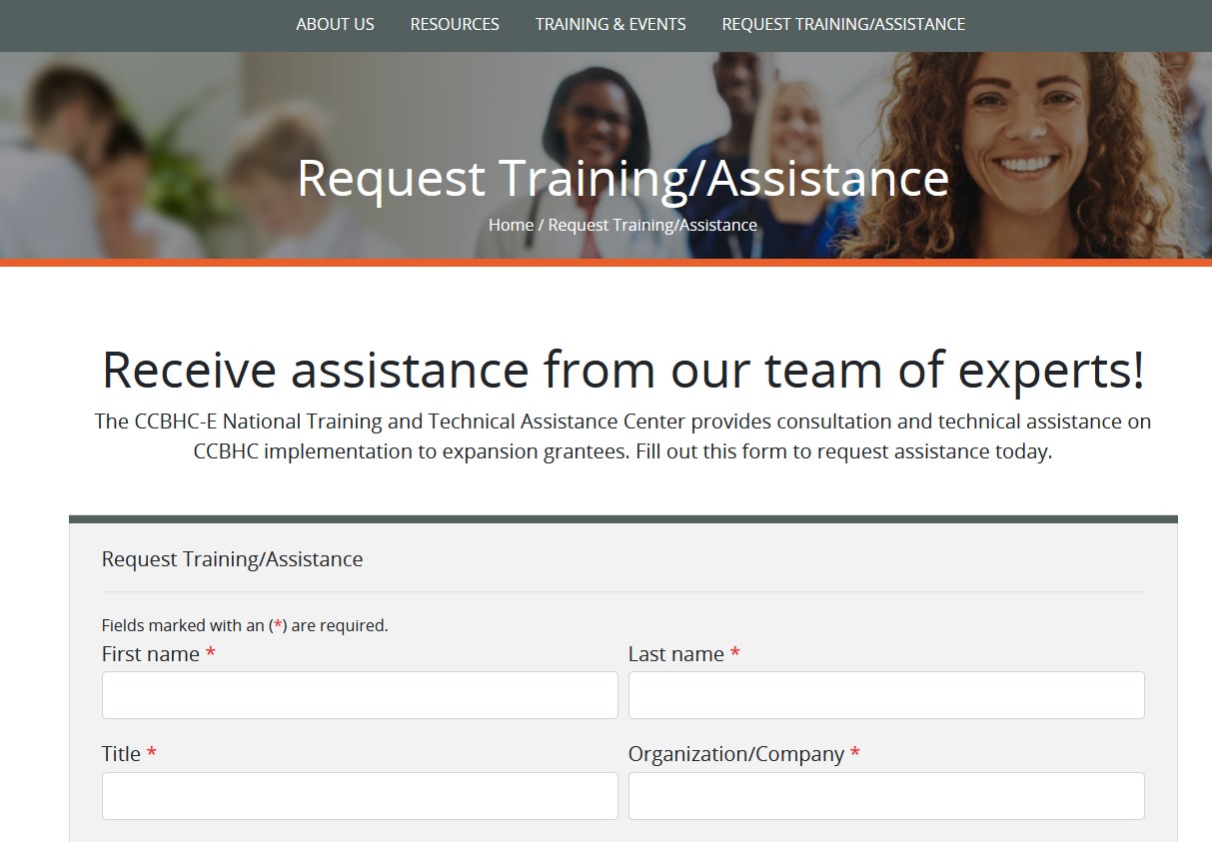
Questions or Looking for Support?
Visit our website and complete the Request Technical Assistance form (links located at the top and bottom of the home page)
https://www.thenationalcouncil.org/ ccbhc-e-nttac/

