Slide 1
CoE-IHS Office Hour: Findings and Recommendations from the Oral Health Integration ECHO
Tuesday, January 17, 2023
2-3pm ET

Slide 2
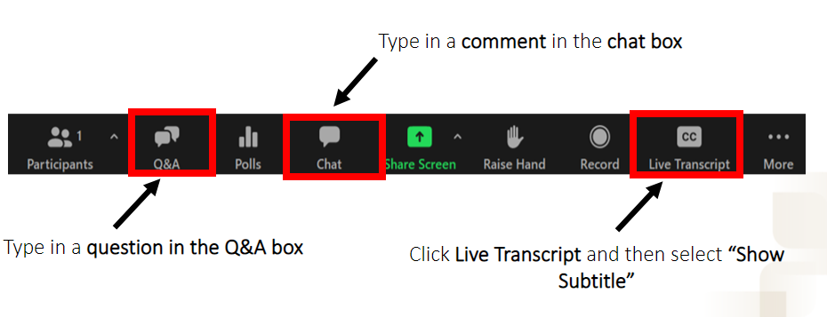
Questions, Comments & Closed Captioning

Slide 3
Disclaimer
The views, opinions, and content expressed in this presentation do not necessarily reflect the views, opinions, or policies of the Center for Mental Health Services (CMHS), the Substance Abuse and Mental Health Services Administration (SAMHSA), or the U.S. Department of Health and Human Services (HHS).
www.samhsa.gov

Slide 4
Introductions
Moderator
•Rachael Matulis, MPH, Principal, Bowling Business strategies
Panelists
•Mana Mozaffarian, DMD, Former Chief Dental Officer, Commonwealth of Pennsylvania, Integration Dental Consultant
•Stacey Chazin, MPH, MSODL, Principal, Chazin Consulting
•Yurilka A Hernandez, LCSW, CASAC, Vice President in Care Coordination in Crises Services Intervention, Acacia- Bronx, New York
•Kaitlin E. Eddleman, MA, Clinical Care Coordinator Team Supervisor, Berks Counseling Center
•Lynn Manganaro, Clinical Care Coordinator, Berks Counseling Center
Learn more about our speakers & their subject matter expertise on our website!
Notes:
[insert bios here]
Ivanova Smith, Rights Activist, Chair of Self Advocates in Leadership (SAIL) and Advocate Faculty at the University of Washington Leadership Education in Neurodevelopmental and Related Disabilities (LEND) Program

Slide 5
Past Oral Health Integration ECHO
15 participating organizations providing services to a total of 227,303 individuals
18-session ECHO series
Peer-to-peer learning & didactic presentations
Development of new tools and resources
Read more in our final brief

Slide 6
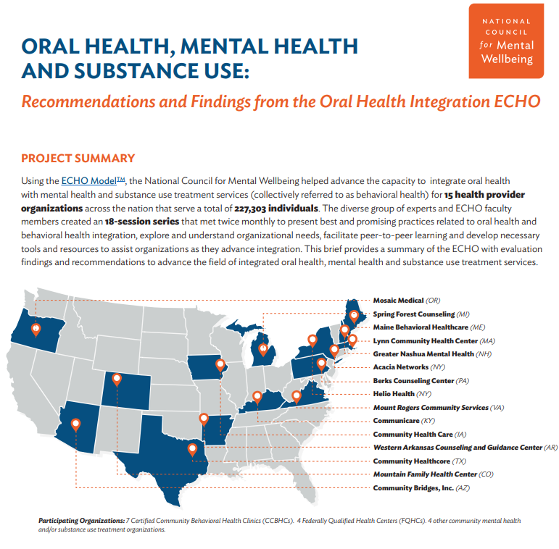
Tools & Resources
Center of Excellence for Integrated Health Solutions
CareQuest Institute for Oral Health
Oral Health Integration Resource Repository
Oral Health, Mental Health and Substance Use: Recommendations and Findings from the Oral Health Integration ECHO
Oral Health, Mental Health and Substance Use: A Framework for Increased Coordination & Integration
Environmental Scan of Oral Health Integration Models
Buprenorphine & Oral Health
Dental as Mental Health – Blog Post
Notes:
[insert bios here]
Ivanova Smith, Rights Activist, Chair of Self Advocates in Leadership (SAIL) and Advocate Faculty at the University of Washington Leadership Education in Neurodevelopmental and Related Disabilities (LEND) Program

Slide 7
Additional Tools & Resources
Trauma-Informed Care and Oral Health: Recommendations for Practitioners
American Dental Association, Medications that Cause Dry Mouth
Oregon Oral Health Coalition
Oral Health Care Tips for Children with Developmental or Behavior Concerns
A Framework for Stratifying Race, Ethnicity and Language Data
Oral Health Risk Assessment Tool
Oregon Oral Health Coalition’s Oral Health Toolkit

Slide 8
Upcoming CoE Events
CoE Office Hour: Advancing Health Equity ECHO Opportunity Information Session
Register for the office hour on Tuesday, January 24th, 2-3pm ET
CoE Office Webinar: Population Health Part 2- Measurement-Informed Care
Register for the webinar on Tuesday, January 31st, 1-2pm ET
Interested in an individual consultation with the CoE experts on integrated care?
Contact us through this form here!
Looking for free trainings and credits?
Check out integrated health trainings from Relias here
Subscribe for Center of Excellence Updates
Subscribe here

Slide 9
Thank You
Questions?
Email integration@thenationalcouncil.org
SAMHSA’s Mission is to reduce the impact of substance abuse and mental illness on America’s communities.
www.samhsa.gov
1-877-SAMHSA-7 (1-877-726-4727) 1-800-487-4889 (TDD)

