Slide 1
CoE-IHS Integration in Action: State Innovations to Improve Integrated Care
August 31, 2023
1-2pm ET

Slide 2
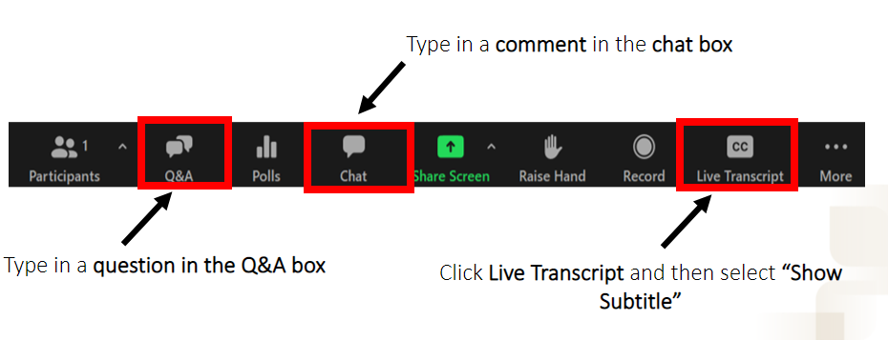
Questions, Comments & Closed Captioning

Slide 3
Disclaimer
The views, opinions, and content expressed in this presentation do not necessarily reflect the views, opinions, or policies of the Center for Mental Health Services (CMHS), the Substance Abuse and Mental Health Services Administration (SAMHSA), or the U.S. Department of Health and Human Services (HHS).
www.samhsa.gov

Slide 4
Speakers
Moderator:
Alicia Kirley, Senior Director for PIC, National Council for Mental Wellbeing
Panelists:
Jay Todd, MPH, Director of Innovation and Engagement, Behavioral Health Services, Texas Health and Human Services
Christina Horan, PIPBHC Site Coordinator, Behavioral Health Services, Texas Health and Human Services

Slide 5
How are States Improving Integrated Care?
Improving access for people with comorbid chronic health conditions as well as mental health and substance use conditions requires more than integrated health care services – it requires health systems integration. State led initiatives in Medicaid, as well as critical Federal integrated care program support and models, such as the Promoting the Integration of Primary and Behavioral Health Care (PIPBHC) grant program and Certified Community Behavioral Health Clinic (CCBHC) model, focus efforts on achieving the aims of improved health, enhanced care, and reduced costs that are associated with developing person-centered systems of care that address an individual's holistic health.
This session will highlight how states are leveraging programs and models like these to develop innovative ways to advance and sustain health systems integration, as well as discuss opportunities for supporting the unique integrated care needs across your state.

Slide 6
Tools and Resources
Sustaining Statewide Certified Community Behavioral Health Clinic Programs
CCBHC State Certification Resource Guide
State Models for Addressing Opioid Use Disorders: Recovery Supporting Integrated Care Settings (2022)
Behavioral Health Workforce is a National Crisis: Immediate Policy Actions for States
2021 CCBHC State Impact Report: Transforming State Behavioral Health Systems
Comprehensive Health Integration Framework- 2022
General Health Integration Framework- 2020
Partnering with Schools to Improve Youth Mental Health

Slide 7
Upcoming Events
Sept.
12
from 2-3pm ET
CoE-IHS Webinar:
Integrating Peer Recovery Services and Substance Use Crisis Care Across State Lines
Register Here
Sept.
26
from 11-12pm ET
CoE-IHS Webinar: Partnering with Schools to Improve Youth Mental Health
Register Here
Relias On-Demand Training
Learn More
Subscribe for Center of Excellence Updates​
Subscribe Here

Slide 8
Chat with an Expert!
Health Equity
Workforce Development
Integrated Care Operations
Population Health in Integrated Care
Implementing Models of Integrated Care
Diversity, Equity and Inclusion & Impacts of COVID-19 Pandemic
Interested in connecting with our integrated care experts for a free customized training and technical assistance? Submit a request here!
Notes:
Sarah
Integration with Schools & Social Services
Rural Health Integration
Perinatal Integration

Slide 9
Thank You
Questions?
Email integration@thenationalcouncil.org
SAMHSA’s Mission is to reduce the impact of substance abuse and mental illness on America’s communities.
www.samhsa.gov
1-877-SAMHSA-7 (1-877-726-4727) 1-800-487-4889 (TDD)

