Slide 1
CoE-IHS Equity in Action: Honoring Native American Cultures in Integrated Health
Thursday, November 16th, 2023
1-2pm ET

Slide 2
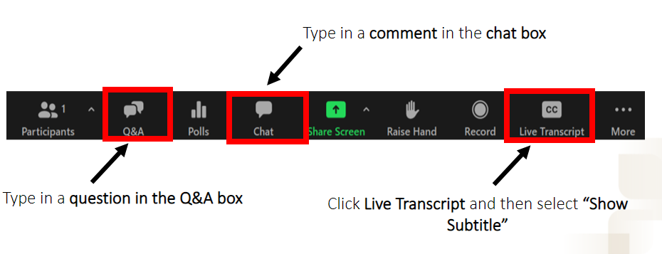
Questions, Comments & Closed Captioning

Slide 3
Disclaimer
The views, opinions, and content expressed in this presentation do not necessarily reflect the views, opinions, or policies of the Center for Mental Health Services (CMHS), the Substance Abuse and Mental Health Services Administration (SAMHSA), or the U.S. Department of Health and Human Services (HHS).
www.samhsa.gov

Slide 4
Introductions
Moderator: Dr. Pierluigi Mancini, President, Multicultural Development Institute
Panelists:
Dolores Jimerson, LCSW, ADS, CPC, Behavioral Health Education Director, Northwest Portland Area Indian Health Board
Katie Hunsberger, MPP, BHA Program Manager, Northwest Portland Area Indian Health Board, Tribal Community Health Provider Project
Health Equity Faculty Panelists
Aaron Williams, Senior Advisor, Practice Improvement & Consulting, National Council
Dr. Ami Roeschlein, Consultant, Practice Improvement & Consulting, National Council
Dr. Terence Fitzgerald, Consultant, Trauma-Informed, Resilience-Oriented Services, Center of Excellence for Integrated Health Solutions
Notes:
[insert bios here]
Ivanova Smith, Rights Activist, Chair of Self Advocates in Leadership (SAIL) and Advocate Faculty at the University of Washington Leadership Education in Neurodevelopmental and Related Disabilities (LEND) Program

Slide 5
Honoring Native American Cultures in Integrated Health
Because of historical oppression and systemic marginalization, Native American and Indigenous communities across the country face increased barriers to accessing equitable health care services and resources. This has led to disproportionately higher rates of untreated mental health, substance use, and general health conditions. Integrated and equitable care includes culturally responsive care. Native American and Indigenous healers and practitioners have provided culturally responsive care for generations and have much insight to share with those in integrated health care roles.

Slide 6
End of Session Poll Questions
See pop up box for 3 poll questions.

Slide 7
Resources
Northwest Portland Area Indian Health Board resources
Tribal Community Health Provider Program (TCHPP)
Addressing OUD in BIPOC Communities Part 3: Treatment and Recovery for Native American Populations- Webinar Recording
Native American Motivational Interviewing: A Manual for Counselors- Webinar Recording
Native American Rehabilitation Association of the Northwest, Inc.
SWEETGRASS Native American Health Center, Oakland CA
Breaking Down Barriers to Access, No Matter Where People Live
Culture and Heritage are Key to Tribal Community Health
Native Americans: A Crisis in Health Equity
Cultural Competence in Caring for American Indians and Alaska Natives
We R Native - A multimedia health resource for Native teens and young adults
Making Relatives - YouTube
Indian Country ECHO programs
Arizona continues to lead the way in seeking CMS coverage for traditional healing. Here is the proposed language TraditionalHealingWaiverLanguage.pdf (azahcccs.gov)
Oregon Health Authority : Approved Evidence-Based Practices : Behavioral Health Services : State of Oregon

Slide 8
Health Equity Tools & Resources
Center of Excellence for Integrated Health Solutions
Access for Everyone: A Toolkit for Addressing Health Equity & Racial Justice within Integrated Care Settings
Health Equity Toolkit, Module 5: Cultural and Linguistic Literacy
Health Equity Toolkit, Module 4: Health Literacy
Social Justice Leadership Academy (SJLA) Workbook
Racial Equity Tools
Diversity, Equity & Inclusion Framework
Racial Equity Toolkit
Rasing the Bar (RtB) Framework
Health Equity and Racial Justice Webpage
National Council for Mental Wellbeing
See our page for more information on Webinars and Upcoming Events, Resources and Tools, and Training and Technical Assistance focused
on Health Equity and Racial Justice

Slide 9
Are You Ready to INSPIRE Change? Join Us As a Panelist!
Upcoming Event Topics
Integrated Care Among Incarcerated Individuals Living with HIV
Stay Tuned for more 2024 topics!
Complete brief survey to submit interest in being a panelist!

Slide 10
Upcoming Events
Nov.
30
from 2-3pm ET
CoE-IHS Webinar: The Youth Mental Health Crisis and Opportunities for Integrated Care
Register Here
Stay Tuned for Events 2024!!
Relias On-Demand Training
Learn More
Subscribe for Center of Excellence Updates​
Subscribe Here

Slide 11
CHAT WITH AN EXPERT!
Schedule a free call with an integrated care expert to discuss:
Health Equity through Integrated Care
Workforce Development
Integrated Care Financing & Operations
Implementing Models of Integrated Care
Population Health in Integrated Care
Diversity, Equity and Inclusion
Ongoing Impacts of COVID-19 Pandemic
Submit a Request!
Notes:
Sarah
Integration with Schools & Social Services
Rural Health Integration
Perinatal Integration

Slide 12
Thank You
Questions?
Email integration@thenationalcouncil.org
SAMHSA’s Mission is to reduce the impact of substance abuse and mental illness on America’s communities.
www.samhsa.gov
1-877-SAMHSA-7 (1-877-726-4727) 1-800-487-4889 (TDD)

