Slide 1
Huntington QRT (Quick Response Team) Changing Course with the Innovative QRT Model
Cabell county ems Huntington, wv

Slide 2
Presented By:
Connie Priddy MA, RN, MCCN
Director of Quality Compliance/Huntington QRT Program Coordinator
Cabell County Emergency Medical Services
connie.priddy@ccems.org

Slide 3
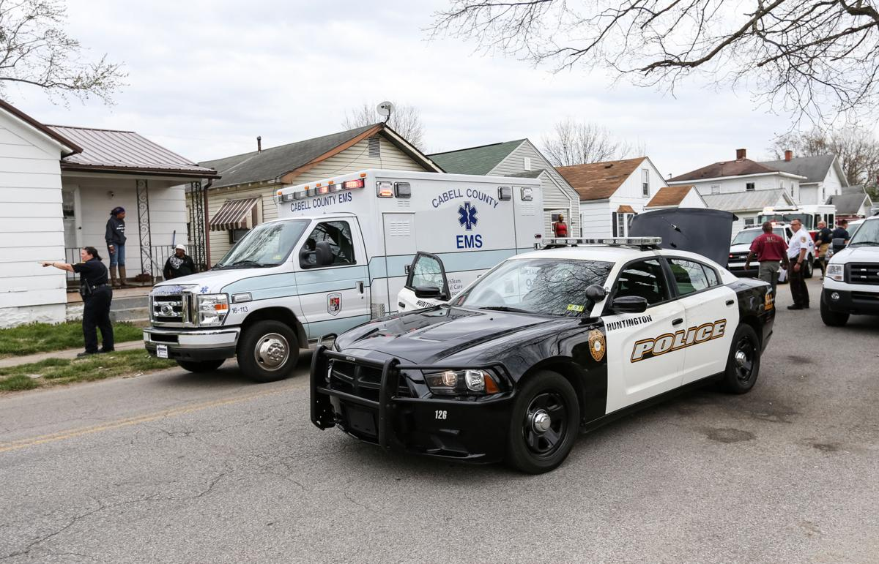
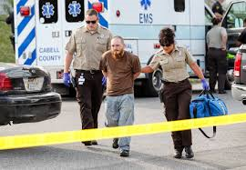
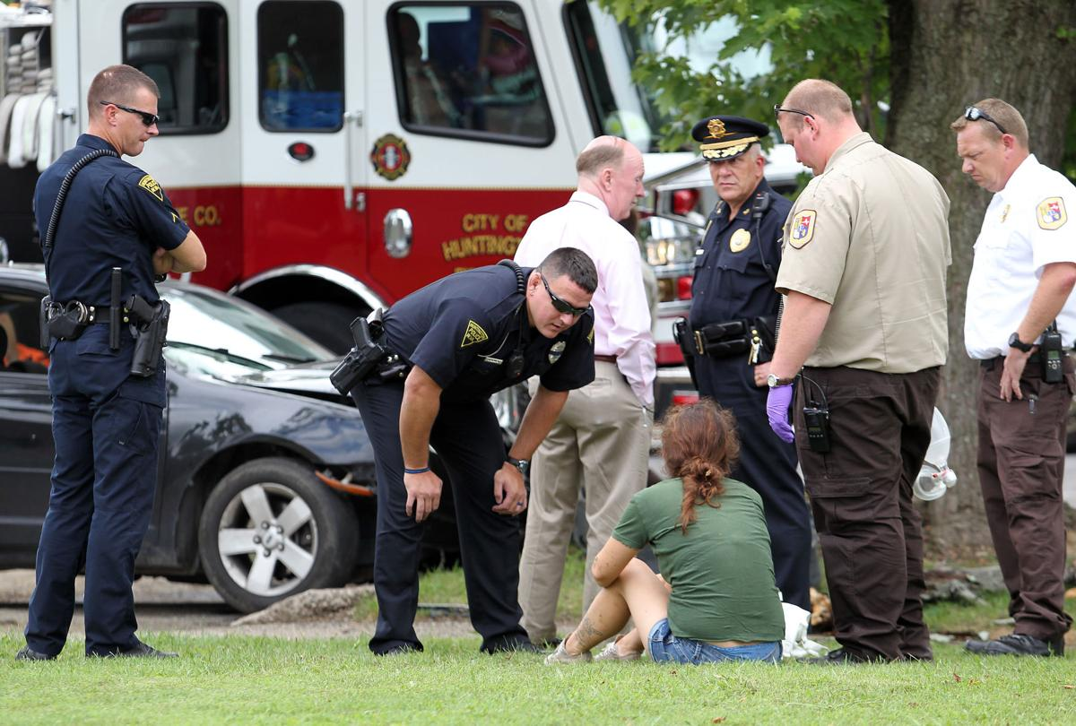
Changing Course
Community in Crisis
*City population: 50,000 *County population: 100,000 *Cabell County EMS runs 36,000 calls annually (county-based EMS agency). One service covers the entire county, inclusive of the City of Huntington.

Slide 4
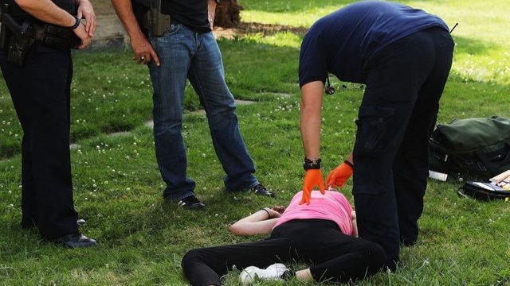
Changing Course
2016
“Suspected Overdose” Calls – 1217
Narcan Usage – 768
2017
“Suspected Overdose” Calls – 1831
Narcan Usage – 1153
2018
“Suspected Overdose” Calls – 1089
Narcan Usage - 686
2019
“Suspected Overdose” Calls – 878
Narcan Usage – 502
2020
“Suspected Overdose” Calls – 999
Narcan Usage - 554
2021
“Suspected Overdose” Calls – 961
Narcan Usage - 520
FACING A PUBLIC HEALTH EPIDEMIC

Slide 5
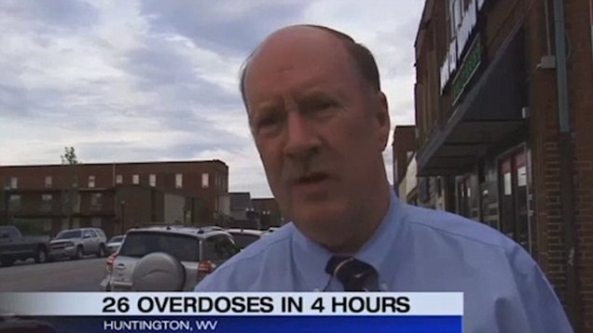
Changing Course
August 15, 2016
Gordon Merry - Cabell County EMS Director
A DAY THAT CHANGED EVERYTHING!

Slide 6
By the end of that day, 28 individuals had overdosed in a 5 hour period. A post action plan revealed after that infamous day…not one person was offered or entered treatment
Taylor Wilson was the first person to overdose on August 15, 2016. Her family tried desperately to get her into a treatment facility. She overdosed and died at home, 41 days later. Upon returning from her daughter’s funeral, Leigh Ann Wilson said the phone rang…there was finally a bed available for treatment…

Slide 7
West Virginia led the nation per capita in overdose deaths….and Huntington, WV was at the heart of that devastating statistic
Our community became quite aware that how we were handing this crisis was not working. It was still believed by many, that you could arrest your way out of this epidemic. As the numbers spiraled out of control, with nearly 200 individuals overdosing in one month by August of 2017 (which averaged over 6 people a day). It became very apparent a new way of thinking was needed. Community leaders began working together. Our Mayor developed an Office of Drug Control Policy. Programs like Harm Reduction followed. The criminal justice system developed court diversion programs. Finally, the community leaders from Marshall University, both local hospitals, multiple treatment facilities, city and county government, Police, Fire and EMS officials were in the same room….looking for solutions.

Slide 8
Changing Course
Innovative Solutions
Radical new model…doing personal visits after an overdose event. The idea sounded so novel…it just might work!
Great idea…but no funding initially available. Our community applied for two federal grants
Both grants were approved in October 2017. By December 4, 2017, the QRT made their first visit

Slide 9
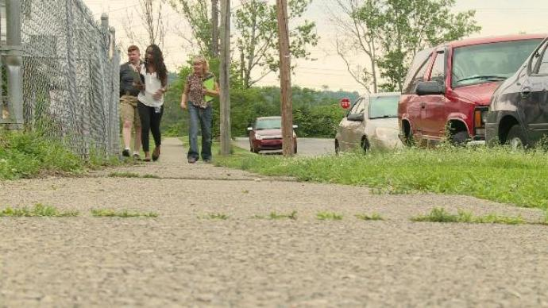
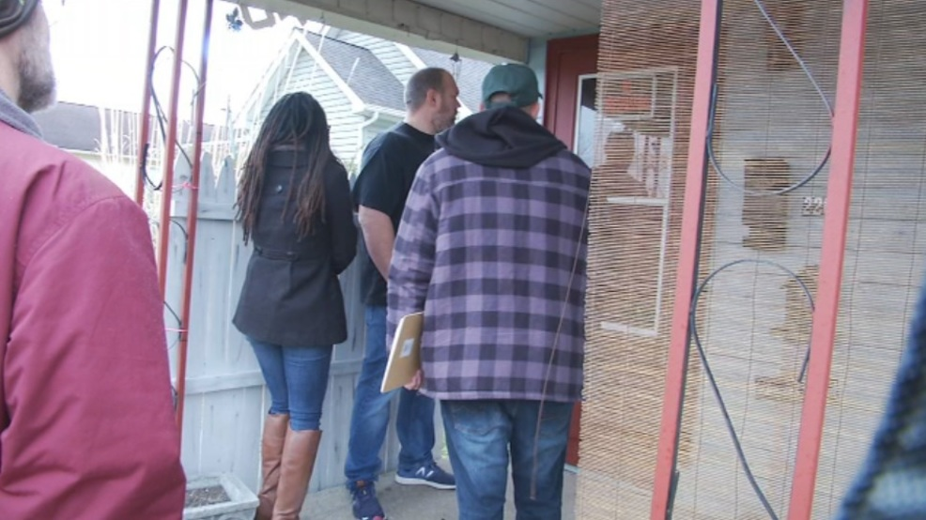
Changing Course
First Responder Diversion Program Model
Cabell County EMS
Huntington Police Department
Behavioral Health
Faith Leaders

Slide 10
Changing Course
EMS responds to overdose
OR
Outside Referral
QRT identifies the next day
QRT attempts to locate individual
If individual found, treatment offered, information provided
Individual ready for treatment?
No
QRT continues to keep in contact, encourage treatment
Yes
Individual linked to treatment by QRT through warm handoff
QRT Flow Chart

Slide 11
Changing Course
Initial QRT Challenges:
Confidentiality – Sharing of EMS data between all involved agencies
Physical Location – Office space and access to vehicle for visits
Data Collection – Determined a need for electronic medical record keeping
Client Location – Correct current address (contact information)
Encountering clients actively overdosing

Slide 12
Changing Course
Overcoming Challenges:
Confidentiality Agreement signed among all agencies. Each agency signs HIPAA agreement
Donated office space/vehicle by CCEMS
Electronic charting system purchased for documentation
Active education/involvement to obtain first responder “buy-in”. More information obtained at scene
Our team carries a “first-out” bag for an active emergency

Slide 13
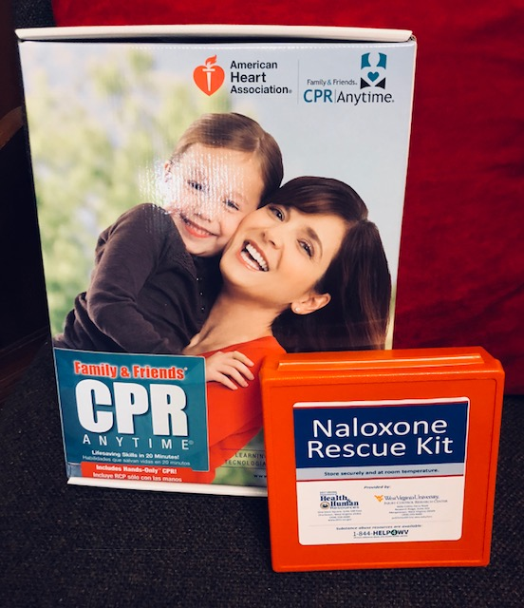
QRT FACTS
QRT Cards provided on all ambulances for distribution on-scene
CPR/Naloxone training provided to clients/family/friends
Data collection and entry done by team
Volunteer Days distribute information to targeted neighborhoods
Works closely with all local social service agencies
Refers client not ready for treatment, to the Harm Reduction Program
Cabell County EMS Data used to do visits
All outside referrals accepted
Team seeks to do visits within a 48-hour period of overdose event
If no personal contact made, team will leave QRT brochure/calling card/Naloxone behind
Team is a resource for multiple needs (link to SUD treatment, transportation, assist in health testing and screenings, assist to obtaining medical insurance)
The team is the link and personal connection
to someone who cares…

Slide 14
QRT Impact
In the first year of operation, CCEMS saw a 40% decrease in ambulance “suspected overdose” calls. This was a year over year comparison between 2017 & 2018. This number represents nearly 750 less ambulance calls
Total cost savings for CCEMS alone was over $370,000
Team has made well over 1000 contacts, and approximately 30% enter some type of formalized treatment
Overall decrease in “suspected overdose” ambulance from 2016 & 2017 (crisis years) through 2020 & 2021 (which includes the “Covid Years”) continue to be at 36%
HUNTINGTON QRT/CCEMS DATA

Slide 15
Changing Course
Number of overdoses before and after deployment of QRT. Intervention resulted in a statistically significant decrease in number of overdoses (Parameter-AR1,1; t value 32.55; Pr>/t/-<.0001)
Data provided by: Dr. Nandini Manne (Marshall University Department of Public Health – QRT research partner)

Slide 16
Changing Course
Quickly realized that individuals experiencing Substance Use Disorder do not live in a vacuum
Many other needs were identified (social and medical)
There was a significant lack of healthcare access to these individuals
During COVID-19 the QRT partnered with other agencies and begin doing “Wellness Clinics”. Provided COVID testing, flu vaccines, naloxone training, and HIV testing
Recognized a need to provide care to this underserved population

Slide 17
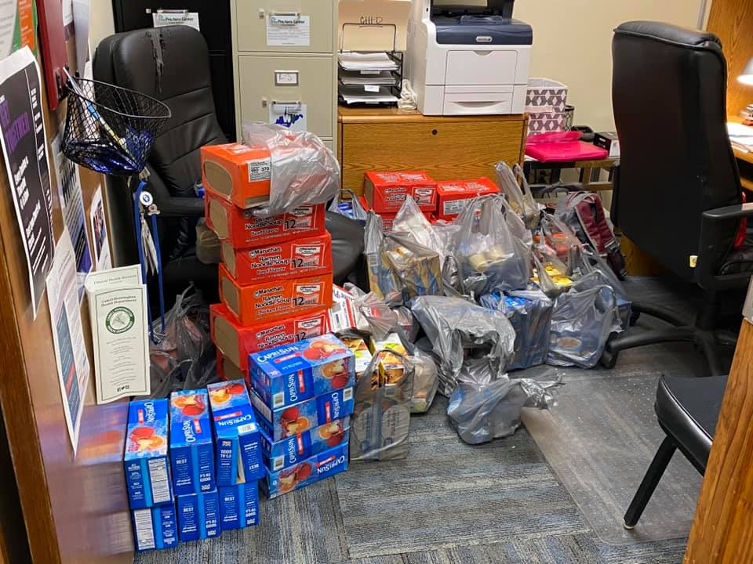
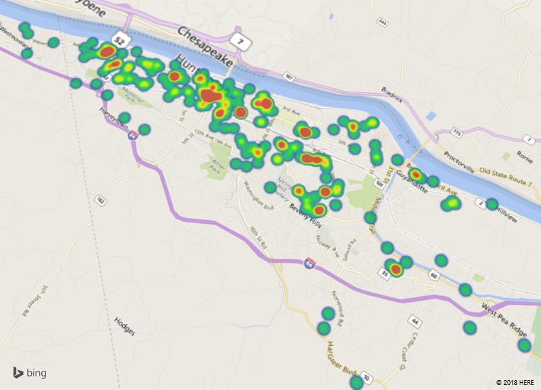
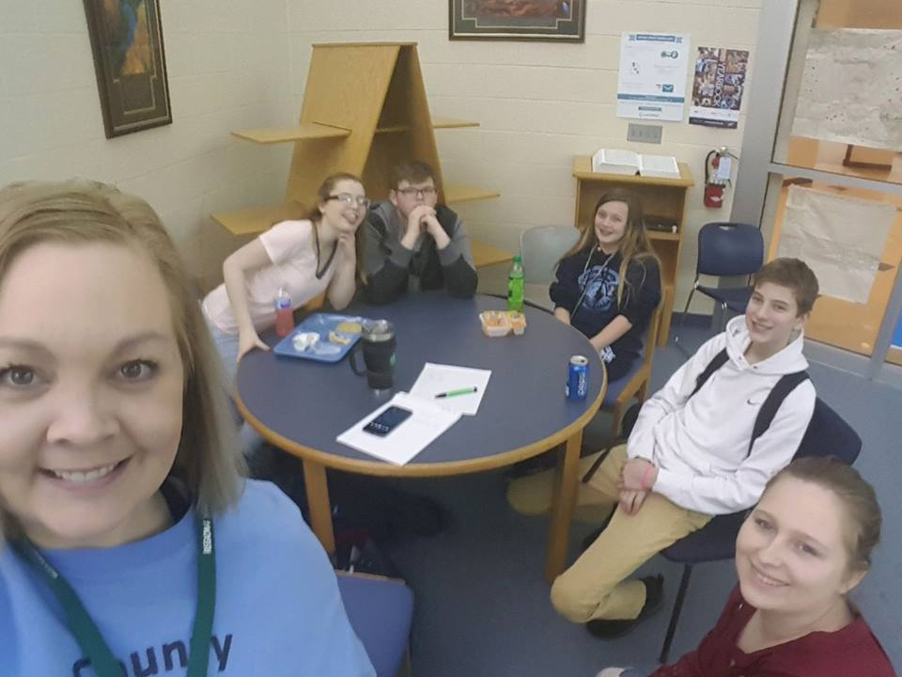
Changing Course
Huntington QRT Community Partner

Slide 18
Changing Course
Expanded Services:
Risk Reduction – Referral to Health Department for Harm Reduction
Educate on the use of naloxone
HIV field testing
COVID testing/vaccines
Distribution of Fentanyl test strips
Condom distribution
CPS/APS referral
Homeless referral
Transportation
Distribution of “snack bags”, blankets, gloves, hats

Slide 19
Changing Course
EMS holds the key to become the leaders in healthcare. The Paramedics/EMT’s at Cabell County EMS have “buy-in”. They see a benefit to themselves, the individuals they serve and their communities.

Slide 20
Changing Course
Collaboration works to benefit the entire community. Police/Fire/EMS, City/County/State government, businesses, hospitals, social service agencies, and many countless others… most importantly the individuals and their families we serve
Ignoring the issues do not make them “go away”. Work proactively based on the data being gathered (even if initially you “don’t like” the trends being observed)
Find allies with like mindset
Giving HOPE is the strongest tool we have in the toolbox…
LESSONS LEARNED

Slide 21
Changing Course
CHANGING MINDS… ONE MIND AT A TIME

Slide 22
Changing Course
QUESTIONS
https://www.coapresources.org/Learning/PeerToPeer/Diversion

