Slide 1
Outreaching & Engaging with Underserved Communities
Featuring Andrea Boxill and Atiim Boykin
Thursday, June 22nd 3:00 – 4:30 PM ET

Slide 2
Columbus and Franklin County Addiction Plan (CFCAP)
Columbus Public Health Commissioner Dr. Mysheika Roberts
Presented by Andrea Boxill

Slide 3
Columbus and Franklin County Addiction Plan (CFCAP)
A collective impact model coalition that addresses addiction and the overdose epidemic in our community while providing interventions to increase health equity and decrease health disparities

Slide 4
CFCAP Goals
Within three years, CFCAP members will:
Reduce drug overdose deaths by 15% within three years
Reduce drug overdose incidents by 15%
Reduce infectious disease rates for HepC by 10%

Slide 5
Organizational Structure
█ Principle Partners
█ Emergency Response
█ Subcommittees
█ Subcommittee Workgroups
Core Steering Committee
(boxes with grey dashed outline)
Surge Notification and Response
CPH, FCPH, FC Coroner, CPD, FCSO, EMS
Guide Vision and Strategies • Mobilize Resources • Advance Policy • Build Public Will • Establish Core Goals
Principle Partners (Columbus City Mayor, City Attorney, City Council, County Commissioners, ADAMH CEO)
Action Plan Monitoring
Situation Status
Evaluation
Dr. Mysheika Roberts
Implementation
Public Awareness
Surge Call
Andrea Boxill
Kaelyn C. Poindexter
Data Collection & Analysis
Data Reports
Kathy Cowen
& Robert Lonardo
Infectious Disease Data
Columbus Public Health
Overdose Fatality Review
Franklin County Public Health
Education & Prevention
Healthcare & Harm Reduction
Faith & Community
Treatment & Recovery
Public Safety
Prescriber Education
Syringe Exchange & Infectious Disease
Stigma in Faith-Based Settings
Recovery Housing
Law Enforcement
Peer Recovery Support
EMS
Broad Community Education
Naloxone Distribution
Congregation and Faith Leaders Training
Courts
School and Community- Affiliated Education and Gaps in Services
Neo Natal Abstinence Syndrome
Designated Recovery Congregations
Data
Data
Data
Data
Data

Slide 6
Data to Inform and Direct Action: Inputs
Overdose Fatality Review (OFR):
City and County Public Health Departments, Coroner, DEA, Hospital EDs, Crisis Stabilization Centers, Ohio Board of Pharmacy, Poison Control, Sheriff’s Department
• Overdose Detection Mapping Application:
EMS, Coroner, Epi-center
• People Who Use Drugs Interviews:
Outreach Teams, Ohio Substance Abuse Monitoring Report
• State Interdiction Efforts:
Ohio Narcotics Intelligence Center Monthly Meeting

Slide 7
The Scope of the Problem

Slide 8
Sample OFR Findings - April 2020
Coroner’s Office Updates
• 84 total drug overdose deaths in April 202. 64 of those deaths were determined to be caused by Fentanyl. The were 20 remaining cases awaiting toxicology reports.
Characteristics of 10 Decedents From DODI
• The majority of cases lacked criminal history and/or involvement in any of our
systems: probation, child protective services,
• 3 decedents worked in the restaurant/food industry
• 5 decedents had sought some form of treatment prior to death
• 3 decedents had domestic violence–both perpetrators and victims
• 3 decedents had a history of mental health issues–suicide attempts
• Polysubstance was present in 9 of the toxicology reports

Slide 9
Challenges
COVID-19 stay-at-home order resulting in isolation, depression, boredom, risk taking, lack of natural supports
Cocaine has become extremely expensive, resulting in its’ adulteration with fentanyl.
First responders cannot differentiate drugs the, “white powder” substances at the scene
Individuals are using two or more drugs in a setting, sometimes with alcohol, increasing the risk of overdose even without Fentanyl being in the mix
9-1-1 not been contact for transport to emergency department
Unable to engage with People Who Use Drugs due to social distancing order

Slide 10
Opportunities
Reinforce the risk of overdose from combining drugs and alcohol
Publicize the, “Good Samaritan”, law to encourage contacting EMS for response
Creative messaging with geo-fencing and reach to specific audiences based upon primary drug of abuse
Collaborate with Ohio Restaurant Association to educate employees about the risk of drugs being adulterated and harm reduction resources
Conduct outreach pop-up events to provide vaccinations and harm reduction resources
Work with Central Ohio Hospital Association to develop protocols for distributing Naloxone to overdose victims when leaving the ED

Slide 11
Action Plan
Data:
Identify the communities that we need to target and develop outreach strategies with PPE and safety assessments
Prevention and Education:
Define our target populations within the high incident communities and use imagery and language specific to the population
Harm Reduction:
Pop-up Naloxone events with bundled services, (Hygiene Kits, Masks, Sanitizer, WIC services and Sexual Health)
Public Safety:
Distribute Naloxone to those who score high on the Clinical Opiate Withdrawal Scale, (COWS) before release and provide education, MOUD and treatment in the jail with linkage at release as well.

Slide 12
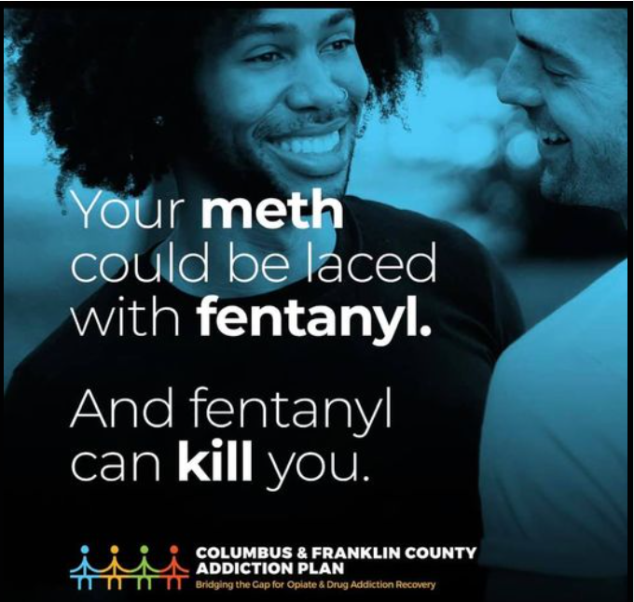
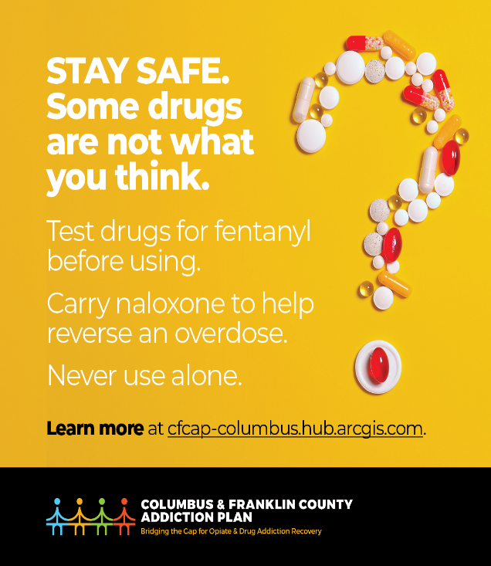
Messaging and Connecting

Slide 13
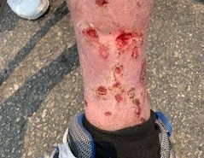
Timing is Critical in Messaging

Slide 14
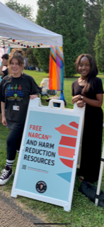
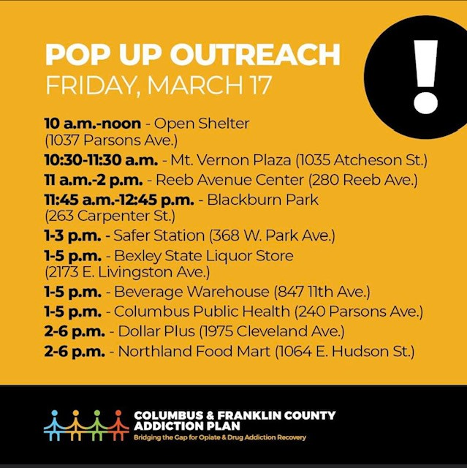
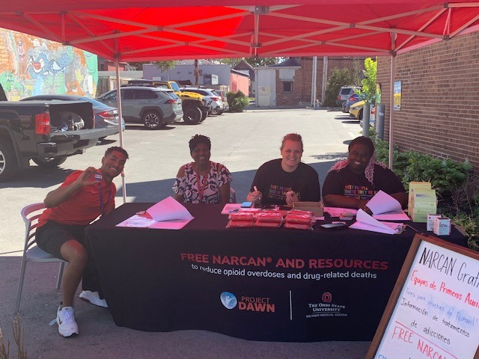
Partnership Events

Slide 15
Giving Options

Slide 16
Results

Slide 17
Questions?
Please drop any questions you have in the chat or unmute yourself to speak.
Andrea Boxill, MA, LCDCII
Alcohol & Drug Services akboxill@Columbus.gov
Columbus Public Health
Columbus and Franklin County Addiction Plan

Slide 18
Atiim B. Boykin MFT, MHRTC
Forensic Intensive Case Manager, Office of Behavioral Health / DHHS - York & Cumberland County

Slide 19
Discussion and Q&A

