Slide 1
The Power of Collaboration:
Success Stories of Harm Reduction and Public Safety Partnerships to Prevent Overdose
Thursday, November 9th, 2023| 3:00 – 4:30 pm ET
Notes:
Sam

Slide 2
Housekeeping
You will be muted automatically upon entry and for the duration of the webinar.
This webinar is being recorded and will be archived for future viewing on the National Council’s website.
Please submit your questions using the Q&A box at the bottom of the screen.
Notes:
Sam

Slide 3
Frequently Asked Questions
This webinar will be recorded and will be made available to view on demand, along with a copy of these slides, within 3 days following the event’s conclusion.
This webinar is not CEU accredited.
There will not be a certificate of completion for attending this webinar. However, if you would like proof of attendance for your employer, please email WSloyer@thenationalcouncil.org and we would be happy to provide you with an email verification.
Notes:
Sam

Slide 4

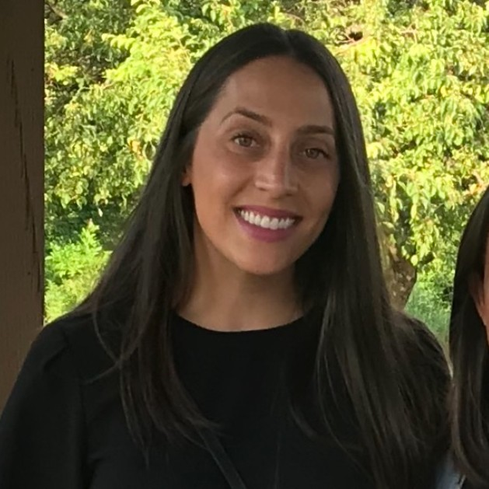

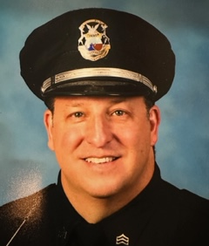


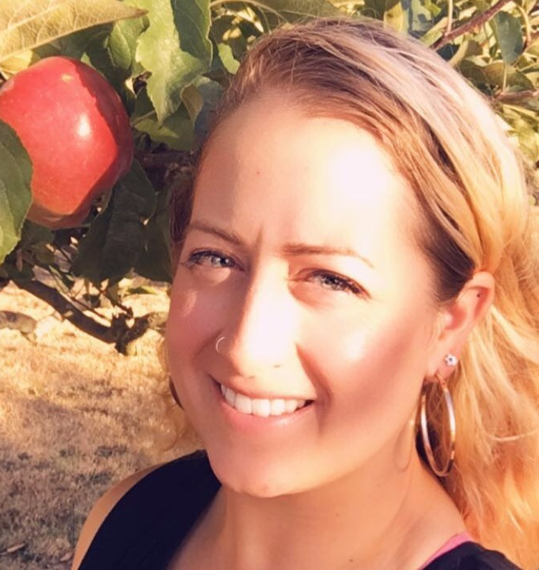
Today’s Presenters
Caroline Davidson
Director,
National Council for Mental Wellbeing
Dunya Barash
Director of Operations,
Families Against Narcotics
Judge Linda Davis
Families Against Narcotics
Deputy Chief of Police Jeffrey Filzek
Madison Heights Police Department
and Joel Cohen
Consultant with the National Council for Mental Wellbeing
as Panel Moderator
Neil Calmjoy, LICSW
Program Manager,
Catholic Community Services of Western Washington
Carolina Hershey, CPC
Prevention Case Manager/
Certified Peer Counselor,
Catholic Community Services of Western Washington
Teal Gardner
Crisis Response Unit Lead,
Olympia Police Department
Notes:
Sam

Slide 5
Project Overview
The National Council for Mental Wellbeing (National Council), with support from the Centers for Disease Control and Prevention (CDC), invited organizations to apply for grant funding to support one-year pilot projects integrating harm reduction strategies and public safety initiatives.
Pilot Project Goals:
Support the implementation and enhancement of evidence-based or promising strategies to prevent and reduce overdose and other drug-related harms through collaborations with public safety (e.g., naloxone and fentanyl test strip (FTS) distribution and linkages to primary care, mental health care, evidence-based treatment for SUDs and other support services).
Integrate harm reduction strategies and public safety initiatives to prevent and reduce overdose risk and other harms for people who use drugs (PWUD) and people with substance use disorders (PWSUD).
This project is supported by the Centers for Disease Control and Prevention (CDC) of the U.S. Department of Health and Human Services (HHS) as part of a financial assistance award totaling $1,000,000 with 100% funded by CDC/HHS. The contents are those of the author(s) and do not necessarily represent the official views of, nor an endorsement by, CDC/HHS or the U.S. Government.
Notes:
Sam

Slide 6
Agenda
Background
  Overview and history of harm reduction
  Historic areas of tension between harm reduction and public safety
Panelist presentations
Panelist discussion and Q&A
Actionable takeaways
  Lessons learned and recommendations from panelists
  Preview of upcoming resources from the National Council
Notes:
Sam

Slide 7
Background
Harm Reduction Basics and the Intersections of Harm Reduction and Public Safety
Notes:
Caroline

Slide 8
Tackling Fatal Overdose and Substance Use Disorder
Prevention
Recovery Support
Treatment
Harm Reduction
Notes:
Caroline

Slide 9
Harm Reduction
Meeting people where they’re at, but not leaving them there
  Recognizing that change is a process and helping people in their journey along that process without judgment
Harm reduction is…
  “…a set of practical strategies and ideas aimed at reducing negative consequences associated with drug use.”
  “…a movement for social justice built on a belief in, and respect for, the rights of people who use drugs.”
In particular, harm reduction “emphasizes kindness and autonomy in the engagement of people who use drugs.”
Sources:
National Harm Reduction Coalition. 2019. “Principles of Harm Reduction.” Harmreduction.org. https://harmreduction.org/about-us/principles-of-harm-reduction/.
Substance Abuse and Mental Health Services Administration. 2023. “Harm Reduction.” https://www.samhsa.gov/find-help/harm-reduction
Notes:
Caroline

Slide 10
Pillars of Harm Reduction
Harm reduction…
Is guided by people who use drugs (PWUD) and with lived experience of drug use
Embraces the inherent value of people
Commits to deep community engagement and community building
Promotes equity, rights, and reparative social justice
Offers lowest barrier access and non-coercive support
Focuses on any positive change, as defined by the person
Want to know more? Substance Abuse and Mental Health Services Administration. 2023. Harm Reduction Framework. https://www.samhsa.gov/sites/default/files/harm-reduction-framework.pdf
Notes:
Caroline

Slide 11
Examples of harm reduction practices include…
peer support programs
risk reduction education
bridge programs (low barrier linkage to treatment and/or medication)
syringe exchange/ distribution
housing-first programs
wound care
fentanyl test strips
non-punitive approach to return to use
naloxone distribution
safe consumption spaces
methadone and buprenorphine*
navigation services
testing and prevention for infectious disease (such as HIV and viral hepatitis)
Notes:
Caroline

Slide 12
Ultimately…
Harm reduction can encompass many different pieces.
These grant projects were focused specifically on overdose prevention and risk reduction related to substance use, which will largely be the focus of this presentation.
Notes:
Caroline

Slide 13
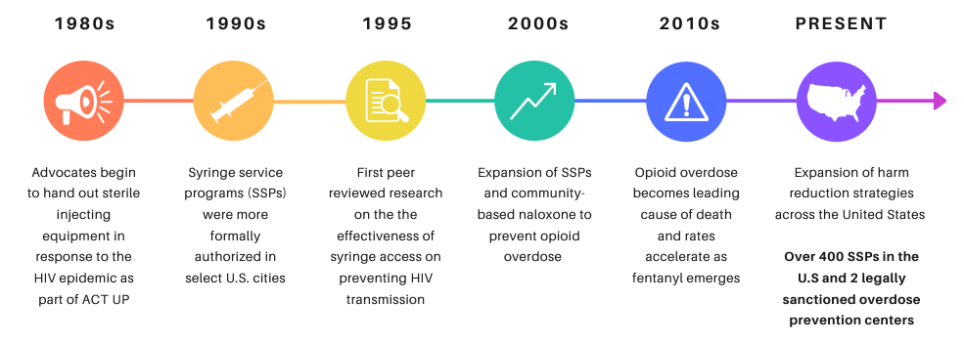
Harm Reduction (Mini) History
From In the Works
Notes:
Caroline

Slide 14
Areas of Tension Between Harm Reduction and Public Safety
Collective stigma may lead to public viewing substance use or substance use disorder as an issue that should be tackled by public safety (rather than a systemic need)
Harm reduction services that help people who use drugs (PWUD) may be illegal or not completely legal
Public safety are generally available 24 hours a day, and may therefore be a measure of last resort to address social challenges
Policies have historically penalized PWUD, so interactions with public safety may be colored by this historic pattern
PWUD may have had previous negative experiences with public safety, which could contribute to their or their peers’ tensions
Public safety may be frustrated with what they see as “revolving door” – PWUD who deal with consequences of substance use and then choose to use again
Notes:
Caroline

Slide 15
Comeback Quick Response Team (QRT)
Families Against Narcotics (FAN)
Dunya Barash
Judge Linda Davis
Deputy Chief of Police Jeffrey Filzek
Notes:
Dunya

Slide 16
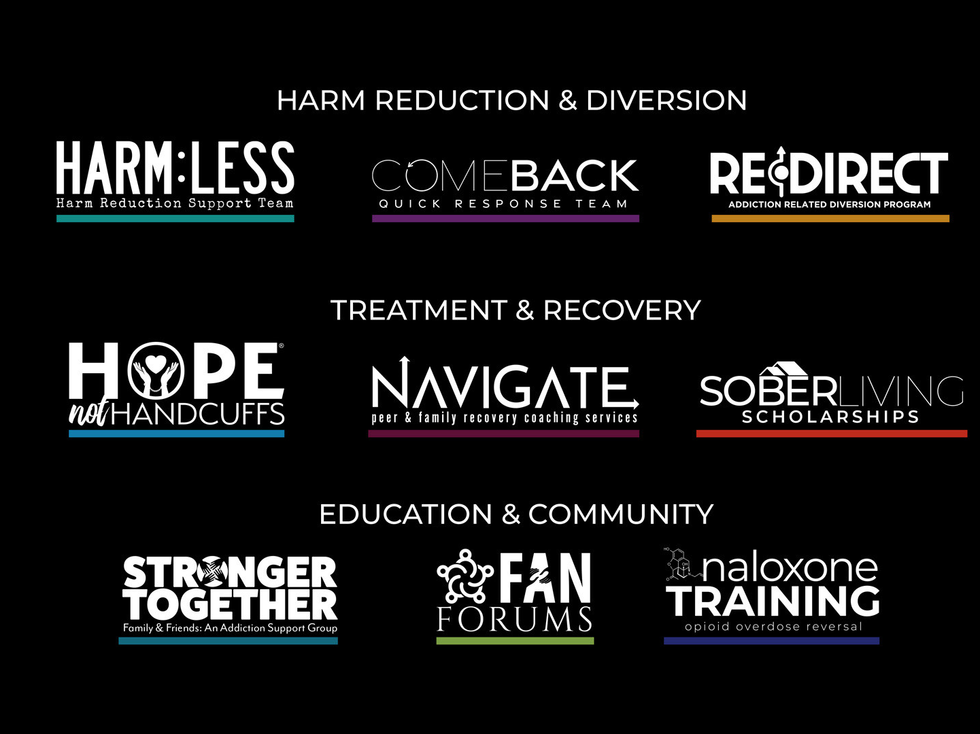

Slide 17
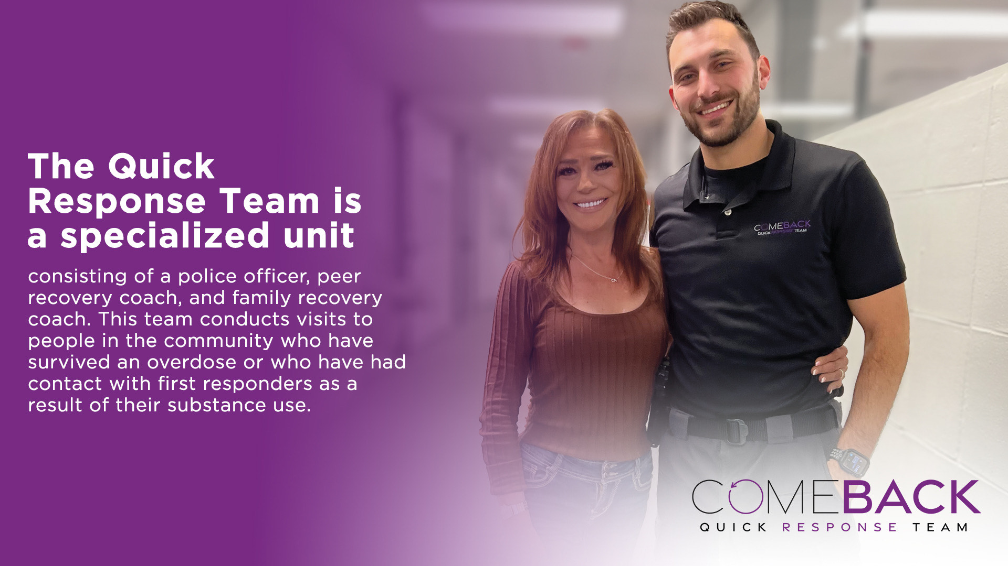

Slide 18
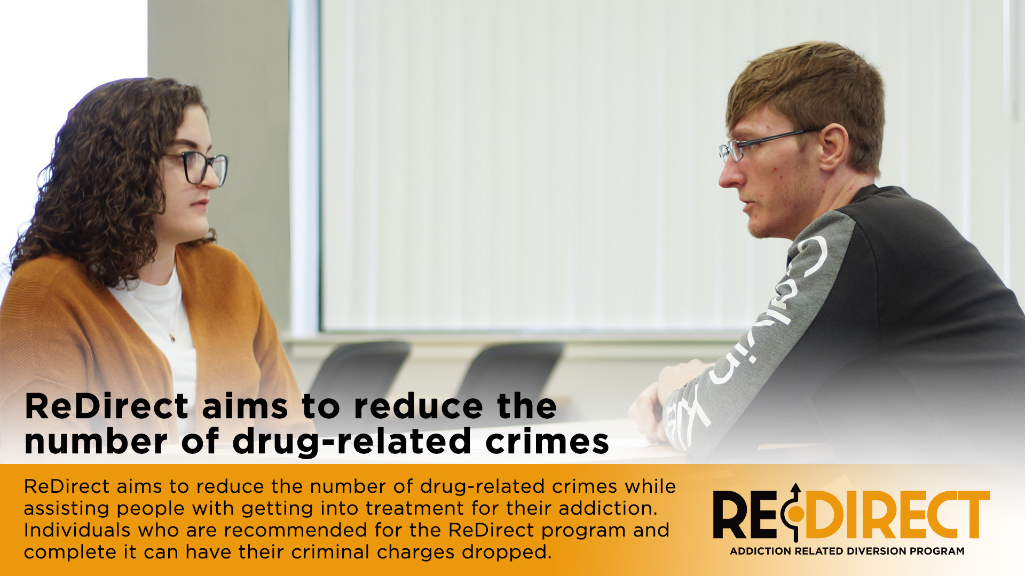

Slide 19

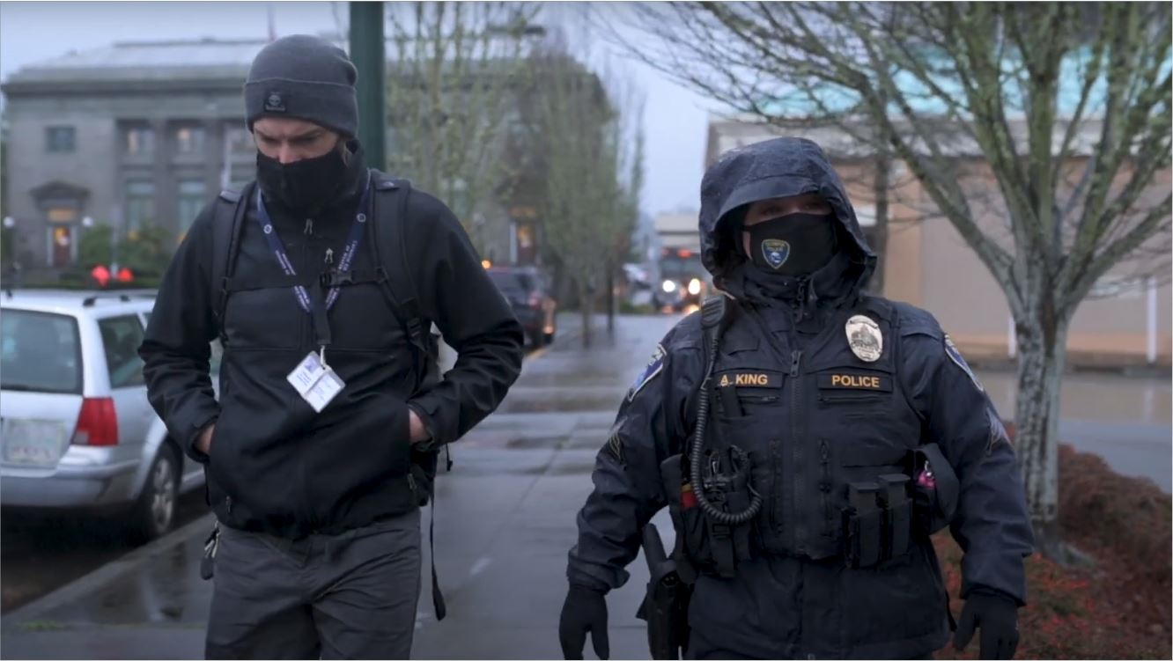
Arrest and Jail Alternatives (AJA)
Catholic Community Services of Western Washington
Neil Calmjoy, LICSW
Carolina Hershey, CPC
Notes:
Neil

Slide 20
Program Overview
Arrest & Jail Alternatives works with Public Safety partners to engage justice-impacted individuals in case management to reduce recidivism.
Individuals referred are often at the intersection of homelessness, substance use disorder, and unmet behavioral health needs.
Participants work with Peer Case Managers who utilize their training and lived experience to build rapport and assist with navigating complex systems.
Notes:
Neil

Slide 21
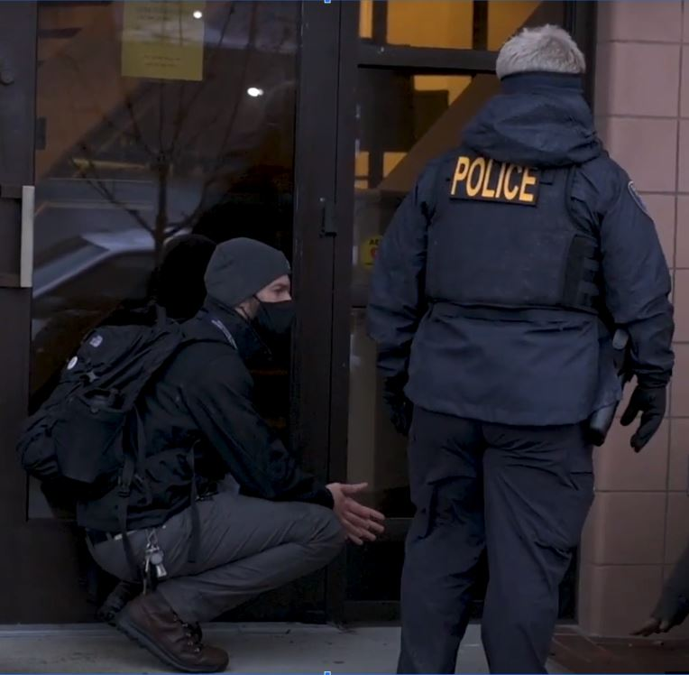
Partnership with Public Safety
Referral Criteria- frequent, high utilizers of First Response entities with MH/SUD needs.
AJA Case Managers assist at point of contact when arrest is imminent in order to de-escalate or divert arrest.
Collaborate with for additional insight around encounters, behavior, BOLOs, other notable information.
Work with courts and jails to provide peer counseling during incarceration and advocacy during legal proceedings.
Notes:
Neil

Slide 22
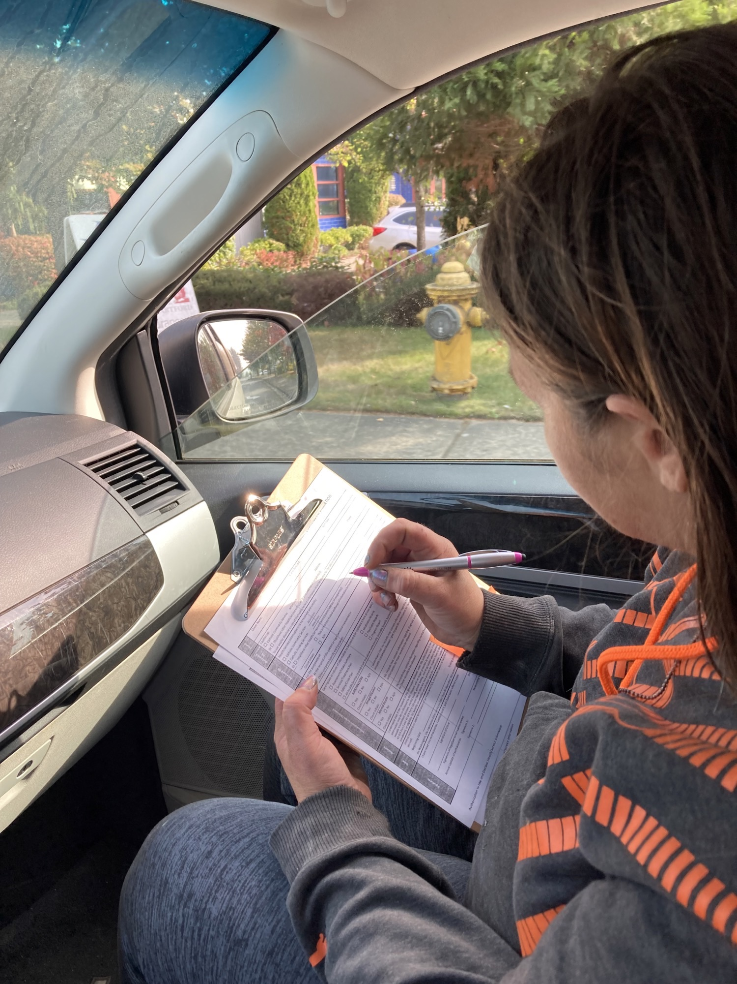
Implementing Harm Reduction
Peer Case Managers assist participants in connecting to low barrier housing, medical & mental health services, and MAT services.
Also connect participants with recovery goals around access to MAT, syringe services, Naloxone, and other resources.
AJA’s work is applied through the belief that being justice impacted is an inherently harmful and traumatic experience to the community we serve.
Notes:
Neil

Slide 23
AJA’s Prevention Program
In 2023, the National Council funded an AJA subprogram focused on prevention—assisting individuals further upstream, prior to falling into chronic homelessness and behavioral health crisis.
Referral Criteria—housed with unmet substance use or behavior health needs, increased contact with Public Safety, possible risk of losing housing.
AJA provides short term and intensive case management to assist with stability, strong systems advocacy, and overall reduction in emergency calls.
Notes:
Neil

Slide 24
Panelist Discussion & Q&A
and Joel Cohen
Consultant with the National Council for Mental Wellbeing
as Moderator
Dunya Barash
Director of Operations,
Families Against Narcotics
Judge Linda Davis
Families Against Narcotics
Deputy Chief of Police Jeffrey Filzek
Madison Heights Police Department
Please submit your questions using the Q&A box at the bottom of the screen.
Neil Calmjoy, LICSW
Program Manager,
Catholic Community Services of Western Washington
Carolina Hershey, CPC
Prevention Case Manager/
Certified Peer Counselor,
Catholic Community Services of Western Washington
Teal Gardner
Crisis Response Unit Lead,
Olympia Police Department
Notes:
Sam

Slide 25
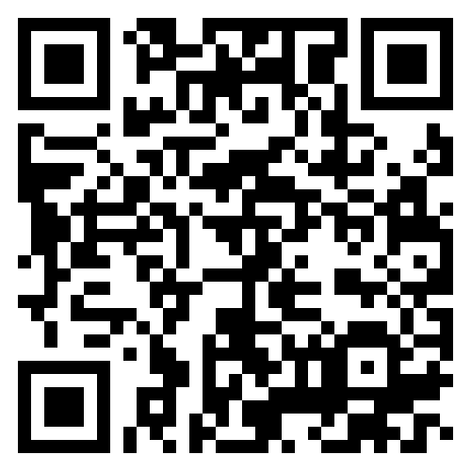
Thank You!
Caroline Davidson
National Council for Mental Wellbeing
Dunya Barash
Families Against Narcotics
Judge Linda Davis
Families Against Narcotics
Deputy Chief of Police Jeffrey Filzek
Madison Heights Police Department
Neil Calmjoy, LICSW
Catholic Community Services of Western Washington
Carolina Hershey
Catholic Community Services of Western Washington
Teal Gardner
Olympia Police Department
Joel Cohen
Consultant with the National Council for Mental Wellbeing
https://www.surveymonkey.com/r/BYNNVVQ
Notes:
Will
Don’t forget to mention our resource to come!
Sam to put PSCOPE link in the chat - https://www.thenationalcouncil.org/resources/public-safety-cope/
Sam to put survey monkey eval. link in the chat - https://www.surveymonkey.com/r/BYNNVVQ

Slide 26
Appendix

Slide 27

Why Harm Reduction?
Quality of life benefits
Harm reduction can:
Reduce stigma associated with substance use and co-occurring disorders.
Promote a philosophy of hope and healing ― by employing people with living and lived experience in leadership and in the planning, implementation, and evaluation of services.
People with lived experience can also model meaningful change for their peers.
Build community and increase protective factors ― for people who use drugs and their families.
Encourage client autonomy.
Source: Substance Abuse and Mental Health Services Administration. 2023. Harm Reduction Framework. https://www.samhsa.gov/sites/default/files/harm-reduction-framework.pdf

Slide 28

Why Harm Reduction?
Physical health benefits
Harm reduction programs have been associated with:
  Reducing the risk of spreading infections related to substance use¹ (in particular, HIV and hepatitis C²)
  Increasing referrals to substance use disorder (SUD) treatment^{3,4}
  Reducing hospital visits⁵
Wilson, D. P., Donald, B., Shattock, A. J., Wilson, D., & Fraser-Hurt, N. (2015). The cost-effectiveness of harm reduction. International Journal of Drug Policy, 26 Suppl 1:S5-11. doi:10.1016/j.drugpo.2014.11.007
Puzhko, S., Eisenberg, M. J., Filion, K. B., et al. (2022). Effectiveness of interventions for prevention of common infections among opioid users: A systematic review of systematic reviews. Frontiers in Public Health, 2022;10:749033. doi:10.3389/fpubh.2022.749033
Strathdee, S., & Vlahov, D. (2001). The effectiveness of needle exchange programs: A review of the science and policy. AIDScience. 2001:1
Surratt, H. L., Otachi, J. K., Williams ,T., Gulley, J., Lockard, A. S., & Rains, R. (2020). Motivation to change and treatment participation among syringe service program utilizers in rural Kentucky. Journal of Rural Health, 2020; 36(2):224-233. doi:10.1111/jrh.12388
Coye, A. E., Bornstein, K. J., Bartholomew, T.S., et al. (2021). Hospital costs of injection drug use in Florida. Clinical Infectious Diseases 2021;72(3):499-502. doi:10.1093/cid/ciaa823

Slide 29

Why Harm Reduction?
System benefits
Harm reduction programs have also been shown to:
  Be cost effective by resulting in fewer instances of infectious disease, ambulance calls, emergency department visits, hospital stays and overdose death.⁶⁻⁹
  Advance health equity and have the potential to address racial disparities.¹⁰
Ijioma, S. C,. Pontinha, V. M., Holdford, D. A., & Carroll, N. V. (2021). Cost-effectiveness of syringe service programs, medications for opioid use disorder, and combination programs in hepatitis C harm reduction among opioid injection drug users: A public payer perspective using a decision tree. Journal of Managed Care and Specialty Pharmacology. 2021;27(2):137-146. doi:10.18553/jmcp.2021.27.2.137
Cousien, A., Tran, V. C., Deuffic-Burban, S., et al. (2018). Effectiveness and cost-effectiveness of interventions targeting harm reduction and chronic hepatitis C cascade of care in people who inject drugs: The case of France. Journal of Viral Hepatitis. 2018;25(10):1197-1207. doi:10.1111/jvh.12919
Ritter, A., & Cameron, J. (2006). A review of the efficacy and effectiveness of harm reduction strategies for alcohol, tobacco and illicit drugs. Drug and Alcohol Review. 2006;25(6):611-624. doi:10.1080/09595230600944529
Pollack, H. A. (2001). Cost-effectiveness of harm reduction in preventing hepatitis C among injection drug users. Medical Decision Making. 2001;21(5):357-367. doi:10.1177/0272989X0102100502
Vearrier, L. (2019). The value of harm reduction for injection drug use: A clinical and public health ethics analysis. Disease-a-Month. 2019;65(5):119-141. doi:10.1016/j.disamonth.2018.12.002

Slide 30
Ultimately…
You can’t help someone recover if they’re not alive.

Slide 31

Emerging Trends in Harm Reduction
Spread of safe consumption spaces
Decriminalization of fentanyl test strips
Naloxone approval for over-the-counter purchase
Widespread naloxone availability (in schools and beyond)
Increase in medication accessibility (telehealth expansion, mobile units, updated limits on prescribing)
Adapted strategies for emerging drugs
Novel partnerships
Increase in housing-first programs
Intentionally incorporating peer work into non-peer spaces

