Slide 1
Mastering the Art of Recovery From Lived Experience to Professional Impact
Tuesday, Sept. 10 || 12-2 p.m. ET

Slide 2
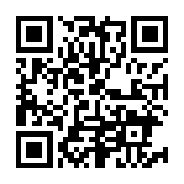
A Note on Language...
If we want addiction destigmatized, we need a language that’s unified.
The words we use matter. Caution needs to be taken, especially when the disorders concerned are heavily stigmatized as substance use disorders are.
https://www.recoveryanswers.org/addiction-ary/

Slide 3
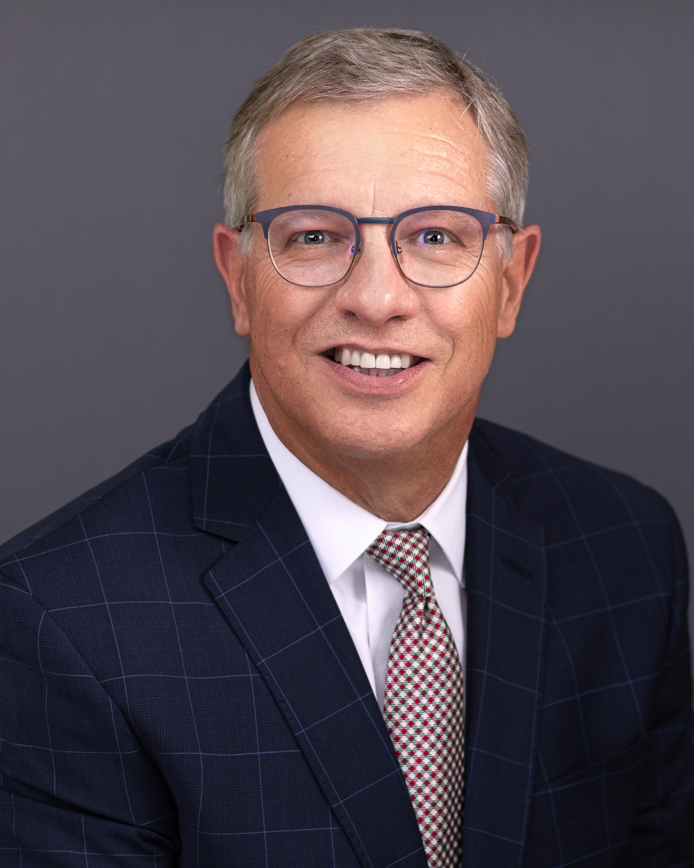
Panelists
Moderator
Philip Rutherford
Strategy Lead, Substance Use Disorder, National Council for Mental Wellbeing
Marvin Ventrell
CEO, National Association of Addiction Treatment Providers
Alexandra Plante
Senior Advisor, Substance Use Disorder, National Council for Mental Wellbeing

Slide 4
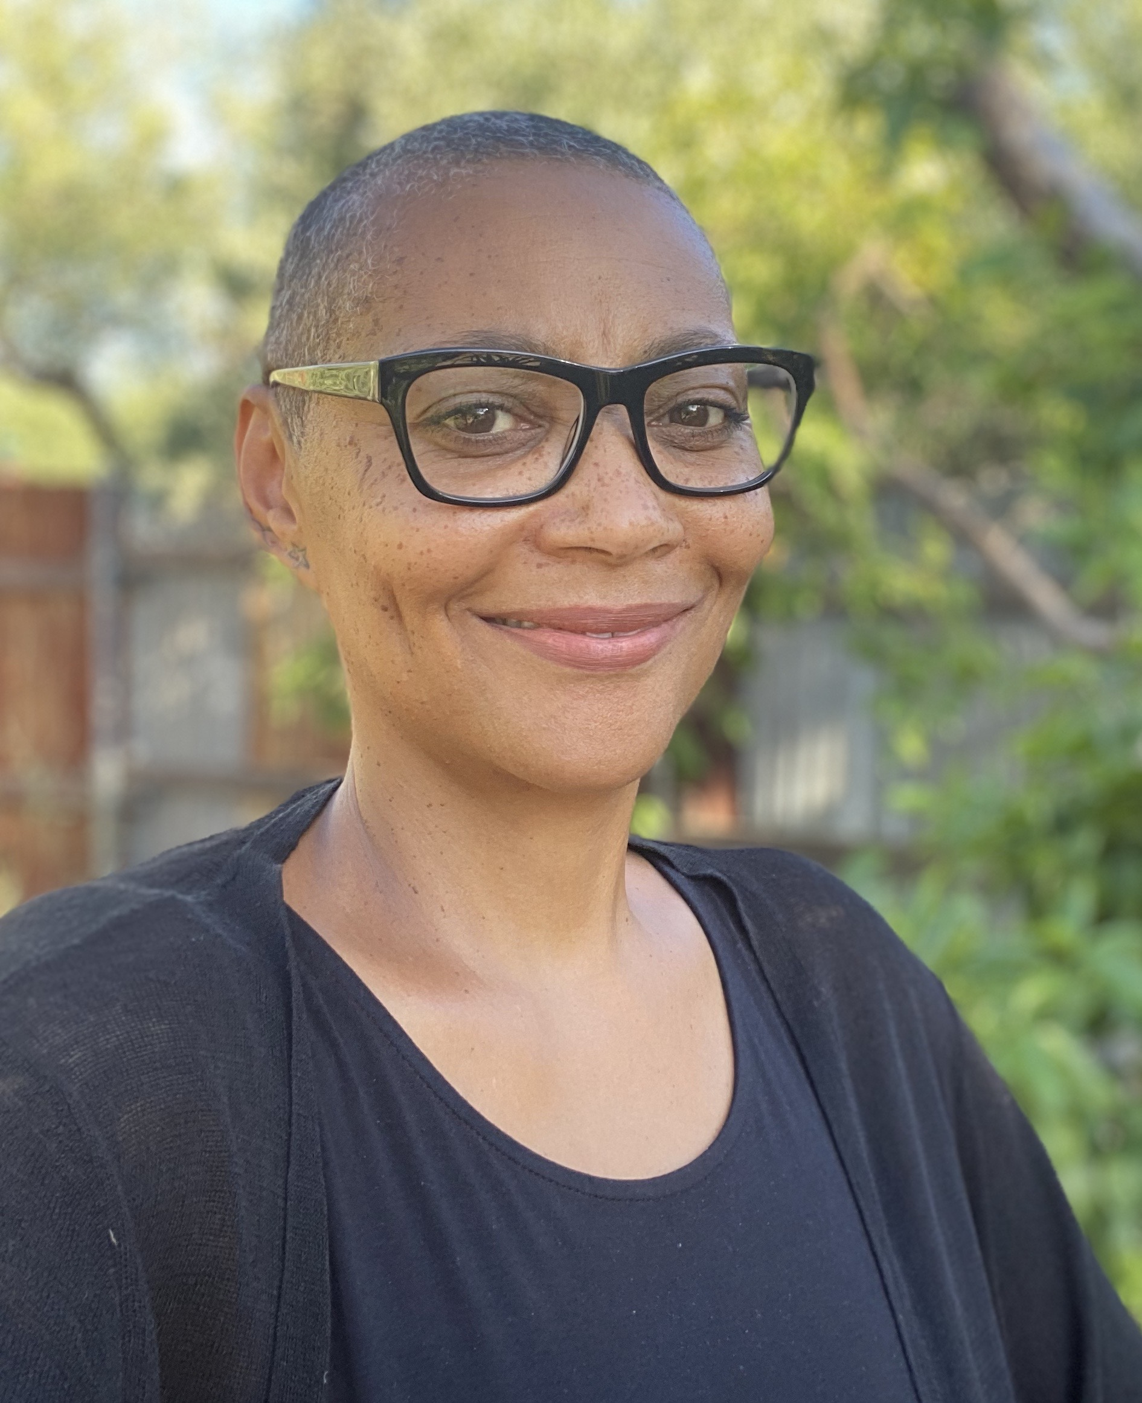
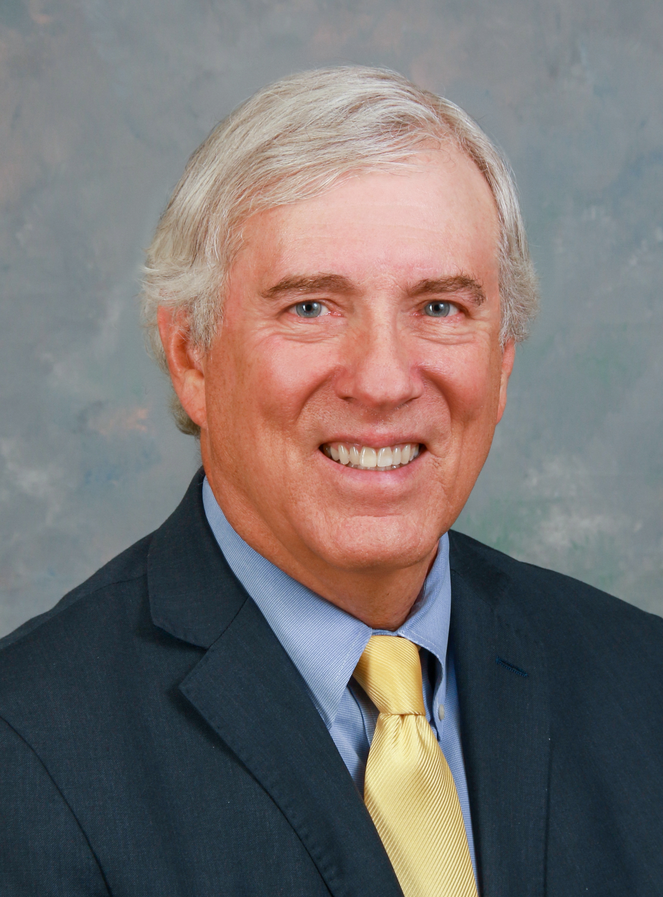
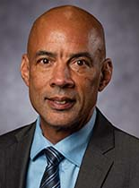
Panelists
Cortney Lovell
Director, Practice
and Improvement,
National Council for Mental Wellbeing
Elizabeth Burden
Senior Advisor, Practice
and Improvement,
National Council for
Mental Wellbeing
Kevin Doyle
President, Hazelden Betty Ford Graduate School
Andrew Williams National Director of Diversity, Equity and Inclusion, Hazelden
Betty Ford Foundation
Cherene Caraco
Chief Executive Officer/Chief Global Strategist, Promise Resource Network

Slide 5
Agenda
Welcome - Marvin Ventrell (NAATP) and Philip Rutherford (National Council)
Current Challenges Facing the Peer Recovery Workforce - Elizabeth Burden (National Council)
Expanding Recovery Teams: Lived Experience or Not - Kevin Doyle (Hazelden Betty Ford Graduate School)
From Equity Talk to Equity Walk: Strategies for Diversifying the SUD Workforce - Andrew Williams (Hazelden Betty Ford Graduate School)
Peers and Grief Support - Cortney Lovell (National Council)
The Future of the Peer Recovery Workforce - Cherene Caraco (Promise Resource Network)
Recovery Month Joint Call to Action Q&A - Marvin and Phil

Slide 6
Expanding Recovery Teams: Lived Experience or Not Kevin Doyle, Ed.D, LPCC/LPC

Slide 7
The Addiction Treatment Workforce
Needs
Characteristics
Where will the workforce come from
How will we get there

Slide 8
Needs: Substance Use, Behavioral Health, and Mental Health Disorders
Job Outlook: 2022-2032
18.3% increase projected (“much greater than average”)
71,500 jobs but about 42,000 per year (retention!)
Particularly acute needs with diverse populations/workers
Source: Occupational Outlook Handbook
https://www.bls.gov/ooh/community-and-social-service/substance-abuse-behavioral-disorder-and-mental-health-counselors.htm

Slide 9
Workforce Characteristics
Current median wage $53,710 ($25.80) /$50,053 ($24.06) #319!
Approximately 30% (29-34) identify as personally in recovery
Predominantly white, female, over 45
49% of Americans live in a mental health shortage area
Substance abuse and behavioral disorder counselors | Data USA
VitalSignsReport.pdf (attchub.org)
The Behavioral Health Care Workforce (nihcm.org)

Slide 10
Where will workforce of tomorrow come from
Selected Strategies
Address retention (18.5% turnover!)
Recruit a younger, more diverse workforce (current white, female, over 45)
Educational and training benefits
Enhance clinical supervision
Establish management training
VitalSignsReport.pdf (attchub.org)

Slide 11
How will we get there?
Position this profession as legitimate/rewarding
Pay/benefits
Workplace culture
Reframe: not only for those in recovery themselves (“lived experience”)
Remove barriers
Artificial/arbitrary, non-evidence-based, such as criminal history, academic, “freedom from use”
Compete

Slide 12
DEIB & SUD Peer Support Workers Andrew Williams National Director of Diversity, Equity, & Inclusion The Hazelden Betty Ford Foundation

Slide 13
DEIB, Peer Support & Recovery (Cultural) Capital
“A lot of people broke my trust, especially in the medical field. So I think that the more I show people that I’m just another human being definitely makes the connection better, which keeps them coming back to treatment with their providers.” (Scannell 2021)
“To have a secret that is just ours, played out through some quiet and invented choreography. A touch between us that lingers just long enough to know we’ve put some work into our love for each other. We’ve made something that no one outside can get through. I don’t waste time or language on our enemies, beloveds. But if I ever did, I would tell them that there is a river between what they see and what they know. And they don’t have the heart to cross it.”-Hanif Abdurraqib
Notes:
DEIB recovery capital represents the resources an organization has available to find and maintain recovery in the face of systemic racism and other forms of marginalization and oppression.
Can be built through personal, cultural, and community efforts.
People effectively connect with people with similar experiences and build community and
relationships, which strengthens a person’s recovery journey. More specifically, this
component highlights the need for more equitable access and a multidisciplinary approach toservices across the continuum, with peer support as a key element. This approach includes care
and support outside of the traditional system of behavioral healthcare (i.e., community-driven
models).

Slide 14
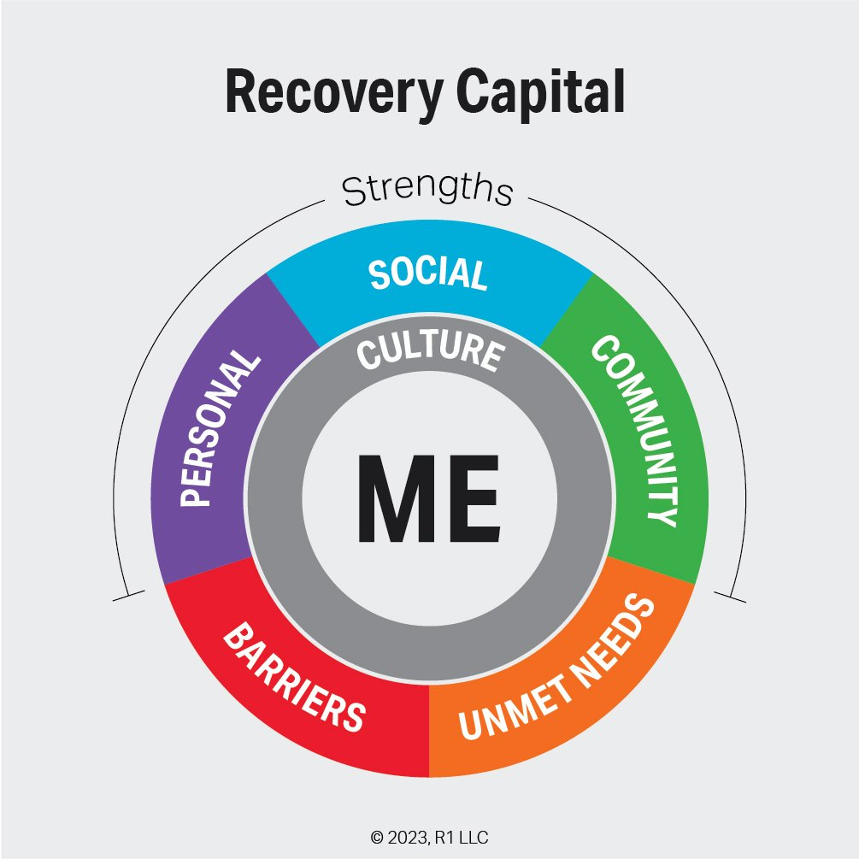
Peer Support Workers & Recovery Equity
SAMHSA’s principle of diversity indicates that recovery is culturally based and influenced. Culture and cultural background, in all of its representation—including values, traditions, and beliefs—are paramount in determining a person’s journey and unique pathway to recovery. It emphasizes that services should be culturally grounded, attuned, sensitive, congruent, and competent, as well as personalized to meet each individual’s unique needs.

Slide 15
Peer Specialists & The Liberation Health Model
Peer specialists in an SUD treatment setting teach individuals in or seeking recovery and their families how to advocate for themselves to make sure they get the services they need and to reduce barriers to access.

Slide 16
Peer Support Workers & The Liberation Health Model
PSWs bring needed cultural and socioeconomic diversity to our service delivery methods in the context of underrepresentation of BIPOC behavioral health professions and offer more expansive possibilities for connections with those in recovery beyond shared experience of SUD.
PSWs bring diversity to our workforce as an employee category that pushes us to think about how our roles definitions, interactions, supports, ways of being either support or diminish their sense of inclusion, belonging and raise important questions in relation to equity: compensation, benefits, and office space
PSWs report encountering skepticism, bias, lack of trust, marginalization and lack of appreciation for the value of their lived experience. (Scannell, 2021)
Notes:
it is crucial to explore their experiences and their perspectives on how this role is integrated into existing service delivery models

Slide 17
Peers and Grief Support Cortney Lovell, National Council for Mental Wellbeing

Slide 18
Past Month Substance Use: Among People Aged 12 or Older; 2023
12 Month-ending Provisional Counts of Drug Overdose Deaths: United States; 2023
Substance Abuse and Mental Health Services Administration. (2024). Key substance use and mental health indicators in the United States: Results from the 2023 National Survey on Drug Use and Health (HHS Publication No. PEP24-07-021, NSDUH Series H-59). Center for Behavioral Health Statistics and Quality, Substance Abuse and Mental Health Services Administration.
Ahmad FB, Cisewski JA, Rossen LM, Sutton P. Provisional drug overdose death counts. National Center for Health Statistics. 2024.

Slide 19
107,543
Humans
Loved ones
Friends
Children
Parents
Neighbors
died from overdose
Notes:
MetLife Stadium, 82,500
4,302 school buses

Slide 20
“To be believed is radical.”
Meghan Hetfield, PRSS, CRPA

Slide 21
Reminders
Recognize the impact
Not all relationships to this work are equal
Role clarity is crucial
People grieve differently
Burnout is real
Notes:
Recognize the impact: Acknowledge the emotional toll of the work and validate peer specialists' feelings.
Not all relationships to this work are equal and it doesn’t serve us to that as different staff have different relationships to the people you serve – mutual self disclosure inherent to the peer specialist role
Role clarity is crucial. Often times ill-defined peer specialists roles or a lack of boundaries can mean that peer specialists were very involved with their clients and ensuring their success, answering calls during off hours, etc. May hit closer to home for peers as they are individuals with lived/living experience (think: survivors guilt - wondering if there was more that they could have done to keep this person alive) or reliving/re-experiencing trauma.
People grieve differently, people do not grieve the same. People will not respond similarly to the same to services offered to all staff. For example, offering group/individual support to staff after a death may be appreciated by most staff, but not all. You force staff to do grief work, and not everyone wants to talk about it. Avoid forced participation.

Slide 22
Opportunities
Pay a “thriving” wage to peers
Develop clear protocols and offer services
Be flexible
Create spaces for connection and reflection
Create memorials
Notes:
Pay a “thriving” wage to peers: I have heard it argued that the biggest thing and support for grief support is paying a living wage. "But the bottom line is that if your staff is not making a living wage, it doesn't matter if you offer grief support to them, because if they work a second job to be able to be employed by you, they don't have time to grieve. – replace the word burnout with exploitation
Develop clear protocols: Establish guidelines for what to do when a patient overdoses, including support mechanisms for staff. EAP, mindfulness and stress reduction programs, exercise assistance benefits. Provide education on grief and trauma: Offer workshops on understanding and managing grief, trauma responses, and self-care.
Give Flexibility: flexible work arrangements that include flexible scheduling or time off when needed to grieve, assistance with workload management, flexibility for emotional recovery.
Create spaces for Connection: Grief counseling services/support groups, creating safe spaces, debriefing sessions, regular check-ins, individual supervision. Create a peer support system: Pair experienced peers with newer ones for mentorship and emotional support. Room for Reflection: Regular check-ins, debriefing sessions, crisis counseling
Create memorials. Develop appropriate ways to honor and remember patients who have passed. Events (per incident or individual, monthly, or annual remembrances and include everyone and do this in a space together) and remembrance spaces (alters, remembrance walls, sandwich boards, decorating your van, online spaces), can make it specific and individual to your organization and culture.

Slide 23
Thank you!

Slide 24
Reading the “Tea Leaves”: The Future of the Peer Recovery Workforce

Slide 25
Let’s Examine the Trends and Context…
Trends
Opportunities
Considerations
Biden Unity agenda, Medicare, Olmstead, Integrated Care, CCBHC
Peer Support Standard Occupational Classification Medicaid clarifies supervision for peer supporters
Crisis/988/Non-Police Response
Racial Disparities/Equity
PS Integrated into ED, Crisis Services, CJS, etc, etc
Increase incarceration, involuntary commitment, suicide attempt rates, homelessness, etc.
Workforce shortages
Issues with access
A call back to institutions
Back to the Future- rights, peer run orgs and peer-run alternatives
Expansion of “specialty” peer support- (“forensic,” older adults, lgbtqia+, unhoused, HIV +, youth peer support….
Workforce from Peer-Run organizations know peer support, integrated settings frequently do not. Subcontracted peer support
Peer Support “Private Practice”
Leveraging technology for access (warm line/chat, social media, videogames, avatars, etc)
Peer Support in transportation
Peer support for peer supporters (app)
National certification pros/cons
National association- advantages/disadvantages
Can we standardize the role while adapting to different settings?
Research-
Participatory action research
Practice based evidence
Call to Action:
We have to drive innovation, set standards, maintain integrity- its up to peer supporters!
Think beyond sharing our stories
Peer Support as a career, not a job
Peer support is not the only option- policy, community organizing, system change, exec. Leadership…)

Slide 26
Thank You!!!!
Cherene Caraco
ccaraco@promiseresourcenetwork.org
(704) 776-6708

Slide 27
Recovery Month Joint Call to Action Q&A

Slide 28
Stay Connected
Visit: thenationalcouncil.org/national-recovery-month
Sign up for Substance Use Monthly

Slide 29
Thank you to our speakers!

