Slide 1
Liability and Risk Considerations When Adopting AI Technology

Slide 2
Molly S. Evans
Partner
mevans@feldesman.com
Molly, a member of the firm’s Management Committee, advises health centers on the management of clinical, employment and workforce related risks, with a particular focus on professional liability, FTCA and HIPAA matters. Molly counsels health care entities such as community health centers on contracting, regulatory compliance, fraud and abuse, patient privacy and confidentiality and risk management matters.
From her experience as both a private attorney and in-house counsel, Molly knows the importance of managing liability and risk issues in mission-driven organizations.

Slide 3
Dianne K. Pledgie
Partner and Compliance Counsel
dpledgie@feldesman.com
Dianne advises health centers on implementing effective compliance programs and on addressing top compliance risk areas. A former Compliance Officer at a health center, she understands the challenges that health centers face in achieving and maintaining compliance.
Dianne also advises health centers and other organizations on patient privacy and confidentiality, including the HIPAA Privacy Rule and 42 CFR Part 2. She has experience responding to privacy and security incidents, notifying patients and the government, and creating corrective action plans.

Slide 6
AGENDA
Discuss the various ways AI may be used in behavioral health settings.
Understand the potential risks and legal implications associated with using AI.
Discuss how behavioral health providers can adopt certain protections to reap the benefits of AI without incurring unnecessary risk.

Slide 7
AI IN BEHAVIORAL HEALTH SETTINGS

Slide 8
Our organization is using AI for the following tasks (choose all that apply):
Administrative Tasks
Clinical Decision-making
Other
We aren’t using AI as far as I know

Slide 9
HOW IS YOUR ORGANIZATION USING AI?
Personalized Treatment Plans
Predictive Analytics for Early Intervention
Virtual Therapists and Chatbots
Sentiment Analysis in Therapy Sessions
Automated Administrative Tasks

Slide 10
HOW IS YOUR ORGANIZATION USING AI?
Telehealth Support and Triage
Natural Language Processing (NLP) for Clinical Documentation
Medication Management and Adherence
Suicide Prevention
Cognitive and Behavioral Assessments

Slide 11
FEDERAL LEGAL AND REGULATORY LANDSCAPE

Slide 12
Should there be special laws, regulations and guidance related to the use of AI in healthcare?
Yes
No
Not sure

Slide 13
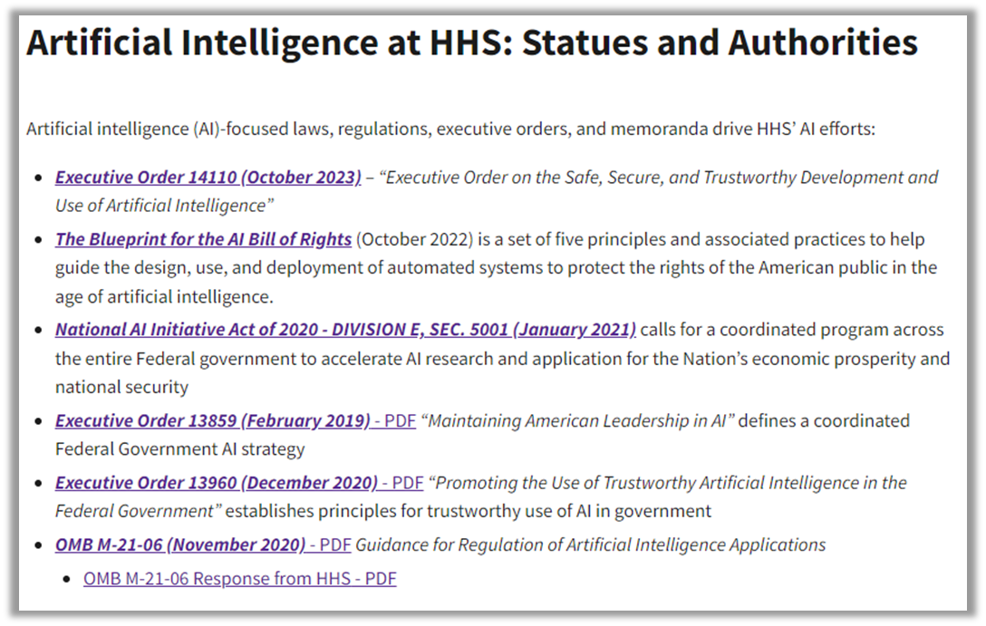
ARTIFICIAL INTELLIGENCE AT HHS
See: https://www.hhs.gov/about/agencies/asa/ocio/ai/statutes/index.html

Slide 14
BLUEPRINT FOR AN AI BILL OF RIGHTS
(OCTOBER 2022)
Safe and Effective Systems
Algorithmic Discrimination Protections
Data Privacy
Notice and Explanation
Human Alternatives, Consideration, and Fallback

Slide 15
EXECUTIVE ORDER 14110 (OCT 2023)
Within 90 days of the date of this order, the Secretary of HHS shall, in consultation with the Secretary of Defense and the Secretary of Veterans Affairs, establish an HHS AI Task Force that shall, within 365 days of its creation, develop a strategic plan that includes policies and frameworks — possibly including regulatory action, as appropriate — on responsible deployment and use of AI and AI-enabled technologies in the health and human services sector (including research and discovery, drug and device safety, healthcare delivery and financing, and public health), and identify appropriate guidance and resources to promote that deployment, including in the following areas:

Slide 16
EXECUTIVE ORDER 14110 (OCT 2023)
(A) development, maintenance, and use of predictive and generative AI-enabled technologies in healthcare delivery and financing — including quality measurement, performance improvement, program integrity, benefits administration, and patient experience — taking into account considerations such as appropriate human oversight of the application of AI-generated output;
(B) long-term safety and real-world performance monitoring of AI-enabled technologies in the health and human services sector, including clinically relevant or significant modifications and performance across population groups, with a means to communicate product updates to regulators, developers, and users;
(C) incorporation of equity principles in AI-enabled technologies used in the health and human services sector, using disaggregated data on affected populations and representative population data sets when developing new models, monitoring algorithmic performance against discrimination and bias in existing models, and helping to identify and mitigate discrimination and bias in current systems;

Slide 17
EXECUTIVE ORDER 14110 (OCT 2023)
(D) incorporation of safety, privacy, and security standards into the software-development lifecycle for protection of personally identifiable information, including measures to address AI-enhanced cybersecurity threats in the health and human services sector;
(E) development, maintenance, and availability of documentation to help users determine appropriate and safe uses of AI in local settings in the health and human services sector;
(F) work to be done with State, local, Tribal, and territorial health and human services agencies to advance positive use cases and best practices for use of AI in local settings; and
(G) identification of uses of AI to promote workplace efficiency and satisfaction in the health and human services sector, including reducing administrative burdens.

Slide 18
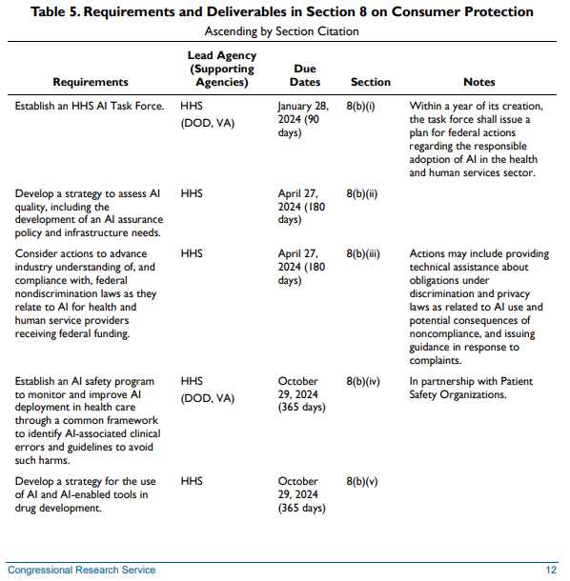
EXECUTIVE ORDER 14110 (OCT 2023)
Congressional Research Service, “Highlights of the 2023 Executive Order on Artificial Intelligence for Congress” (Nov. 17, 2023) available at: https://crsreports.congress.gov/product/pdf/R/R47843/2

Slide 19
OMB: GUIDANCE AND REQUIREMENTS
FOR FEDERAL AGENCIES
The White House Office of Management and Budget (OMB) released two memos:
Memorandum M-24-10: Advancing Governance, Innovation, and Risk Management for Agency Use of Artificial Intelligence (March 2024)
Memorandum M-24-18: Advancing the Responsible Acquisition of Artificial Intelligence in Government (October 2024)

Slide 20
ONC: HEALTH DATA, TECHNOLOGY, AND INTEROPERABILITY FINAL RULE
The Office of the National Coordinator for Health IT (ONC) released a Final Rule that includes:
Finalized certification criterion for “decision support interventions” (DSI) to ensure that certified Health IT modules:
Reflect an array of contemporary functionalities
Support data elements important to health equity
Enable the transparent use of predictive models and algorithms to aid decision-making in healthcare
See: https://www.federalregister.gov/documents/2024/01/09/2023-28857/health-data-technology-and-interoperability-certification-programupdates-algorithm-transparency-and

Slide 21
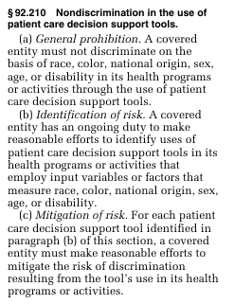
SECTION 1557: NONDISCRIMINATION IN HEALTH PROGRAMS AND ACTIVITIES
See: https://www.federalregister.gov/documents/2024/05/06/2024-08711/nondiscrimination-in-health-programs-and-activities

Slide 22
STATE LAWS: 2024
Colorado, Utah and California passed laws impacting private-sector AI governance:
The Utah AI Policy Act went into effect in May 2024
Colorado AI Act and California Assembly Bill 2013 and Senate Bill 942 go into effect in 2026
Illinois, Massachusetts and Ohio have private-sector AI governance bills working their way through committees; 13 other states have inactive bills
Other states have bills and laws that apply only to government entities, that would create state AI task forces, or apply to specific sectors (like employment)
https://iapp.org/resources/article/us-state-ai-governance-legislation-tracker/#enacted-laws

Slide 23
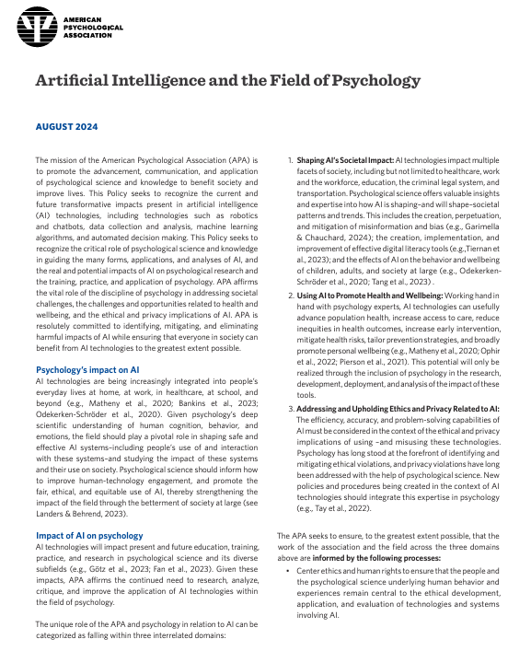
AMERICAN PSYCHOLOGICAL ASSOCIATION POLICY ON ARTIFICAL INTELLIGENCE AND THE FIELD OF PSYCHOLOGY
“This Policy seeks to recognize the current and future transformative impacts present in artificial intelligence (AI) technologies, including technologies such as robotics and chatbots, data collection and analysis, machine learning algorithms, and automated decision making. This Policy seeks to recognize the critical role of psychological science and knowledge in guiding the many forms, applications, and analyses of AI, and the real and potential impacts of AI on psychological research and the training, practice, and application of psychology.”
https://www.apa.org/about/policy/artificial-intelligence-psychology

Slide 24
RISKS AND LEGAL IMPLICATIONS ASSOCIATED WITH USING AI

Slide 25
Which of the following do you consider to be the greatest legal risk when implementing AI in behavioral health settings?
Patient privacy and data protection
Liability for misdiagnosis or treatment errors
Bias and discrimination in AI algorithms
Compliance with healthcare regulations and standards

Slide 26
IDENTIFYING RISKS RELATED TO AI
Professional Liability
Cybersecurity
Patient Privacy
Informed Consent

Slide 27
Anytown Behavioral Health Center (ABHC)’s CISO and Medical Director received a notice that the EMR vendor was implementing a new AI tool to support clinical decision-making. Both busy preparing for the upcoming CARF survey, they did not fully review the AI tool. Two weeks later, the AI tool recommended a prescription change for Ms. Jones; her psychiatrist prescribed the medication; and Ms. Jones experienced an adverse outcome. Who is responsible?
The EMR vendor
The AI tool
ABHC
The physician
All of the above

Slide 28
PROFESSIONAL LIABILITY
Elements of a medical malpractice claim:
Duty: Based upon a provider-patient relationship
Breach: When a provider fails to use the appropriate level of care when diagnosing or treating a patient
Causation: Causal connection between the provider’s breach and the patient’s injury
Damages: Damages suffered by the patient

Slide 29
PROFESSIONAL LIABILITY: KEY QUESTIONS
Will using AI become the “standard of care”?
How can providers validate and verify an AI tool to ensure it is accurate, comprehensive and free from bias?
What documentation will be required, especially as AI tools evolve?
How will liability be assessed as between the provider and the AI tool?
Will payors, health plans or others mandate that providers use AI tools and, if so, how will that impact liability?

Slide 30
ABHC’s Medical Director calls to check on Ms. Jones. The Medical Director says, “We’re very sorry about the issue with your prescription, obviously we’re all getting used to AI and how to use it.” Ms. Jones says that that she “never agreed to have a robot psychiatrist” and she plans to sue ABHC for letting computers care for her without telling her. Should ABHC have required Ms. Jones to sign an informed consent form related to the use of AI clinical decision support tools?
Yes, based upon federal law
Yes, based upon state law
Yes, based upon federal and state law
Yes, because it is the ethical thing to do
No, consulting AI is like consulting a colleague

Slide 31
INFORMED CONSENT
Elements of a breach of informed consent tort:
Failure to disclose a specific risk in violation of a governing standard
Materialization of the risk
Causation: If the risk had been disclosed, the patient or a prudent person would not have proceeded
No exception, like an emergency, excuses the failure to disclose

Slide 32
INFORMED CONSENT
Valid informed consent is premised on:
Disclosure of relevant information: Purpose of the treatment, potential benefits and risks, possible alternative treatment options
To a competent patient: Able to understand relevant medical information and implications of treatment alternatives
With the patient permitted to make an independent, voluntary decision
Documented in the medical record, including written consent form when applicable

Slide 33
INFORMED CONSENT: KEY QUESTIONS
Are providers required to tell patients about the use of AI tools for diagnostic and treatment purposes?
If it is not required, should providers still tell patients?
If they do tell patients, are providers knowledgeable about AI tools, able to explain their use and answer questions from patients?
What modifications, if any, can the provider make if a patient refuses AI-enhanced care?
Should providers require written consent from patients when relying on AI?

Slide 34
Dr. Torres, Ms. Jones’ psychiatrist, was interviewed by the local newspaper about how AI is improving health care. Dr. Torres stated, “AI combs through patient data to identify trends that change the way we provide care. It is amazing!” Ms. Jones calls ABHC and says, “What I find amazing is that you would violate HIPAA by not having patients sign a consent form!” Did ABHC violate HIPAA by using an AI clinical decision support tool?
Yes
No
It depends
Not sure

Slide 35
PATIENT PRIVACY
As HIPAA covered entities, healthcare providers may only use or disclose protected health information (PHI):
As required by the Privacy Rule
As permitted by the Privacy Rule, including for purposes of treatment, payment and health care operations
As authorized by the individual or their personal representative, including marketing and the sale of PHI

Slide 36
PATIENT PRIVACY
A covered entity may use a business associate to perform certain functions or activities or to provide certain services that involve the use or disclosure of PHI if a business associate agreement (BAA) is executed.
Many BAAs permit the business associate to de-identify the PHI. Once de-identified, the HIPAA Rules no longer apply to the use and disclosure of that data.

Slide 37
PATIENT PRIVACY: KEY QUESTIONS
Covered entities:
If a patient requests their PHI not be disclosed or requests their PHI be removed from a dataset, can the covered entity restrict or remove the PHI?
Does the notice of privacy practices’ description of the uses or disclosures of PHI the covered entity is permitted to make without the individual’s written authorization include disclosures of de-identified data?

Slide 38
PATIENT PRIVACY: KEY QUESTIONS
Business associates and BAAs:
What function, activity or service is the business associate providing to the covered entity?
Is the business associate authorized to de-identify the PHI?
Does the BAA address how the business associate will de-identify the PHI?
Does the BAA address the permitted uses and disclosures by the business associate of the de-identified data?

Slide 39
At her next appointment, Dr. Torres tells Ms. Jones that ABHC has started using CyberScribe, which will record the visit and create the appropriate documentation. Ms. Jones asks Dr. Torres who is responsible for protecting the recordings from a ransomware attack. Who would be responsible?
ABHC
CyberScribe
Both
It depends
Not sure

Slide 40
CYBERSECURITY
Under the HIPAA Security Rule, covered entities and business associates must:
Ensure the confidentiality, integrity, and availability of all ePHI the covered entity or business associate creates, receives, maintains, or transmits.
Protect against any reasonably anticipated threats or hazards to the security or integrity of such information.
Protect against any reasonably anticipated uses or disclosures of ePHI that are not permitted or required under the HIPAA Privacy Rule.
Ensure workforce members comply with the HIPAA Security Rule.

Slide 41
CYBERSECURITY
HIPAA Security Rule includes:
Administrative safeguards:
Security management process, including requirements to conduct security risk analyses and implement risk management measures
Technical safeguards:
Access control, including requirements for unique user identification and emergency access procedures
Transmission security, including addressable implementation specifications for integrity controls and encryption

Slide 42
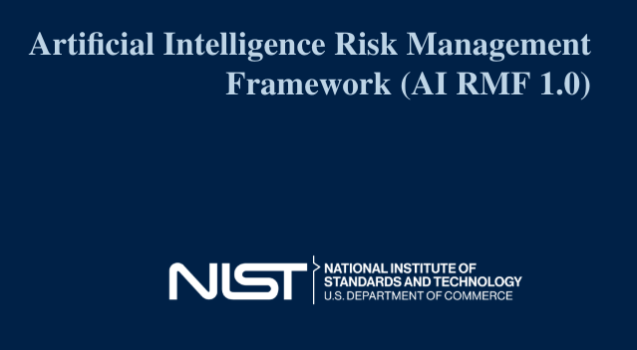
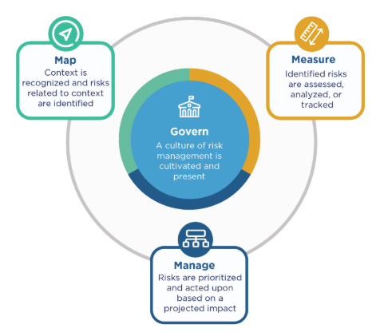
CYBERSECURITY
See: https://nvlpubs.nist.gov/nistpubs/ai/NIST.AI.100-1.pdf

Slide 43
ADOPTING PROTECTIONS TO REAP THE BENEFITS OF AI WHILE MITIGATING THE RISKS

Slide 44
ADOPTING PROTECTIONS
TO REAP THE BENEFITS OF AI
Oversight and Human Review
Investment in Training for Staff
Use Diverse and Representative Data Sets
Maintain Transparent Communication with Patient
Stay Informed on Legal and Regulatory Changes

Slide 45
POLICY IDEAS
AI Use and Oversight Policy: Policy on how AI tools are to be used within clinical practice, including the scope of AI assistance, the process for human oversight, and the steps for intervention when AI recommendations are in question.
Data Privacy and Security Policy: Incorporating the protection of patient data privacy and security when using AI systems into data privacy and security policies.
Patient Consent and Transparency Policy: Policy for obtaining informed consent from patients when their data is used in conjunction with AI tools. This policy should include informing patients about the role of AI in their care, any potential risks, and how their data will be used in a transparent manner.
Quality Assurance and Performance Evaluation Policy: Set up regular quality assurance checks and performance evaluations for AI systems to ensure they are functioning as intended and delivering accurate, reliable support in clinical decision-making. This policy should detail the procedures for auditing AI tools, addressing any errors or biases identified, and updating systems in line with technological advancements and clinical standards.

Slide 46
Molly S. Evans
Dianne K. Pledgie
mevans@feldesman.com
dpledgie@feldesman.com

