Slide 1
CCBHC-E National Training and ​​
Technical Assistance Center
CCBHC Rural Services
Session 1: Orientation To Learning Community
October 15, 2024
Notes:
Blaire

Slide 2


This publication was made possible by Grant No. 1H79SM085856
from the Substance Abuse and Mental Health Services Administration (SAMHSA). Its contents are solely the responsibility of the authors and do not necessarily represent the official views, opinions or policies of SAMHSA, or the U.S. Department of Health and Human Services (HHS).
Notes:
Ensure this is included in all slide decks

Slide 3
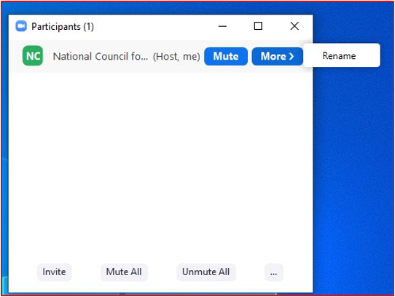
Logistics
Please rename yourself so your name includes your organization.​
For example:​
  Emma Hayes, National Council​
To rename yourself:​
  Click on the Participants icon at the bottom of the screen​
  Find your name and hover your mouse over it​
  Click Rename​
If you are having any issues, please send a Zoom chat message to Emma Hayes, National Council

Slide 4
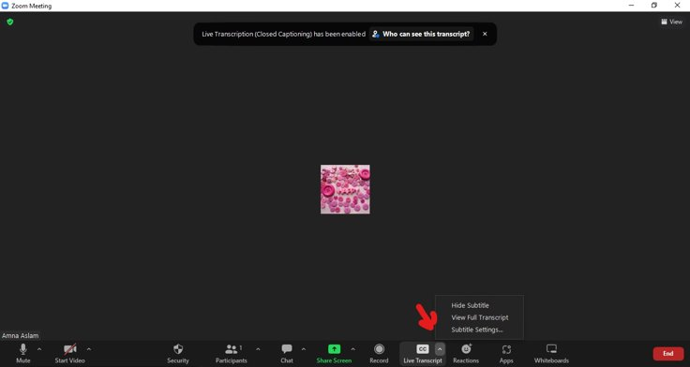
How to Enable Closed Captions (Live Transcript)
Next to “Live Transcript,” click the arrow button for options on closed captioning and live transcript.

Slide 5
Today’s Agenda
1
Welcome and Brief CCBHC-E NTTAC Orientation
2
CCBHC Rural Services Community Overview and Expectations
3
Community Building Activity

Slide 6
Today’s Learning Objectives
Identify the structure and curriculum of the learning community.
Review expectations of learning community participants.
Foster connection and relationship building with participants.

Slide 7




Your Learning Community Team
Renee Boak, MPH
Consultant and Subject Matter Expert
Clement Nsiah, PhD, MS
Project Director
Roara Michael, MHA
Project Manager
Emma Hayes, MSW
Project Coordinator

Slide 8
Welcome and Orientation to CCBHC-E NTTAC

Slide 9



We’re Here to Support You
Purpose: Provide training and technical assistance to SAMHSA CCBHC-Expansion grantees for:
Implementation and adherence to the CCBHC model
Utilization and integration of evidence-based practices
Sustainability and alignment of CCBHC model and state adoption

Slide 10





CCBHC-Expansion Grantee National Training
and Technical Assistance Center
CCBHC grantees can access...
Virtual Learning Communities, Webinars and Office Hours
Regular monthly offerings that are determined based on grantees expressed needs.
Opportunities for Collaboration with
Other Grantees
Monthly Peer Cohort Calls for CCBHC Program Directors, Executives, Evaluators and Medical Directors.
Direct
Consultation
Request individual support through our website requesting system and receive 1:1 consultation.
On-demand
Resource Library
Includes toolkits, guidance documents, and on-demand learning modules.
Access our website to register for upcoming events, submit a consultation request or scan our on-demand resource library:
https://www.thenationalcouncil.org/program/ccbhc-e-national-training-and-technical-assistance-center/

Slide 11
Rural CCBHC Services Learning Community Overview and Expectations

Slide 12
Learning Community Purpose
Purpose: This learning community is designed to deliver lessons focused on sharing best practices (including implementation strategies, and identification of opportunities and challenges) that can be applied by rural CCBHCs to inform effective service offerings and access to meet the needs of the people they serve.
Learning Objectives
  Increase knowledge and understanding of CCBHC criteria elements that can be leveraged to identify and address rural service and access challenges.
  Identify effective strategies to improve rural CCBHC service alignments.
  Explore ways to address challenges identified with access to and delivery of core rural CCBHC services.

Slide 13
Learning Community Structure
Monthly, 90-minute learning sessions
Sessions will follow a curriculum of topics
Expect approximately 75 minutes of content and 15 minutes for questions/discussion
Resources
Welcome packet serves as a reference for expectations, accessing sessions and resources
Resources such as on-demand videos, reference guides, or other materials complimenting content will be shared
Session recording, slides, and any accompanying resources will be maintained on a webpage shared with all participants, so you can access them and share them with others at any time.

Slide 14


Participant Expectations
  CCBHC implementation requires organization buy-in and team collaboration – we welcome organizations to bring extended teams to these sessions
  All content is intended to build upon past sessions, so we ask for participant commitment in all sessions
  Life happens! If you can’t attend some sessions, please make efforts to have others on your team join to represent you
  Meeting and engaging with your peers can be one of the most rewarding parts of this experience – we ask for you to have your camera on and to share experiences so we can all benefit
  Speak up and ask – there NO dumb questions, everyone is new to this – drop questions in the chat as they come to you
  If you have multiple teammates joining a call, consider joining from separate laptops to be able to fully engage in breakout discussions

Slide 15
Learning Community Curriculum
Month | Topic
October 2024 | Orientation to Learning Community
November 2024 | Workforce: Recruitment, Retention, and Innovations in Rural Communities
December 2024 | Access to and Delivery of Core CCBHC Services
January 2025 | Strategies for Meeting the CCBHC Crisis Services Requirements in Rural Communities
February 2025 | Innovative Partnerships in Rural Communities
March 2025 | Addressing Disparities and DEI-B Efforts
April 2025 | Strategies for Engaging in Care Coordination and Population Health Management in Rural Communities

Slide 16

Getting to Know You!

Slide 17
Poll Questions
On a typical day, how much time do you spend commuting to work?
15 min
30 min
45 min
60+ minutes
Is there a reliable, and accessible, public transportation system where you live?
Yes
No

Slide 18
Do you have sidewalks outside of your residence?
Yes
No
As part of a typical day, do you lose cell phone or internet connection?
Yes
No
Do you share the road with farmers, truck drivers, or animals?
Farmers
Truck drivers
Animals
Other (insert in chat)

Slide 19
Is there a healthcare provider shortage in your area?
Yes
No
How far do you have to travel to a grocery store?
15 min or less
15 – 30 min
30 – 45 min
45-60 min
More than 60 min

Slide 20
Are you able to purchase fruits and/or vegetables directly from a farm/farm stand?
Yes
No
What is the most predominant sound you hear in the evening?
Birds, crickets, frogs, and other nature-y sounds
Pedestrians, honking horns, and other city sounds
I try my best to keep sounds to a minimum!
Does your community reflect diversity?
Yes
No

Slide 21
Rural Health

Slide 22
Reality of Rural Healthcare
Rural Communities face a unique set of challenges and health inequities that are not seen in urban communities (transportation, internet and infrastructure, distance to provider, workforce shortages, etc.).
Approximately 63% of Primary Care Health Professional Shortage Areas are in rural areas and related to mental health and substance use treatment services, 65% of rural areas do not have a psychiatrist, and 47% do not have a psychologist. ​

Slide 23
Resources

Slide 24
Resources
CCBHC-E National Training and Technical Assistance Center
Rural Health Information Hub

Slide 25



Reminder – Next Session
Workforce: Recruitment, Retention, and Innovations in Rural Communities
Identify workforce challenges relevant to rural CCBHCs
Increase strategies that support workforce innovations in rural CCBHCs
Engage opportunity to learn from peers who have demonstrated workforce innovations
November 19th
3-4:30pm ET

Slide 26
CCBHC-Expansion Grantee National Training
and Technical Assistance Center
We offer CCBHC grantees…
Virtual Learning Communities, Webinars and Office Hours
Regular monthly offerings that are determined based on grantees expressed needs.
Opportunities for Collaboration with
Other Grantees
Monthly Peer Cohort Calls for CCBHC Program Directors, Executives, Evaluators and Medical Directors.
Direct
Consultation
Request individual support through our website requesting system and receive 1:1 consultation.
On-demand
Resource Library
Includes toolkits, guidance documents, and on-demand learning modules.
Access our website to register for upcoming events, submit a consultation request or scan our on-demand resource library: https://www.thenationalcouncil.org/program/ccbhc-e-national-training-and-technical-assistance-center/

Slide 27

Questions or Looking
for Support?
thenationalcouncil.org/program/ccbhc-e-national-training-and-technical-assistance-center/request-training-assistance/
Visit our website
and complete the CCBHC-E NTTAC Request Form
www.thenationalcouncil.org/program/ccbhc-e-national-training-and-technical-assistance-center/request-training-assistance/
Notes:
Need to add image from slide 26 on ODW Needs Assessment

