Slide 1
Population Specific Services Alaska Natives/American Indians
Notes:
Blaire

Slide 2
Acknowledgements and Disclaimer
This session was made possible by Grant Number 1H79SM085856 from the Substance Abuse and Mental Health Services Administration (SAMHSA). Its contents are solely the responsibility of the authors and do not necessarily represent the official views, opinions, or policies of SAMHSA, or the U.S. Department of Health and Human Services (HHS).
Notes:
Kat

Slide 3
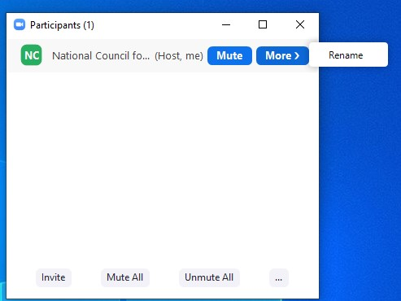
Logistics
Please rename yourself so your name includes your organization.
For example:
Roara Michael, National Council
To rename yourself:
Click on the Participants icon at the bottom of the screen
Find your name and hover your mouse over it
Click Rename
If you are having any issues, please send a Zoom chat message to Kathryn Catamura, National Council
Notes:
Kat

Slide 4
How to Enable Closed Captions (Live Transcript)
Next to “Live Transcript,” click the arrow button for options on closed captioning and live transcript.
Notes:
Kat

Slide 5
How to Ask a Question
Share questions throughout today’s session using the Q&A Feature on your Zoom toolbar. We’ll answer as many questions as we can throughout today’s session.
Notes:
Blaire

Slide 6
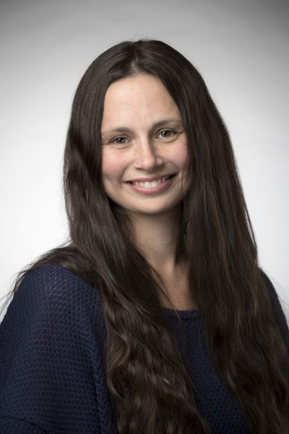
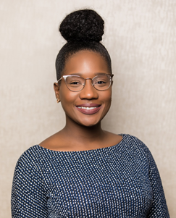
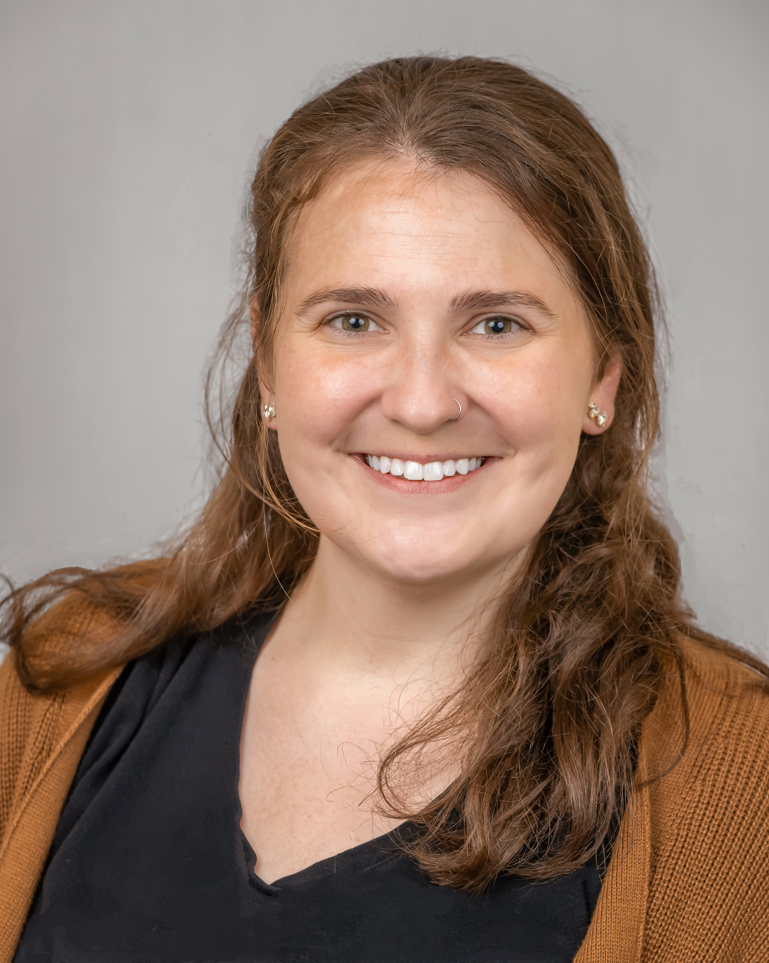
NTTAC Learning & Action Series Team
Renee Boak, MPH
Consultant
Blaire Thomas, MA
Sr. Project Manager
Danielle Foster, LMSW
Project Coordinator
Notes:
Sam

Slide 7
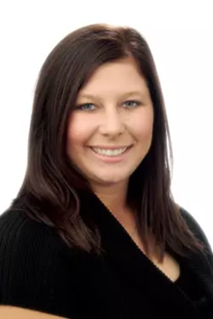
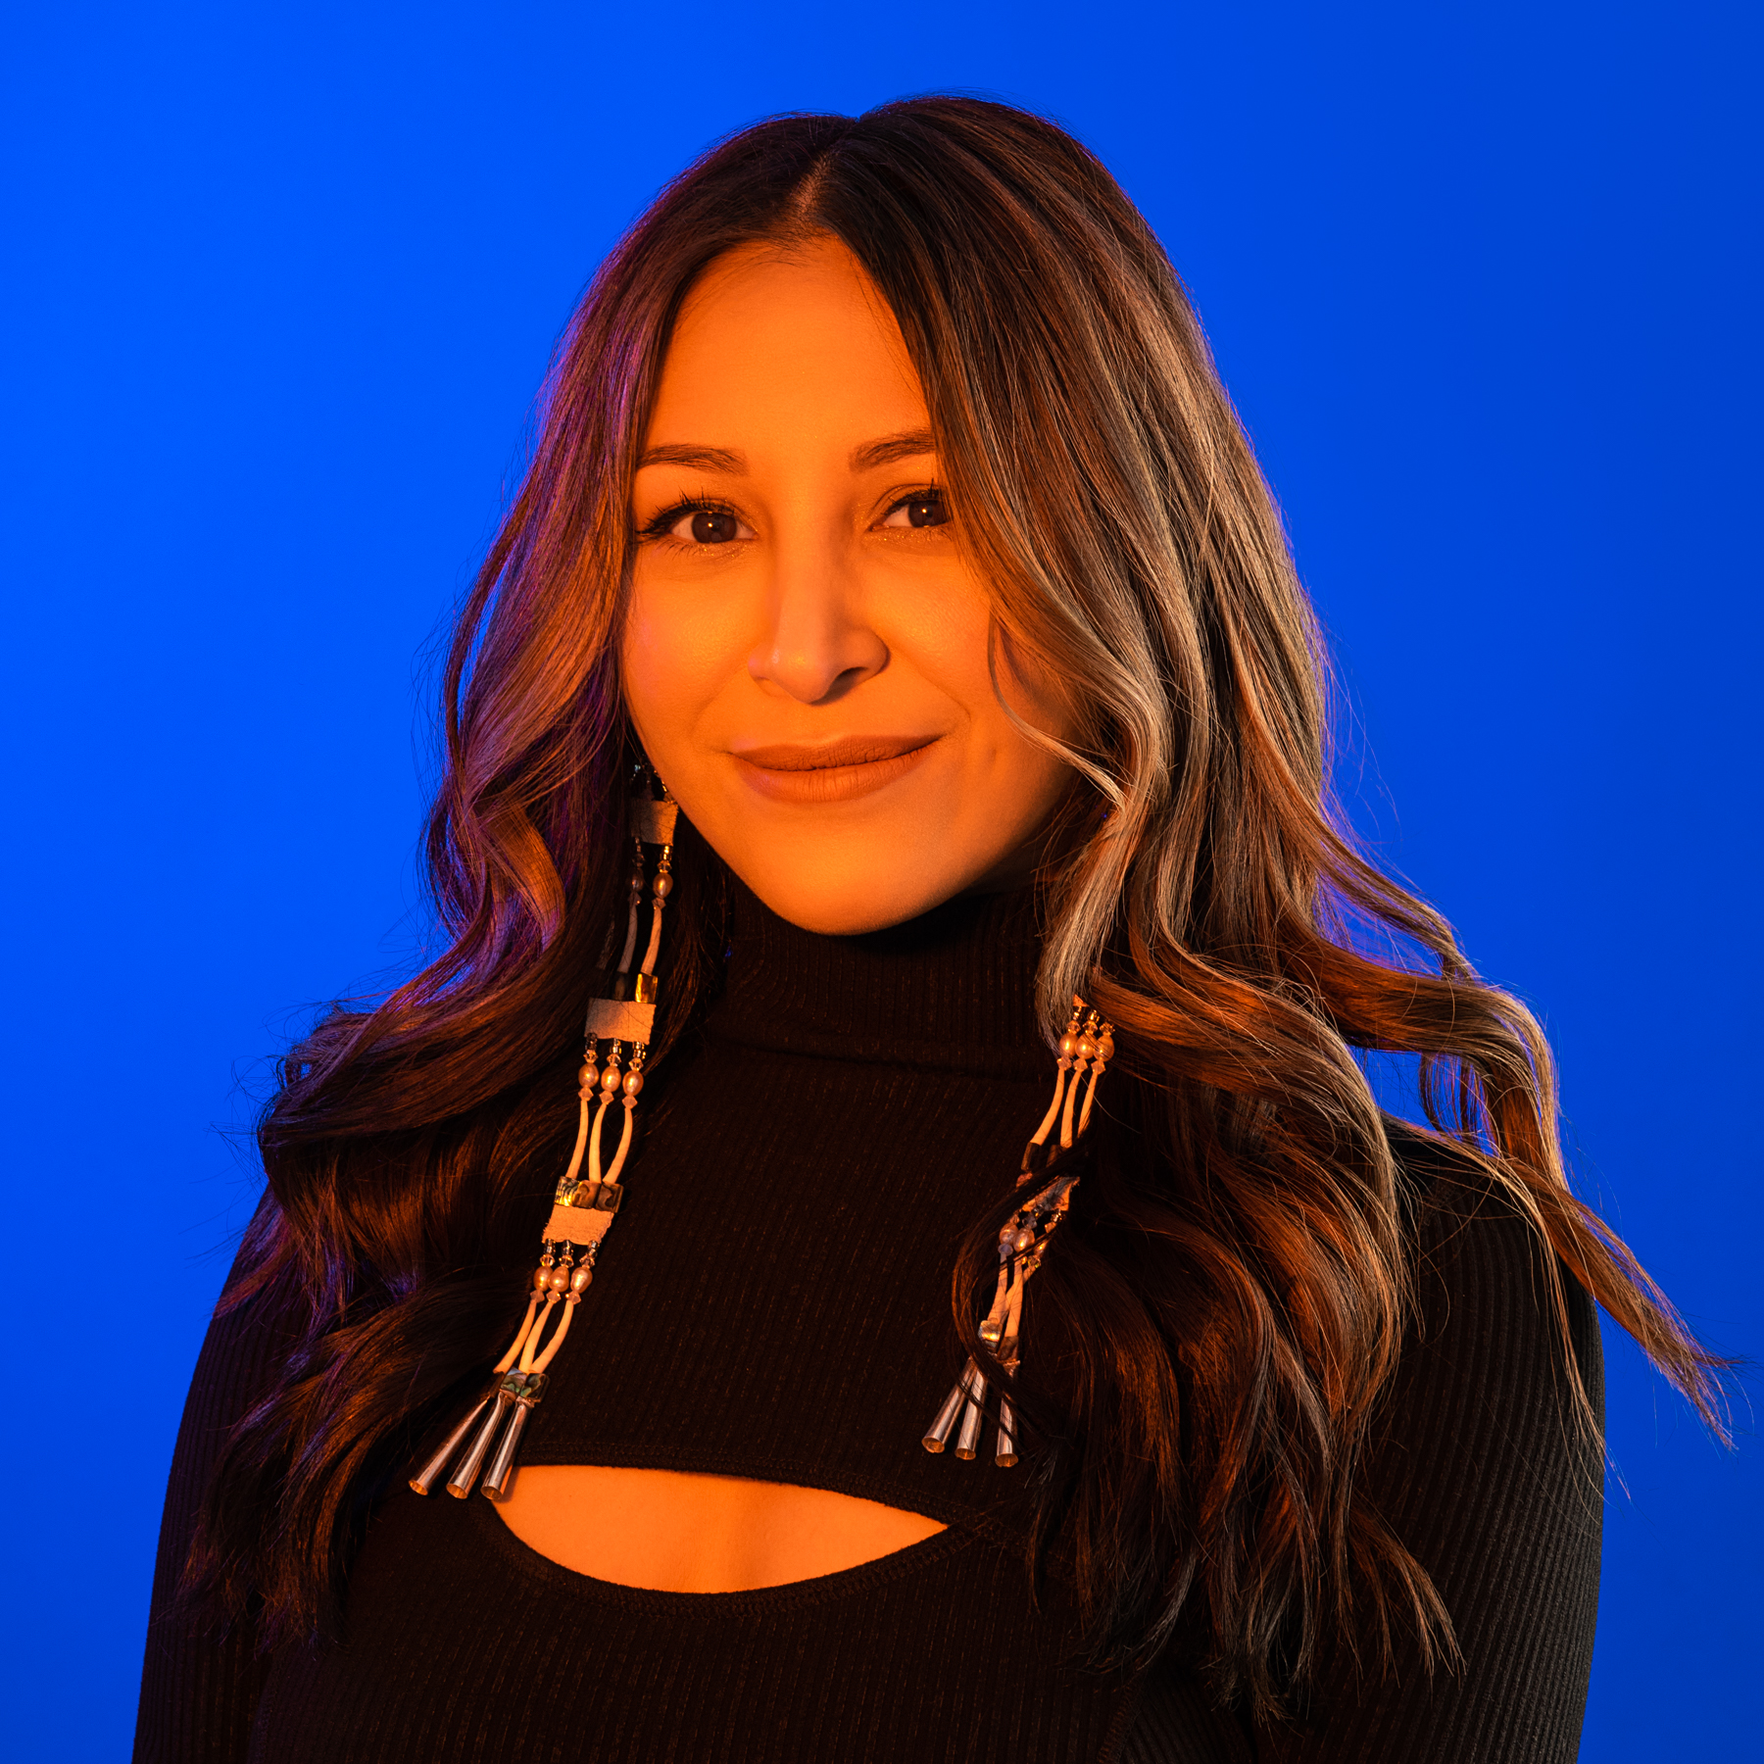
Session Presenters
Katie Hunsberger, M.P.P.
BHA Program Manager,
Northwest Portland Area Indian Health Board
Christa Johnson
Assistant Site Director, Creoks Health Services

Slide 8
Learning Series Curriculum
Date | Topic
December 4 | Population Specific Services: Alaska Natives/American Indians
January 8 | Population Specific Services: Individuals who are Hearing Impaired
February 5 | Population Specific Services: Native Spanish Speakers
March 5 | Population Specific Services: LGBTQ+ Individuals

Slide 9
Learning Objectives
Increase awareness of how Alaska Natives/American Indians are receiving culturally informed service through CCBHC
Identify strategies that support community outreach and engagement with Alaska Natives/American Indians
Identify strategies that support care coordination and improving health outcomes with Alaska Natives/American Indians
Notes:
Kat

Slide 10
Poll Questions
Approximately, within how many miles of a reservation do you live?
0-20
21-40
50+
To your knowledge, is the reservation sovereign?
Yes
No
Do school age children on the reservation attend a local school or do they integrate into schools in the larger community?
Yes
No

Slide 11
What is a Certified Community Behavioral Health Clinic (CCBHC)?
CCBHC is an integrated community behavioral health model of care that aims to improve service quality and accessibility. CCBHCs do the following:
Provide integrated, evidence-based, trauma-informed, recovery-oriented and person-and-family-centered care
Offer the full array of CCBHC-required mental health, substance use disorder (SUD) and primary care screening services
Have established collaborative relationships with other providers and health care systems to ensure coordination of care

Slide 12
CCBHC Requirements
3.d.2 The CCBHC designates an interdisciplinary treatment team that is responsible, with the person receiving services and their family/caregivers, to the extent the person receiving services desires their involvement or when they are legal guardians, for directing, coordinating, and managing care and services. The interdisciplinary team is composed of individuals who work together to coordinate the medical, psychiatric, psychosocial, emotional, therapeutic, and recovery support needs of the people receiving services, including, as appropriate and desired by the person receiving services, traditional approaches to care for people receiving services who are American Indian or Alaska Native or from other cultural and ethnic groups.
4.b.2 Person-centered and family-centered care is responsive to the race, ethnicity, sexual orientation and gender identity of the person receiving services and includes care which recognizes the particular cultural and other needs of the individual. This includes, but is not limited to, services for people who are American Indian or Alaska Native (AI/AN) or other cultural or ethnic groups, for whom access to traditional approaches or medicines may be part of CCBHC services. For people receiving services who are AI/AN, these services may be provided either directly or by arrangement with tribal organizations.
4.d.7 The CCBHC uses culturally and linguistically appropriate screening tools and approaches that accommodate all literacy levels and disabilities (e.g., hearing disability, cognitive limitations), when appropriate.

Slide 13
Northwest Portland Area Indian Health Board
Katie Hunsberger, M.P.P.
BHA Program Manager

Slide 14
Embracing Indigenous Worldviews
Acknowledging the Soul Wound (Duran, 2010)
Colonization, boarding schools, MMIW
Multigenerational trauma: current, ancestral, historical, individual, or collective experiences
Bridging Western psychology and Indigenous Ways of Knowing & Being
Avoiding language of deficiency
“Nothing about us, without us.”

Slide 15
Using Culture As Medicine
Advocating for cultural connectedness
Embracing w(holistic) approaches to health
Physical
Spiritual
Mental
Emotional
Incorporation of tribal traditional healing mechanisms
Cultural assessments are opportunities for transformation
@restoringancestralwinds

Slide 16
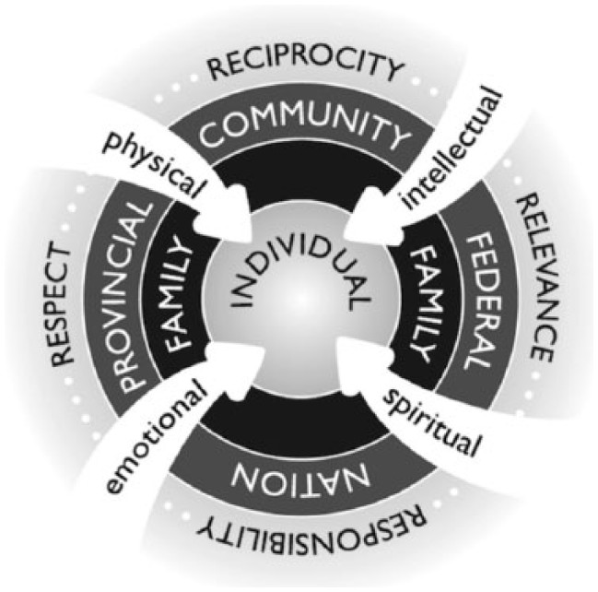
Embracing the 6 Rs
Relationship
Respect
Reciprocity
Reverence
Responsibility
Representation
Indigenous Holistic Framework (Pidgeon, 2014)

Slide 17
Centering Relationality for Trusting Partnerships
@hheininge

Slide 18
References
Duran, E., Duran, B., Heart, M. Y., & Horse-Davis, S. Y. (1998a). Healing the American Indian Soul Wound. International Handbook of Multigenerational Legacies of Trauma, 341–354. https://doi.org/10.1007/978-1-4757-5567-1_22
Linklater, R., & Mehl-Madrona, L. (2020). Decolonizing trauma work: Indigenous stories and Strategies. Fernwood Publishing.
Grant, A. D., Swan, K., Wu, K., Plenty Sweetgrass-She Kills, R., Hill, S., & Kinch, A. (2022). A Research Publication and Grant Preparation Program for Native American Faculty in STEM: Implementation of the Six R's Indigenous Framework. Frontiers in psychology, 12, 734290. https://doi.org/10.3389/fpsyg.2021.734290
Moving beyond good intentions: Indigenizing higher education in British Columbia universities through institutional responsibility and accountability,” by M. Pidgeon, 2014, Journal of American Indian Education, 53(2), p. 10.
Nechi Institute Centre of Indigenous Learning: Saint Albert Ab. Medicine Wheel Research Guide. https://www.Nechi.com/
Carla Listener (Developer) and Doreen Cardinal (Graphics)

Slide 19
Creoks Health Services
Christa Johnson
Assistant Site Director

Slide 20
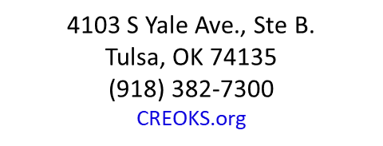
Help Today. Hope Tomorrow.
Notes:
Quick introduction of self: Current role, previous roles, speaking specifically about employment with MCN

Slide 21
CREOKS-Okmulgee
Okmulgee is the capital of Muscogee (Creek) Nation.
Tribal headquarters are located here.
Partnerships with tribal entities
Child welfare division (Beyond Families)
Behavioral health
Juvenile Justice (Muscogee Nation and Seminole Nation)
Muscogee Nation Tribal Court
Reintegration program
Photo credit: Mvskoke tourism
Notes:
Discuss what services are provided. LOOKING FOR STATS FOR OKMULGEE SPECIFIC ETHNIC GROUPS

Slide 22
How did we get here
If possible, have someone who knows the community.
Establish cultural competency training for your staff.
Connect with local referral sources, such as tribal community centers, local Johnson O’Malley Program (JOM), tribal hospitals.
If possible, have evidence based curriculum geared towards Native American/Alaskan Native populations
Attend community events when possible!
Notes:
How to engage with community partners. Transition fair-parents with kiddos w/developmental disabilities transitioning out of high school.

Slide 23
When working with American Indian/Alaskan Native Population
Ask if there are any cultural inferences with treatment.
Listen to gain understanding of their cultural background
Have a list of tribal resources
Notes:
Quick introduction of self: Current role, previous roles, speaking specifically about employment with MCN

Slide 24
Resources
National American Indian Alaska Native ATTC
Indian Health Services
Tribal Training and Technical Assistance Center
Native Health Resources

Slide 25
Questions?

Slide 26
Remaining Population Specific Services Sessions
Date | Topic
January 8 | Population Specific Services: Individuals who are Hearing Impaired
February 5 | Population Specific Services: Native Spanish Speakers
March 5 | Population Specific Services: LGBTQ+ Individuals
Notes:
1/8/25: https://form.jotform.com/242915931622154
2/5/25:https://form.jotform.com/242916463039157
3/5/25:https://form.jotform.com/243044133384147

